Slide 1
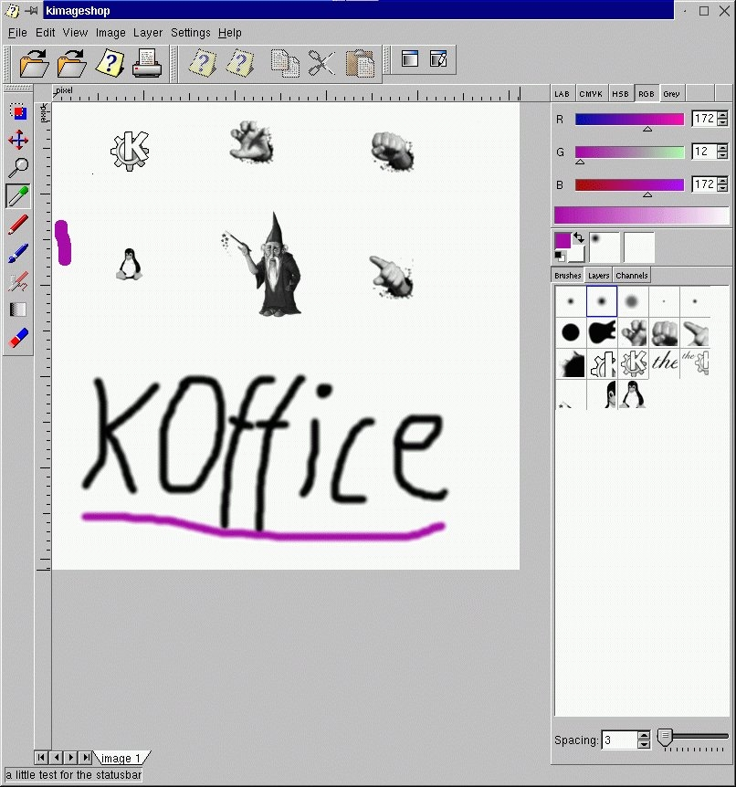
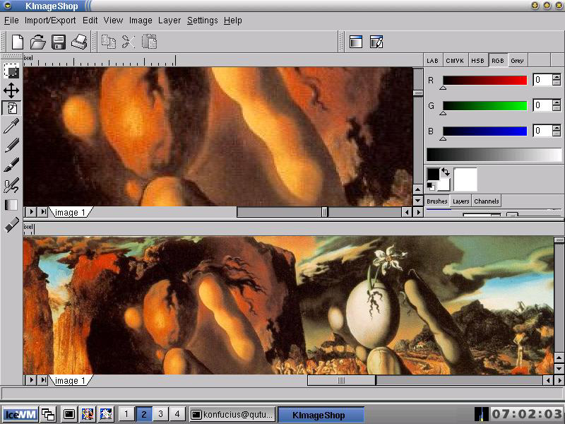
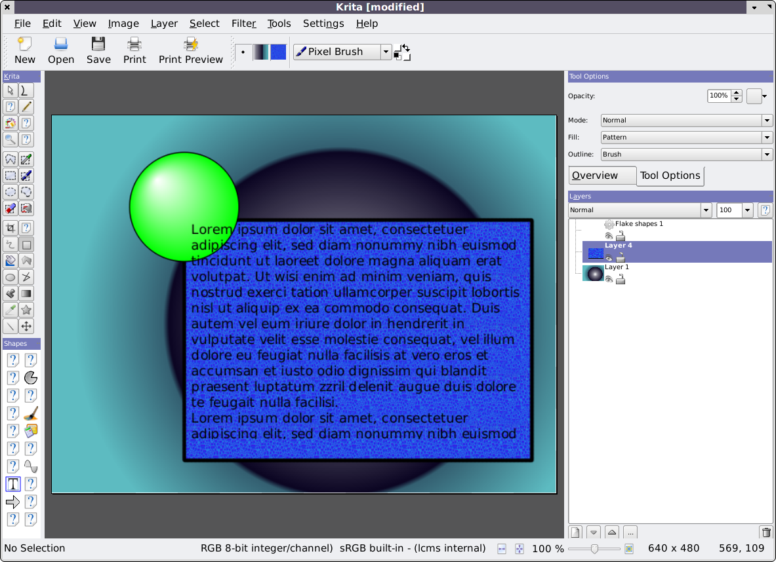
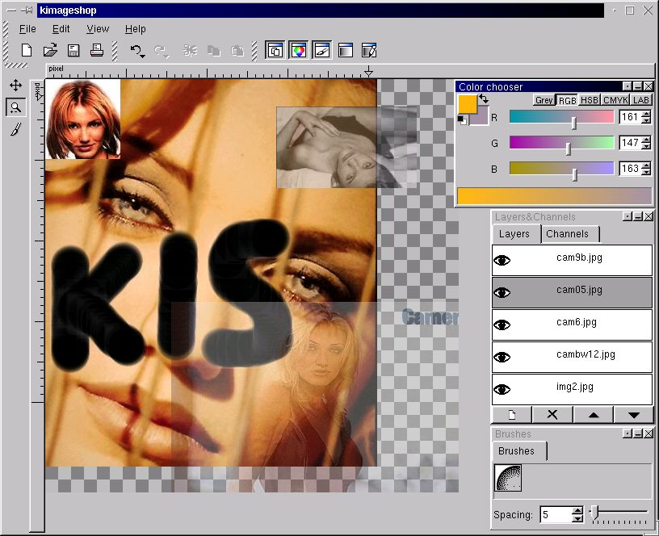
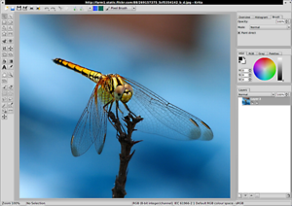
Krita
Past Present and Future

Slide 2
Krita’s Disreputable Past
1998: Kimp
1999: KImageShop
2000: Krayon
2002: Krita
2003, 2004...
2005: First release (1.4)
2006: Lots of releases (1.5, 1.6)
2007: Port to Qt4, KDE4, KOffice 2

Slide 3
What Can Krita do for You
Krita lets you create images
Raster images
Based on existing images or from scratch
That are color-corrected
Can be in rgb, cmyk, lab, ycbcr, gray, watercolors or lms
8, 16 or more bits per channel including HDR
Using pixels, text or vectors
In many, grouped layers
With adjustment layers filtering your work
That you can manipulate with scripts in Python and Ruby

Slide 4
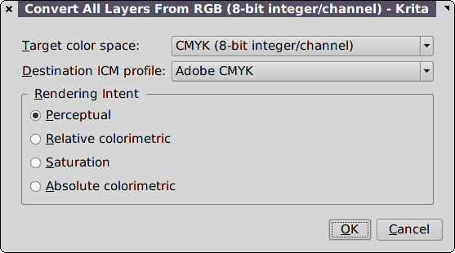
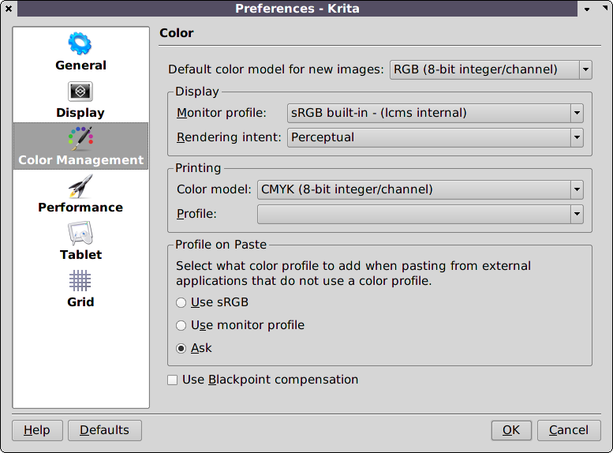
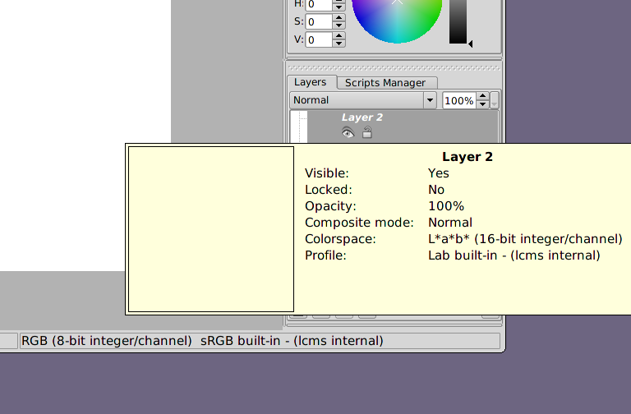
Color

Slide 5
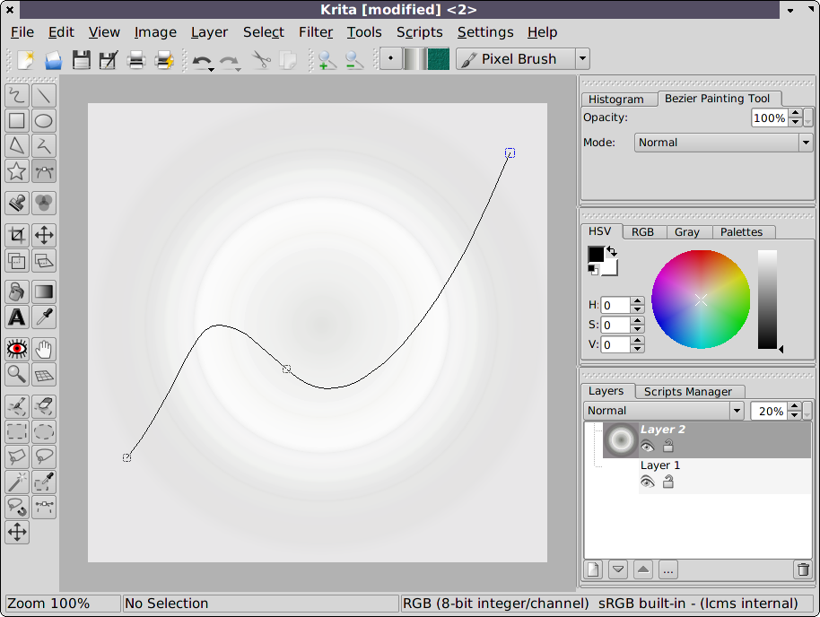
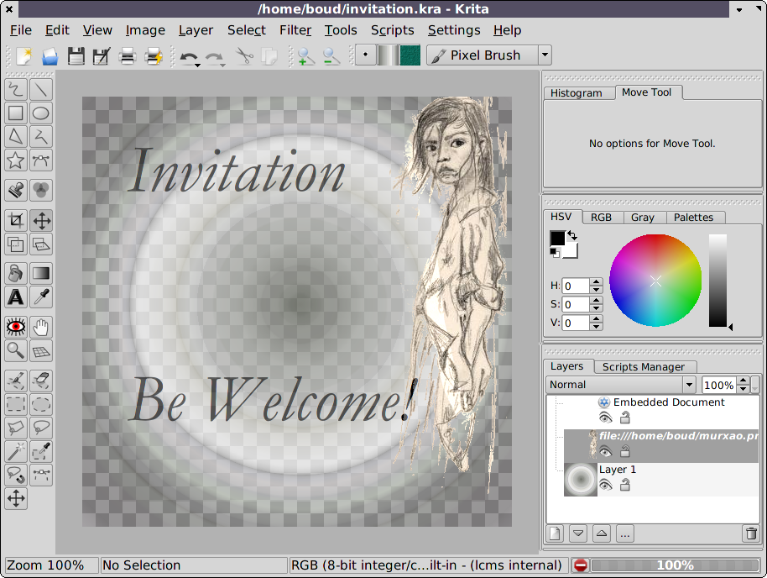
Pixels, Text and Vectors

Slide 6
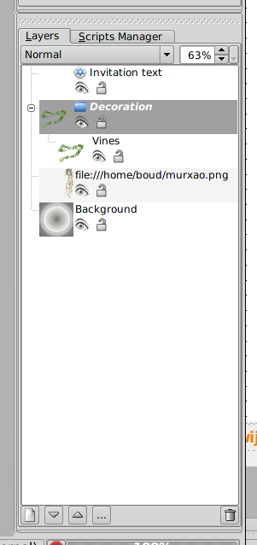
Layer Organization
Types of Layers:
Paint Layer
Object Layer
Adjustment Layer
Group Layer
Group Layers optmize rendering
Group Layers can be nested
Object layers must be in the "root" group

Slide 7
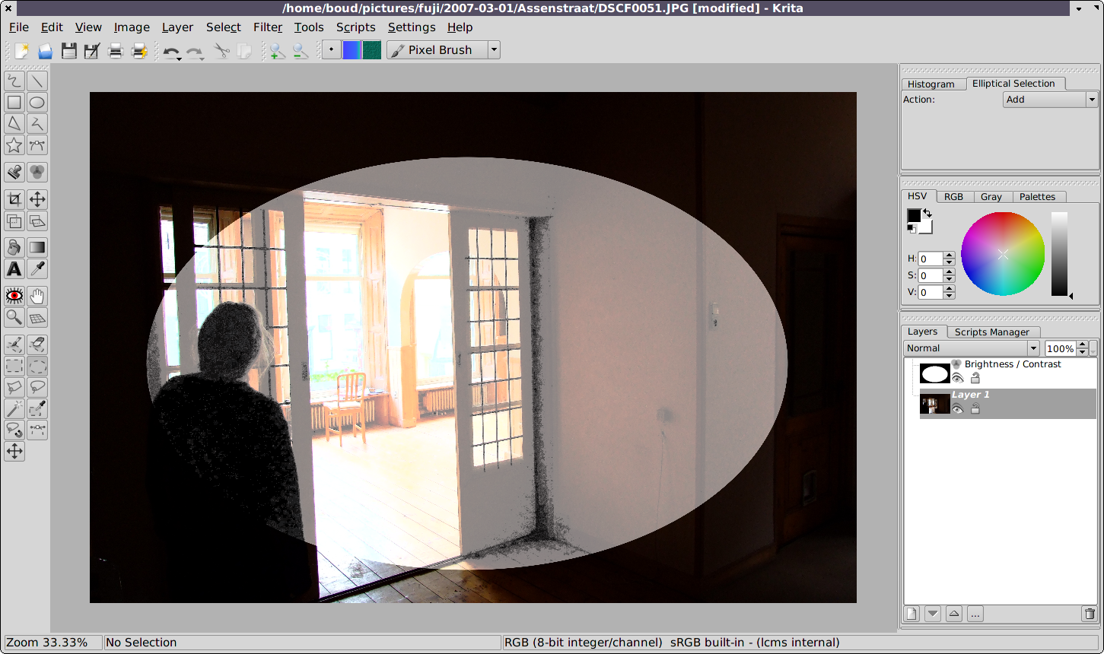
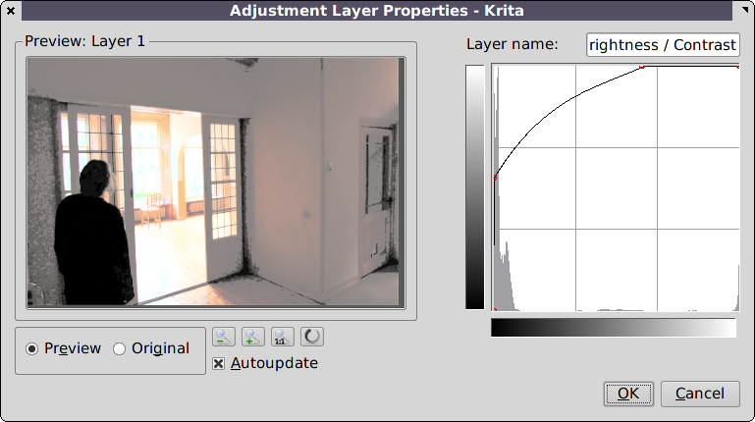
Adjustment Layers
Act like a filter on top of a layer stack
Contain a mask that constrains the filter effect
Are editable
Are dynamic
Are fun

Slide 8
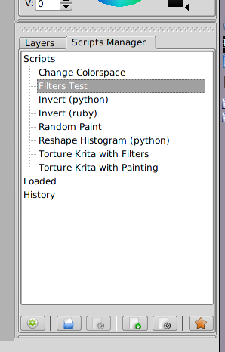
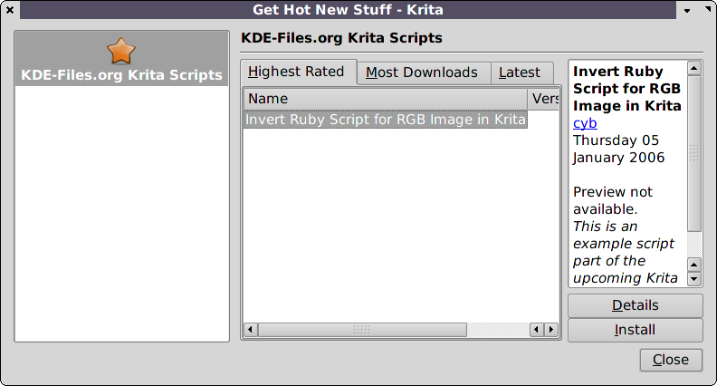
Scripting
Python and Ruby
Same document model, same API
Integrated in the gui
Well-documented

Slide 9
The Future
Qt4, Arthur, Scribe, Flake, Pigment...
Shapes: seamless mixing of pixels, vectors and text
More Colorspaces (XYZ, Spectral Colorspaces)
GPU-accelerated filters
Selections, Masks, Painterly Overlays
Image Resolution
Tonemapping, Bracketing to HDR
Natural Media Simulation (chinese brush, dynamic brush, gouache brush)
Performance Improvements

Slide 10
Shapes
Text
Paths
Connections
Tables
Music
...

Slide 11
Pigment: Color for everyone
Colormanagement for all of KOffice
Fast & easy to add new colorspaces
Out-of-gamut warning
Color manipulation
Per-channel filtering and composition

Slide 12
Selections, Masks, Overlays
A Global Rethink of Selecting Pixels
Select pixels for changing: protection mask
Select pixels for reading and changing: selection
Select pixels for filtering non-destructively: effect mask
Select pixels for showing in the image: opacity mask
Global selections and per-layer selections
Painterly overlays
Visualisation: ants, mask: a Google Summer of Code project

Slide 13
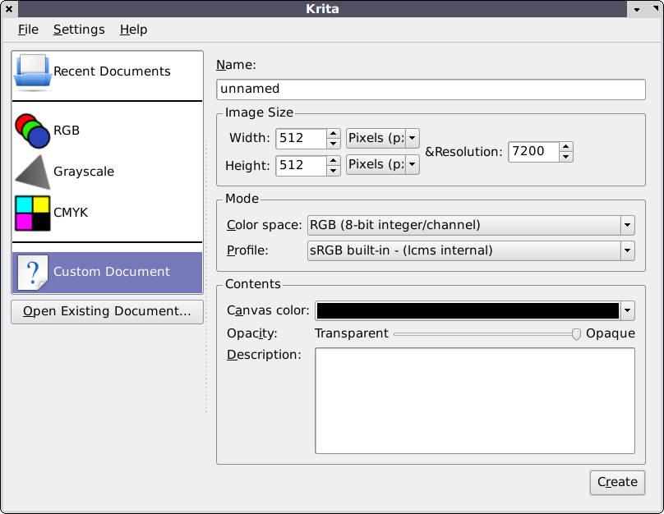
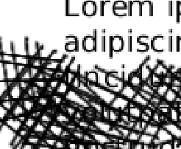
Image Resolution
Document has resolution
Screen has resolution
Printer has resolution
And vectors and text?

Slide 14
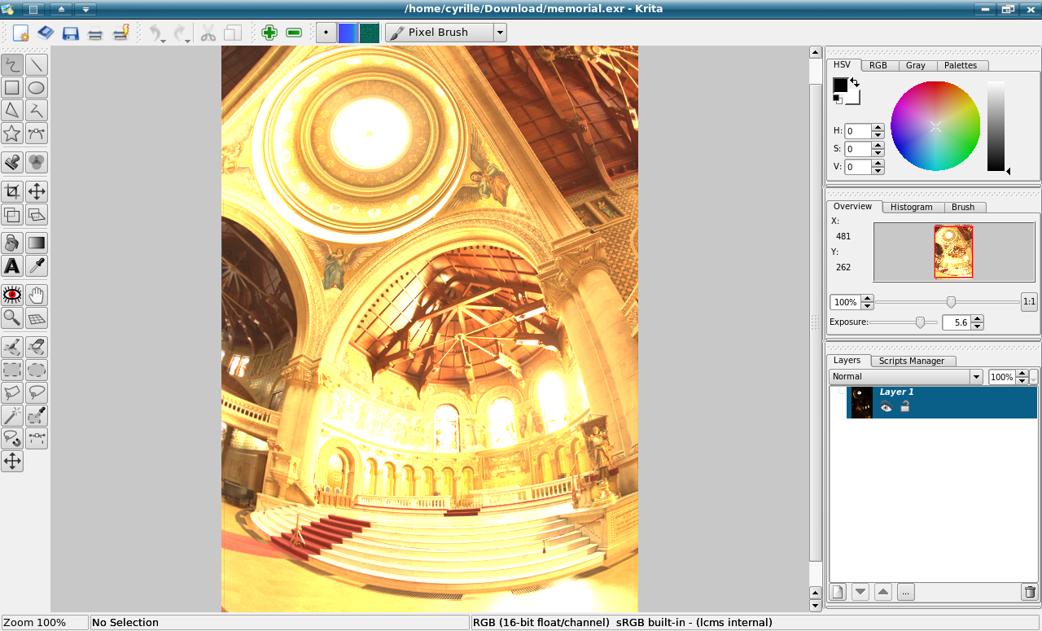
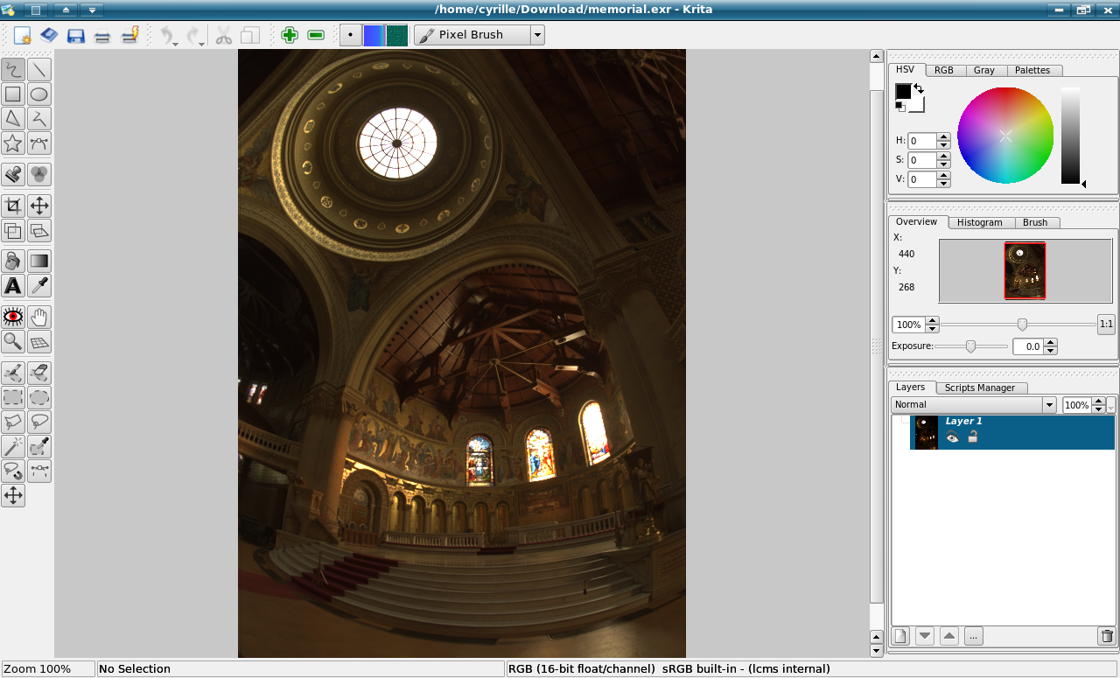
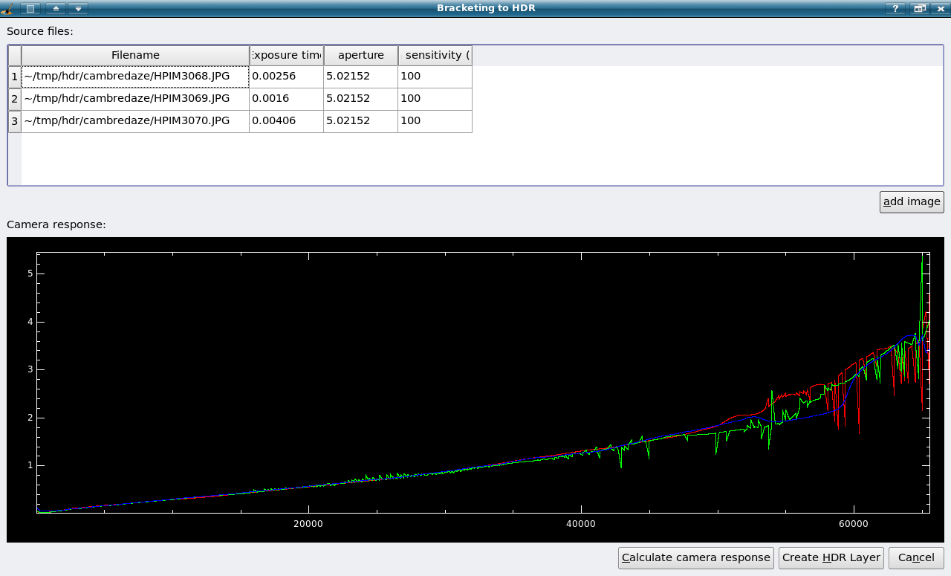
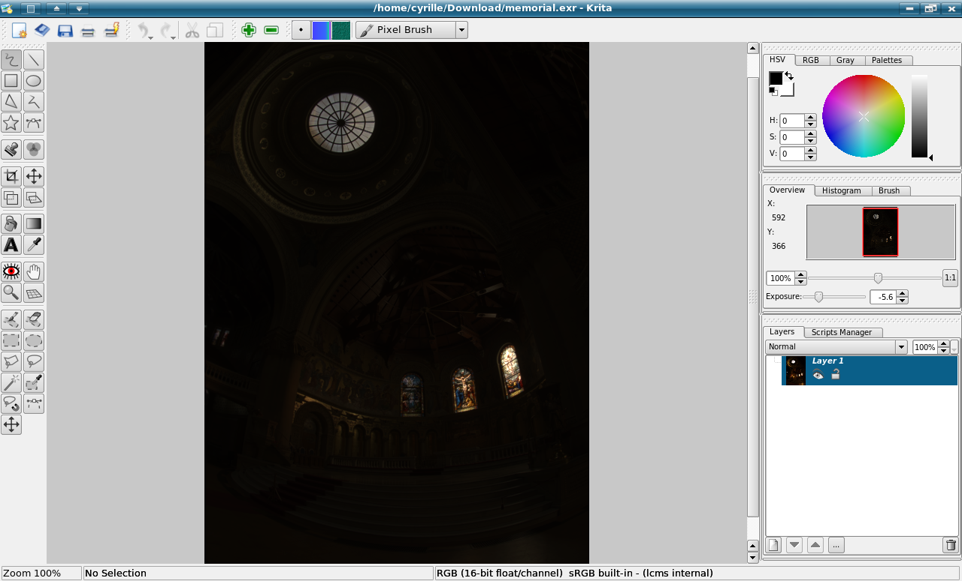
Tone Mapping, Bracketing
creating High-Dynamic-Range images
Tone mapping (OpenICC SoC)

Slide 15
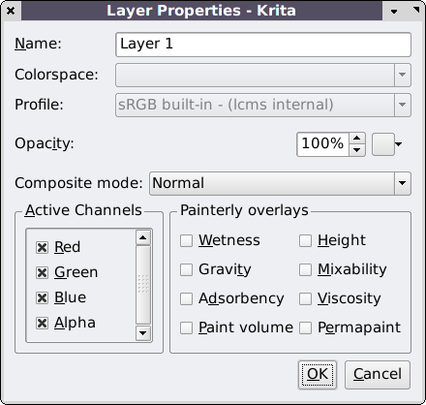
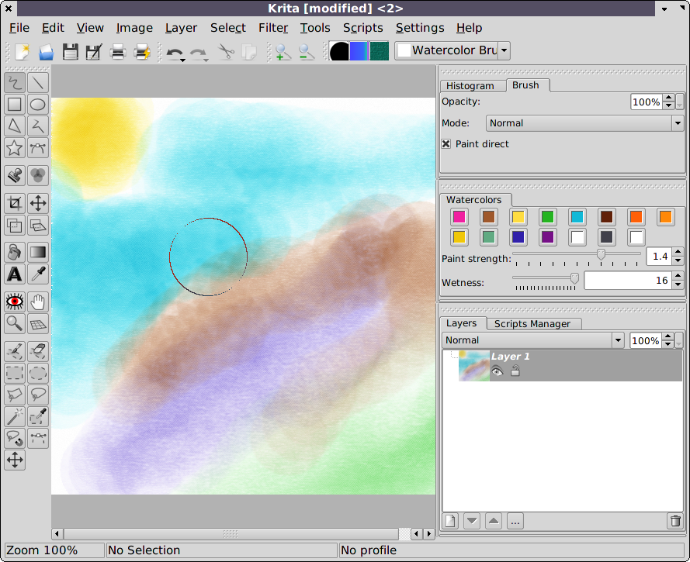
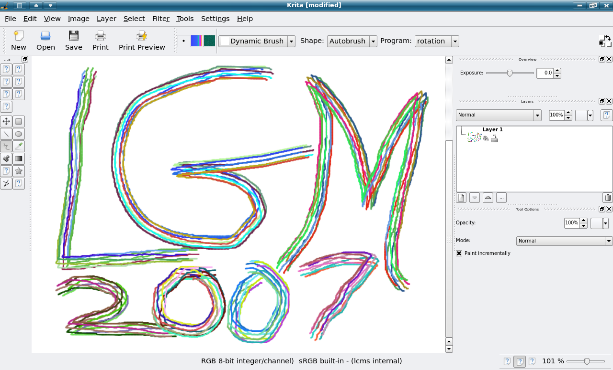
Natural Media
Google Summer of Code Project
Paint mixing
Paint simulation
Canvas simulation
Brush simulation

Slide 16
Questions and Answers
Questions and Answers

