Slide 1
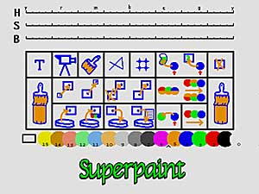
Shoup’s Superpaint (1973)

Slide 2
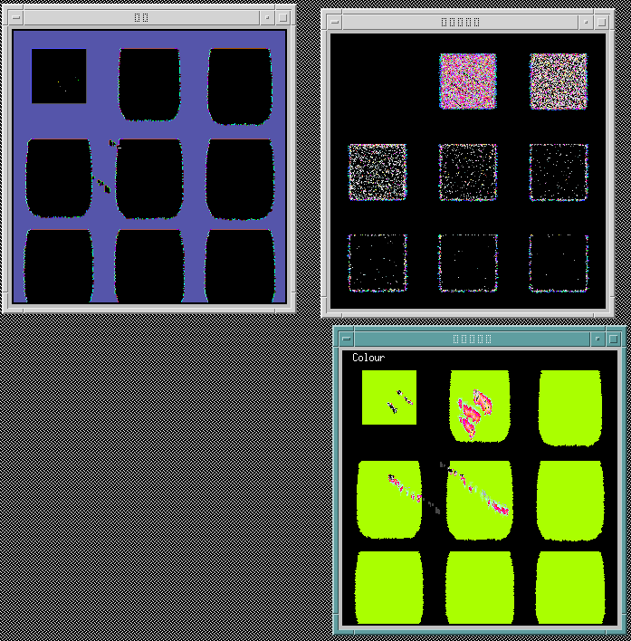
Tunde Cockshott: Wet & Sticky

Slide 3
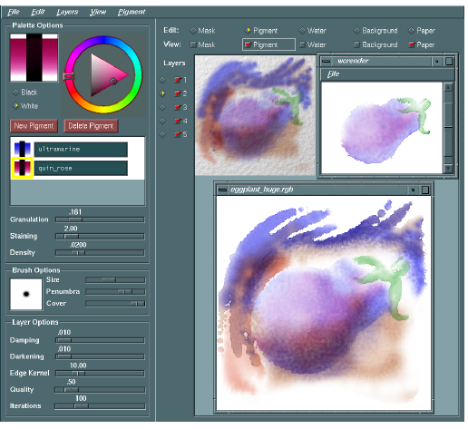
Curtis, Salesin et al:
Computer Generated Watercolor

Slide 4
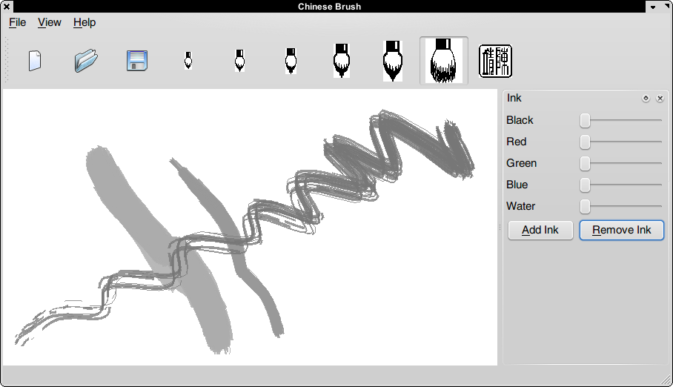
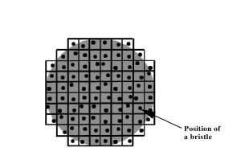
Clara Chan: Chinese Paint

Slide 5
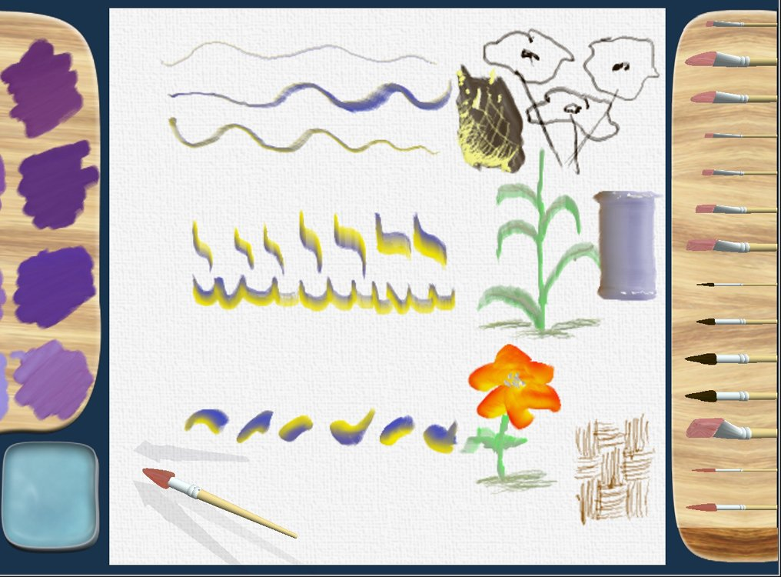
Bill Baxter: Dab, Impasto

Slide 6
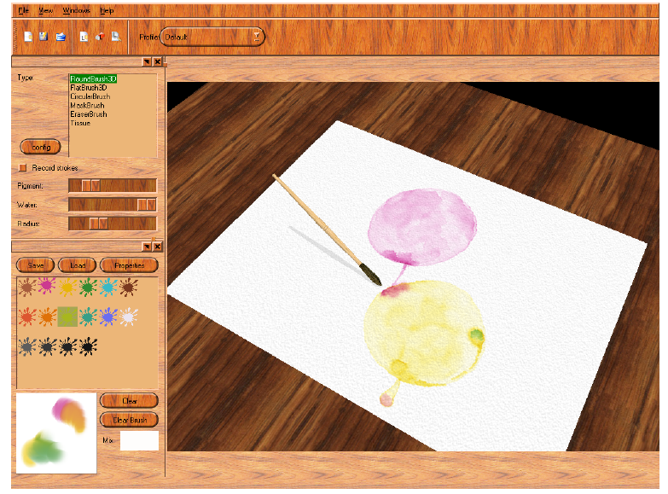
Van Laerhoven: Waterverve

Slide 7
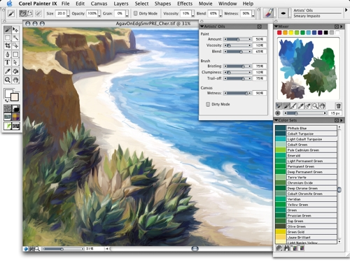
Corel Painter

Slide 8
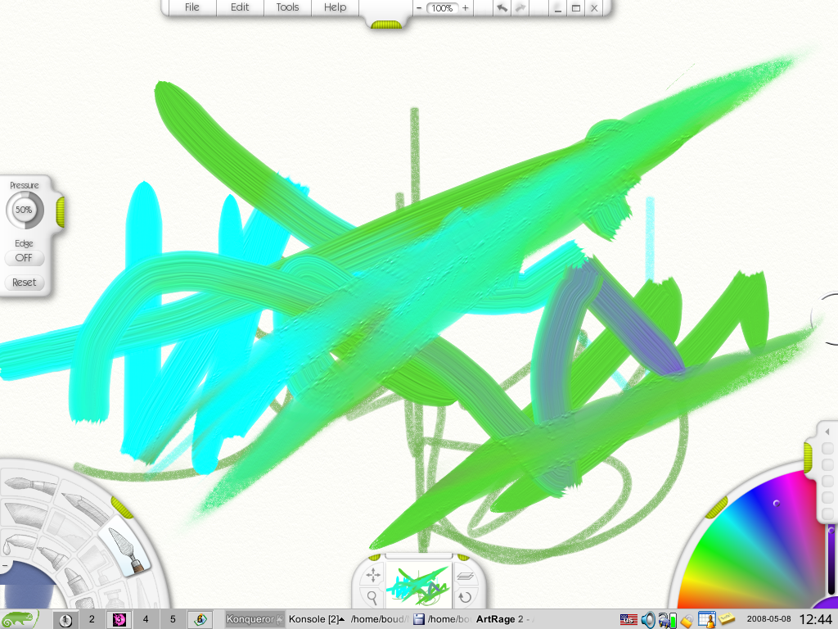
Art Rage

Slide 9
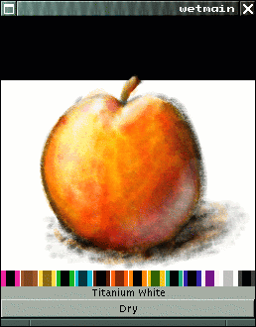
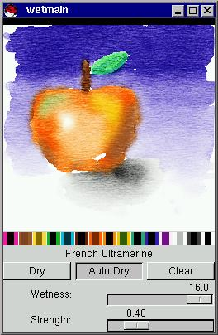
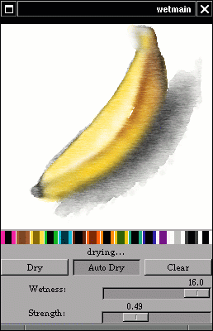
Raph Levien: Wet Dream

Slide 10
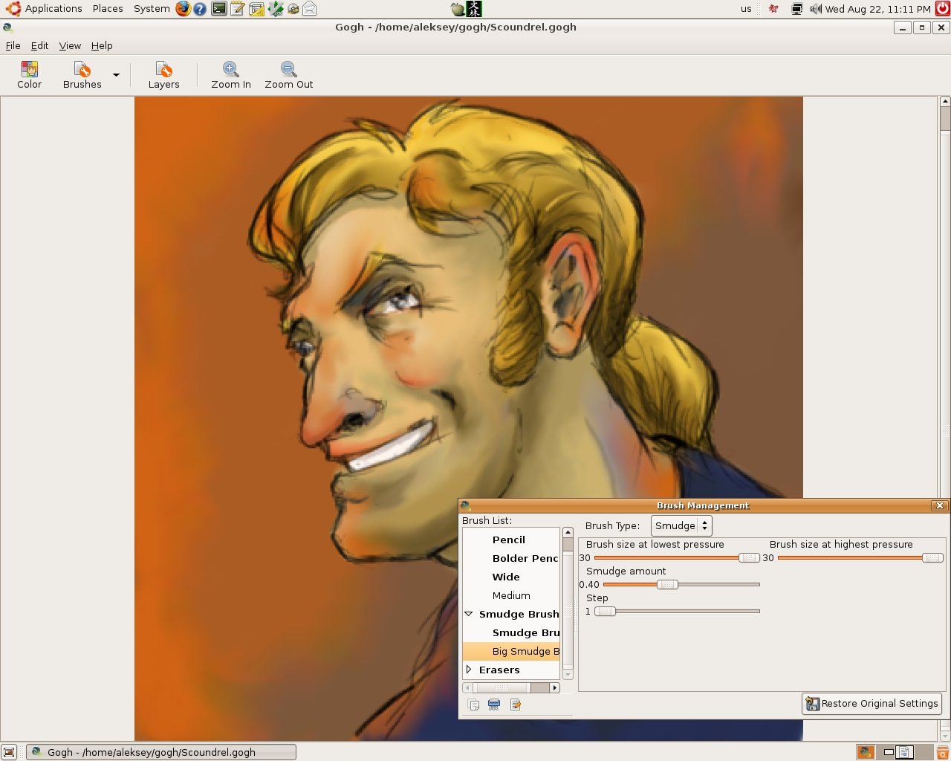
Aleksey Nelipa: Gogh

Slide 11
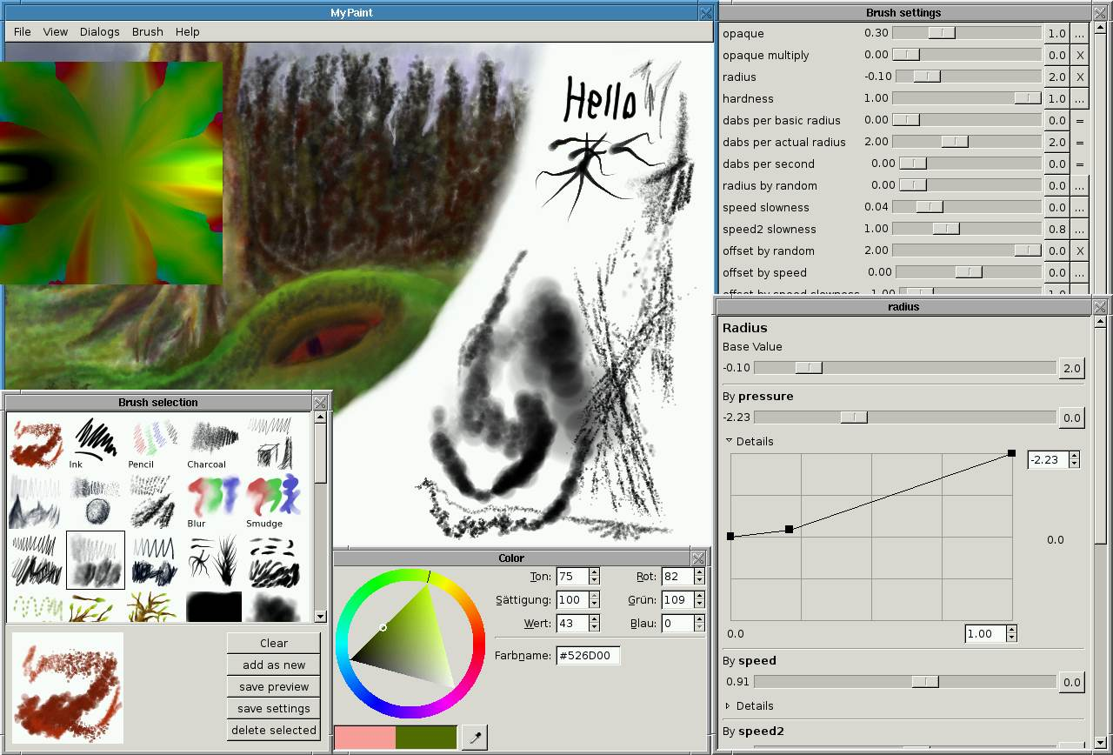
Martin Reynold: MyPaint

Slide 12
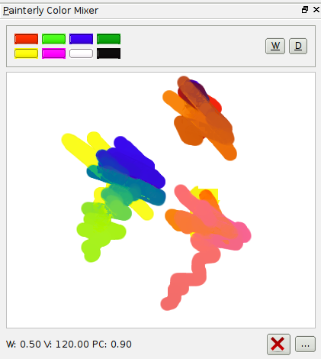
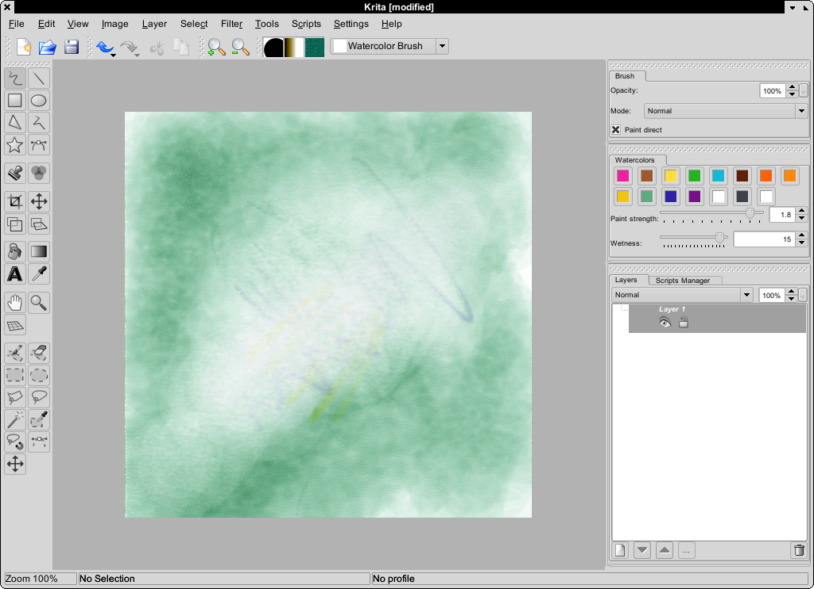
Krita

Slide 13
Why?
Lumpers vs splitters
Style of working, building up vs discovering, constructing vs serendipity:
Serendipity aided by complexity
Parameters not considered by pototo-stamp applications (even if they may have jitter, fade and other programmable features in their brush engines):
Viscosity
Mixability
Time-based property modification on canvas
Mixability
Graininess .... and more
Thickness, height
Gravity (direction, strength)

Slide 14
Interesting Problems
Subtrate — Tool — Material
Colour Mixing
Fishkin: Pigmentary Mixture
Kubelka-Munk Model
Real-Time physical filters
Undo/Redo
Rainwiper effect
Interactivity
Painting is not two dimensional
thickness of material, thickness of canvas, shadows
Resolution
Berman, Bartell, Salesin: Multi-resolution painting: pyramid approach
Velho, Perlin: B-Spline Wavelet Paint: unbounded, smooth, multi-resolution paint

Slide 15
Future
All the elements together:
Substrate: extensible canvas representation with painterly channels in Krita
Tool: support for pluggable devices: tablets, navigator
Material: pluggable brush engines
Interaction: physics engines (filters)
Color: Emanuele Tamponi’s color work

