Slide 1
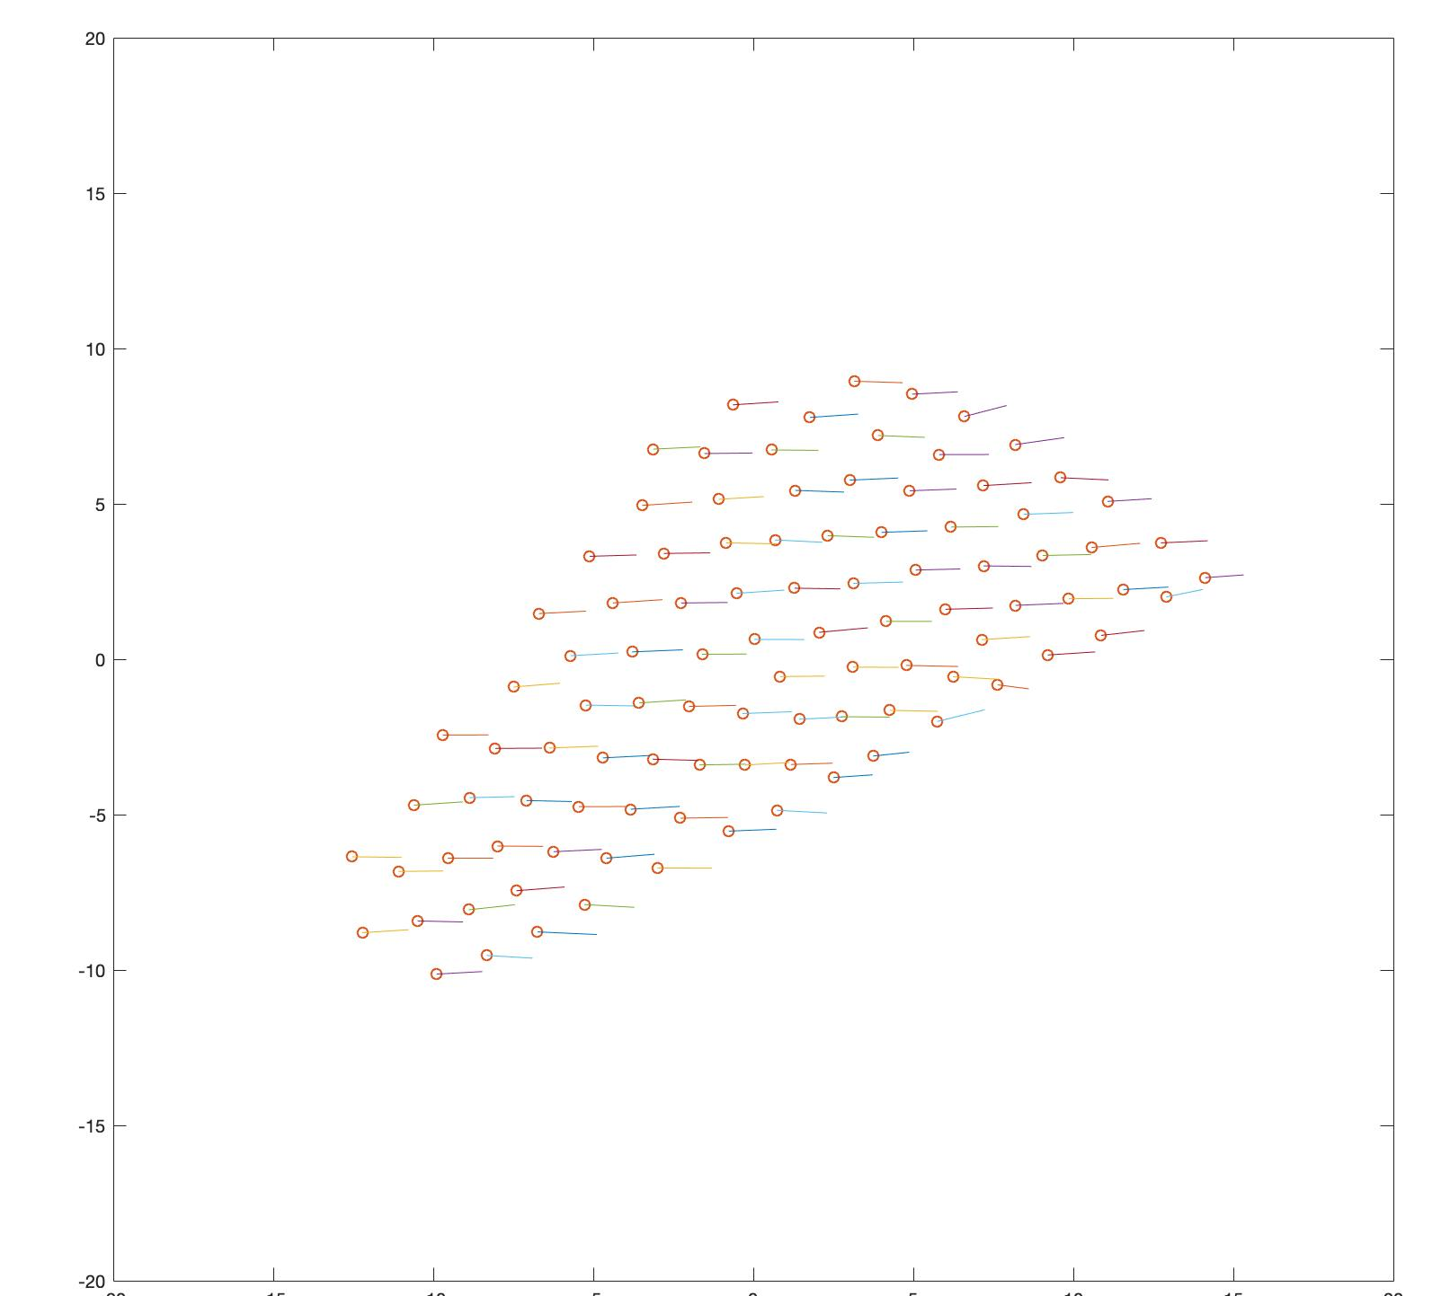
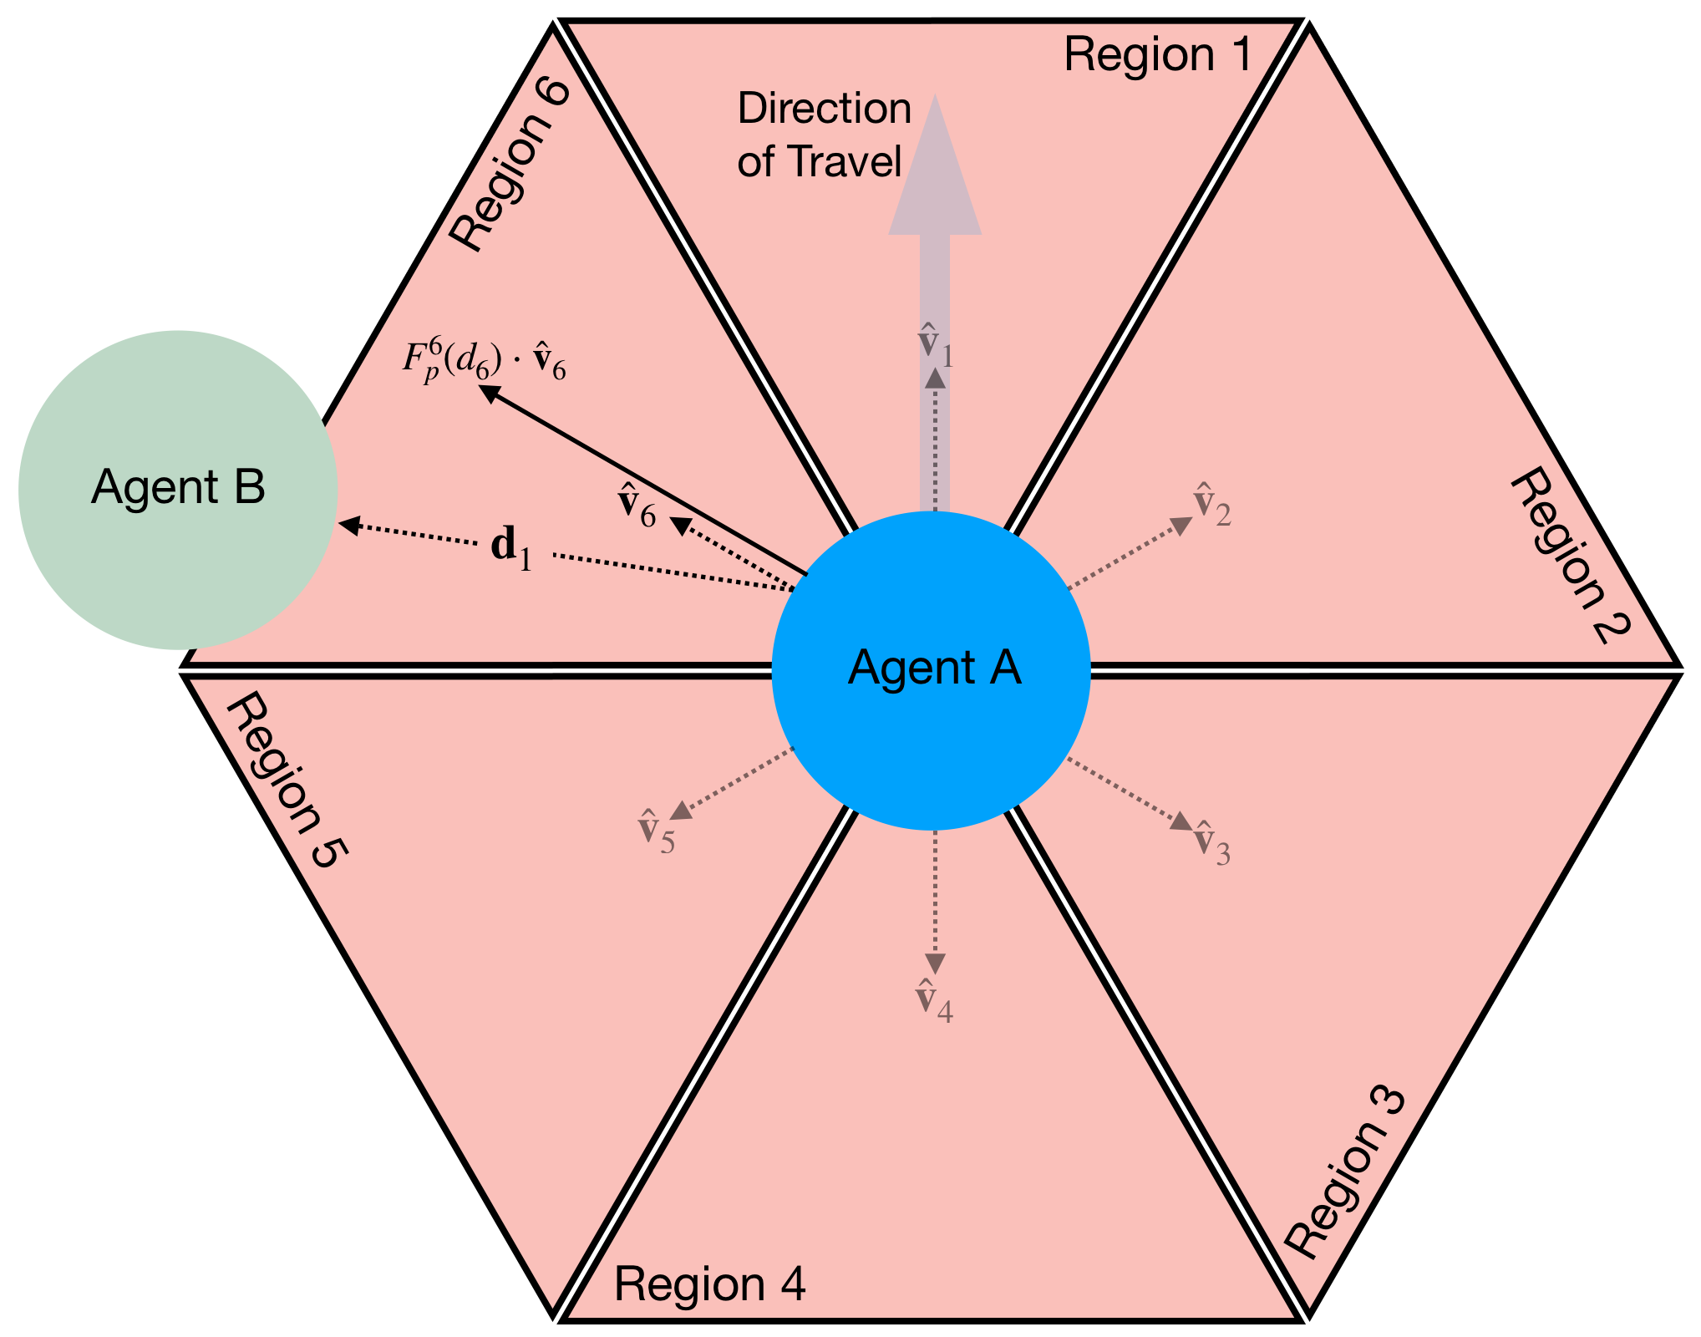
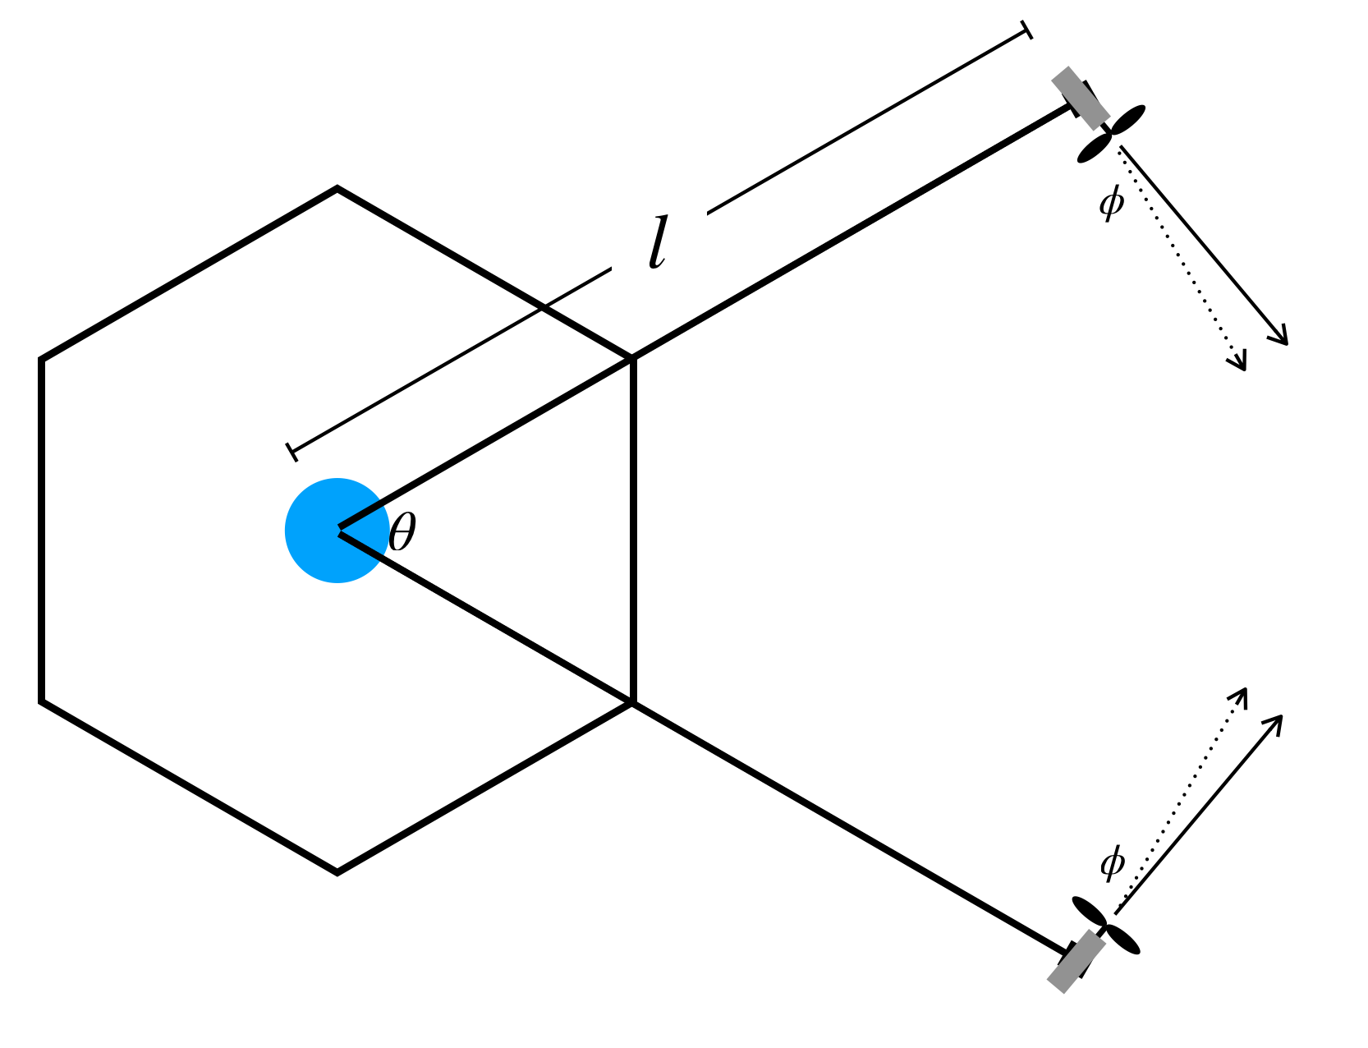
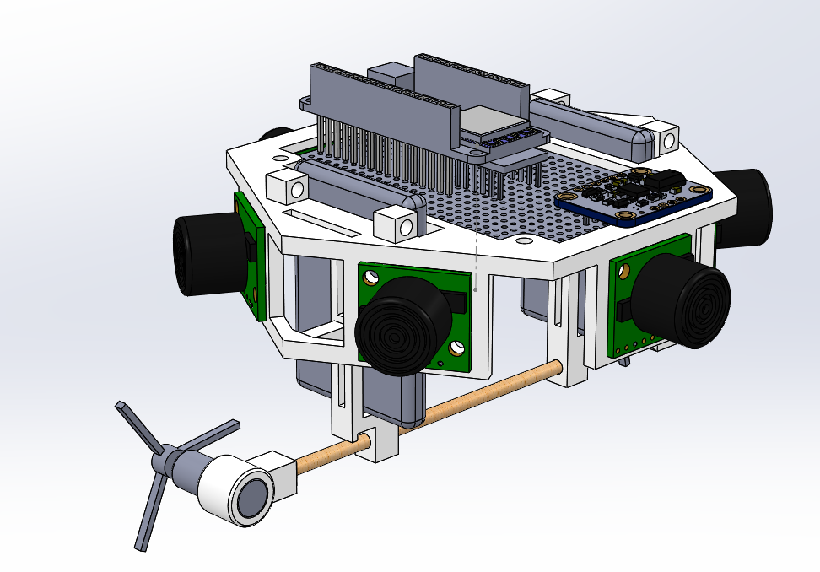
Control and Emergent Behavior of Swarms under Virtual Forces
Objective: Abstract away the control of a swarm to a simplified state space describing the swarm’s mass properties. This would facilitate the use of complex control methods used in a centralized or decentralized fashion along with HITL control. To maintain scaling, assume no individual agent global positioning and no agent-agent communication.
Technology Overview: An swarm that can be controlled with global swarm inputs and whose agent’s use common sensor technology to obtain relative position
Development Stage: The swarm will be simulated to explore possible emergent behaviors and verify the global dynamic equations
End Product: An agent design that creates a swarm easily controllable with centralized, or decentralized controllers.
Background: Many advanced controller designs, such as Model Predictive Control, struggle with large State Spaces. By abstracting the individual agent’s states into a global state space, these advanced controllers will be better suited for swarm control and exploiting emergent behavior.
Approach: Create a new blimp design capable to sensing its neighbor’s location and adhering to a global orientation. Create a swarm of these blimps and use their relative distances and global inputs to create control inputs.
Challenges: Developing a sensor array that is simple but reliable. Blimp actuation that is rapid but controlled.
Objectives: Demonstrate the swarm’s control and emergent behavior using simulation with 100+ agents. Verify the simulation by comparing a simple, 2 agent simulation with the physical actions of 2 blimps.
Results: During simulations, we observed several forms of emergent behavior. By altering the properties of the potential fields and applying global forces, we can adjust the swarms density and shape. One such behavior is pictured above where the swarm created an arrow shape. We have two agents built with two more in construction. Using these, we have observed the validity of the simulations.
Investigator: Richard Hall
Affiliation: Duke University – Mechanical Engineering
Internship Program: SEAP
Mentor: Don Sofge
Notes:
<number>

