Slide 1

Gold Price Prediction using Time Series
-Vijay Kaniti & Halle Purdom
Notes:
Predict gold price over a period of time using time series techinuq

Slide 2

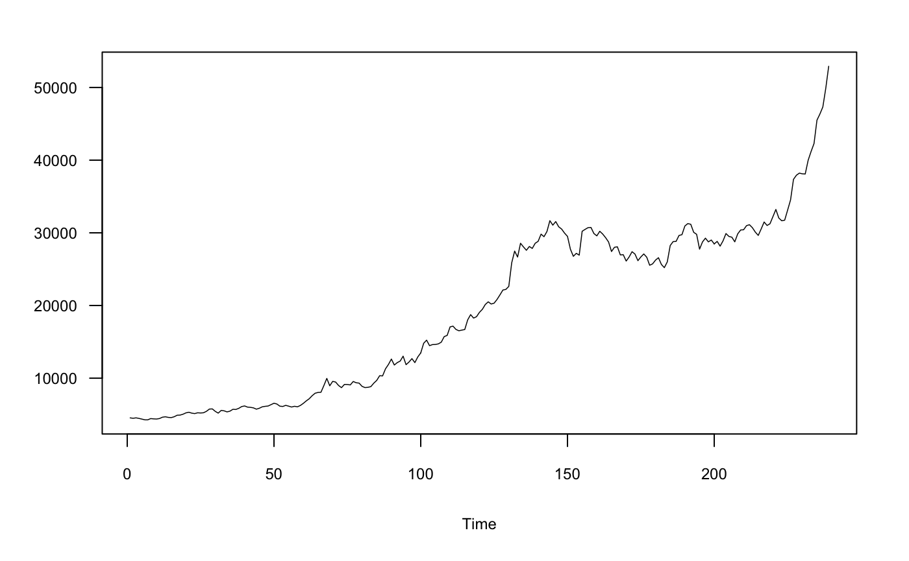
Objective & Data Set
The objective of our project is to predict the gold price and find the relation between other explanatory variables based on the historical data
Other variables include crude oil, interest rate, CPI, and USD index
20 years of monthly data from October 1st , 2000 to August 1st, 2020
Data represents the gold price in India
Monthly Gold Price over 20 Years
Gold Price
Month
Notes:
Forecasting rise and fall in the daily gold rates can help investors to decide when to buy (or sell) the commodity.
Gold reserves shows the strength of country. ,It can be used to control inflation as well
Gold prices are dependent on many factors such as prices of other precious metals, prices of crude oil, stock exchange performance, etc.
The challenge of this project is to accurately predict the future price of Gold across a given period of time
Our data is collected from kaggle and it is 20 years of monthly data from October 1st , 2000 to August 1st, 2020

Slide 3
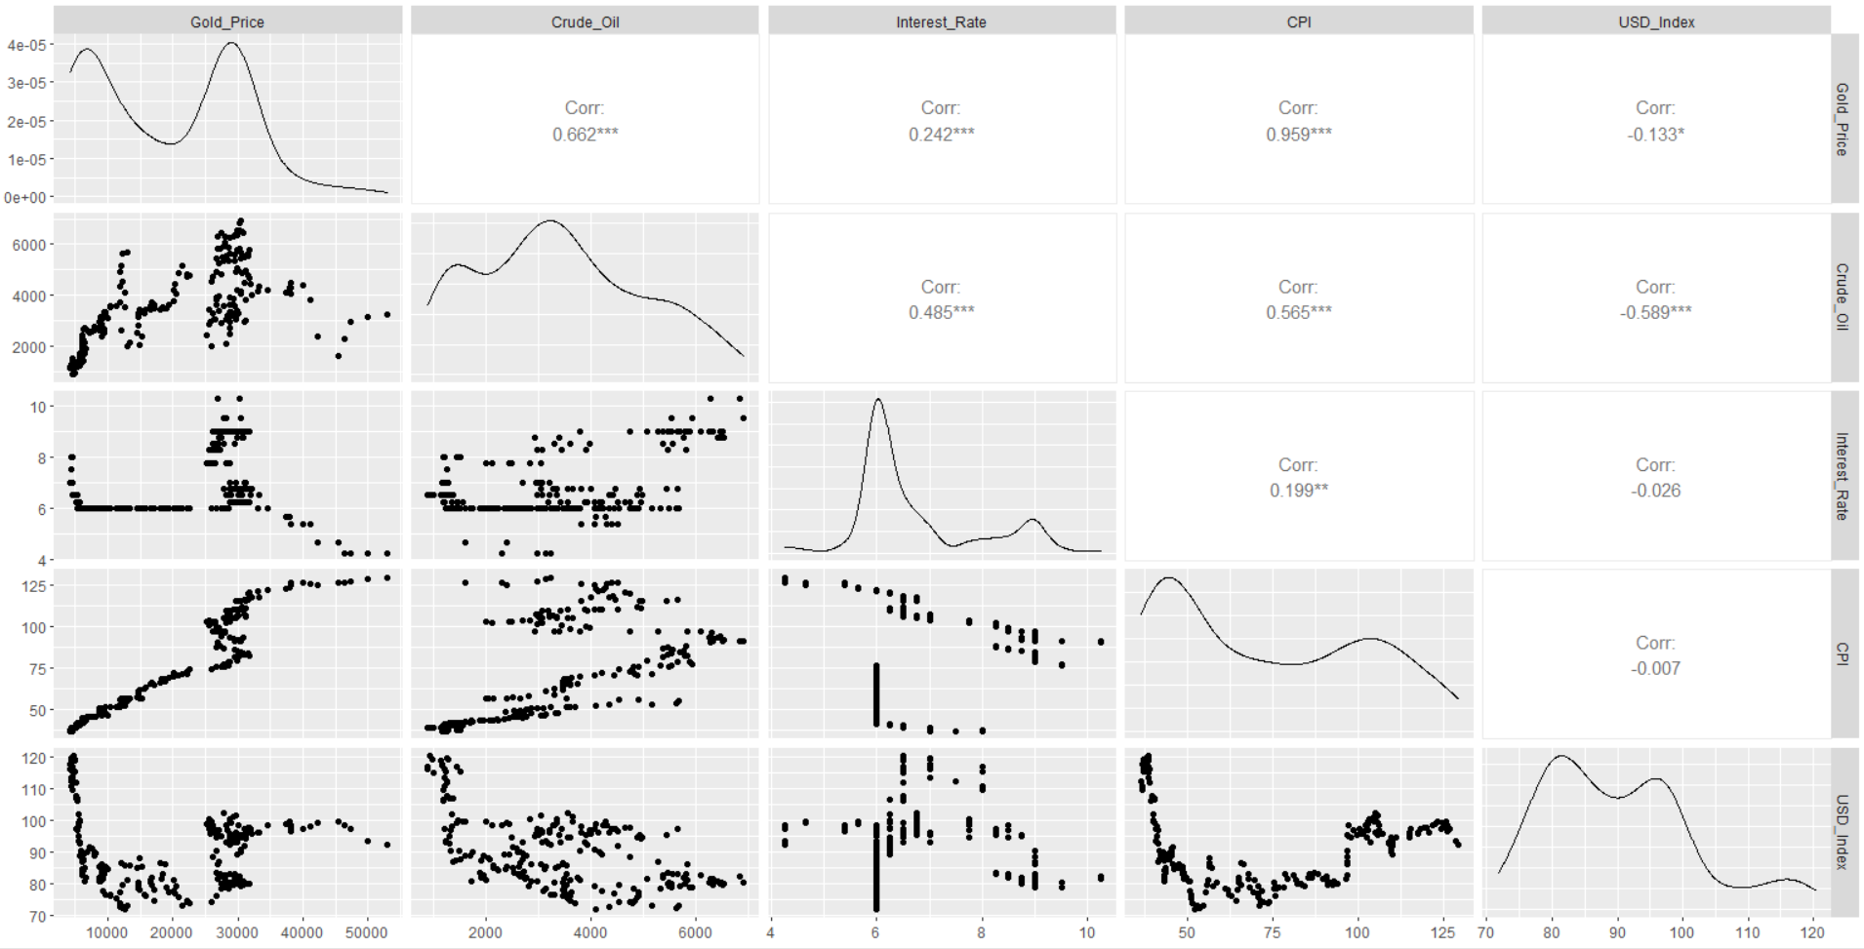
EDA
The graphs show the correlations between the variables in the data set.
Notes:
Gold price & CPI (Consumer Price Index ), crude oil has positive correlation
Crude Oil price and US stock index are negatively correlated.

Slide 4
Methods
ARIMA(p,d,q)
VAR model
Multivariate Perceptron Neural Network
Ensemble of current models
Notes:
ARIMA-It is a powerful method for time series forecasts.
AR: Autoregression. A model that uses the dependent relationship between an observation and lagged observations. And also considers relation between an observation and a residual error, differencing of raw observations can be made to make the time series stationary.
In a VAR model, each variable is a linear function of the past values of itself and the past values of all the other variables .It captures the correlation among a set of variables and analyzes to provide better forecasting results
MLP
deep learning approaches in time series do not make assumptions about the underlying data, there is no need for the series to be stationary. It is highly used for non linear and time variant problems which have uncertain behavior

Slide 5
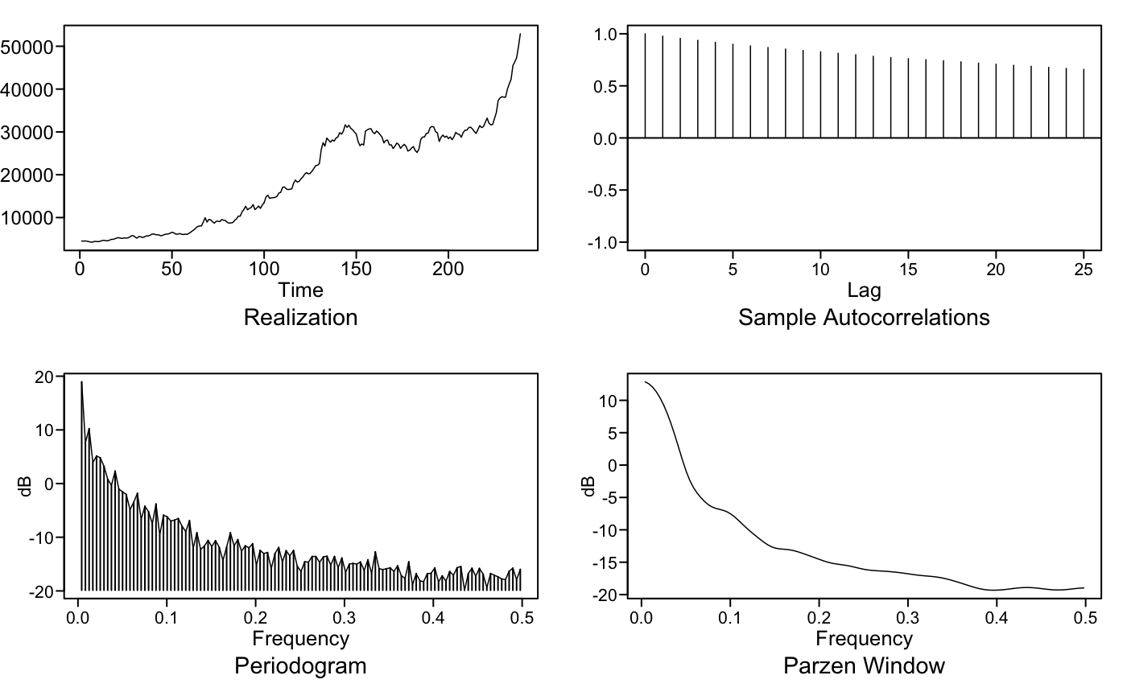


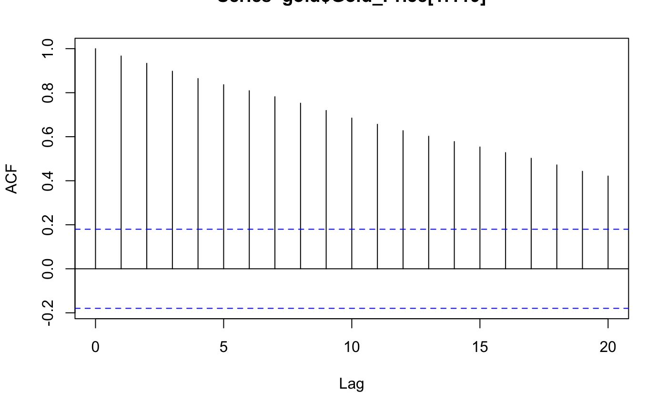
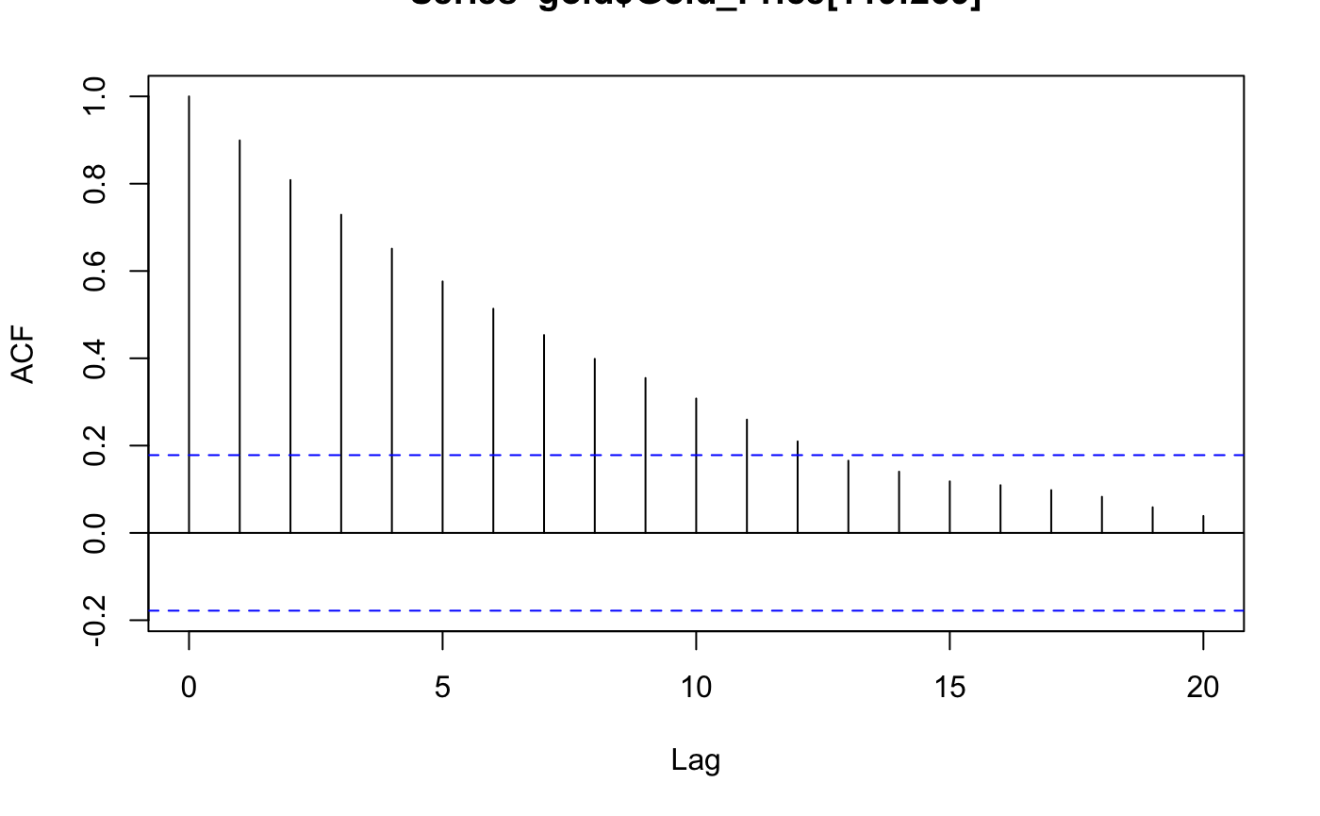
Stationary or Non Stationary ?
Conditions of Stationarity:
Constant mean
Constant variance
Correlation between two datapoints depends only on how far apart they are in time, not where they are in time
Non Stationary
Spectral density shows, wandering behavior and peak at zero.
ACF of Months 1 – 119
ACF of Months 119 – 239
Ljung Box test gave p value
< 2.2e-16
Notes:
we observed the first two conditions failed which is constant mean and constant variance .Gold price does not have same mean or variance at two different intervals of time.
Coming to third condition ,The ACF plot looks similar at two different times so we can assume there is not lot of evidence to say it did not met the condition.
From spectral density plot we can say series shows wandering behavior

Slide 6
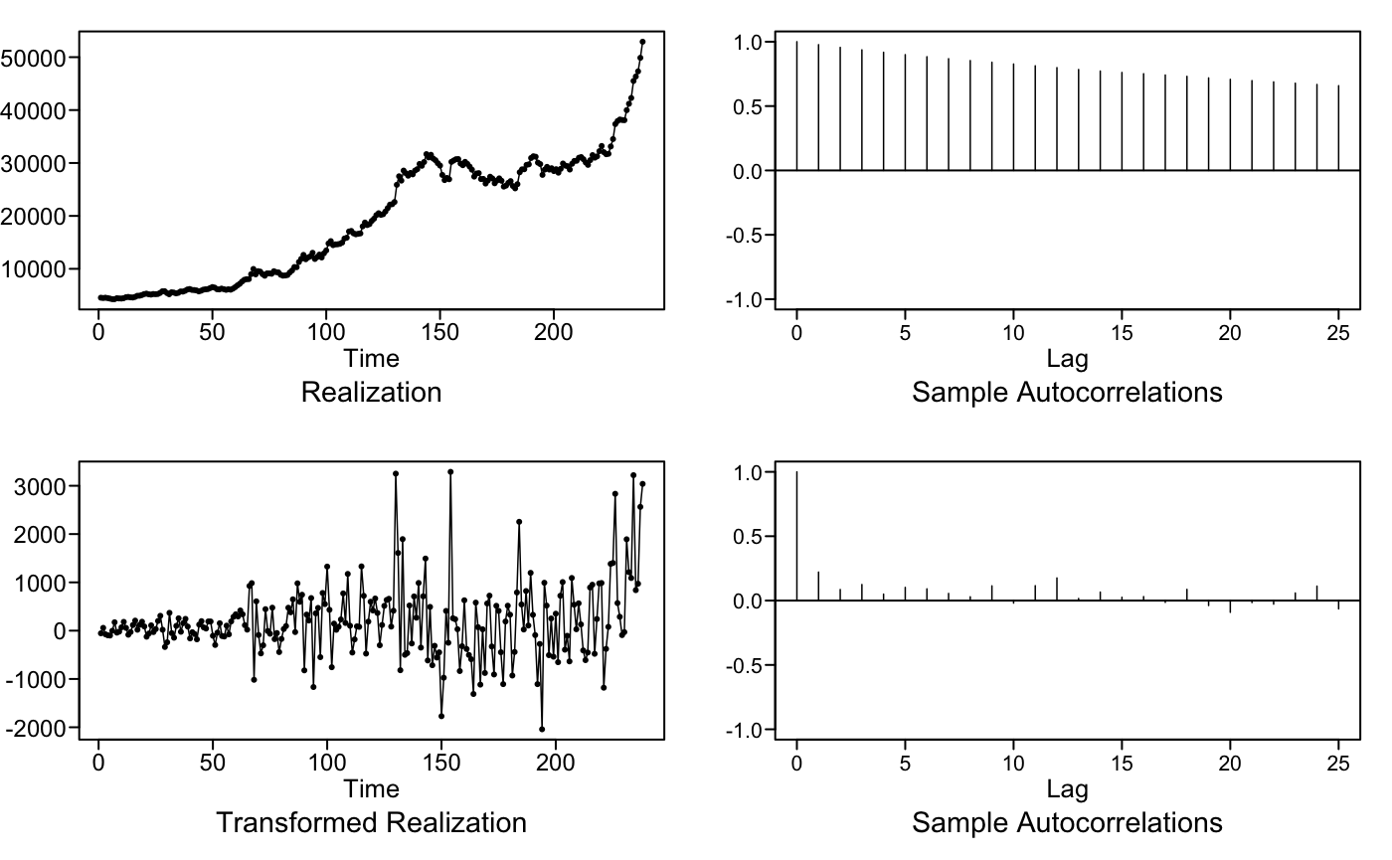
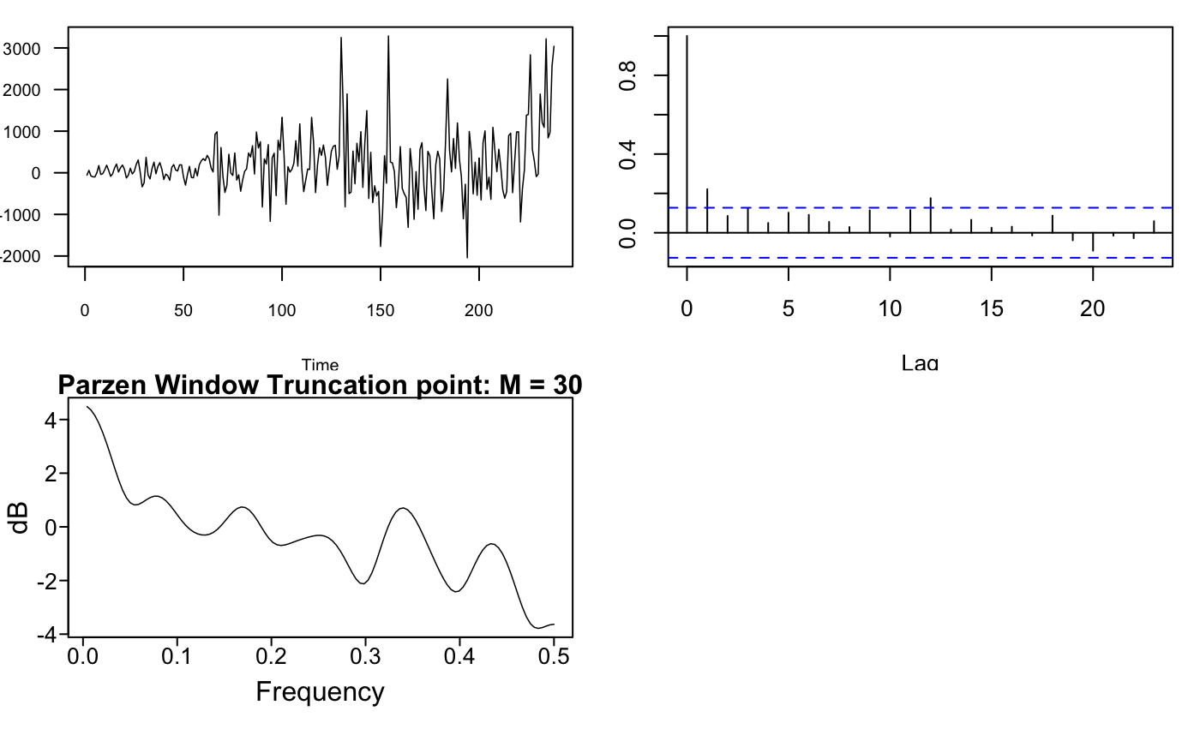
Difference the data
Notes:
To proceed with modelling we have to make series stationary,so we did a first order difference and result is shown here. Now the series look stationary and most of auto correlations are inside the blue line which indicates this has white noise behavior.

Slide 7
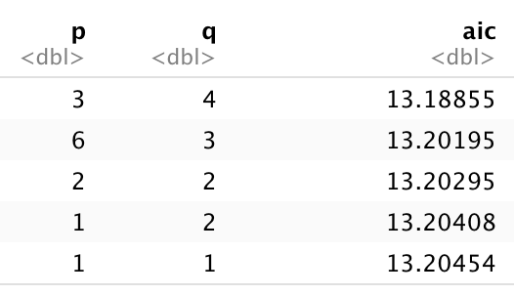
ARIMA(6,1,3) Model
AIC:
AR Factor Table:
Factor | Roots | Abs Recip | System Freq
1+1.0249B+0.9905B^2 | -0.5174+-0.8613i | 0.9952 | 0.3361
1-1.9687B+0.9690B^2 | 1.0159+-0.0052i | 0.9844 | 8.00E-04
1+1.4197B+0.5960B^2 | -1.1911+-0.5092i | 0.772 | 0.4357
1-0.9516B+0.4107B^2 | 1.1583+-1.0454i | 0.6409 | 0.1169
1+0.0645B+0.3709B^2 | -0.0869+-1.6398i | 0.609 | 0.2584
Mean: 19,299.06
Variance: 497,783.9
MA Factor Table:
Factor | Roots | Abs Recip | System Freq
1+0.9823B+0.9528B^2 | -0.5155+-0.8853i | 0.9761 | 0.3339
1-0.7833B | 1.2767 | 0.7833 | 0
1+0.6305B | -1.5861 | 0.6305 | 0.5
Continued..
Notes:
We performed AIC5 on data and it suggested ARIMA(3,1,4) and ARIMA (6,1,3) as best models.After implementing both we got best results for ARIMA(613)

Slide 8
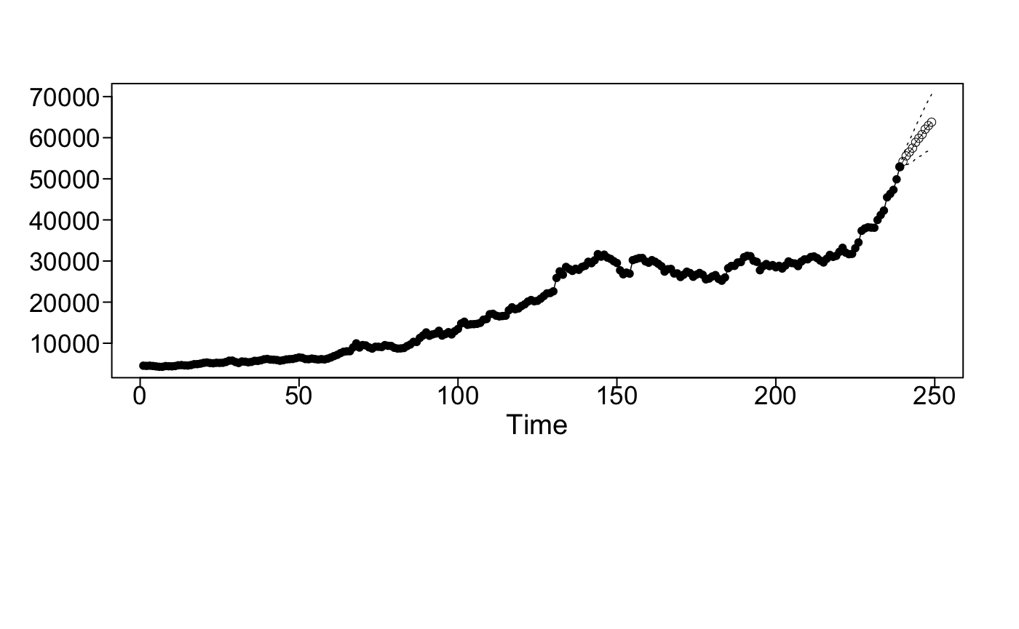
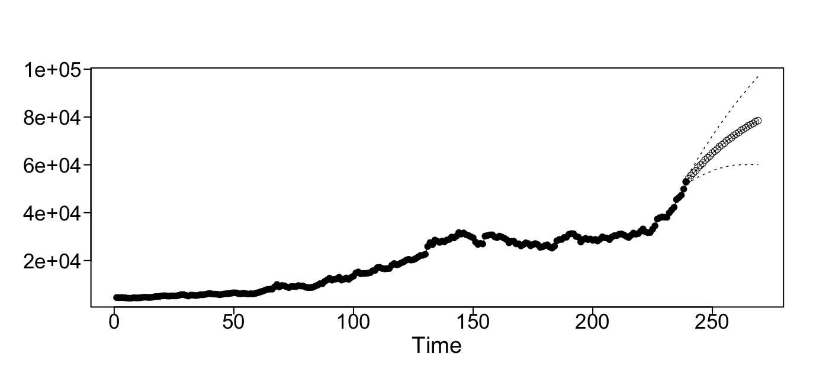
ARIMA(6,1,3) Model
Short Term Forecast: 10 months
Short-Horizon (10 months) Rolling Window RMSE: 1,701.072
Long-Horizon ( 30 months) Rolling Window RMSE: 3,465.115
After 10 months, this model predicts 63,777.17 INR
After 30 months, 78,453.28 INR
Long Term Forecast: 30 months
Notes:
ARIMA 613 model performed better out of AIC suggested models,These are the forecast graph for short term and long term with prediction intervals,It shows increase in trend and gold price in 10 months is 63,777.17 and 30 month is 78453.28 INR.I will hand over to Halle to discuss results of other techniques.

Slide 9
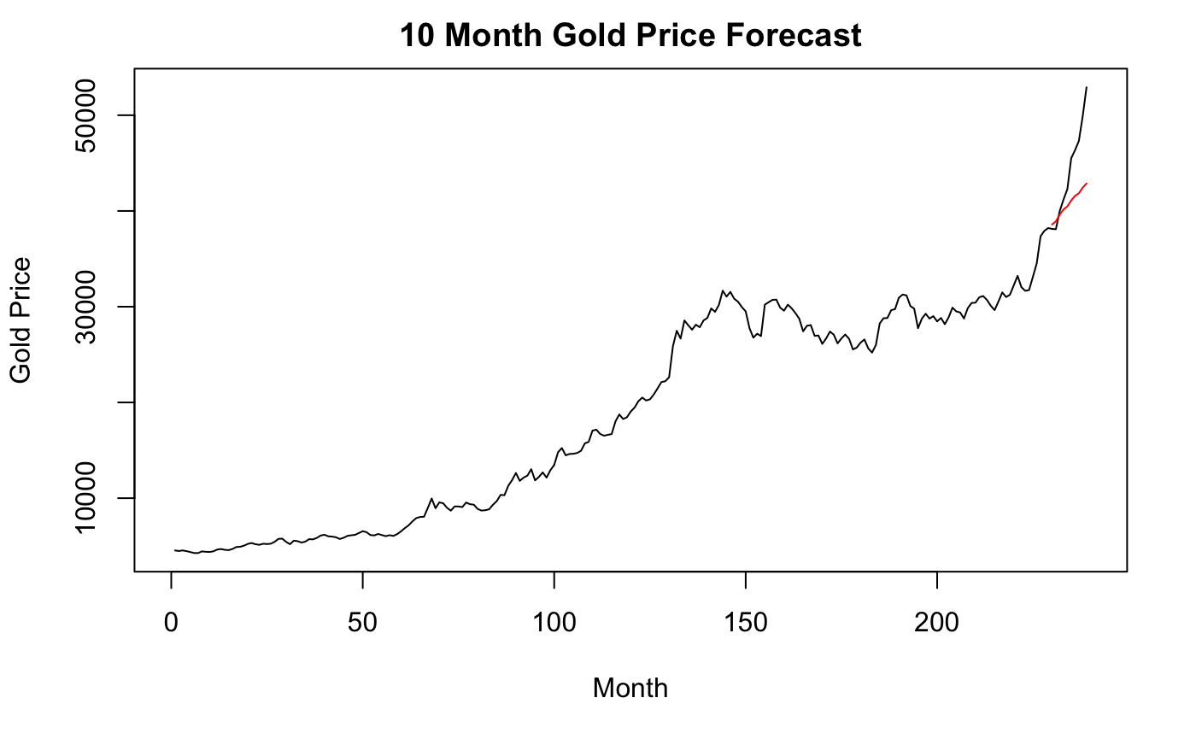

10 Month Forecast Comparison
Univariate Model Results
ARIMA (6,1,3)
Rolling Window RMSE: 1,701.072
Univariate Neural Network
Rolling Window RMSE: 1,506.033

Slide 10
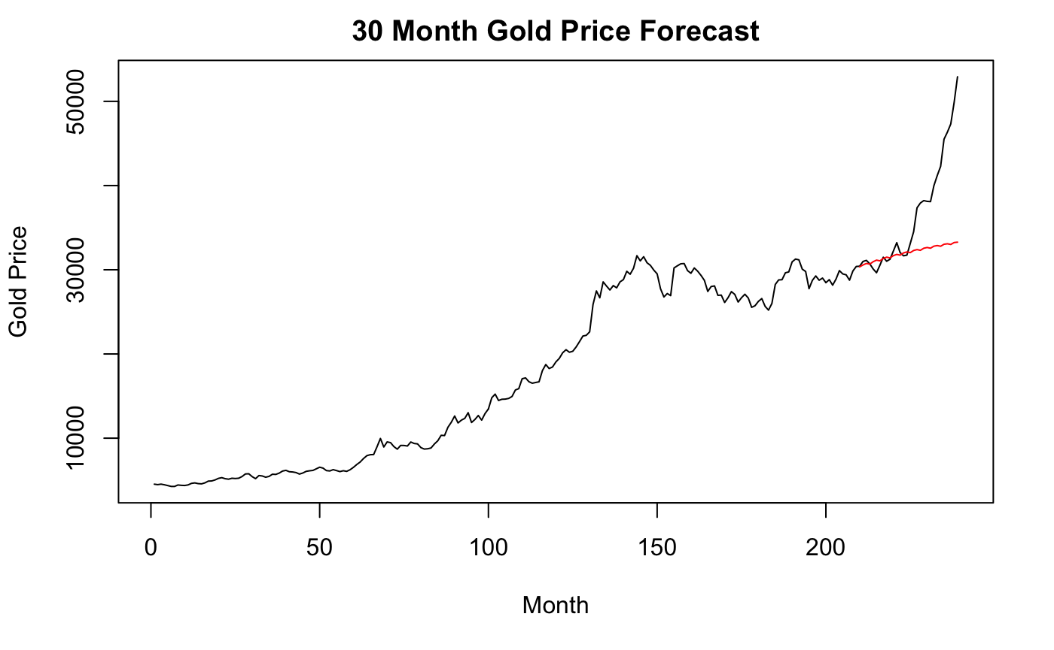

30 Month Forecast Comparison
Univariate Model Results
ARIMA (6,1,3)
Rolling Window RMSE: 3,465.115
Univariate Neural Network
Rolling Window RMSE: 2,708.565

Slide 11
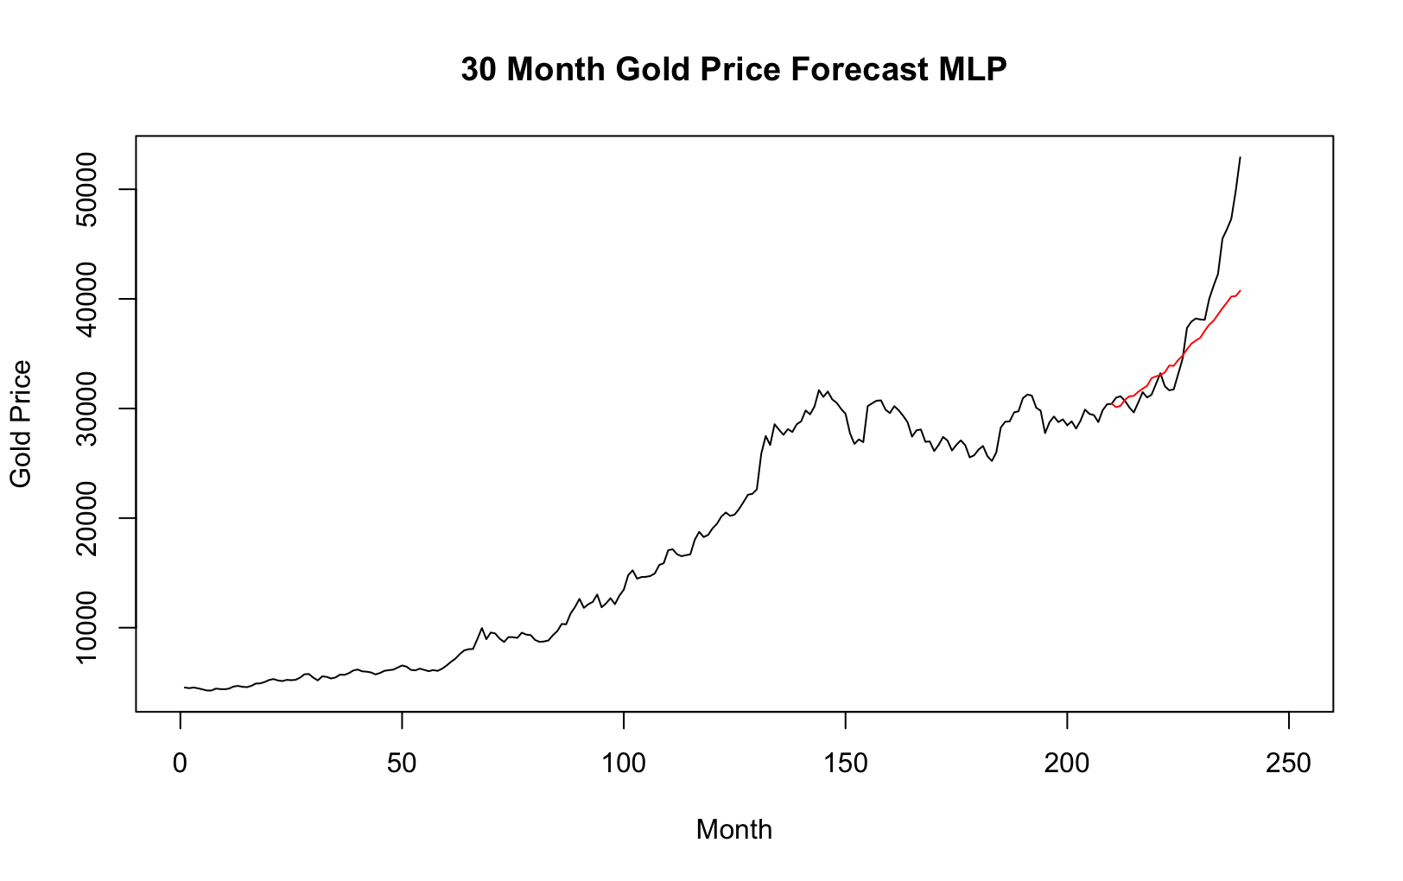
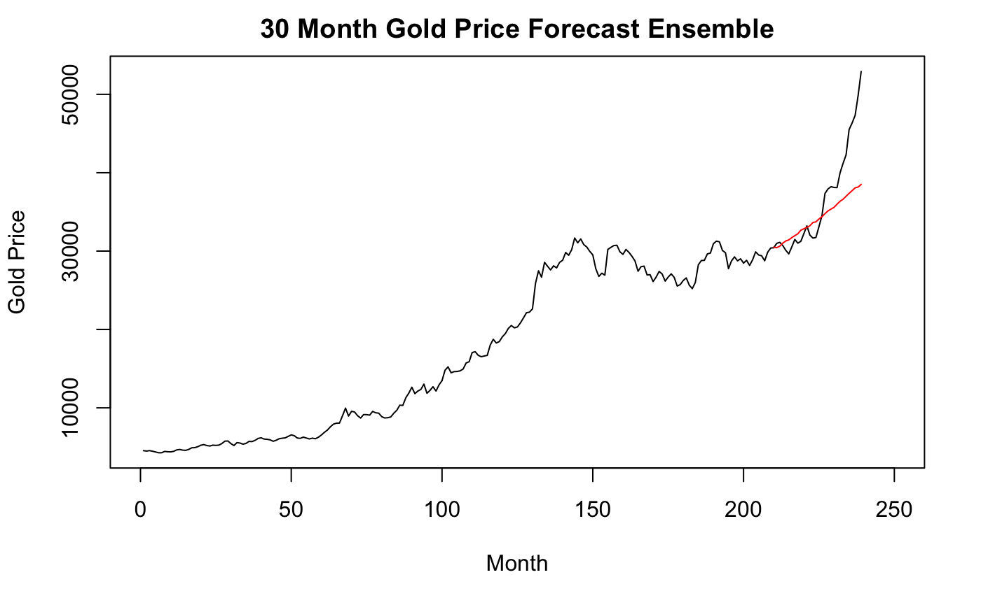
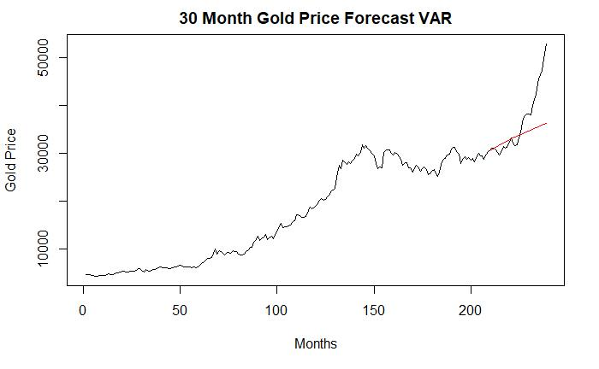
30 Month Forecast Comparison
Multivariate Model Results
VAR Model(p=2)
ASE: 33,167,267
MLP Model
ASE: 14,799,048
Ensemble (VAR + MLP) Model
ASE: 22,925,936

Slide 12
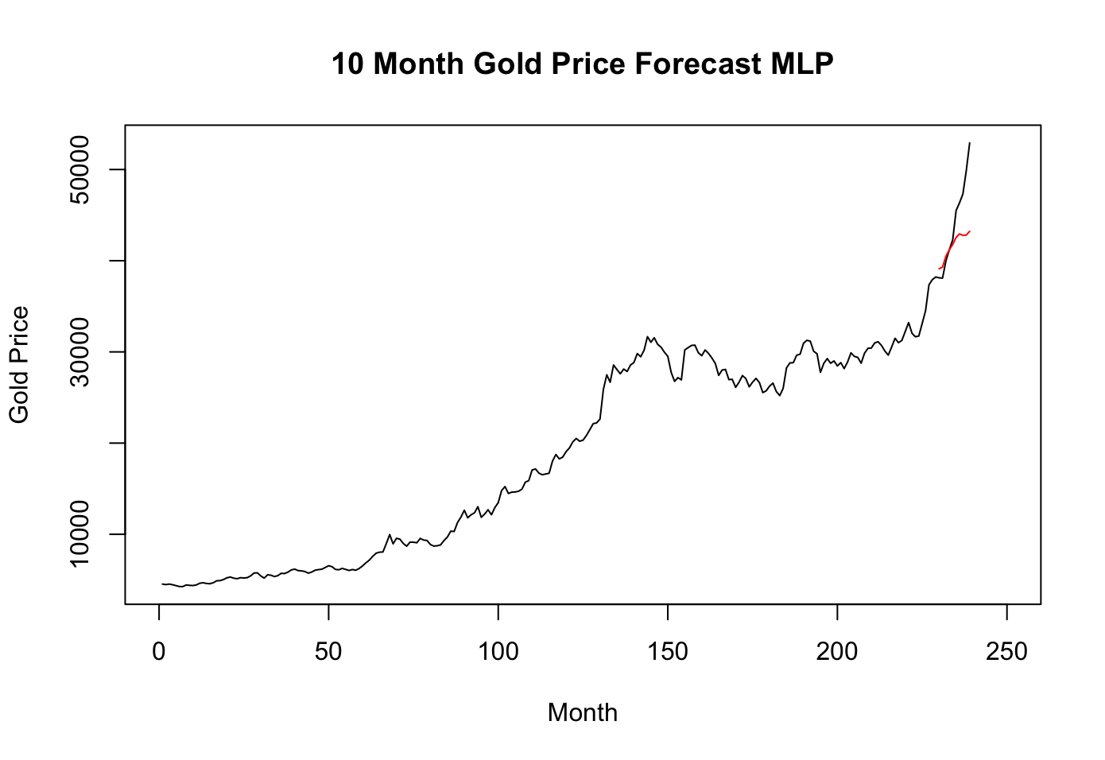
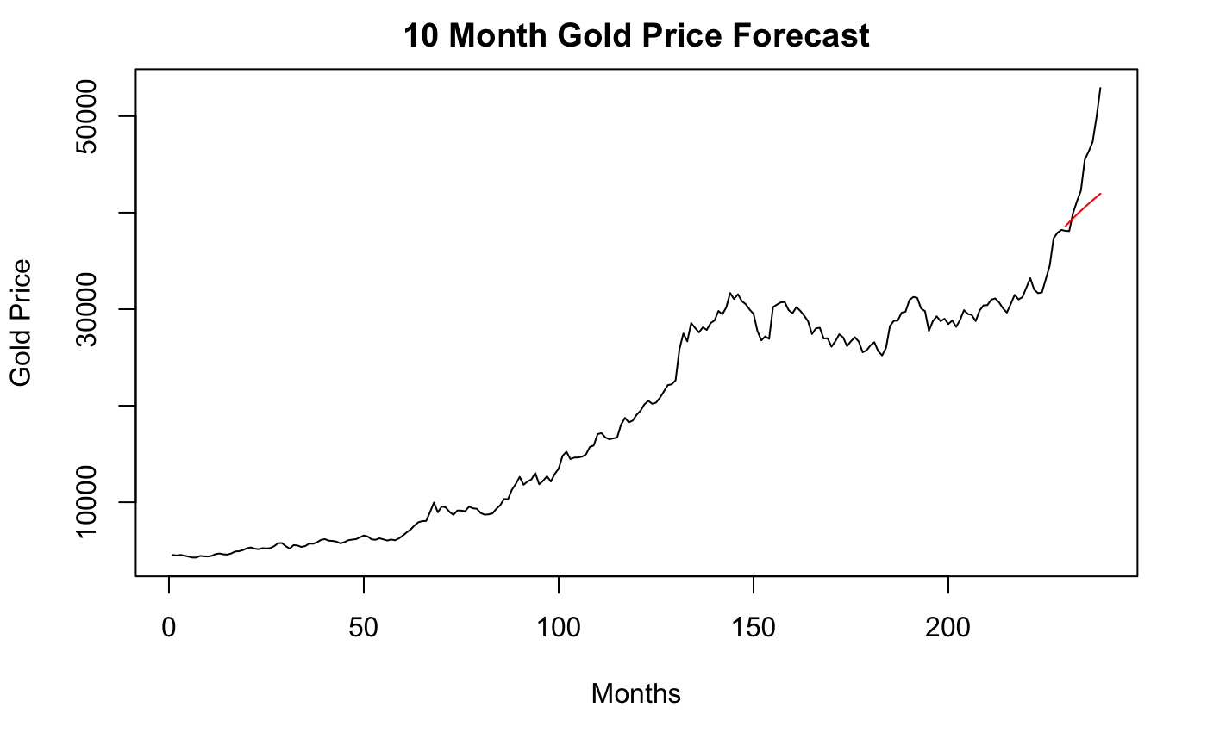
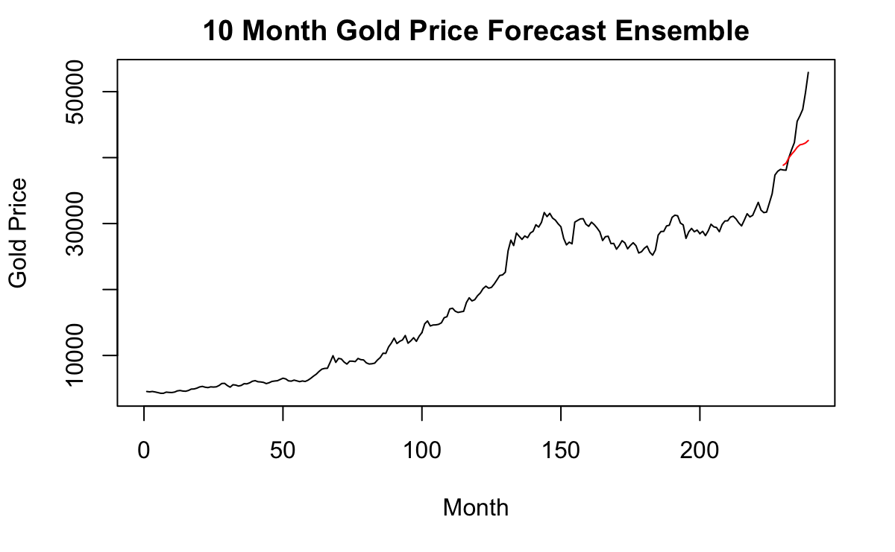
10 Month Forecast Comparison
Multivariate Model Results
VAR Model(p=2)
ASE: 28,534,936
MLP Model
ASE: 18,774,220
Ensemble (VAR + MLP) Model
ASE: 23,180,638

Slide 13
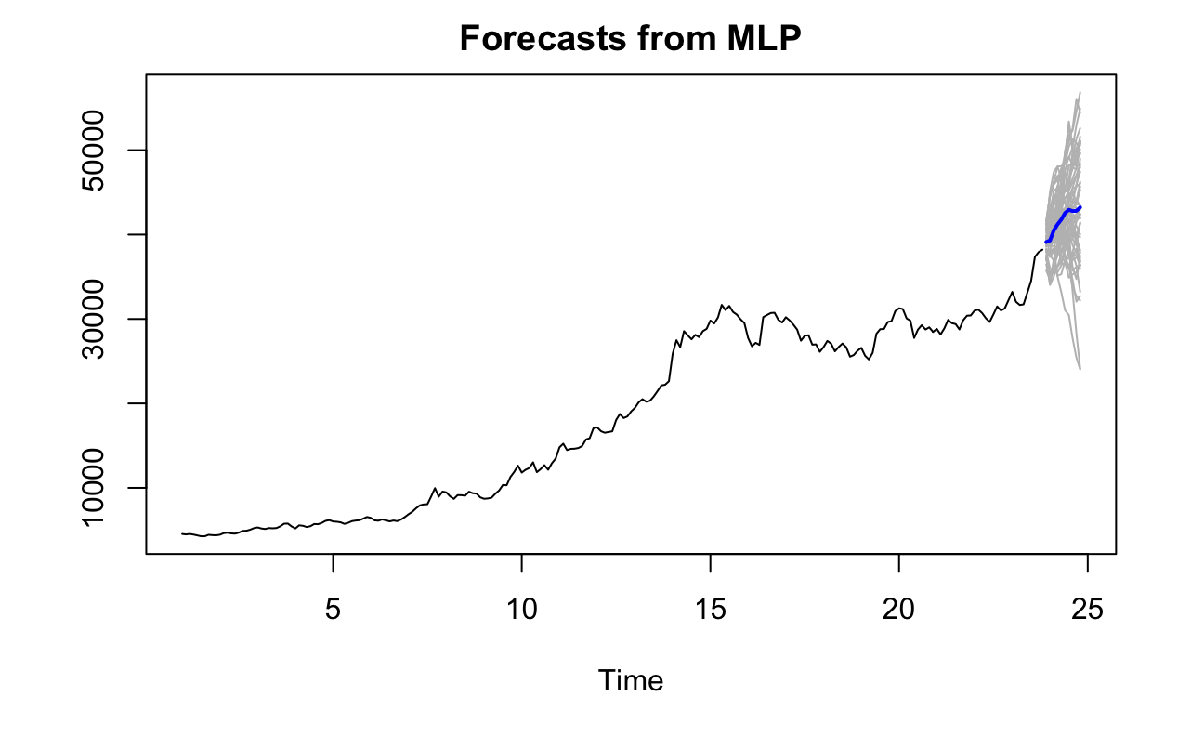
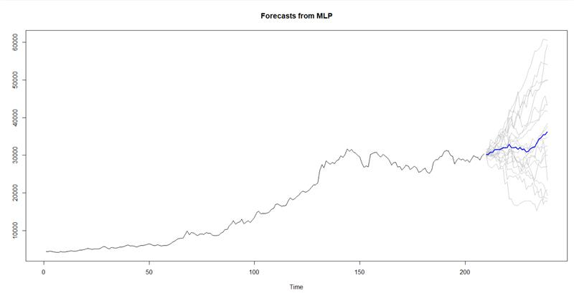
10 month forecast MLP Model
MLP Model Forecasts
30 month forecast MLP Model
Gold Price
Gold Price

Slide 14
Conclusion
The best performing univariate model was the ARIMA(6,1,3)
The best performing multivariate model was the MLP model
When comparing the MLP model with the ARIMA(6,1,3) model, the MLP model performs best
The gold price predictions from the MLP models:
10-month prediction: 75,787.83 INR
30-month prediction: 115,743.96 INR
Multivariate MLP | ARIMA (6,1,3)
10 month forecast ASE: 18,774,220 | 10 month forecast ASE: 23,370,059
30 month forecast ASE: 14,799,048 | 30 month forecast ASE: 52,377,965

Slide 15
Future work
Monitor model performance and update the models as the gold price and other variables continues to change
Bring in other variables outside of the models explored here that could help predict the gold price to get better performing models
Develop and use functions for rolling window metrics on the multivariate models

