Slide 1
Image Filtering
Spatial filtering
Low-pass filtering mask (image blurring, smoothing)
Median filter
High-pass filter (sharpening, edge enhancement)

Slide 2
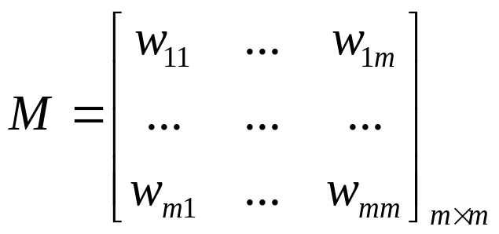
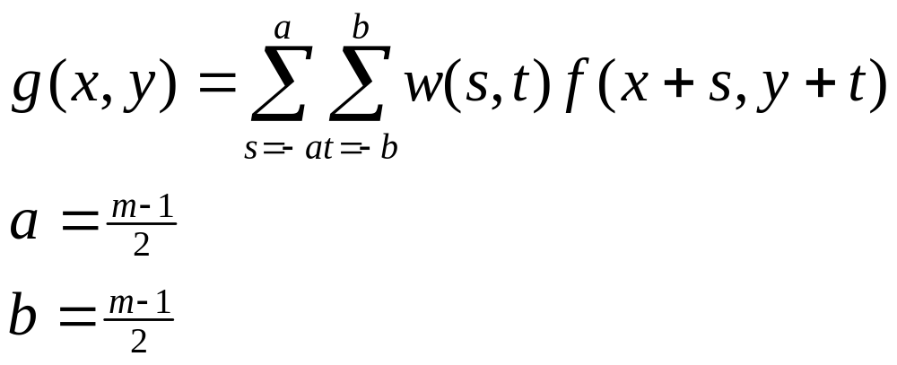
Image smoothing
Mask: m×m
Convolution:

Slide 3
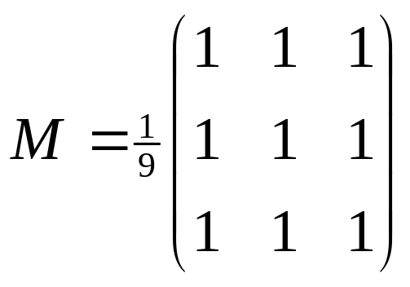
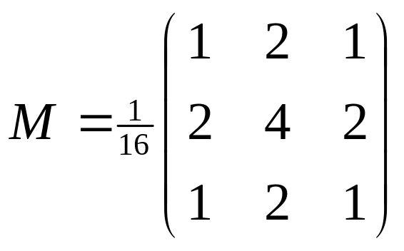
Image smoothing (Cont’d)
Low-pass filtering:
-- box-filter
Operation:
Sliding mask on the image
g(x,y)=convolution(f, M)/Sum(M)

Slide 4
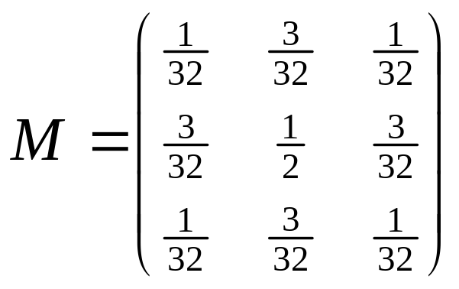
Image smoothing (Cont’d)
EXAMPLE:
PIXSUM(M) = 1
FILTER(f,M)[i,j]= SUM__{u,v}[TRAN(M; (i,j)] * f(u,v)

Slide 5
Image smoothing (Cont’d)
Median filter:
-- remove the salt-and-pepper noise, keep edges clear
-- Sort the pixel values, choose the median value to replace the
pixel in question
-- E.g., Mask size: N=5 (1-D)
80 90 200 110 120
Sort: 80 90 110 120 200

Slide 6
Image smoothing (Cont’d)
Median filter:
-- 2D mask example:
*
* * * *
* * * or * * * * *
* * * *
*

Slide 7
Image sharpening
Edge enhancement for blurred images (e.g., caused by
camera focus, narrow bandwidth, etc.)
-- Image pixel derivative
1st derivative: df/dx = f(x+1) – f(x)
2nd derivative: d²f/dx² = [f(x+1) – f(x)] – [f(x) – f(x-1)]
= f(x+1) + f(x-1) – 2f(x)

Slide 8
Image sharpening (cont’d)
Original
f(x) blurred
df/dx
d²f/dx²
f(x)- d²f/dx²
1-D 1st derivative
1-D 2nd derivative

Slide 9
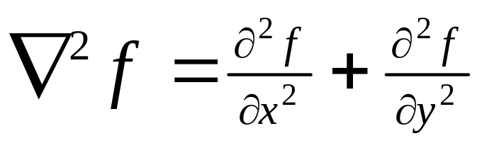
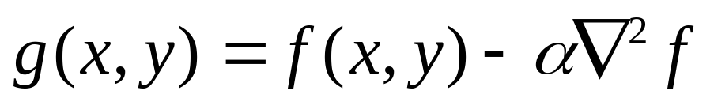
Image sharpening (cont’d)
2-D Laplatian operator
Sharpening:
Laplatian Mask: 0 1 0 1 1 1
1 -4 1 1 -8 1
0 1 0 1 1 1

Slide 10
Image sharpening (cont’d)
Edge enhancement
Sharpening mask: 0 -1 0 (enhance edges in horizontal and
-1 4 -1 vertical direction)
0 -1 0
-1 -1 -1 (enhance edges in horizontal,
-1 8 -1 vertical and two diagonal directions)
-1 -1 -1

Slide 11
Image sharpening (cont’d)
Sharpening = original image + edges (or contours)
Sharpening mask: 0 -1 0 (enhance edges in horizontal and
-1 5 -1 vertical direction)
0 -1 0
-1 -1 -1 (enhance edges in horizontal,
-1 9 -1 vertical and two diagonal directions)
-1 -1 -1

Slide 12
Image sharpening (cont’d)
Unsharp masking:
f_{s}(x,y) = f(x,y) – f_{b}(x,y)
g(x,y) = Af(x,y) + alpha f_{s}(x,y)

Slide 13
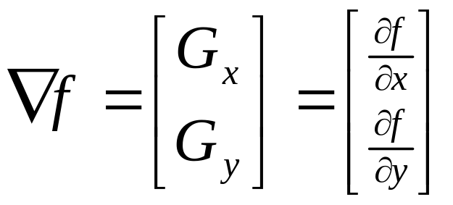
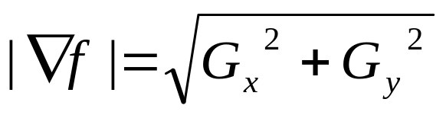
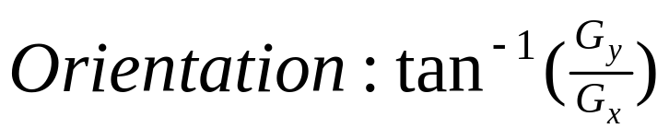
Image sharpening (cont’d)
Gradient operators

Slide 14
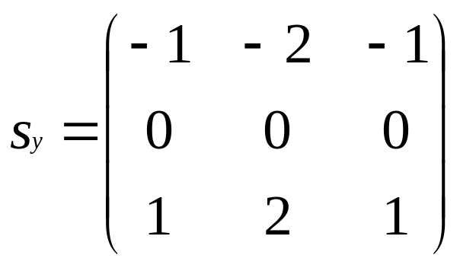
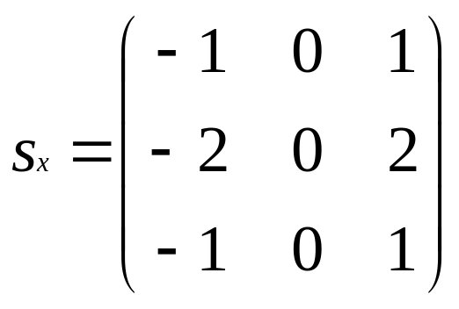
Image sharpening (cont’d)
Roberts operators
Sobel operator
Prewitt operator
Robinson compass masks

Slide 15
Edge detection
Edge detection by image gradient
-- analysis of difference in local contrast
Image → Gradient magnitude operator → Threshold → Edge image

Slide 16
Edge detection (cont’d)
Property of the second derivative of edge (e.g., Laplatian)
-- noise sensitive
-- double edge produced
-- zero crossing

Slide 17
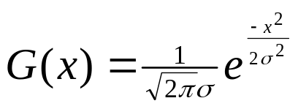
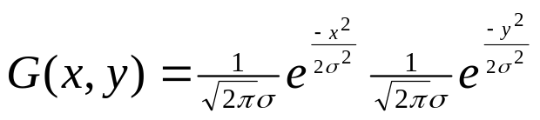
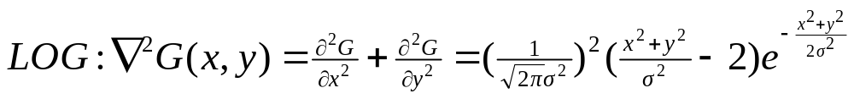
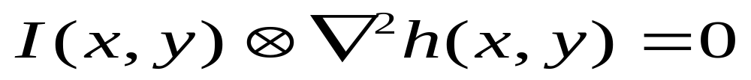
Edge detection (cont’d)
Laplatian of Gaussian (LOG)
Image
→ Gaussian Smoothing for noise removal
→ Laplatian filter
→ Zero crossing
→ Edge image

Slide 18
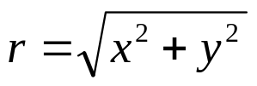
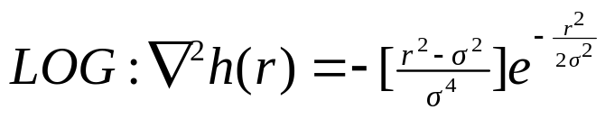
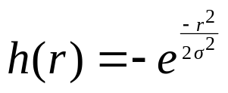
Edge detection (cont’d)
Simplified 2D LOG representation
→ The shape of the curve looks like “Mexican Hat”

Slide 19
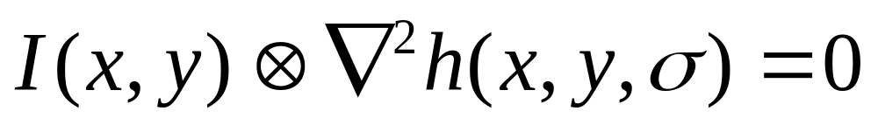
Edge detection (cont’d)
Scale Space – multiscaling
-- In the zero-crossing algorithm, different scale σ will generate different level of details of edges.

Slide 20
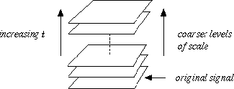
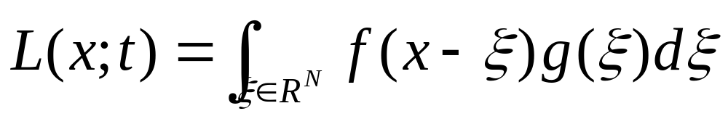
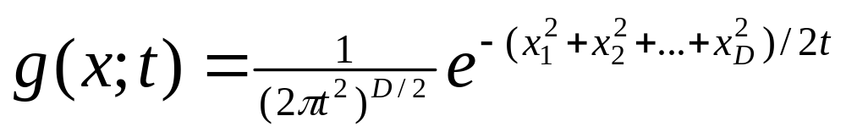
Scale Space
Theory
Scale Space – Definition
-- For any N-dimentional signal f: R^{N}, its scale-space representation L is defined by
Where g denotes the Gaussian kernel
The variance t of this kernel is referred to as the scale parameter

Slide 21
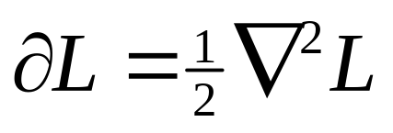
Scale Space
Scale Space – Definition
-- Equivalently, the scale-space family can be obtained as the solution to the (linear) diffusion equation
Then, based on this representation, scale-space derivatives
at any scale t are defined by

Slide 22
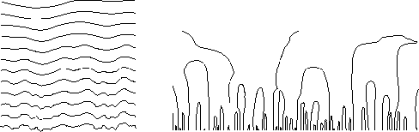
Scale Space
a) The main idea of a scale-space representation is to generate a one-parameter family of derived signals in which the fine-scale information is successively suppressed. This figure shows a signal which has been successively smoothed by convolution with Gaussian kernels of increasing width. (b) Since new zero-crossings cannot be created by the diffusion equation in the one-dimensional case, the trajectories of zero-crossings in scale-space (here, zero-crossings of the second derivative) form paths across scales that are never closed from below.

Slide 23
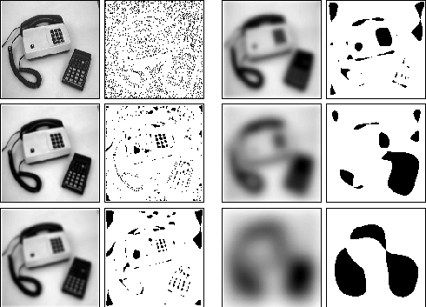
Scale Space
Different levels in the scale-space representation of a two-dimensional image at scale levels t = 0, 2, 8, 32, 128 and 512 together with grey-level blobs indicating local minima at each scale.
(Courtesy of Tony Lindeberg)

Slide 24
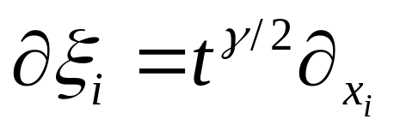
Automatic Scale Selection
Although the scale-space theory presented so far provides a well-founded framework for representing and detecting image structures at multiple scales, it does not address the problem of how to select locally appropriate scales for further analysis. Whereas the problem of finding ``the best scales'' for handling a given real-world data set may be regarded as intractable unless further information is available, there are many situations in which a mechanism is required for generating hypotheses about interesting scales. A general methodology for feature detection with automatic scale selection is based on the evolution over scales of (possibly non-linear) combinations of normalized derivatives defined by

Slide 25

Automatic Scale Selection
γ is a free parameter to be tuned to the task at hand. The basic idea proposed in the abovementioned sources is to apply the feature detector at all scales, and then select scale levels from the scales at which normalized measures of feature strength assume local maxima with respect to scale. Intuitively, this approach corresponds to the selection of the scales at which the operator response is as strongest.
(Courtesy of Tony Lindeberg)

Slide 26
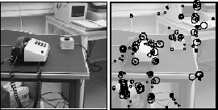
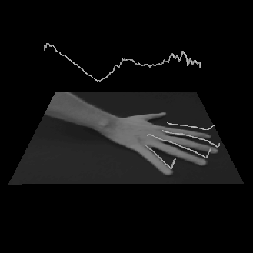
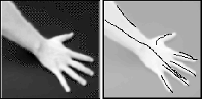
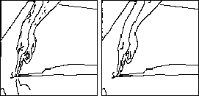
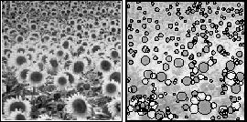
Automatic Scale Selection
(Courtesy of Tony Lindeberg)

Slide 27
Scale Space References
Yuille, A. L. Poggio, T. A. 1986, `Scaling theorems for zero-crossings', IEEE-PAMI 8, 15-25.
Lindeberg, T. 1996, Feature detection with automatic scale selection, Technical Report ISRN KTH/NA/P-96/18-SE, KTH, Stockholm, Sweden.
Witkin, A. P. 1983, Scale-space filtering, in `8th IJCAI', pp. 1019-1022.

Slide 28
Canny Edge Detector
Filter image with derivative of Gaussian
2. Find magnitude and orientation of gradient
3. Non-maximum suppression:
• Thin wide “ridges” down to single pixel width
4. Linking and thresholding (hysteresis):
• Define two thresholds: low and high
• Use the high threshold to start edge curves and the low threshold to continue them
Reference:
J. Canny, A Computational Approach To Edge Detection, IEEE Trans. Pattern Analysis and Machine Intelligence, 8:679-714, 1986.
MATLAB: edge(image, ‘canny’);

Slide 29
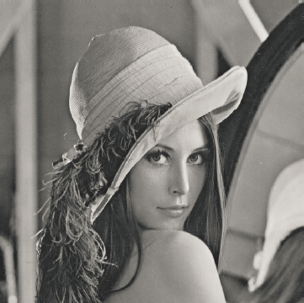
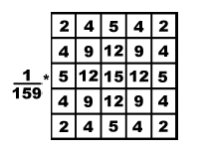
Canny Edge Detector
Noise Reduction (smoothing)
Gaussian Filtering (for example σ = 1.4), 5×5 filter

Slide 30
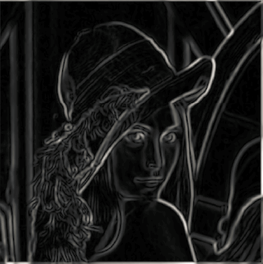
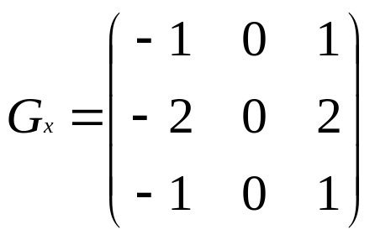
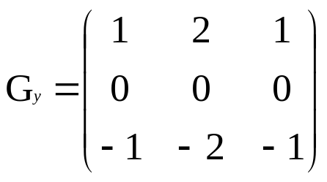
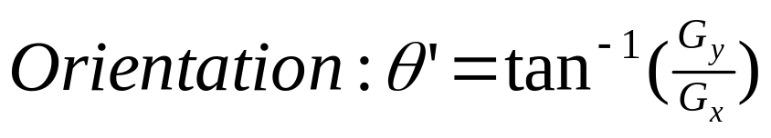
gradient
Canny Edge Detector
2. Gradient magnitude and direction
For example: using Sobel operator
Or for example: first derivative

Slide 31
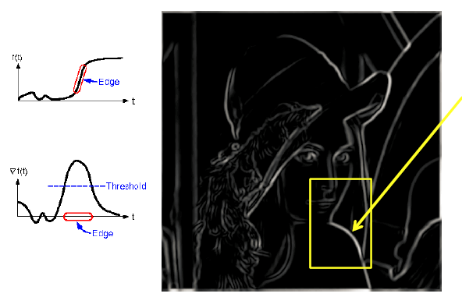
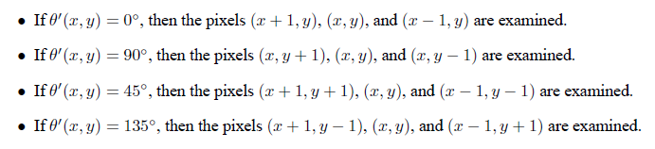
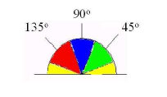
Canny Edge Detector
Thick edges
Disconnected edges
Problem of Single Thresholding
3. Non-Maximum suppression (for thinning)
Rounding the angle θ’ to one of four directions 0◦, 45◦, 90◦, or 135◦.
The “non-maximum suppression” step keeps only those pixels on an edge with the highest gradient magnitude. For example, if pixel (x, y) has the highest gradient magnitude of the three pixels examined, the pixel (x, y) is kept as edge; Otherwise, the (x, y) is discarded.

Slide 32
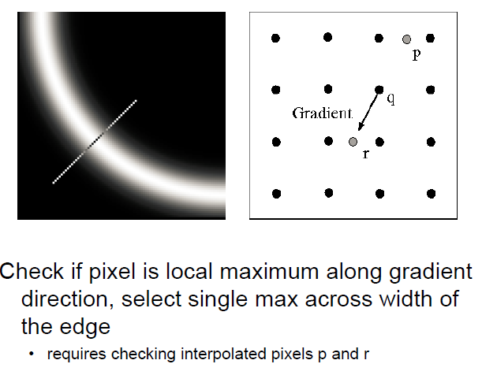
Canny Edge Detector
3. Non-Maximum suppression (continued)
If no rounding the angle θ’ to one of four directions, we have to use interpolated pixels for gradient check

Slide 33
Canny Edge Detector
4. Hysteresis Thresholding (Two stage thresholding)
Problem: simple threshold may actually remove valid parts of a connected edge, leaving a disconnected final edge image.
Hysteresis is one way of solving this problem
- Instead of choosing a single threshold, two thresholds T-High
and T-Low are used. Pixels with a gradient magnitude D < T-Low are discarded immediately. However, pixels with T-Low D < T-High are only kept if they form a continuous edge line with pixels with high gradient magnitude (i.e., above T-High).

Slide 34
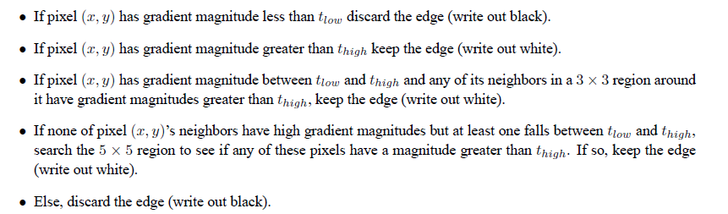
Canny Edge Detector
4. Hysteresis Thresholding (continued)
For example:

Slide 35
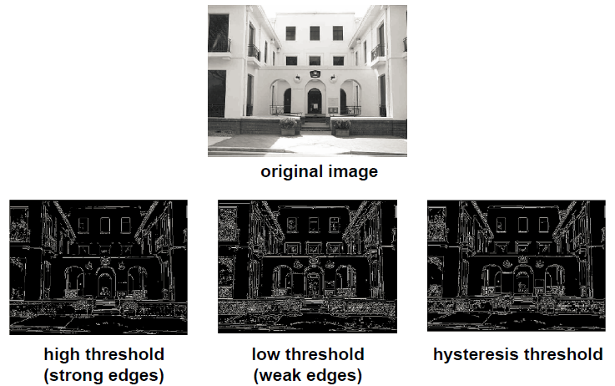
Canny Edge Detector
4. Hysteresis Thresholding (continued)
Source: courtesy of L. Fei Fei

Slide 36
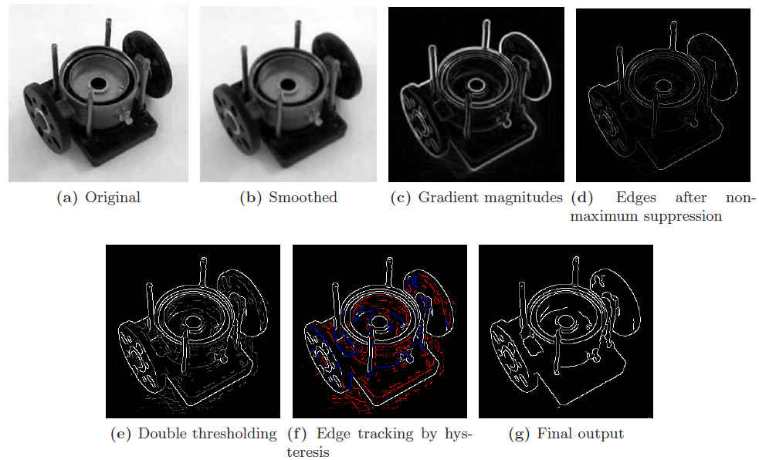
Canny Edge Detector
Example of all processing stages

