Slide 1
Image Transformation
Spatial domain (SD) and Frequency domain (FD)
Fourier Transform: SD → FD
Hough Transform: SD → SD
Wavelet Transform: SD → FD + SD
Geometric Transform: spatial distortion correction, image warping, image interpolation

Slide 2
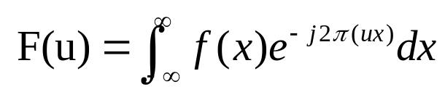

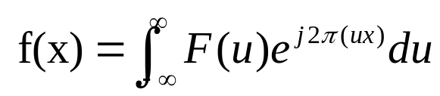
Frequency domain
Fourier transform:
-- periodic function can be represented as a weighted sum of sines and cosines
1-D:
F(u) – frequency components
u – frequency
Domain on “u” – frequency domain

Slide 3
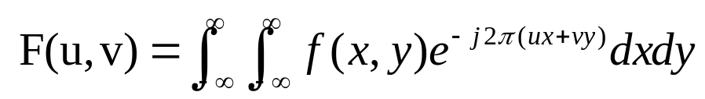
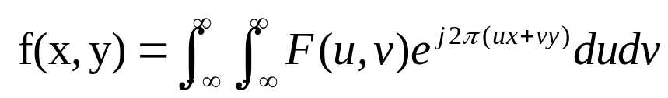
Frequency domain (cont’d)
2D Fourier transform:
-- Forward transform:
-- Inverse transform:
Where x, y are in the range (–infinity, +infinity)
u, v are in the range (–infinity, +infinity)

Slide 4
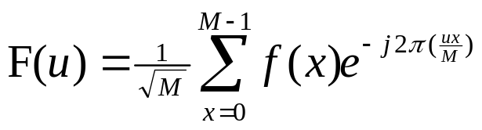
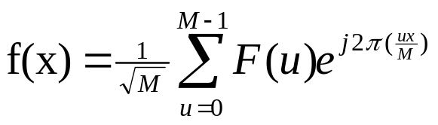
Frequency domain (cont’d)
Discrete Fourier transform (DFT)
-- Forward transform:
-- Inverse transform:
Where x=0,1, …, M-1
u=0,1, …, M-1

Slide 5

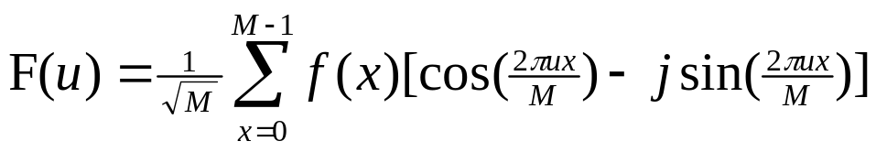
Frequency domain (cont’d)
Discrete Fourier transform (DFT)
Applying Euler’s formula:
We obtain:

Slide 6

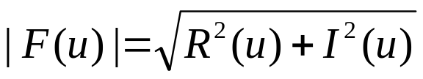
Frequency domain (cont’d)
Discrete Fourier transform (DFT)
Polar coordinate representation:
Frequency u=0: flat uniform signal has zero frequency.
|F(0)| = (A*k)/M
Where: k points out of M points have value A (non-zero) in spatial domain
f(x)
A
x
k M

Slide 7
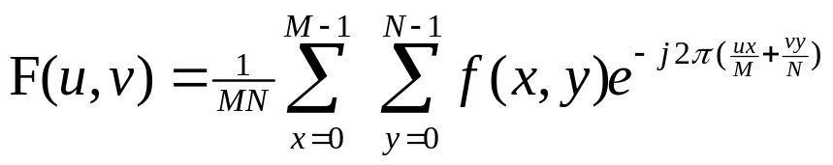
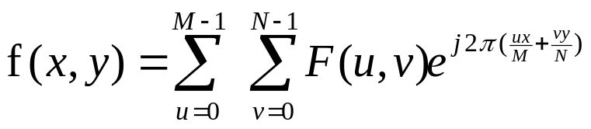
Frequency domain (cont’d)
F(0,0)
M u
2D DFT
Image size: M * N
-- Forward transform:
-- Inverse transform:
Where x, y – spatial variable
u, v – frequency variable
N
v

Slide 8
Filtering in frequency domain
-- Image smoothing
-- Image sharpening (enhancement)
F(u,v) --- > H(u,v) --- > G(u,v)
H(u,v) – filter transfer function
-- increase or pass certain band of frequencies
-- depress other bands of frequencies

Slide 9

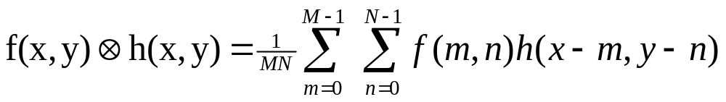
Filtering Operations
Computation
There is correspondence between the filtering in SD and FD
Convolution definition (denote as )

Slide 10
Filtering Operations
SD and FD

Slide 11
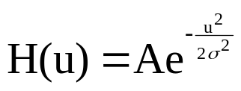

Filtering Operations
Gaussian Filter
Note: large sigma → broad profile H(u)
→ narrow profile of h(x)

Slide 12
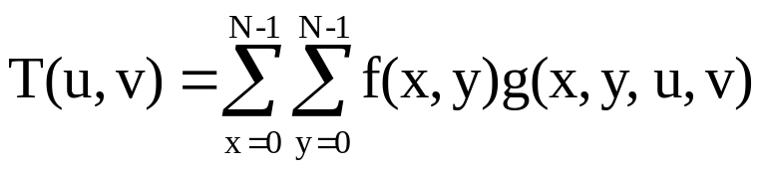
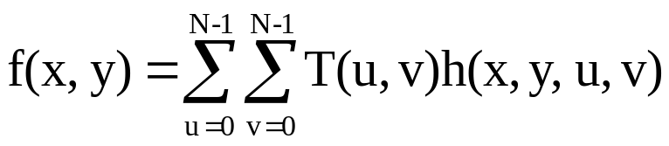
Basis or kernel of transformation
Transform basis
Consider an image f(x,y) of size N*N,whose discrete transform is T(u,v)
x,y,u,v = 0, 1, …, N-1
T(u,v) – transform coefficient

Slide 13
Basis or kernel of transformation
Transform basis (cont’d)
Example: Walsh-Hadamard transform
g(x,y,u,v) = 1/N * (-1)^{B}
h(x,y,u,v) = 1/N * (-1)^{B}
Where:
B= SUM_{i=0}^{m-1} mod₂(b_{i}(x)p_{i}(u) + b_{i}(y)p_{i}(v))
N = 2^{m}
b_{i}(x) – ith bit in the binary representation of x

Slide 14
Basis or kernel of transformation
Transform basis (cont’d)
Example: Walsh-Hadamard transform
B= SUM_{i=0}^{m-1} mod₂(b_{i}(x)p_{i}(u) + b_{i}(y)p_{i}(v))
p₀(u) = b_{m-1}(u)
p₁(u) = b_{m-1}(u) + b_{m-2}(u)
:
:
p_{m-1}(u) = b₁(u) + b₀(u)

Slide 15
Basis or kernel of transformation
Transform basis (cont’d)
Example: Discrete cosine transform (DCT)
Kernel:
where: a(u) = sqrt(1/N) when u=0
= sqrt(2/N) when u=1,2,…, N-1

Slide 16
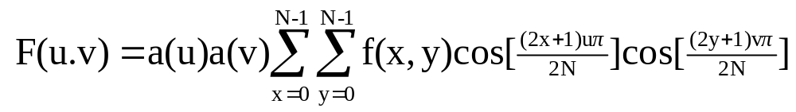
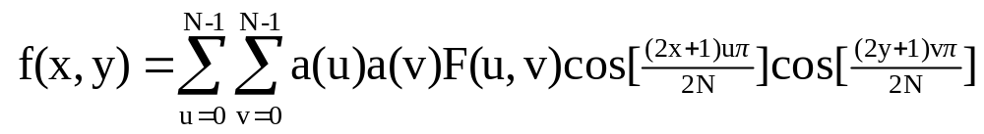
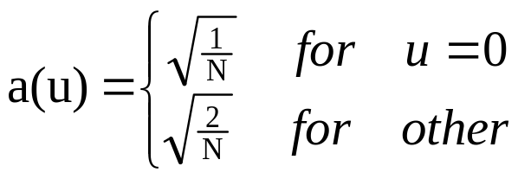
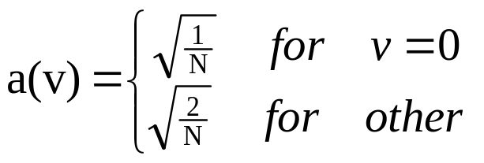
Basis or kernel of transformation
Transform basis (cont’d) Example: 2-D DCT and IDCT
DCT:
IDCT:
where:
Note: u,v =0 (DC, low frequency) ➔ u,v increase (AC, high frequency)

Slide 17

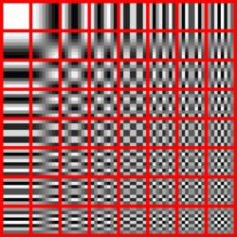
Basis or kernel of transformation
Transform basis (cont’d) Example: 2-D DCT and IDCT
DCT:
IDCT:
2D DCT Frequencies (8*8)
(64 basis functions)

Slide 18
Basis or kernel of transformation
Transform basis (cont’d)
Example: Principal component analysis (PCA)
(or called Karhunen-Loeve (K-L) transform)
(or Hotelling transform)
-- statistics-based transform (kernel is not fixed)
-- application: data compression, rotation, etc.

Slide 19
Basis or kernel of transformation
PCA (cont’d)
Mean vector and covariance matrices
There are n images which have same contents.
Suppose each image has k pixels.
A pixel vector X_{i} at position i is composed of n components.
X_{i} = [ x_{i1}, x_{i2}, …, x_{in}]
i
1 2 3 … n

Slide 20
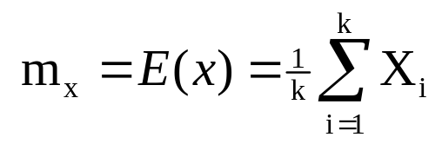
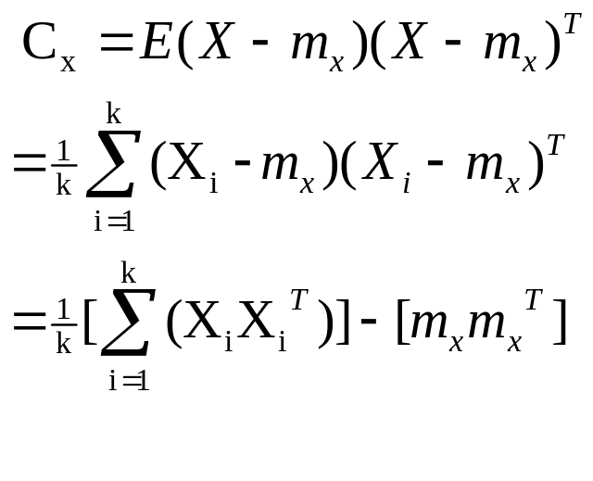
Basis or kernel of transformation
PCA (cont’d)
Mean vector
Covariance matrices
T – transpose

Slide 21
Basis or kernel of transformation
PCA (cont’d)
C_{x} is a real symmetric matrix.
There must be an orthogonal matrix A, such that C_{x} can be transformed to a diagonal matrix C_{y}
A C_{x} A^{T} = C_{y}
A is an orthogonal matrix which consists of n orthogonal vectors
A⁻¹ = A^{T}

Slide 22
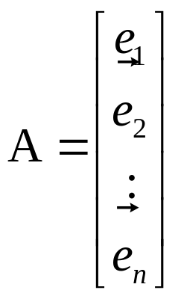
Basis or kernel of transformation
PCA (cont’d)
Because C_{x} is a real symmetric matrix, it is possible to find a set of n orthogonal eigenvectors {e_{i}} and the corresponding eigenvalues {λ_{i}}, i=1,2,…, n.
Definition of eigenvectors and eigenvalues of n*n matrix C
C_{x} e_{i} = λ_{i} e_{i}, i=1,2,…, n.
where λ₁ >λ₂ …>λ_{n}
e_{iT} e_{j} = 1 if i=j
= 0 if i≠ j

Slide 23
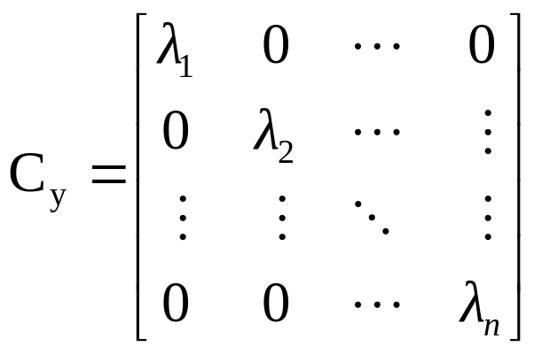
Basis or kernel of transformation
PCA (cont’d)
C_{y} = A C_{x} A^{T}

Slide 24
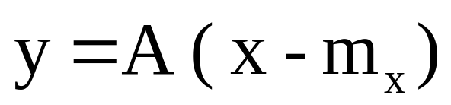
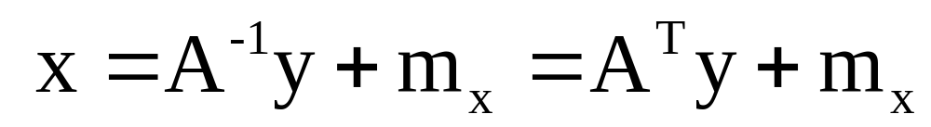
Basis or kernel of transformation
PCA (cont’d)
Forward transform: map the vector x into vector y
Inverse transform:
C_{y} and C_{x} have same eigenvectors and same eigenvalues

Slide 25
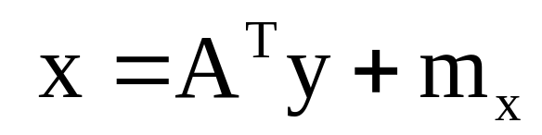
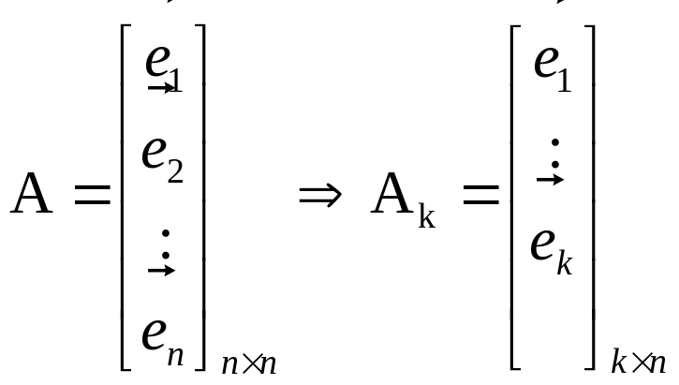
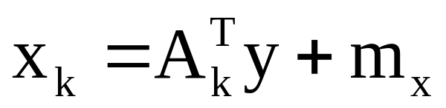
Basis or kernel of transformation
PCA (cont’d)
Applications: -- compression
We can select most significant eigenvectors to approximate the A

Slide 26
Basis or kernel of transformation
PCA (cont’d)
Applications: -- compression (cont’d)
The mean square error between vector X and vector X_{k} is SUM_{j=k+1}^{n} λ_{j}

Slide 27
Basis or kernel of transformation
PCA (cont’d)
Applications: -- compression (cont’d)
Property
(1) mean square error is minimized after the transform
(2) Kernel “A” is not separable (“image-dependant”)
Example:
(1) Apply PCA to 6 images (textbook page 679-682)
As a result, 6 images can be represented by
“ 2 transformed images (e.g. y coefficients)
+ transform matrix A (e.g., first two rows)
+ mean vector”

Slide 28
Basis or kernel of transformation
PCA (cont’d)
Example
-- Eigen-face
-- Object rotation (coordinate transform)

Slide 29
Basis or kernel of transformation
PCA (cont’d)
Comparison
-- PCA is image-adaptive compression which has optimal performance -- DCT is much closer to PCA
Log(e²)
PCA
DCT
DFT
WHT
k number of coefficients
Compression performance comparison

Slide 30
Hough Transform
Purpose
-- Detection of specific structure relationships between pixels in an image
-- Spatial domain to spatial domain transformation
-- Example:
Given a set of points in an image, we want to find subsets of these points that lie on straight lines or on a circle

Slide 31
Hough Transform (cont’d)
Parameter space
Spatial line representation:
-- Slope-intercept form:
y_{i} = ax_{i} +b
-- ab-plane representation (parameter space)
b = -ax_{i} + y_{i}

Slide 32
Hough Transform (cont’d)
Hough transform for straight line detection
b’
y
b
x_{i}, y_{i}
b=-ax_{i} + y_{i}
a’
x_{j}, y_{j}
b=-ax_{j} + y_{j}
x
a
xy plane ab plane

Slide 33
Hough Transform (cont’d)
Hough transform for straight line detection (cont’d)
-- One line in parameter space corresponds to a point in image space
-- All points on a line (y=ax+b) will have lines in parameter space that intersect at (a,b).

Slide 34
Hough Transform (cont’d)
Hough transform for straight line detection (cont’d)
b_{min}
0
b_{max}
b
a_{min}
:
…
…
0
:
a_{max}
a
Discrete ab plane

Slide 35
Hough Transform (cont’d)
Discrete parameter space
-- Subdividing the parameter space into accumulator cells, where (a_{max}, a_{min}) and (b_{max}, b_{min}) are the expected ranges of slope and intercept values.
-- The cell at coordinates (i, j), with accumulator value A(i,j), corresponds to the square associated with parameter space coordinates (a_{i}, b_{j}).

Slide 36
Hough Transform (cont’d)
Line detection in discrete parameter space
-- Initially, all cells are set to zero A(i,j)=0
-- Calculate (a_{i}, b_{j}) for each (x_{k}, y_{k}); If the line passes through cell (i,j) ➔ then A(i,j)= A(i,j) +1
-- The cell with maximum accumulator value indicates a line in the image plane, which contains the most points (i.e., collinear points)

Slide 37
Hough Transform (cont’d)
Problem in Line detection
Vertical line can not be represented in the slope-intercept form
y=ax+b (a →∞)
ρθ-plane representation
xcos(θ) + ysin(θ) = ρ
- each line in image plane is determined by angle θ and distance ρ.
- (ρ_{i},θ_{i}) in parameter space is in cell (i,j), which is associated with an
accumulator A(i,j)
- θ∈[-90°, 90°], measured with respect to the x axis

Slide 38
Hough Transform (cont’d)
ρθ-plane representation
xcos(θ) + ysin(θ) = ρ
θ_{min}
0
θ _{max}
θ
ρ_{min}
:
y
ρ
…
…
θ
0
:
ρ_{max}
ρ
x
Discrete ρθ-plane

Slide 39
Hough Transform (cont’d)
Hough transform for circle detection
-- Hough transforms applicable to any function of the form g(x,c)=0, where x is a vector of coordinates and c is a vector of coefficients
-- Example:
Points on the circle
(x-c₁)² + (y-c₂)² =c₃²
can be detected by 3D parameter space (c₁, c₂, c₃)

Slide 40
Hough Transform (cont’d)
Hough transform for circle detection
-- Cube-like cells and accumulators A(i,j,k).
-- The complexity increases if the number of coordinates and coefficients increases.
c3
c2
c1

