Slide 1
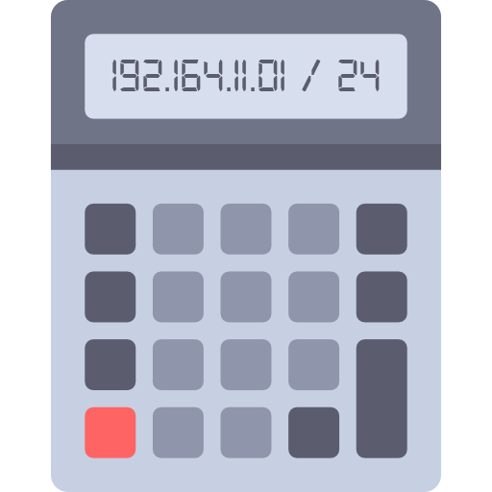
Project in AE
Networkcalculator for the echt GmbH
By
Tom Hüttmann (Teamlead)
Hoang Nguyen
Michael Brandt
Sören Poppe
David Szustowski
Niklas Mohr

Slide 2
DEMO

