Slide 1
Predicting Dota 2 Winning based off of Post-Game Statistics
CS 4981
Ben Halligan

Slide 2
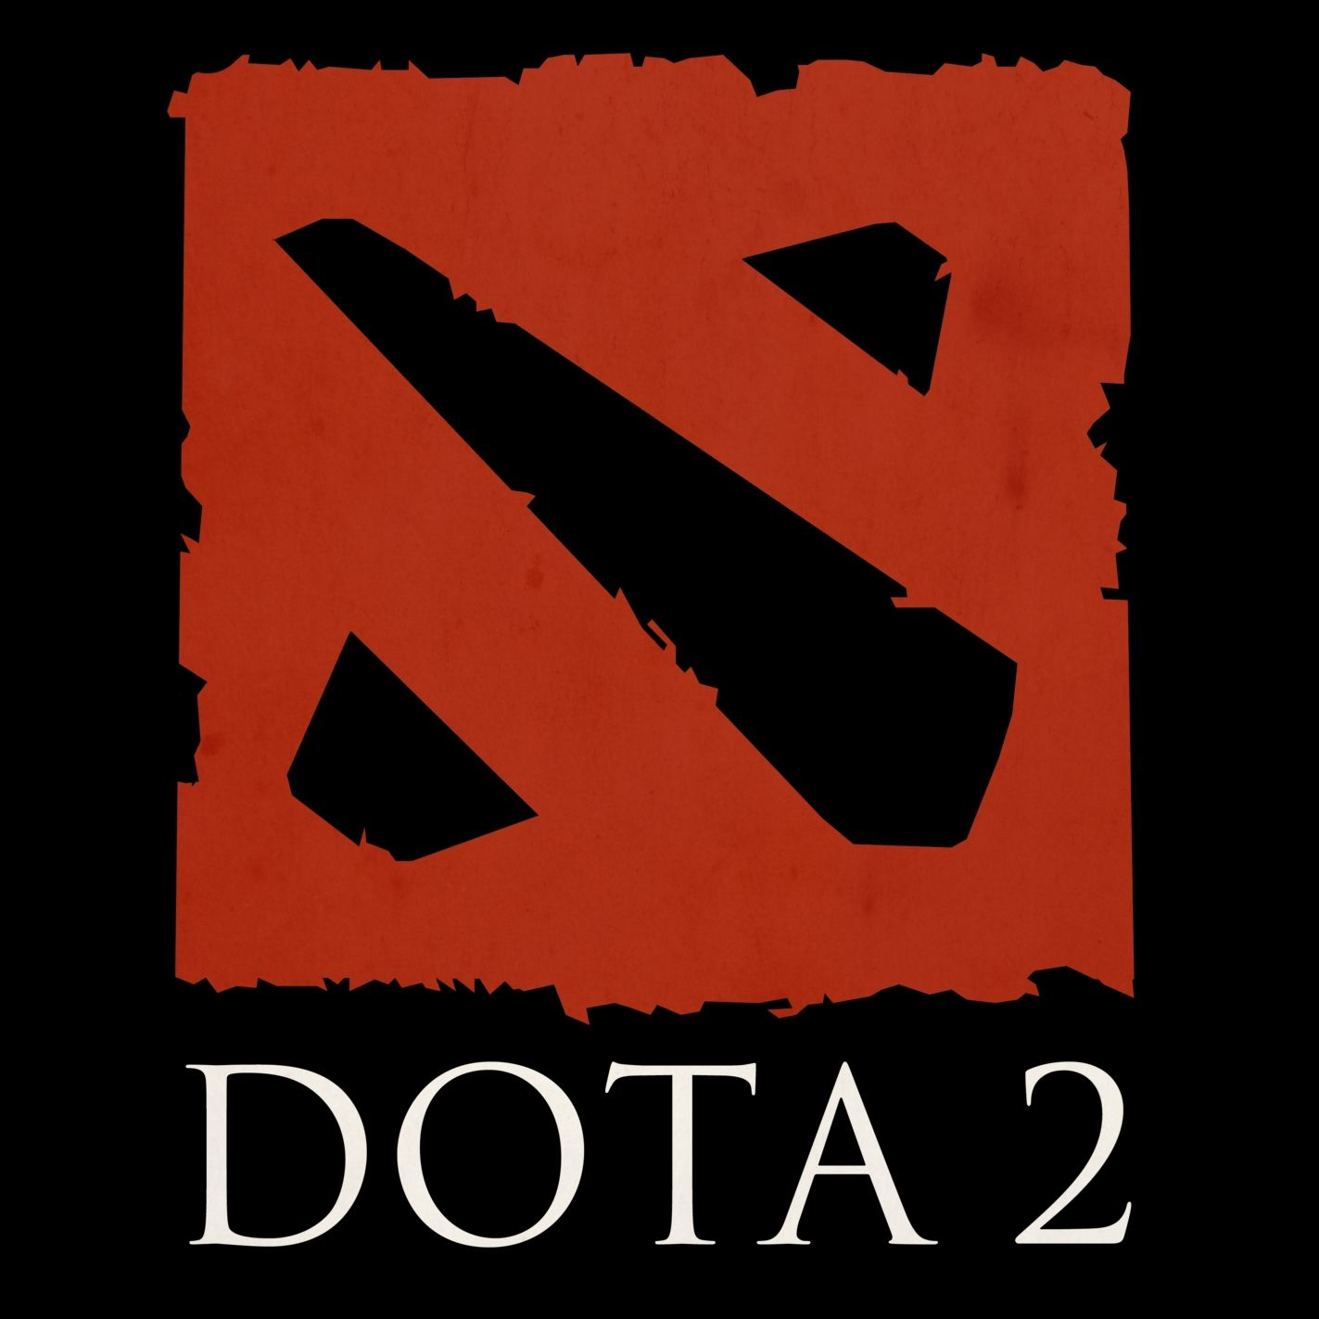
Background
Defense of the Ancients 2 (Dota 2) is a MOBA published and developed by Valve
Between August 20th - August 25th 2019 the 9th International was played in Shanghai, China for a prize pool of $34,330,068 USD
The winner was OG, who is the only team to win two Internationals,

Slide 3

Similar Projects
DotaPlus
Machine Learning plugin for Dota 2 developed by Valve to assist players in what to do, and what items to get
Also used in tournaments to provided casters a metric for which team is more likely to win
<OPENDOTA/>
Project centered around pulling as much data as possible from match replays

Slide 4
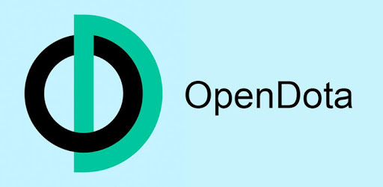
Research Hypothesis
Since TI is the highest level of play for Dota we could determine the likelihood of any team winning by analyzing TI games.
The data for this project will be pulled in from the <OPENDOTA\> free tier, a project an open source player analytic website that scrapes from game replays

Slide 5
Experimental Design
First we will load and clean our data, pulling in all of the columns offered by <OPENDOTA/> project as downloadable, changing certain features to categorical.
Next we plotted each feature against the win column to look for correlations later.
Next, we will create a null to compare against , then use a Greedy Algorithm to select what features we are going to use, and hand select features based off domain knowledge.
Finally, calculate Accuracy and Loss for each model and create a Confusion Matrix
Notes:
Left -> Null, Greedy, Hand picked

Slide 6



Results
In order presented: Null, Greedy, and Selected Models
We were able to reduce the amount false positives and increase the true negatives between the Greedy and Selected models
However kept the same amount of false and true positives between the Greedy and Selected models
Notes:
Matrix
True Negative top left
False Negative bottom left
True positive bottom right
False positive top right

Slide 7
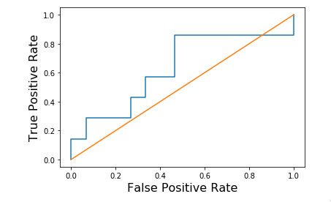
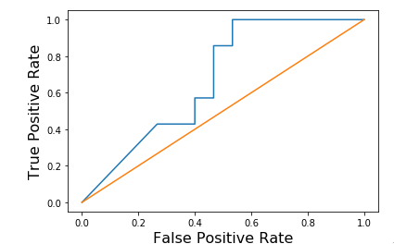
Results
Notes:
Left: Greedy FP vs TP
Right: Hand Picked FP vs TP

Slide 8
Discussion
The best model is only classifying at 54% which isn’t even close to good
From these results there could be underlying problems with the data
Not showing how the game progressed, only how it ended
Not including the chat and when tips occurred during the game
Which items each hero had and at what time
Additional questions from this
How would a team at the start of the tournament match up against themselves based on how they played later.
What Hero Item combos lead to higher Gold per minute or XP per minute

Slide 9
Questions?

