Slide 1

Offline Baking Agent
Manuel Naujoks

Slide 2
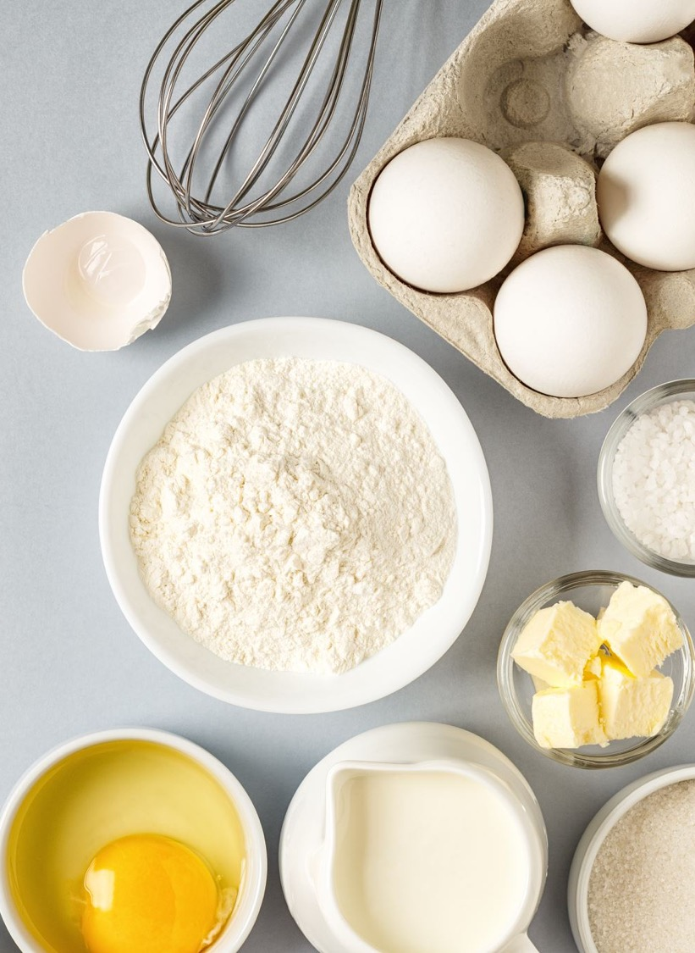
How to bake?
Reading grandma's handwritten recipe DeepSeek-OCR
Understanding the recipe and orchestrating the process Qwen 3
Checking your pantry inventory and ordering missing ingredients MCP
Guiding you through each step with timers and visual aids AG-UI
Baking the result FLUX.1-schnell

Slide 3
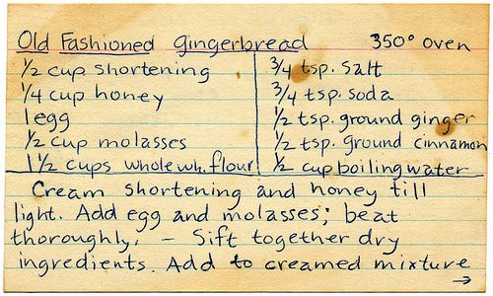
The recipe
https://www.pinterest.com/pin/old-fashioned-gingerbread-cookies-recipe--12736811433094405/

Slide 4
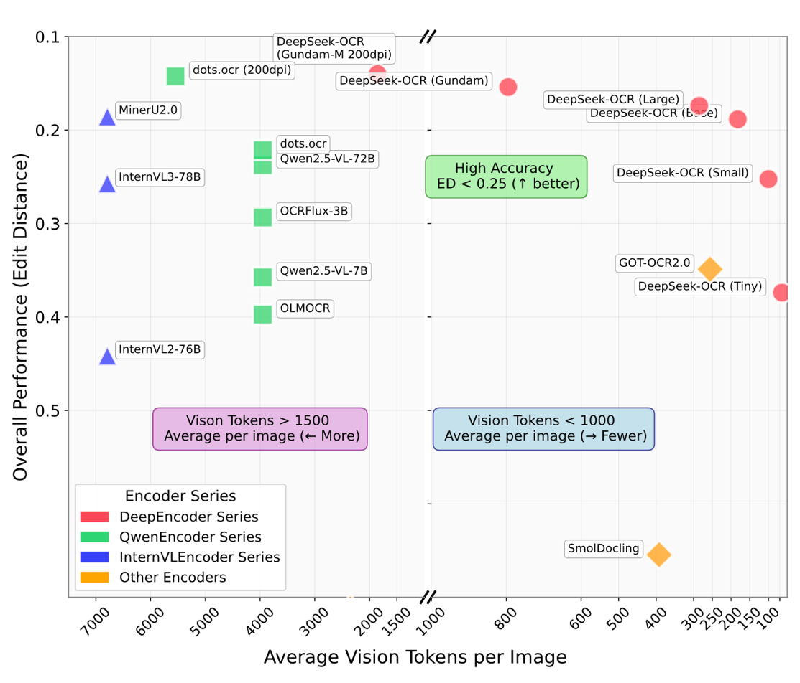
Deepseek-OCR
Context Optical Compression
Full-page ~256 vision tokens
Layout preservation (tables, …)
Output Markdown/Latex
Hybrid Vision Transformer (SAM & CLIP)
3B MoE Decoder
2-3x faster than Tesseract
87% on OmniDocBench
MIT License
https://moazharu.medium.com/deepseek-ocr-a-deep-dive-into-architecture-and-context-optical-compression-dc65778d0f33
https://huggingface.co/deepseek-ai/DeepSeek-OCR

Slide 5
Deepseek-OCR
<|ref|>table<|/ref|><|det|>[[18, 72, 985, 643]]<|/det|>
<table><tr><td>Old Fashioned Gingerbread</td><td>350° oven</td></tr><tr><td>½ cup shortening</td><td>3/4 tsp. salt</td></tr><tr><td>¼ cup honey</td><td>3/4 tsp. soda</td></tr><tr><td>1 egg</td><td>½ tsp. ground ginger</td></tr><tr><td>½ cup molasses</td><td>½ tsp. ground cinnamon</td></tr><tr><td>1/2 cups whole wh. flour</td><td>½ cup boiling water</td></tr></table>
<|ref|>text<|/ref|><|det|>[[18, 610, 975, 959]]<|/det|>
Cream shortening and honey till light. Add egg and molasses; beat thoroughly, - Sift together dry ingredients. Add to creamed mixture
ollama run deepseek-ocr "/path/to/image\n<|grounding|>Convert the document to markdown."

Slide 6
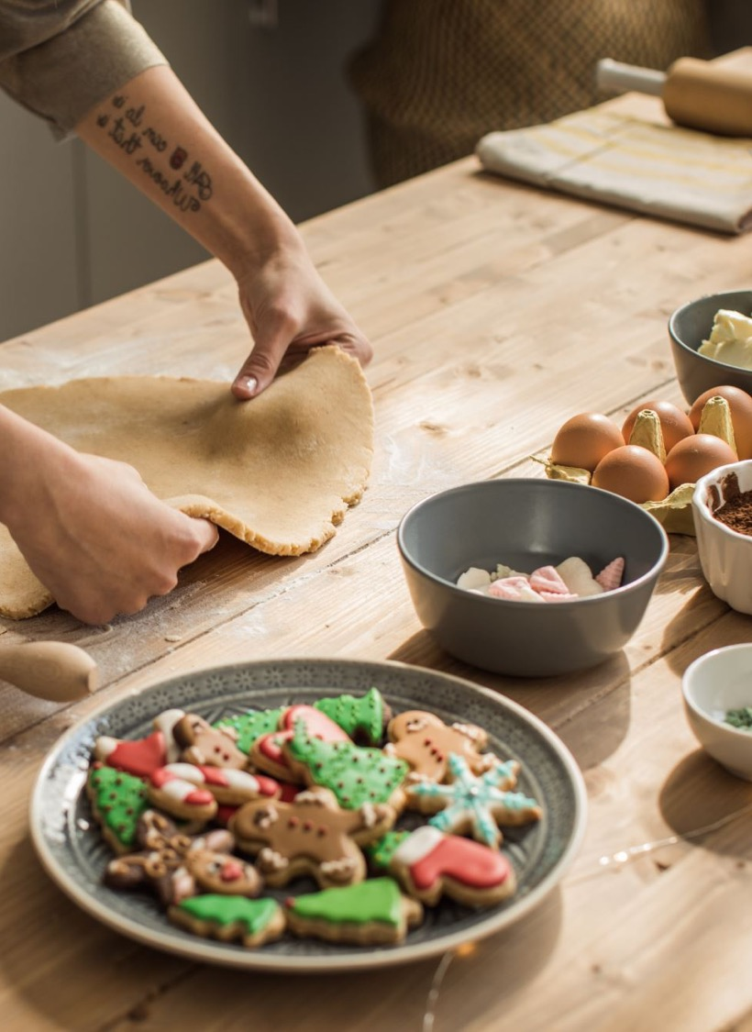
The process
Reading and interpreting the recipe
Breaking down into sequential steps
Selecting the right tools for each action
Executing steps in proper order
Adapting to available ingredients and conditions
Making decisions based on progress
Refining the approach for future bakes
Claude Sonnet 4.5

Slide 7
Qwen 3
Open Weights by Alibaba Cloud
Seamless switching between thinking mode and non-thinking mode
Tool use
Supports 100+ languages and dialects
Multi modal (text, image, audio, video via Qwen 3 Omni)
89% on OmniDocBench (Qwen3-VL-235B-A22B-Instruct)
Apache-2.0 license
https://huggingface.co/Qwen/Qwen3-32B

Slide 8
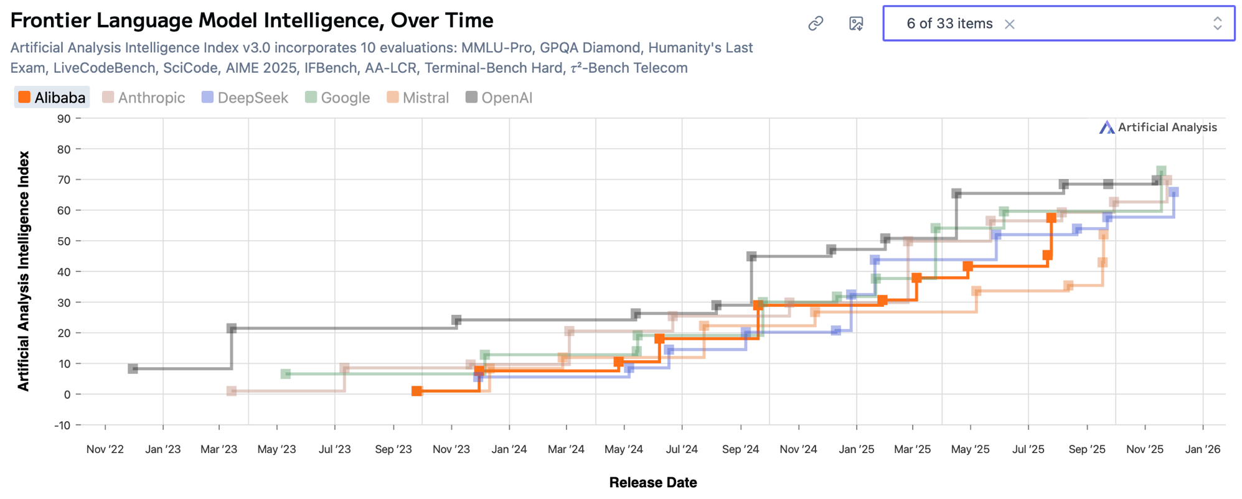
o1
Qwen3
https://artificialanalysis.ai/?models=deepseek-ocr%2Cqwen3-235b-a22b-instruct-2507-reasoning&intelligence=artificial-analysis-intelligence-index

Slide 9
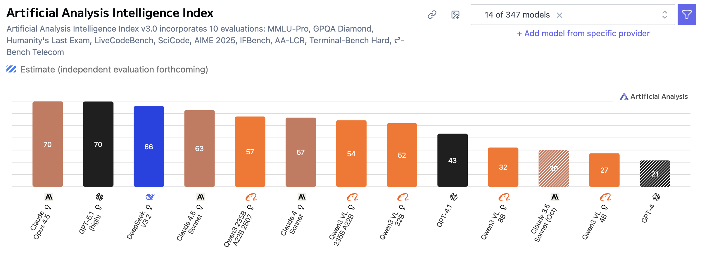
Q4 = 20GB
Q4 = 2.5GB
https://artificialanalysis.ai/?models=gpt-5-1%2Cclaude-opus-4-5-thinking%2Cclaude-4-5-sonnet-thinking%2Cdeepseek-ocr%2Cdeepseek-v3-2-reasoning%2Cqwen3-vl-235b-a22b-reasoning%2Cqwen3-vl-32b-reasoning%2Cqwen3-235b-a22b-instruct-2507-reasoning%2Cqwen3-vl-4b-

Slide 10
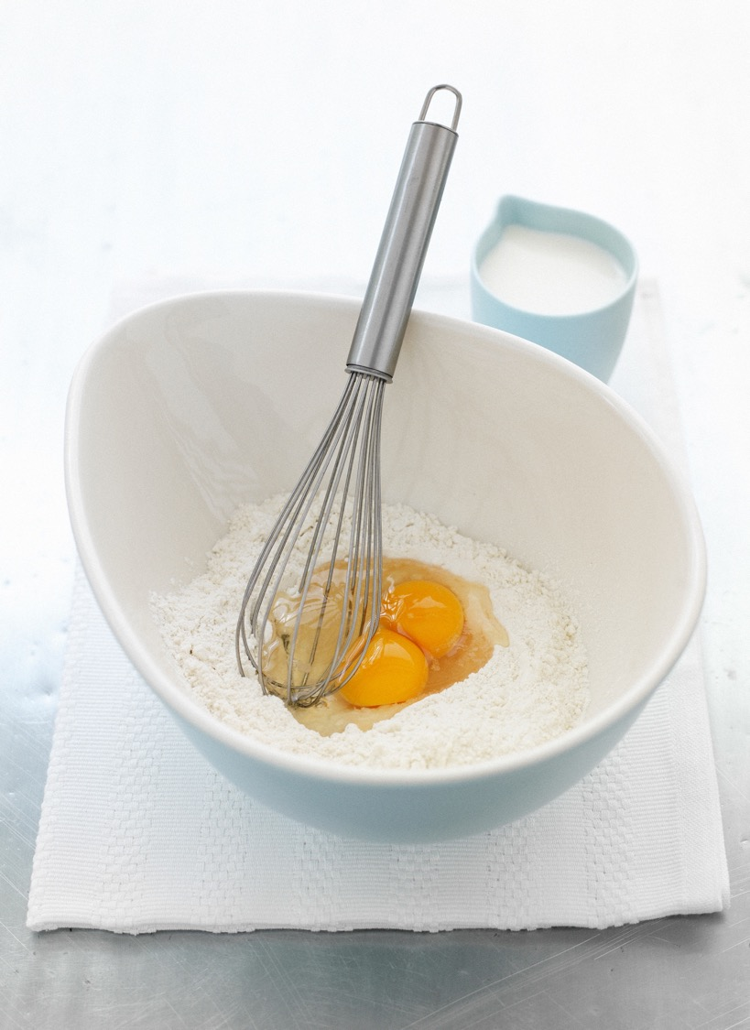
The tools
Checking ingredient availability in the pantry
Ordering missing ingredients from the store
Measuring precise amounts with scales
Mixing ingredients in the right sequence
Preheating the oven to exact temperature
Setting timers for each baking stage
Cooling on a rack at room temperature
Claude Sonnet 4.5

Slide 11
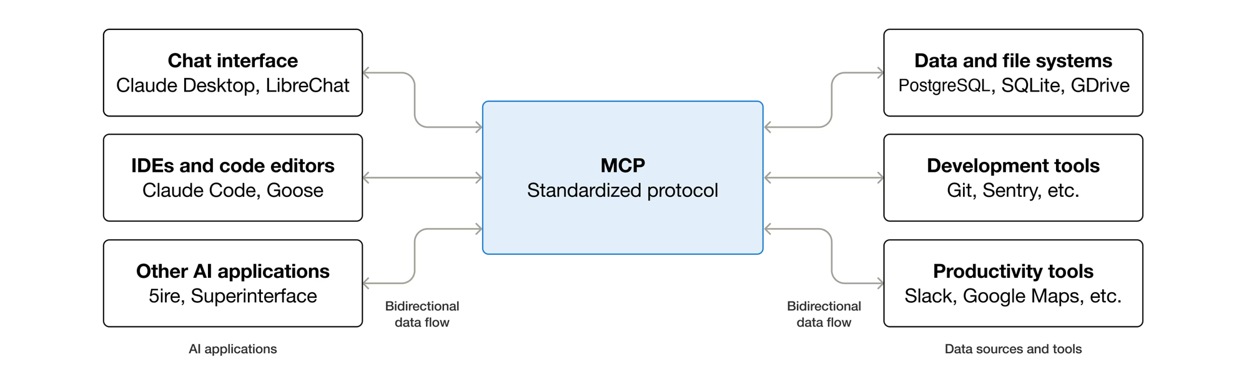
Model Context Protocol
https://modelcontextprotocol.io/docs/getting-started/intro

Slide 12
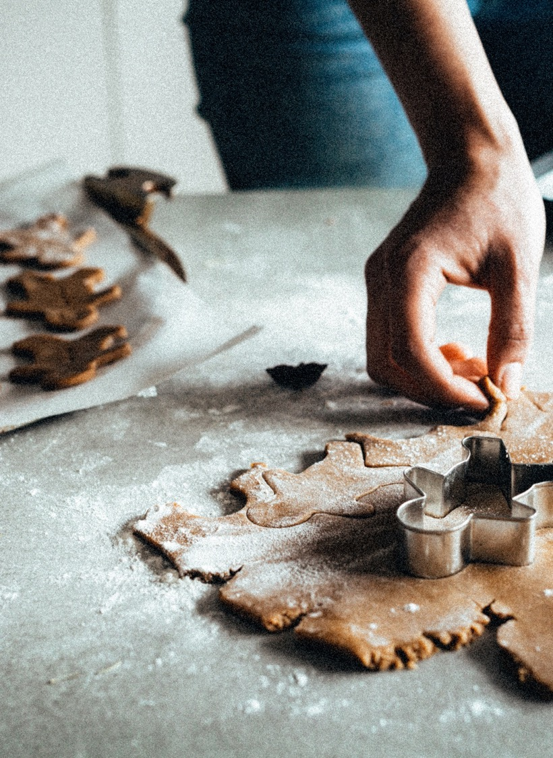
The user interface
Driving the process from start to finish
Observing tool use in real-time
Monitoring inputs and outputs at each step
Keeping the human in the loop
Providing feedback and corrections
Confirming before critical actions
Claude Sonnet 4.5

Slide 13

AG-UI
https://github.com/ag-ui-protocol/ag-ui

Slide 14
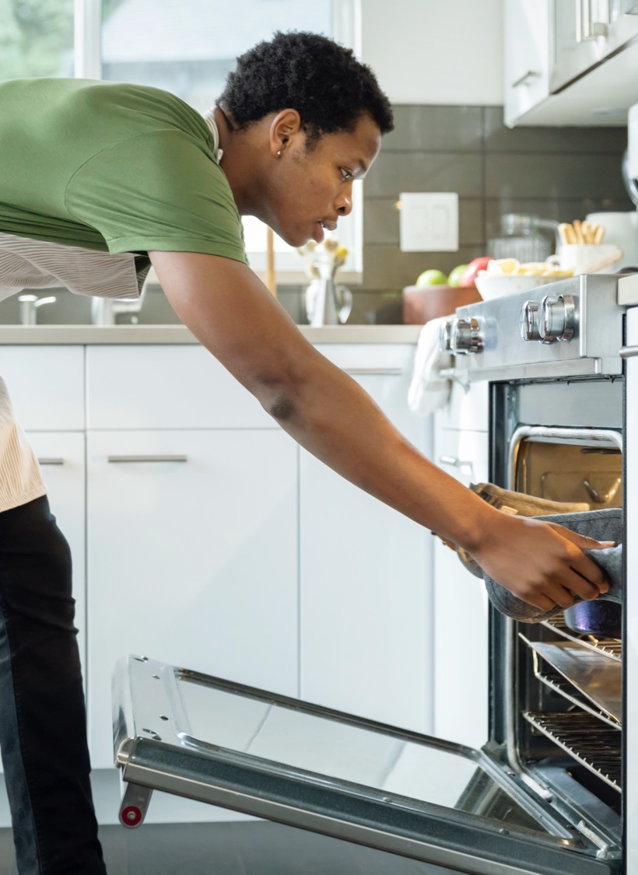
The oven
Protein Denaturation
Starch Gelatinization
Maillard Reaction
Caramelization
Leavening Gas Expansion
Water Evaporation
Fat Melting
Claude Sonnet 4.5
Notes:
Protein Denaturation - Gluten and egg proteins unfold and form new bonds, creating structure
Starch Gelatinization - Starch granules absorb water, swell, and form a gel network that gives body to the dough
Maillard Reaction - Amino acids and sugars react to create hundreds of flavor compounds and golden-brown color
Caramelization - Sugar molecules break down into smaller compounds, creating caramel flavors and darker browning
Leavening Gas Expansion - Carbon dioxide from baking soda/powder and steam expand, causing the dough to rise
Water Evaporation - Moisture escapes from the surface, creating a crispy crust while the interior stays moist
Fat Melting - Butter melts and spreads, tenderizing the dough and carrying flavor throughout

Slide 15
FLUX.1-schnell
Text-to-image
12 billion parameters rectified flow transformer
Cutting-edge output quality and competitive prompt following
Can generate high-quality images in only 1 to 4 steps
Open source under Apache-2.0 license
https://huggingface.co/black-forest-labs/FLUX.1-schnell

Slide 16
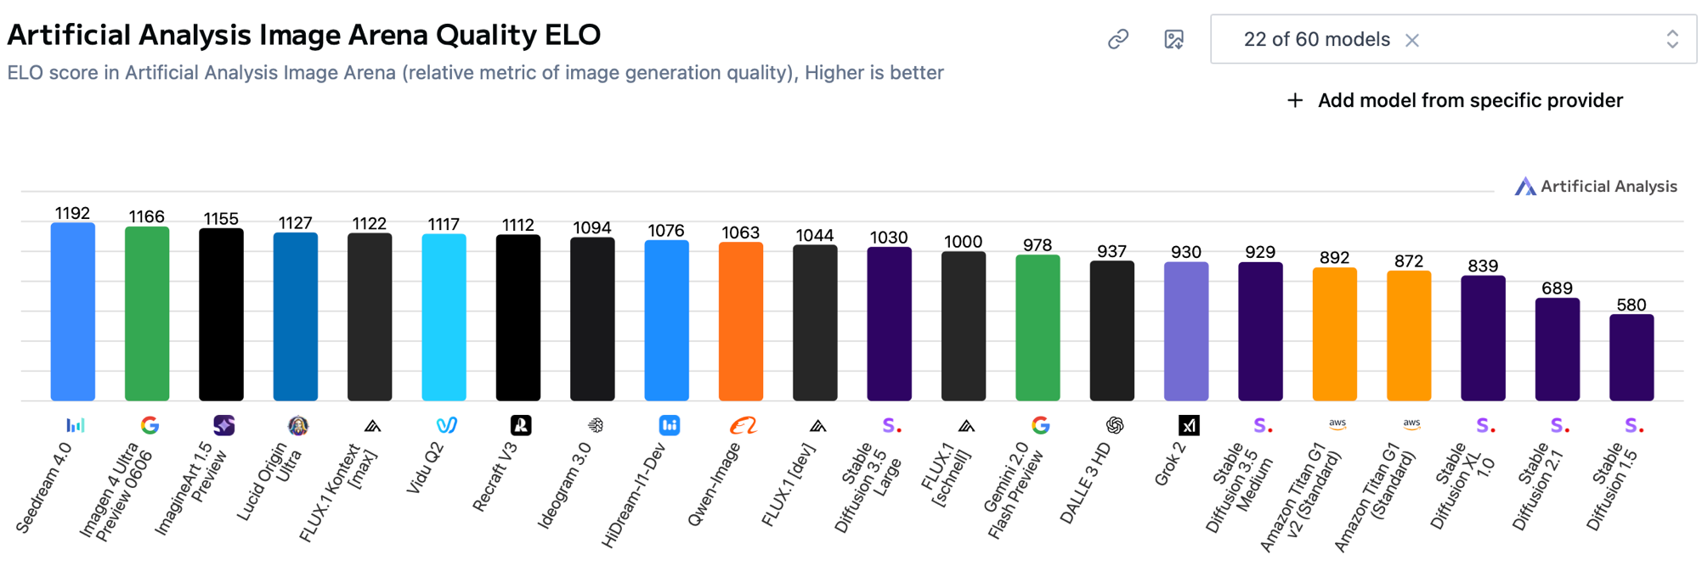
24GB
https://artificialanalysis.ai/image/models?host-models=amazon-bedrock_amazon-titan-v1-standard%2Camazon-bedrock_amazon-titan-v2-standard%2Copenai_dalle-3-hd%2Cprodia_flux-1-dev_fast%2Cblack-forest-labs_flux1-dev%2Cfireworks.ai_flux-1-schnell%2Cblack-fores

Slide 17
Demo
https://github.com/halllo/BakingAgent

Slide 18

Merry
Christmas

