Slide 1
Cairnly
Supply ordering for independent dental practices
Seed round | 2026

Slide 2
The problem
Independent dental practices spend 6-8% of revenue on clinical supplies.
Ordering is run by the office manager on top of the front desk job.
Practices we interviewed reported 3 stockouts of a critical item per quarter.
Office managers spend about 5 hours a week on ordering and reconciling invoices.

Slide 3
How practices order today
1. Office manager walks the supply closet and updates a spreadsheet
2. The distributor rep visits monthly and suggests a re-order
3. Gaps are filled from Amazon Business or a second distributor at retail prices
4. Invoices are matched to deliveries by hand at month end
Notes:
Speaker notes: none of the 22 practices we interviewed tracked usage per procedure. Most said the rep's suggested order is the default because nobody has time to check it.

Slide 4
Cairnly
Connects to the practice management system and reads scheduled procedures
Forecasts supply usage per procedure and flags low stock before it runs out
Places orders across distributors at the best contracted price

Slide 5
Market
About 135,000 dental practices in the US; roughly 70% are independent (company estimate).
Supply distribution is concentrated in two national distributors who run their own ordering portals.
DSOs are consolidating practices and centralizing purchasing, which squeezes independents on price.

Slide 6
Competition
Alternative | How practices use it | Gap
Distributor portals | Free with the distributor account | Locked to one distributor's catalog and prices
Spreadsheets | Office manager tracks counts by hand | No usage forecast; depends on one person
Group purchasing orgs | Negotiate discounts for members | Price only; no ordering workflow
Horizontal inventory apps | Generic stock tracking | No link to the procedure schedule

Slide 7
Traction
14 practices in pilot across Ohio and Michigan
5 paying customers at $249 per location per month
Pilot practices cut supply spend 11% on average over 90 days (internal data, n=5)

Slide 8
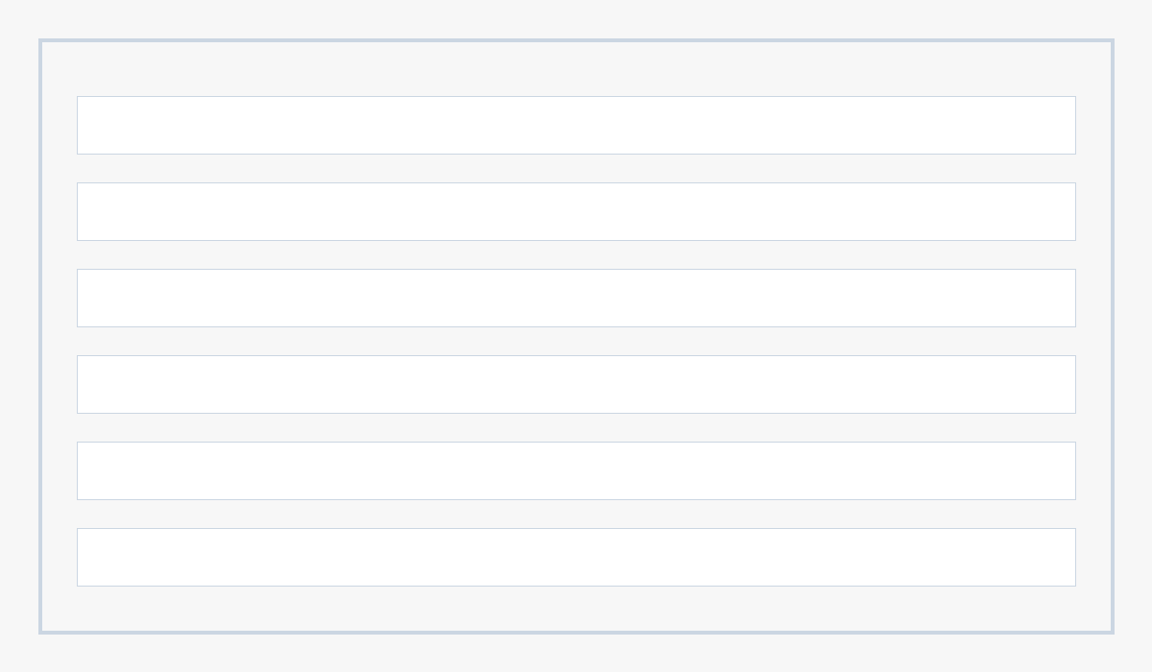

Slide 9
Team
Maya Okafor, CEO - 8 years running operations for a 30-location dental group
Dev Raman, CTO - previously built ordering systems at a restaurant-supply marketplace

Slide 10
The ask
Raising $1.5M seed to reach 150 paying locations in 18 months

