Slide 1
Cardiolyte Health
Home cardiac rehab, prescribed like a drug
Investor Presentation
October 2026

Slide 2
The Problem
Only 24% of eligible heart patients complete cardiac rehabilitation¹
Center-based programs require 36 in-person visits; most patients drop out by week 4
¹ Footnote: synthetic statistic for demonstration purposes only.

Slide 3
Our Solution
Cardiolyte is a prescription digital therapeutic (SaMD) for cardiac rehabilitation
Remote patient monitoring with wearable ECG patch plus clinician dashboard
Pursuing FDA De Novo clearance; cardiology-led clinical protocol

Slide 4
Market
TAM $6.1B: US cardiac rehab and cardiovascular digital health
SAM $1.4B across 1,200 hospital cardiology programs

Slide 5
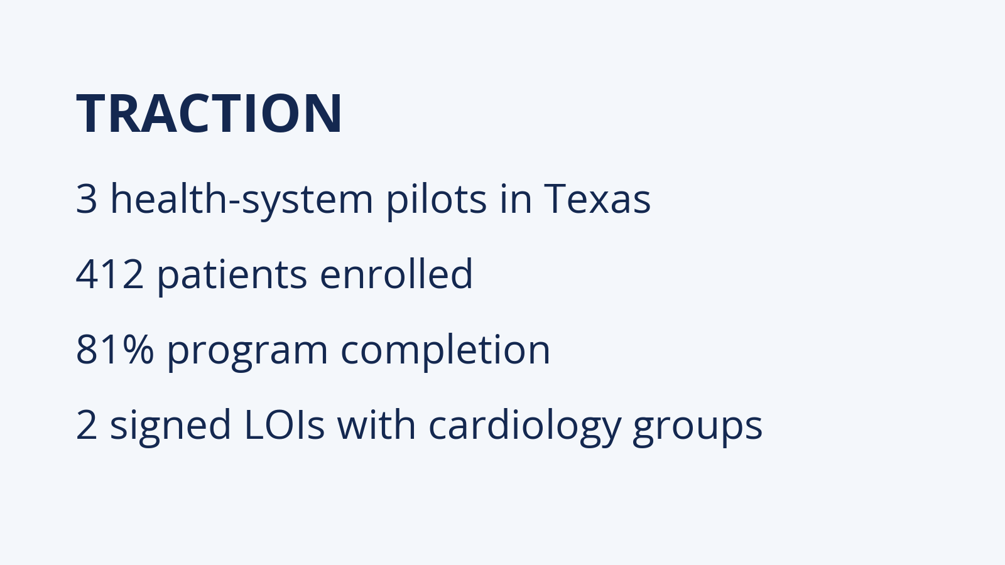

Slide 6
Business Model
$1,200 per patient program, reimbursed under cardiac rehab CPT codes
B2B contracts with health systems and cardiology practices

Slide 7
Team
Headquartered in Austin, Texas
CEO: Dana Whitfield (synthetic) — former VP Product, digital health scale-up
CMO: Dr. Omar Reyes (synthetic) — interventional cardiologist

Slide 8
Competition
 | Cardiolyte | Center-based rehab | Generic fitness apps
Prescribed & reimbursed | Yes | Yes | No
Home-based | Yes | No | Yes
Clinician monitoring | Yes | Yes | No

Slide 9
The Ask
Raising $2.5M Seed round on a post-money SAFE ($12M valuation cap)
Committed: $1.1M in signed SAFEs from angel investors
Soft-circled: $400K (verbal interest from two family offices)
Target close: December 15, 2026
Seeking US-based investors who can co-invest alongside our lead angels
Previously raised $750K pre-seed from friends & family (2025)
Notes:
Speaker notes: walk through milestones; the round is open to co-investors.

Slide 10
Use of Funds
Use of funds | Share
Clinical validation study | 40%
Engineering | 30%
Go-to-market | 20%
Regulatory | 10%

Slide 11
Appendix: Milestone Timeline
Milestone | Timing
Seed close | Q1 2027
FDA De Novo submission | Q3 2027
Next round: Series A of $8M | 2028

Slide 12
Contact
Cardiolyte Health, Inc. · 500 Example Ave, Austin, TX 78701
founders@cardiolyte.example
© 2026 Cardiolyte Health, Inc. Confidential.

