Slide 1
Chapter 5
Signal Encoding Techniques
Notes:
Physical layer에서 일어나는 일.

Slide 2
Encoding Technique
Digital Data ⇒ Digital Signal
Digital Data ⇒ Analog Signal
Analog Data
  Digital Data ⇒ Digital Signal
  Digital Data ⇒ Analog Signal
Analog Data ⇒ Analog Signal
Notes:
Analog data -> digital data로 바꾸는 과정은 analog data를 받는 특정 application에서 일어나는 과정이다.

Slide 3
Digital Data ⇒ Digital Signals (1)
A digital signal is a sequence of discrete, discontinuous voltage pulses.
Each pulse is a signal element.
Encoding Scheme: mapping a digital data into signal element
Binary data are transmitted by encoding each data bit into signal elements.
Notes:
Digital signal : Discrete, discontinuous!

Slide 4
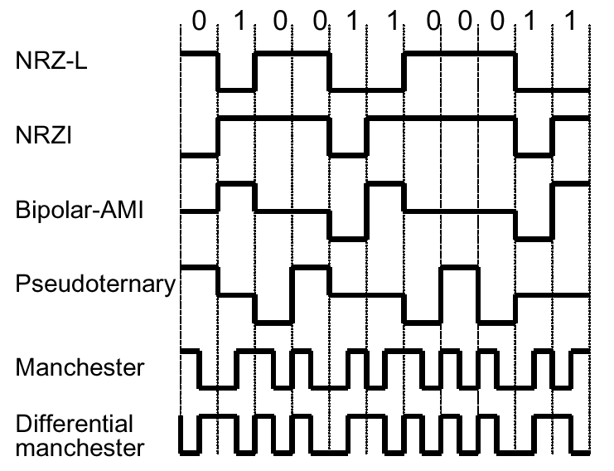
Digital Data ⇒ Digital Signals (2)
Various encoding schemes

Slide 5
Digital Data ⇒ Digital Signals (3)
0 1 1 0
RZ(Return to Zero)
0: positive pulse
1: negative pulse
Signal returns to zero after each encoded bit
+V
0
-V
Notes:
항상 0V로 돌아오기 때문에 RZ.

Slide 6
Digital Data ⇒ Digital Signals (4)
NRZ(Nonreturn to Zero)
Voltage level is constant during bit interval
(no return to a zero voltage level)
NRZ-L(NRZ Level)
  0: positive voltage
  1: negative voltage
NRZ-I(NRZ Inverted)
  a form of differential encoding
  0: no transition
  1: transition at the beginning of bit interval
NRZ strengths
  simple, and efficiently use bandwidth
NRZ limitations
  presence of dc component
  lack of synchronization capability
0 1 1 0
+V
-V
NRZ-L
0 1 1 0
+V
-V
NRZ-I
Notes:
0V로 돌아가지 않는다. 그래서 NRZ.
NRZ-L : 각 voltage가 0과 1 을 나타냄.
NRZ-I : transition(voltage가 바뀜)이 일어나면 1, transitio이 일어나지 않으면 0. voltag의 변화 혹은 유지가 0과 1을 나타냄.
장점 : simple함,

Slide 7
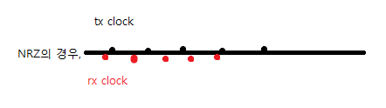
Digital Data ⇒ Digital Signals (5)
Multilevel Binary
Bipolar-AMI(Alternate Mark Inversion)
  three voltage levels(positive, zero, negative)
  0: zero voltage
  1: alternately by positive and negative voltages
  better synchronization than NRZ
  no dc component
  error detection capability
Pseudoternary
  Same as bipolar-AMI, except representation of 0 and 1 is interchanged
Notes:
Voltage level이 3개 이상.
Signal sum(integral)이 0이면 dc component가 ASKY.. -> 나중에 배움ㅋ
Tx clock(보내는?), Rx clock(받는?)이 딱딱 맞아야 완벽한 synchronization이 일어남. -> transition이 자주 일어나게 해야 함.

Slide 8
Digital Data ⇒ Digital Signals (6)
Biphase
Always a transition at the middle of each bit interval
Manchester
  0: high to low transition
  1: low to high transition
Differential Manchester
  0: transition at the beginning of bit interval
  1: no transition
Synchronization and error detection capability,
and no dc component
Notes:
Error detection capability : 다른 형태의 signal이 오는지 확인해서 error를 찾아냄(?)
Manchester : data * clock.
Differential Manchester : 첫 시작에서의 transition?
치명적인 단점 ! : bandwidth를 굉장히 비효율적이게… (다음 시간에 ㅎㅎ)

Slide 9
Digital Data ⇒ Digital Signals (7)
Notes:
Time domain에서 signal를 관찰 한 것.
* Frequency domain에서 signal을 관찰 할 수도 있단다.

Slide 10
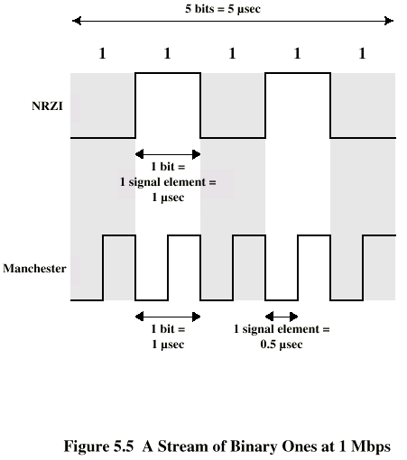
Digital Data ⇒ Digital Signals (8)

Slide 11
Digital Data⇒Digital Signals (9)
Scrambling Techniques
For long-distance communications
No dc component, good synchronization and error detection capability, without reduction in data rate
B8ZS(Bipolar with 8-Zeros Substitution)
  Based on bipolar-AMI
  8 consecutive zeros are encoded as either 000+-0-+ or 000-+0+-, s.t. two code violations always occur
Notes:
문제점 : 원래 000+-0-+인지, 0이 8개 연속으로 나온건지.. -> 2개의 code violations.
이전이 + -> 000+-0-+
이전이 - -> 000-+0+-

Slide 12
Digital Data ⇒ Digital Signals (10)
HDB3(High-Density Bipolar 3-Zeros)
  4 zeros are encoded as either 000-, 000+, +00+, or -00-
  Substitution rule :
    the 4th bit is always a code violation,
    successive violations are of alternate polarity (not to introduce dc component)
Polarity of preceding pulse
Number of ones since last substitution
odd
even
-
000-
+00+
+
000+
-00-

Slide 13
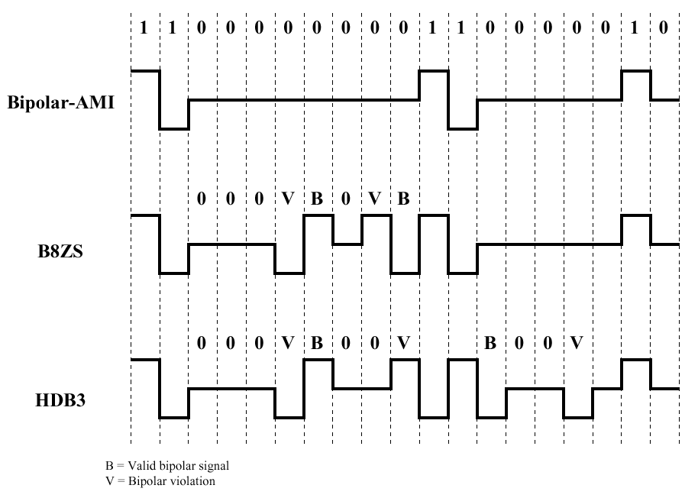
Digital Data ⇒ Digital Signals (11)

Slide 14
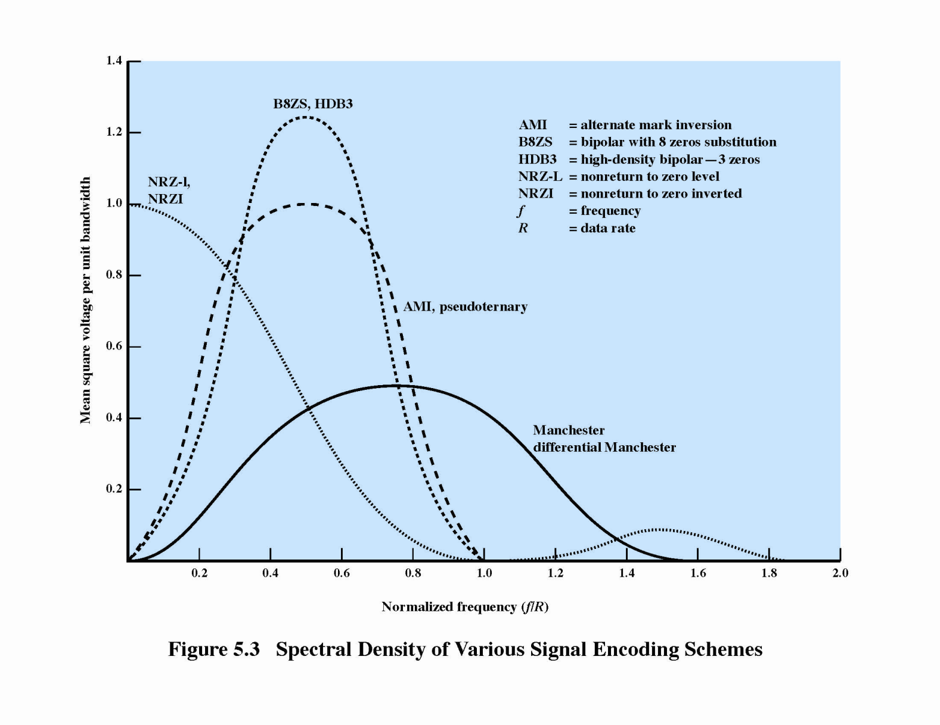
Digital Data ⇒ Digital Signals (12)

Slide 15
Digital Data ⇒ Digital Signals (13)
Evaluation factors for encoding schemes
  Signal spectrum
    less bandwidth, no dc component
    shape of spectrum(better to center in the middle of bandwidth)
  Self-clocking capability
    It is desired for synchronization
  Error detection capability
  Signal interference and noise immunity
  Cost and complexity

Slide 16
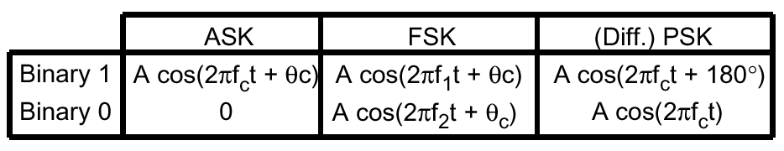
Digital Data ⇒ Analog Signals (1)
Encoding is by modulation of a continuous sinusoidal carrier signal.
This involves alteration of some characteristics of the carrier signal-amplitude, frequency, or phase.
Various encoding techniques: ASK, FSK, PSK, ...

Slide 17
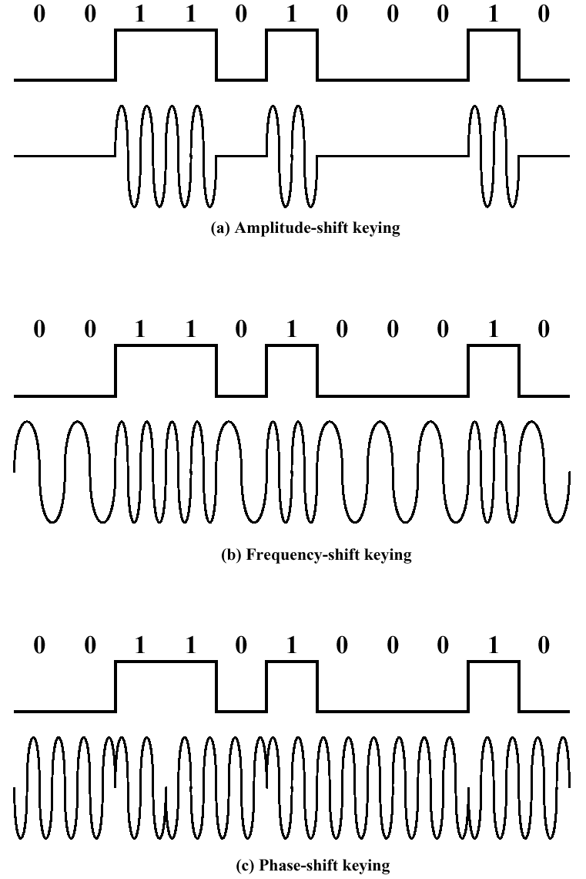
Digital Data ⇒ Analog Signals (2)

Slide 18







Digital Data ⇒ Analog Signals (3)
QPSK(Quadrature PSK)
  I Q phase
  1 1: (+1+j)
  0 1: (-1+j)
  0 0: (-1-j)
  1 0: (+1-j)
I
d₁(t)
1, -1 mapping
S(t)
d₂(t)
Q
modulation

Slide 19
Digital Data⇒Analog Signals (4)
QPSK demodulation
Low pass filter
d₁(t)/2
S(t)
replica
Low pass filter
d₂(t)/2

Slide 20
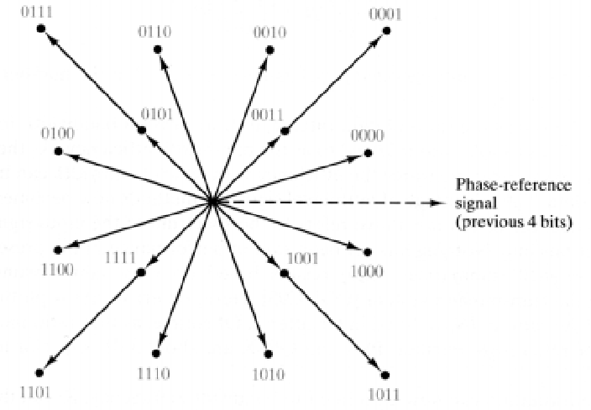
Digital Data⇒Analog Signals (5)
PSK using 12 angles and three amplitudes - 9,600 bps modem (2,400 baud)

Slide 21
Digital Data ⇒ Analog Signals (6)
Modulation Rate
  Data rate (in bps) = modulation rate (in baud) x the number of bits per signal element
Constellation Pattern
  The patterns showing legal combinations of amplitude and phase
Example (2400 baud rate)
  64 points constellation ⇒ 14,400 bps modem
  128 points constellation ⇒ 16,800 bps modem

Slide 22
Digital Data ⇒ Analog Signals (7)
QAM modulator
I
d₁(t)
constellation mapping
S(t)
d₂(t)
Q

Slide 23

Digital Data ⇒ Analog Signals (8)
Offset-QPSK modulation
I
d₁(t)
1, -1 mapping
S(t)
Data rate 1/ T_{b}
d₂(t)
Delay T_{b}
Q

Slide 24
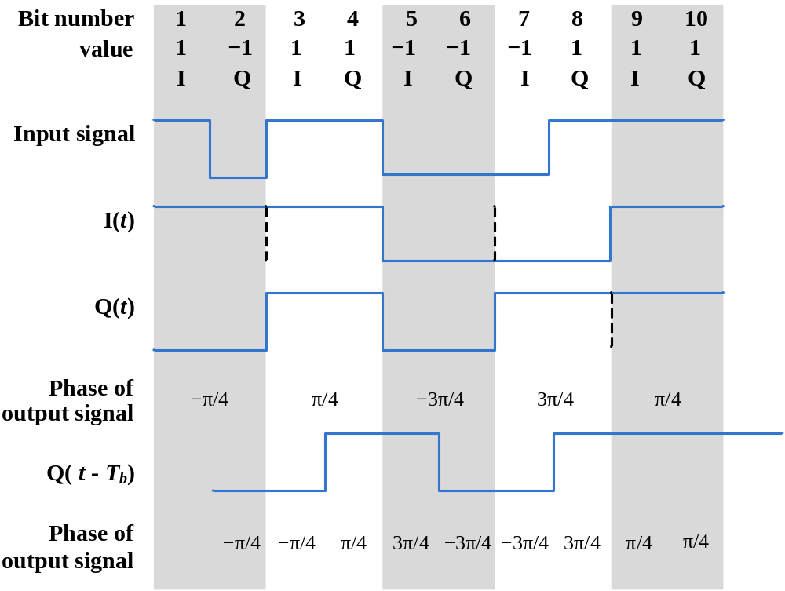
Offset-QPSK

Slide 25
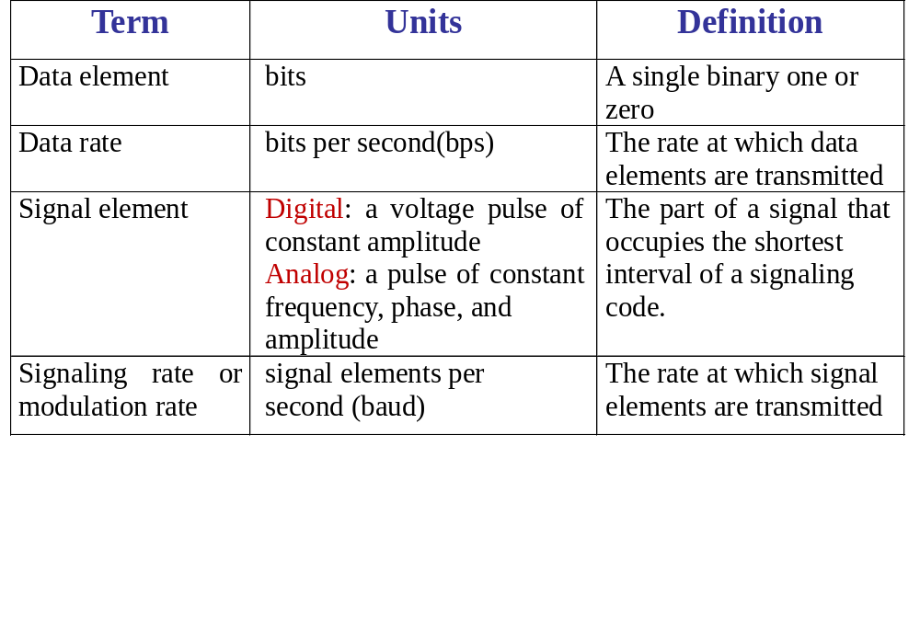
Digital data transmission terminology

Slide 26
Analog Data ⇒ Digital Signals (1)
Digitization
Conversion of analog data into digital data
  Digital data can then be transmitted using NRZ-L
  Digital data can then be transmitted using code other than NRZ-L
  Digital data can converted to analog signal
Analog to digital conversion done using a codec
Pulse code modulation
Delta modulation

Slide 27
Analog Data ⇒ Digital Signals (2)
PCM(Pulse Code Modulation)
  Based on the Nyquist’s Sampling Theorem
Nyquist’s sampling Theorem
  If a signal is sampled at regular intervals at a rate higher than twice the highest signal frequency, the samples contain all the information of the original signal
  example (voice)
    sampling rate = 8000 sampling/sec (1 sampling/125us)
    1 sample = 8 bits
    64kbps

Slide 28
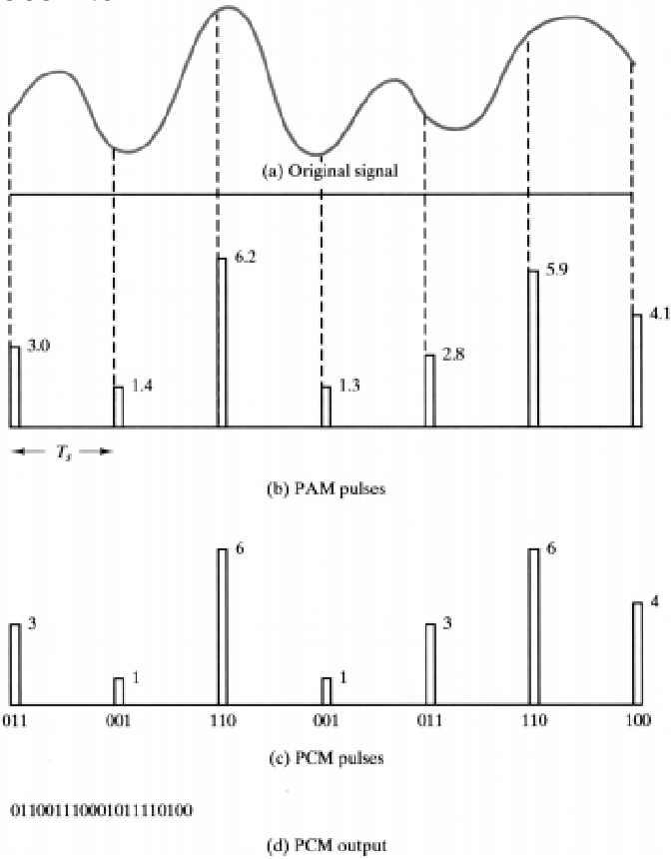
Analog Data ⇒ Digital Signals (3)

Slide 29
Analog Data ⇒ Digital Signals (4)
Analog-to-Digital Conversion
PAM sampler
Quantizer
Encoder
Analog
input signal
PAM pulses
PCM pulses
Digital
output
PCM
  To reduce the information loss due to quantization
    a large n, where n is the number of bits per sample
    nonlinear coding or companding+linear coding

Slide 30
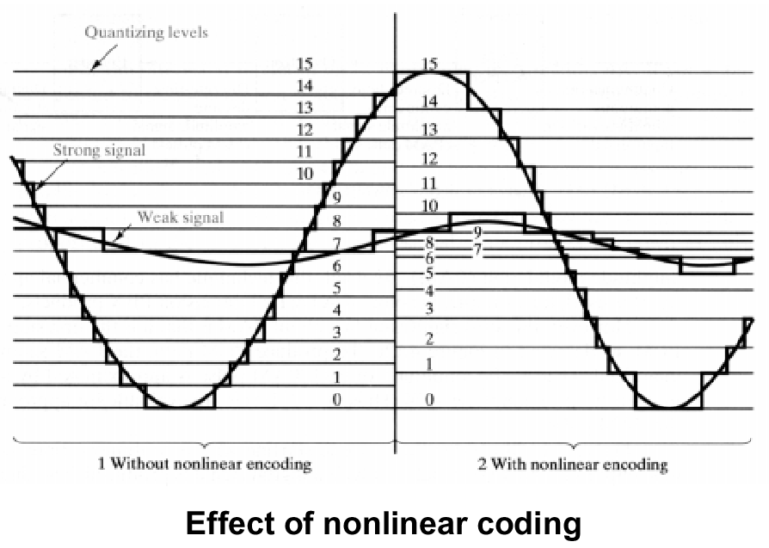
Analog Data ⇒ Digital Signals (5)

Slide 31
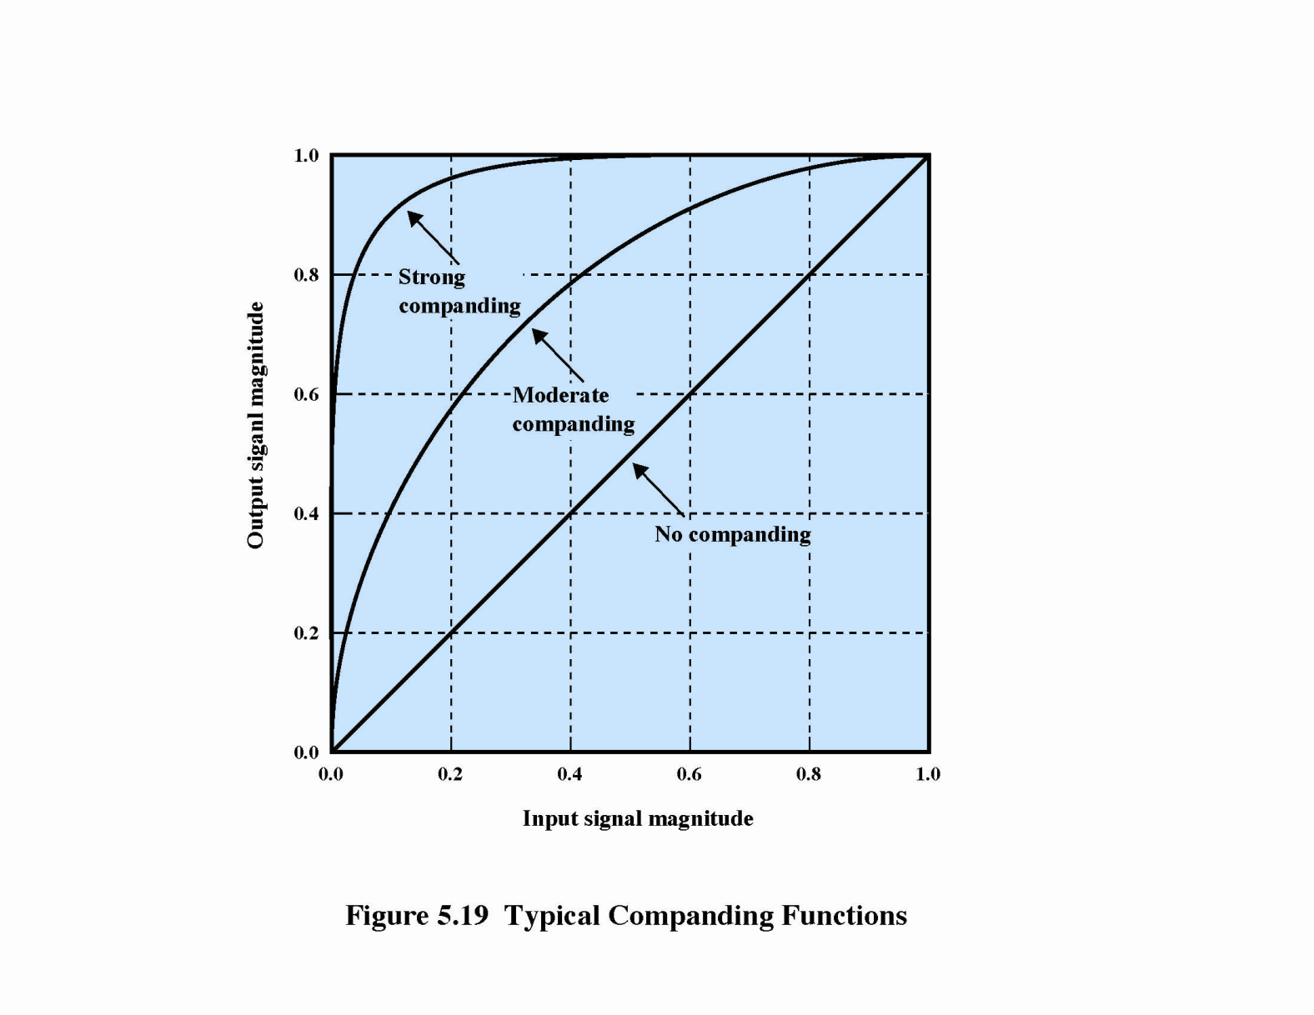
Companding

Slide 32
Analog Data ⇒ Digital Signals (6)
DM(Delta Modulation)
This uses n=1
  binary digital signal is produced;
  “0” stands for change of -δ
  “1” for change of +δ.
Higher sampling rate than PCM(Nyquist’s rate) is needed, but each sample uses only 1 bit instead of n.
Implementation much simpler than PCM.

Slide 33
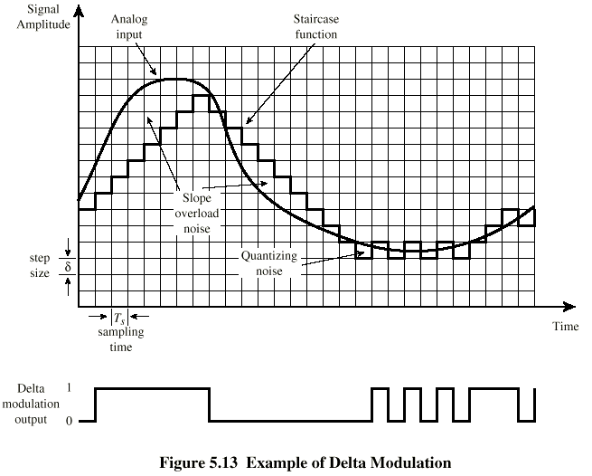
Delta Modulation Example

Slide 34
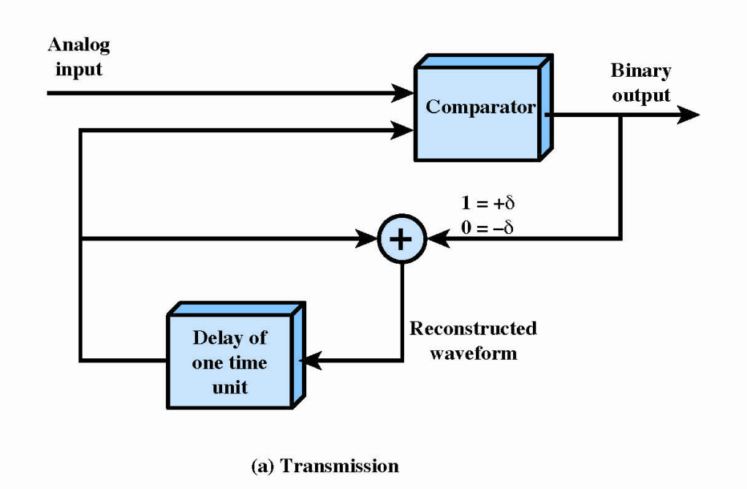
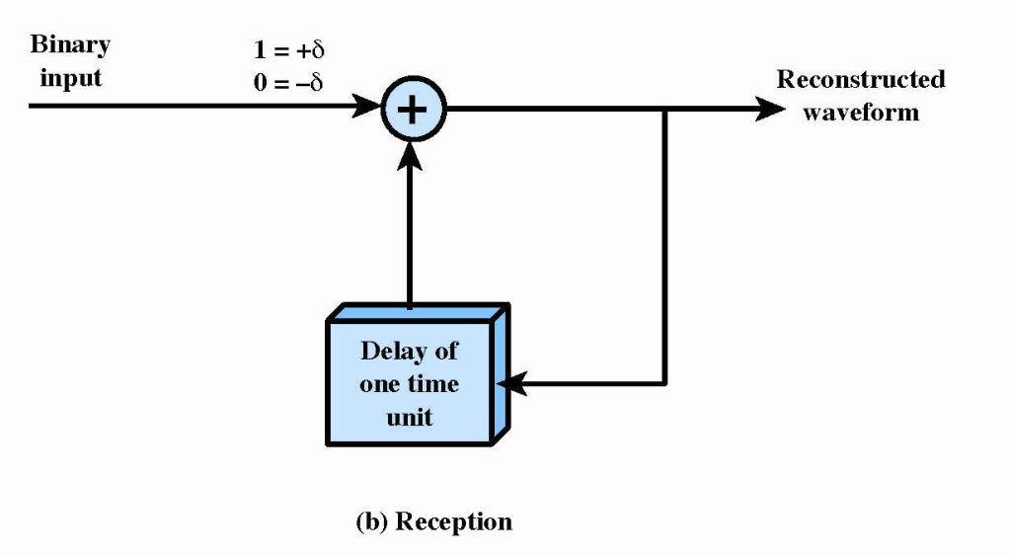
Delta Modulation

