Slide 1
Chap. 1, 2: Overview

Slide 2
Computer Communication
Communication: transfer of information between entities
Information: data plus meaning
Role of Computers in Communication
  As users: main sources and sinks for info and data
  As provider: used to implement switching nodes, controllers, concentrators, protocol translators, etc
Three General Types of Computer Communication
  Computer-to-computer
  Human-to-computer : user interface protocols
  Computer-aided human-to-human : e-mail
Notes:
Communication -> tele-communication
Tele : far라는 의미
과거 통신 수단 : on foot, 봉화, 역참

Slide 3
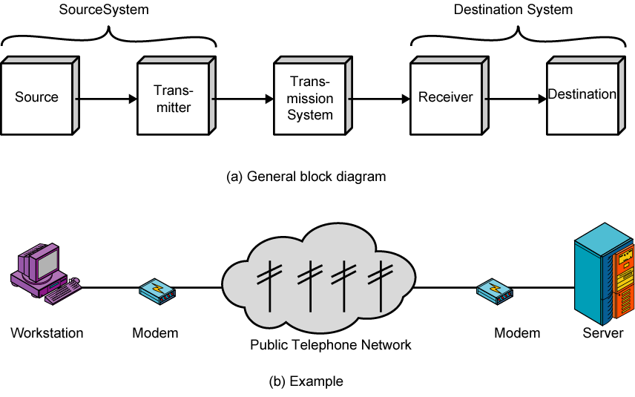
Simplified Communications Model
Notes:
Public Tele Network

Slide 4
Communications Model
Source
  generates data to be transmitted
Transmitter
  converts data into transmittable signals
Transmission System
  carries data
Receiver
  converts received signal into data
Destination
  Takes incoming data

Slide 5
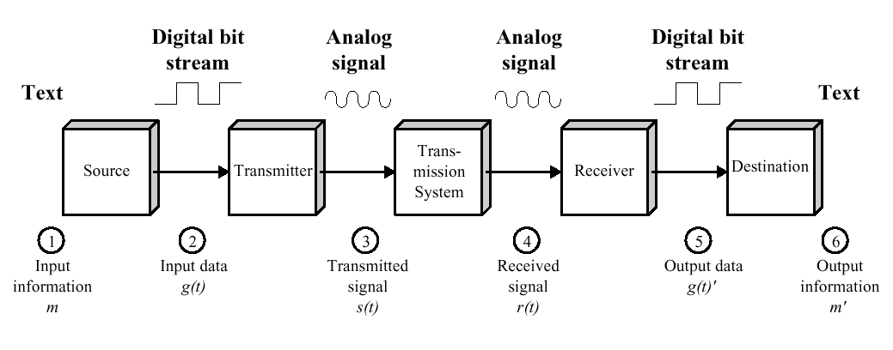
Simplified Data Communications Model

Slide 6
Networking
Point to point communication not usually practical
  Devices are too far apart
  Large set of devices
Solution is a communications network
Various networks exist
  Wide Area Network (WAN)
  Metropolitan Area Networks (MAN)
  Local Area Network (LAN)
  Personal Area Networks (PAN)

Slide 7
Computer Network
An interconnected collection of computers which are
  Cooperative
    Cooperative action is required between components
    No master-slave relationships
  Autonomous
    All components are capable of independent action
  Mutually Suspicious
    Components verify requests

Slide 8
Background of Computer Network Evolutions
Two technological advances in computer and communication fields
  Hardware and software technologies of computer
  Digital transmission
  Optical fiber
  Wireless communication technology
  Digital signal processing
  VLSI technologies

Slide 9
Goals and Trends of Computer Networks
Network Goals
  Resource and Information Sharing
  Reduced Cost
  Reliability
Trends in Computer Networks
  Higher speed network
  Wider geographic coverage
  Multimedia services: text, graphics, voice, audio, image, video, etc
  Wireless access

Slide 10
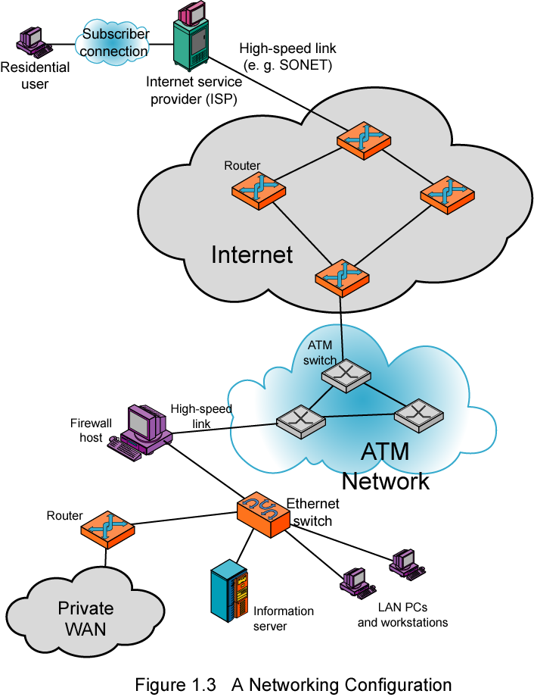

Slide 11
Protocols Architecture (1)
Protocol
  A set of rules governing the exchange of data between two or more (peer) entities.
  Must speak the same language
Key elements of a protocol
  Syntax :
    format, size and contents of protocol messages or packets
  Procedures :
    semantics of messages, actions to take in
    response to reception of different messages
  Timing :
    when to discard a message, retransmit, give up, etc.
Protocols become very complicated

Slide 12
Protocol Architecture (2)
Task of communication broken up into modules
Layering is a popular way of structuring such a family of network protocols
  Layered Architecture
Number of Layers
  Three
  Five (TCP/IP model)
  Seven (OSI model)
Notes:
Abstraction, mdularity,
OSI : Open System Interconnection – ISO에서 만든 국제 표준 Layered Architecture/구현x/five layered에 밀림.
Five : 미국 알파넷

Slide 13
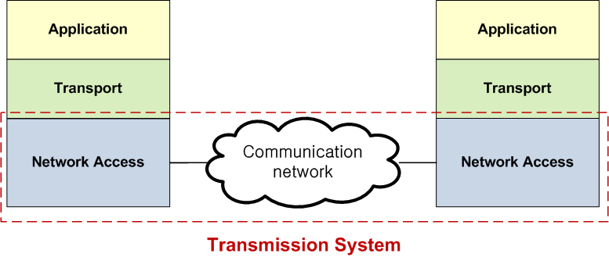
Simple Protocol Architecture (1)
Notes:
Three layered
Application : 작동하는 부분, 이외에는 전송/전달만 하면 된다. 따라서 나눈다.
Network Access : LAN일 수도, MAN일 수도, 무선일 수도, 유선일 수도….
Transport : Reliable transmission이 되었는지 확인하는 부분이 필요. 확인하기 위해 check가능하도록 특정한 정보를 추가하는 것.
Network Access를 더 세분화하면 5 layered

Slide 14
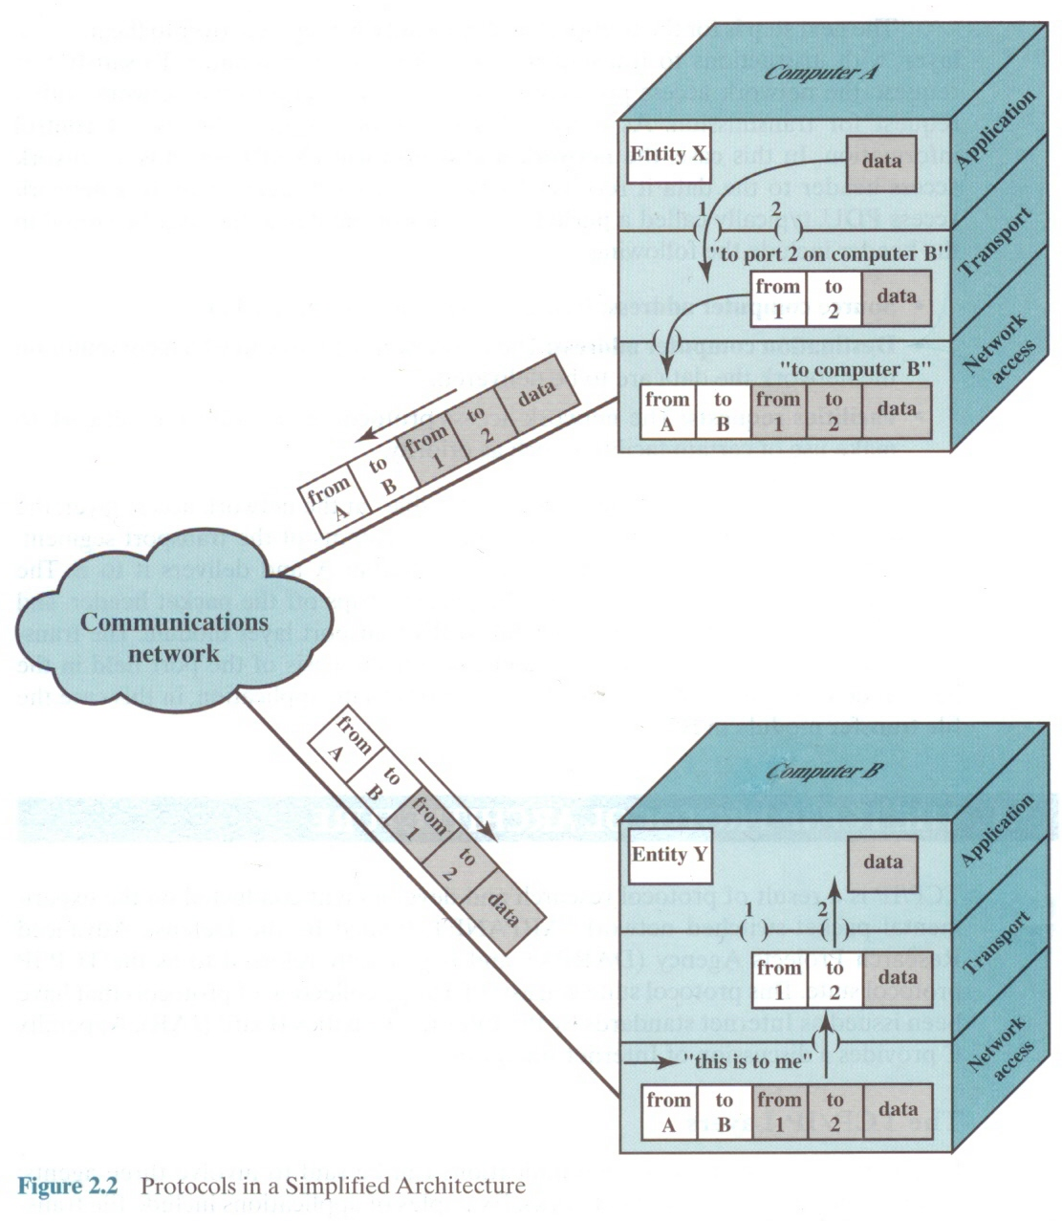
Simple Protocol Architecture (2)
Notes:
Peer application
주소(address) – unique addr. : two-level system – compute의 주소(이것이 ip), 컴퓨터 내부에서 app을 구별하는 주소가 필요하다.(이것이 port!)
Network access는 A컴퓨터에서 B컴퓨터로 보내는 역할, 어느 app인지를 선택하는 것(1, 2)이 Transport.

Slide 15
TCP/IP protocol architecture
Developed by the US Defense Advanced Research Project Agency (DARPA) for its packet switched network (ARPANET)
Used by the global Internet
No official model but a working one
Five Layers

Slide 16
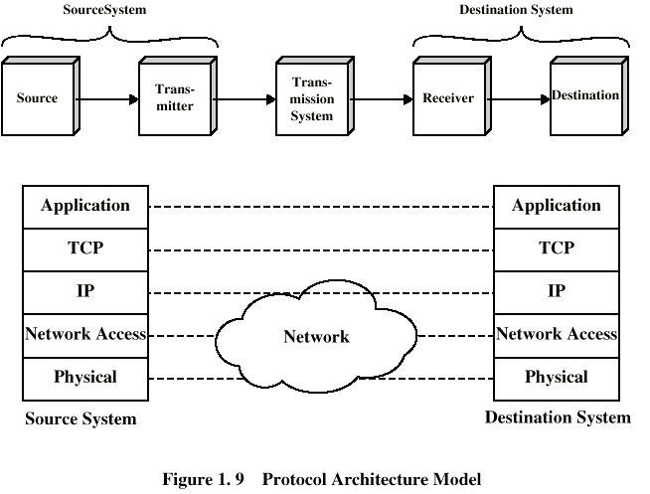
TCP/IP Protocol Architecture Model
Notes:
3-layered와 비교하면,
TCP가 Transport에 대응,
Network Access를 세분화하여 나눔.
App -> TCP -> Network상 경로지정(어느 router로 가라…?), ip주소를 기반으로 -> network access -> physical(케이블마다 특성이 다르고 어쩌고..)
* Router는 layer-3정도만 필요해, network는 layer-2 정도만 필요함ㅋ

Slide 17
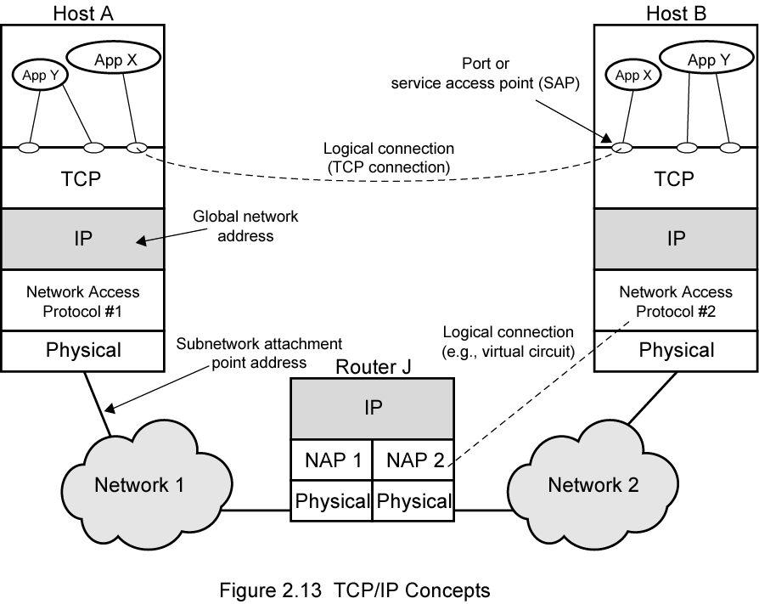
TCP/IP Concept
Notes:
Logical connection = TCP connection
Network Access : 언제 보낼지, 충돌이 나는지, 등등..
Physical : 신호를 결정
NAP : Network Access Protocol(LTE, wifi등..)

Slide 18
Addressing Requirements
Two levels of addressing required
Each computer needs a unique network address
  Network service access point or NSAP (OSI)
  IP or internet address (TCP/IP)
Each application on a (multi-tasking) computer needs a unique address within the computer
  Service access point or SAP (OSI)
  Port number (TCP/IP)
Notes:
IP address는 컴퓨터간의 구분, Port number는 컴퓨터 내부의 구분!

Slide 19
Trace of Simple Operation
Process associated with port 1 in host A sends message to port 2 in host B
Process at A hands down message to TCP to send to port 2
TCP hands down to IP to send to host B
IP hands down to network layer (e.g. Ethernet) to send to router J
Generates a set of encapsulated PDUs
Notes:
Protocol Data Uniset(?) = PDU

Slide 20
Physical Layer
Physical interface between data transmission device (e.g. computer) and transmission medium or network
Characteristics of transmission medium
Signal levels
Data rates
etc.

Slide 21
Network Access Layer
Exchange of data between end system and network
Destination address provision
Internet Layer (IP)
Systems may be attached to different networks
Routing functions across multiple networks
Implemented in end systems and routers
Notes:
네트워크 이내에도 네트워크 상에서 통하는 unique한 주소가 있다.(network address)

Slide 22
Transport Layer: TCP
TCP connection (Connection-oriented)
  Temporary logical association between entities in different systems
TCP PDU
  Called TCP segment
  Includes source and destination port
    Identify respective users (applications)
    Connection refers to pair of ports
TCP tracks segments between entities on each connection
  End-to-end reliable delivery of data

Slide 23
Transport Layer: UDP
User Datagram Protocol
Connectionless
Not guaranteed delivery
No preservation of sequence
No protection against duplication
Minimum overhead
Adds port addressing to IP
Notes:
UDP : dummy만 끼워서 형식만 맞춰서 IP layer로 보낸다.

Slide 24
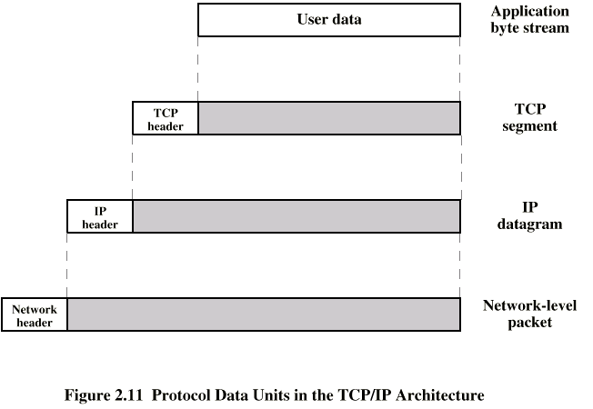
PDUs in TCP/IP
Notes:
Data 손상 여부를 확인하기 위해 추가적인 header를 붙인다. – TCP header
무선은 손상이 많이 일어나기 때문에 데이터를 5배정도(?) 뻥튀기해서…
Incapsulated?

Slide 25
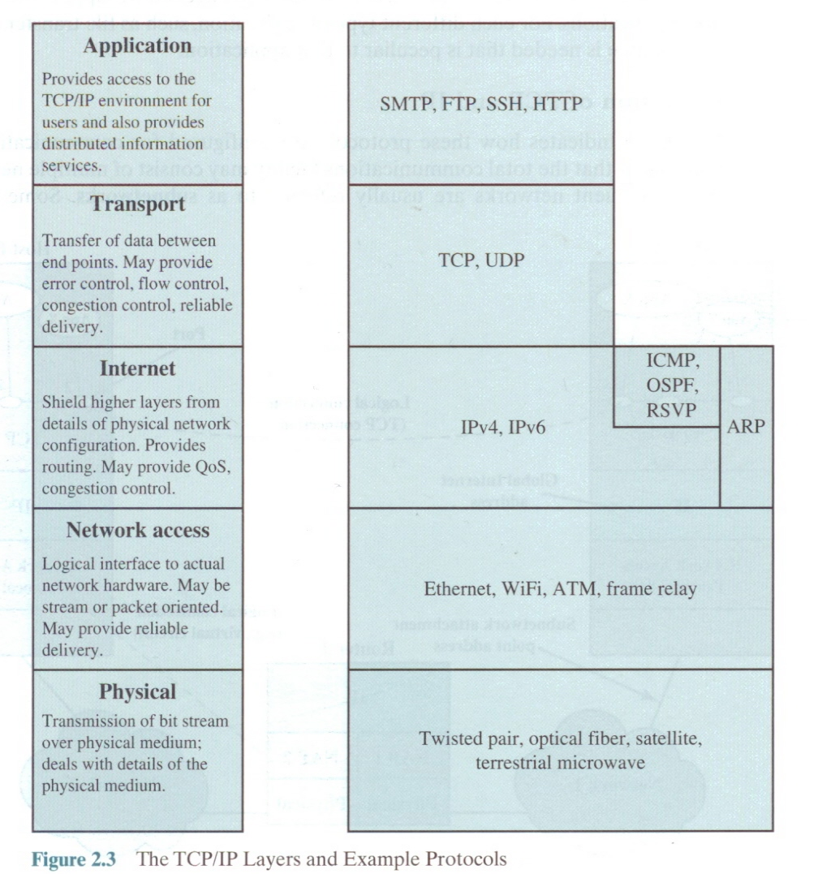
TCP/IP Layers

Slide 26
OSI Model
Open Systems Interconnection
Developed by the International Organization for Standardization (ISO)
Seven layers
A theoretical system delivered too late!
TCP/IP is the de facto standard
Notes:
De facto standard : 사실 상 표준.

Slide 27
OSI Layers
Application
Presentation
Session
Transport
Network
Data Link
Physical

Slide 28
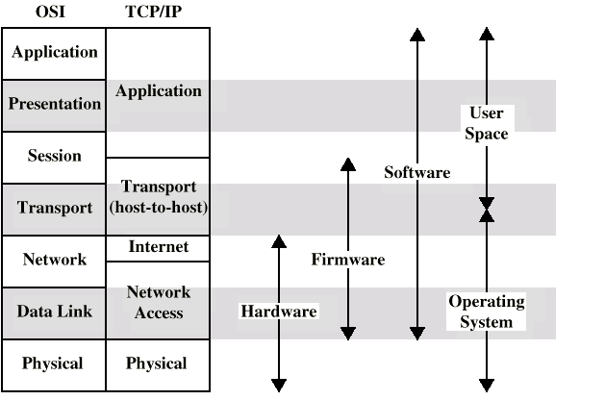
OSI vs TCP/IP

Slide 29
Problems with Layering
Inefficiency
  each layer introduces overhead
Restrictive
  layer N may need access to lower layers than N-1
Redundancy
  of functions such as flow control, error handling, addressing, packetizing and encapsulation between layers
Notes:
Inefficiency : 예) UDP에서 쓸데없이 format을 맞춰주기 위해 dummy를 삽입해야 한다.

Slide 30
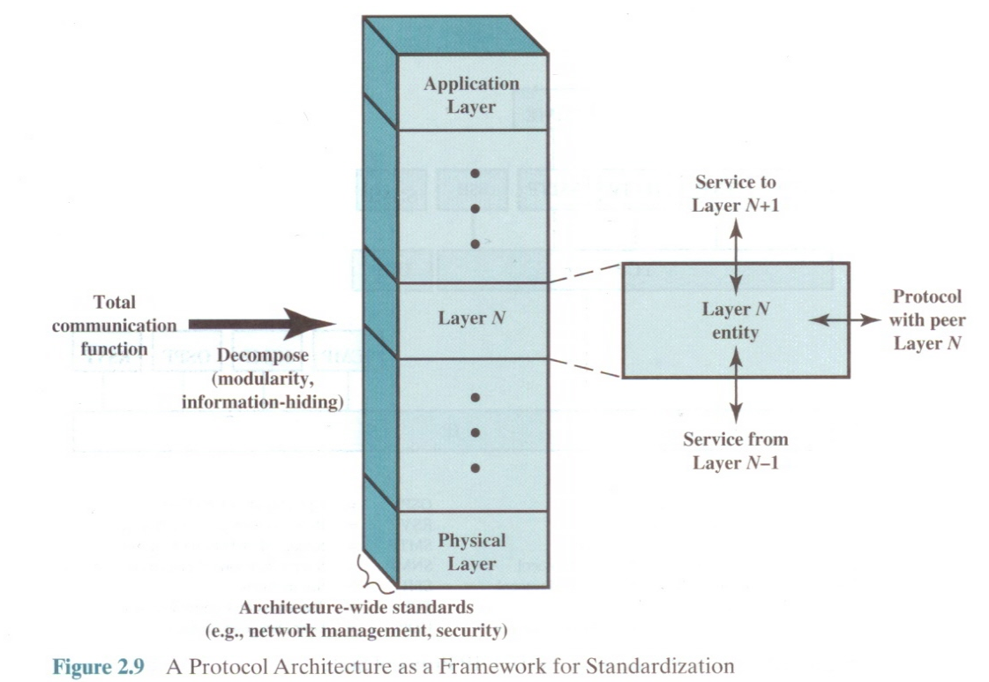
Notes:
TCP에서 일어나는 일 : 데이터를 쪼개어 port number를 각 쪼개진 데이터(TCP segment : PDU – Protocol Data Unit)에 붙이고 쪼개진 데이터가 도착해서 다시 재구성될 수 있게 sequence number도 붙인다.(reliable) end-to-end reliable communication
IP packet(datagram) : PDU?

Slide 31
Standards
Required to allow for interoperability between equipment
Advantages
  Ensures a large market for equipment and software
  Allows products from different vendors to communicate
Disadvantages
  Freeze technology
  May be multiple standards for the same thing
Notes:
LTE-A : Long Term Evolution Advanced

Slide 32
Standards Organizations
Internet Society (IETF)
ISO
ITU
ATM forum
IEEE 802
3GPP, 3GPP2

