Slide 1

discover the basics of the Pygame library

Slide 2

What’s the goal of our meeting?

Slide 3
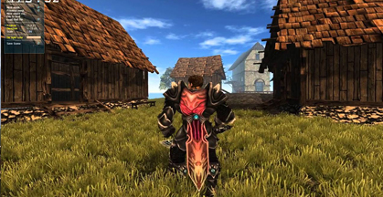
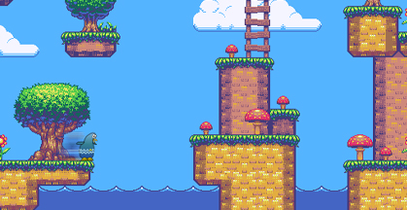
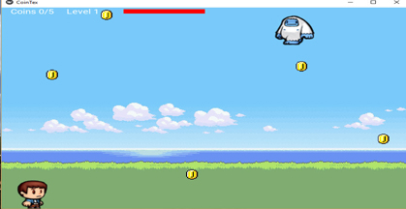
Quick intro
Python programming is a notably very good choice for developers for immediate prototyping of video games.
There are many libraries available in Python that help us to create cross-platform apps and games that can be used on both Android and iOS devices.
Top 5 Python game Engines:
Pygame
PyKyra
Pyglet
PyOpenGL
Kivy

Slide 4

Short overview of game engines
All these engines share the following criteria:
They’re relatively popular engines, or they cover aspects of gaming that aren’t usually covered.
They’re currently maintained.
They have good documentation available.
Today we are talking about Pygame.

Slide 5


What is the Pygame?
It is one of the oldest and most famous libraries of Python for game development. It is a set of Python modules designed for developing amazing games.
Features of Pygame:
Cross-platform library
Suitable for creating client-side applications
Can use multicore CPUs
Generate big results in a small amount of code

Slide 6

Okay, let’s discover Pygame

Slide 7

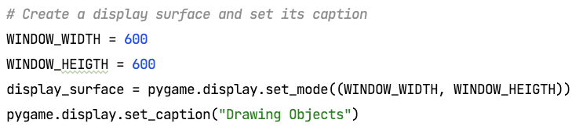
Create a screen
Pygame has a single display Surface that is either contained in a window or runs full screen.
Once you create the display you treat it as a regular Surface.
How to create a display surface?

Slide 8
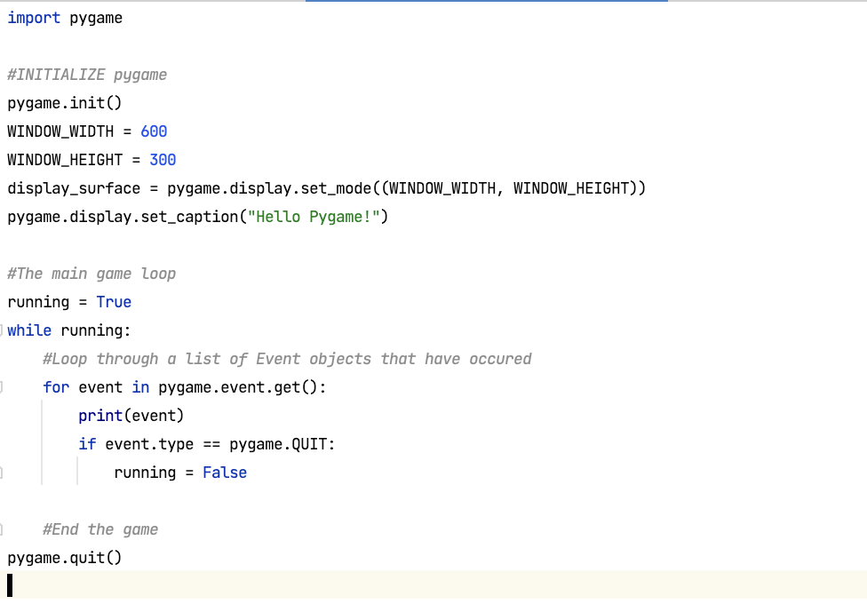
The core of all Pygame projects:

Slide 9
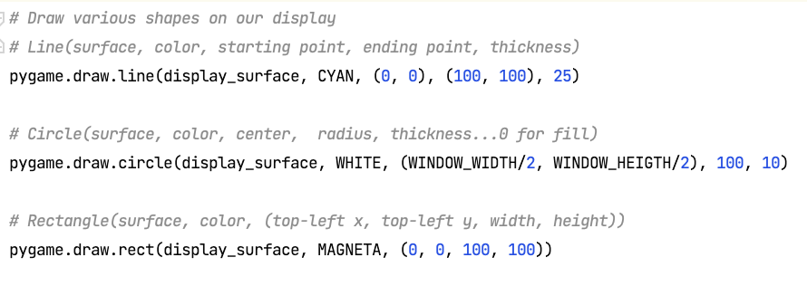
Drawing figures on a display surface
Let’s play with circles, lines and rectangles

Slide 10
One little task for you!

Slide 11
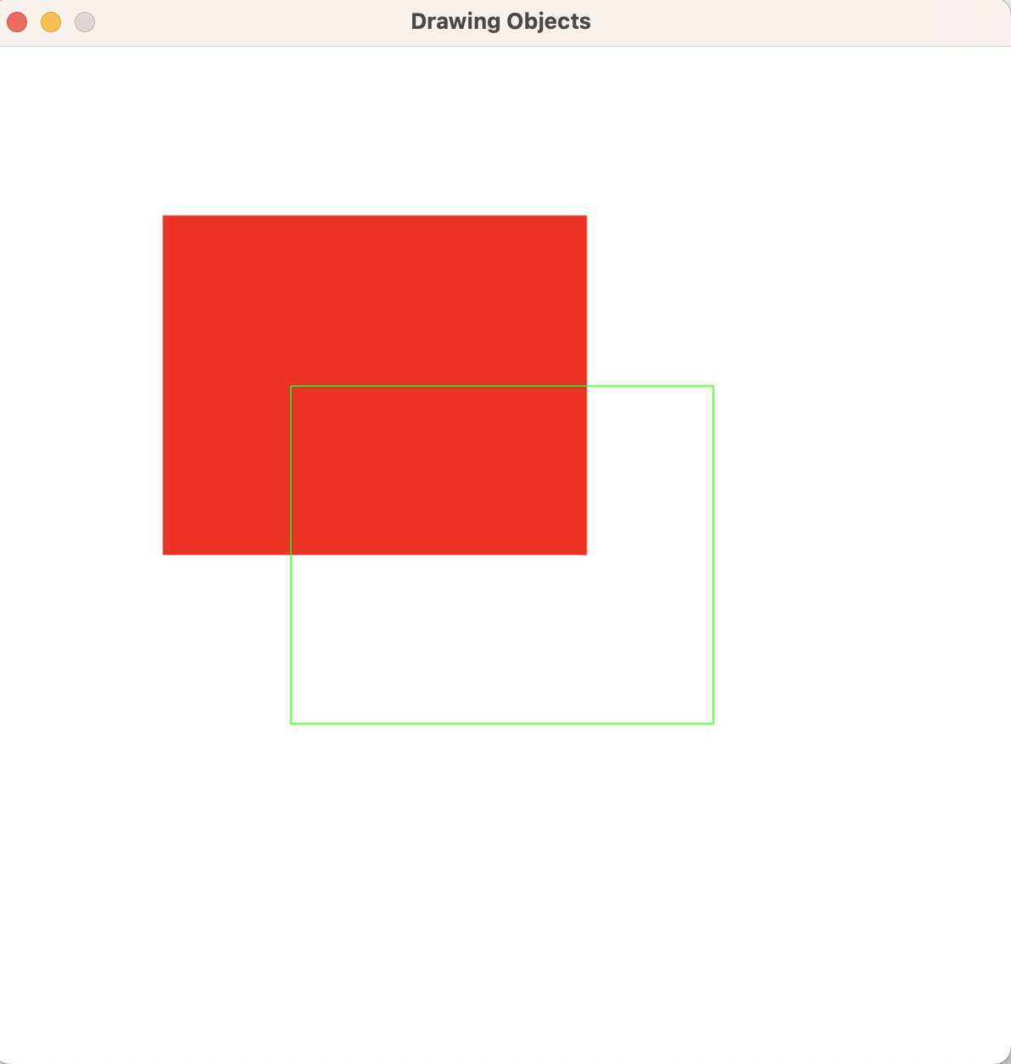

Task 1: Place the rectangles exactly in the center of the screen

Slide 12
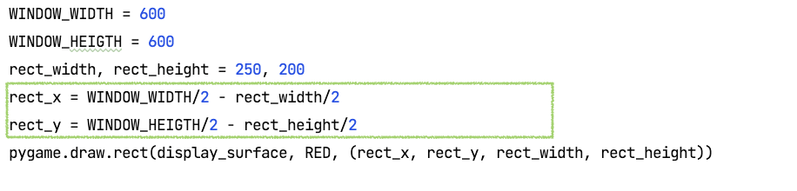
Answer:

Slide 13
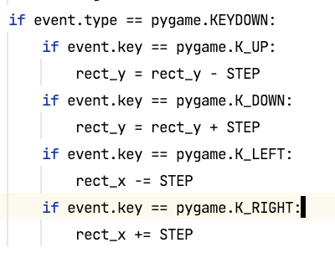
Discrete keyboard movement
Pressing a key its an event in Pygame.
Define what key we pressed and what have to do right after pressing.

Slide 14
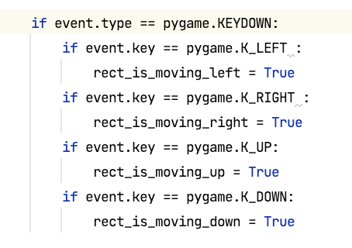
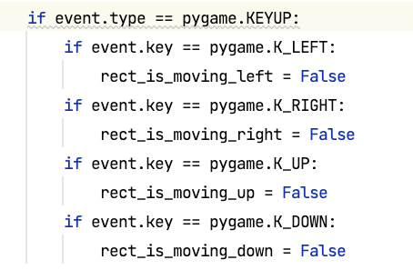
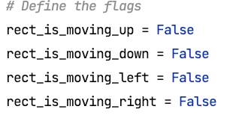
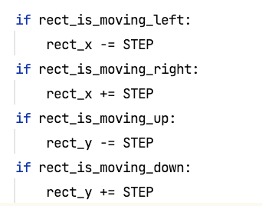
Continuous movement
Step 1: Let’s define flags
Step 2: Let’s define the logic of changing the flag
Step 3: Let’s try to move
Notice:
THE HOLDING OF KEY IS NOT EVENT IN Pygame

Slide 15

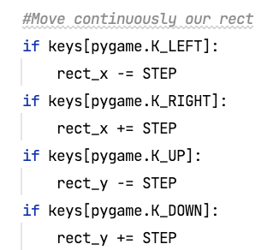
Continuous movement
Step 1: Lets the key being pressed
Step 2: Let’s try to move
Notice:
THE HOLDING OF KEY IS NOT EVENT IN Pygame

Slide 16
One more task for you!

Slide 17
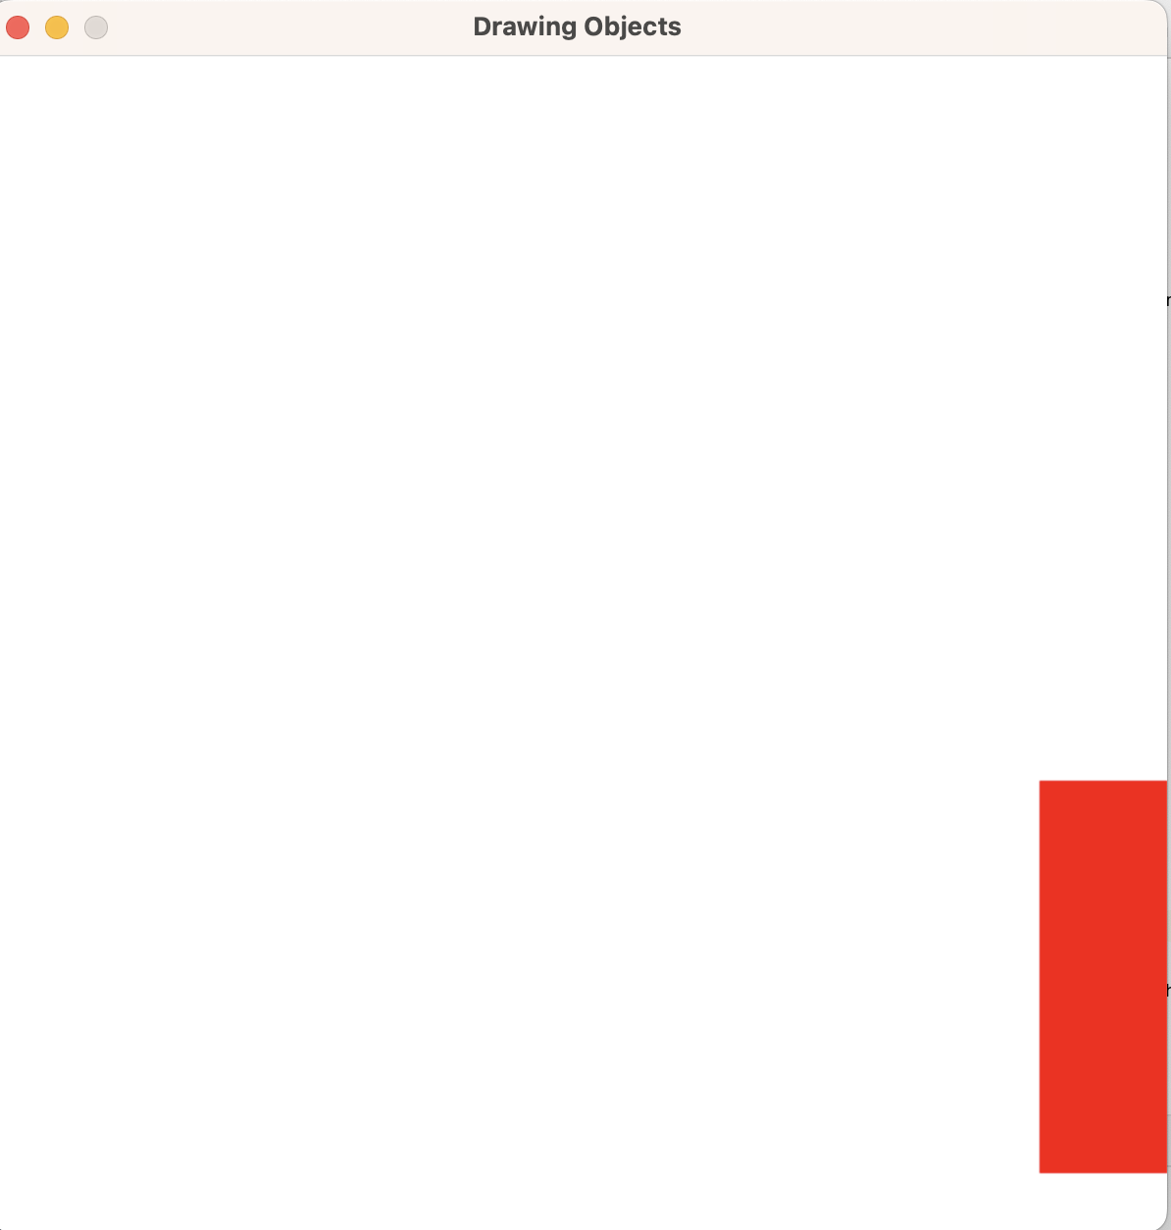
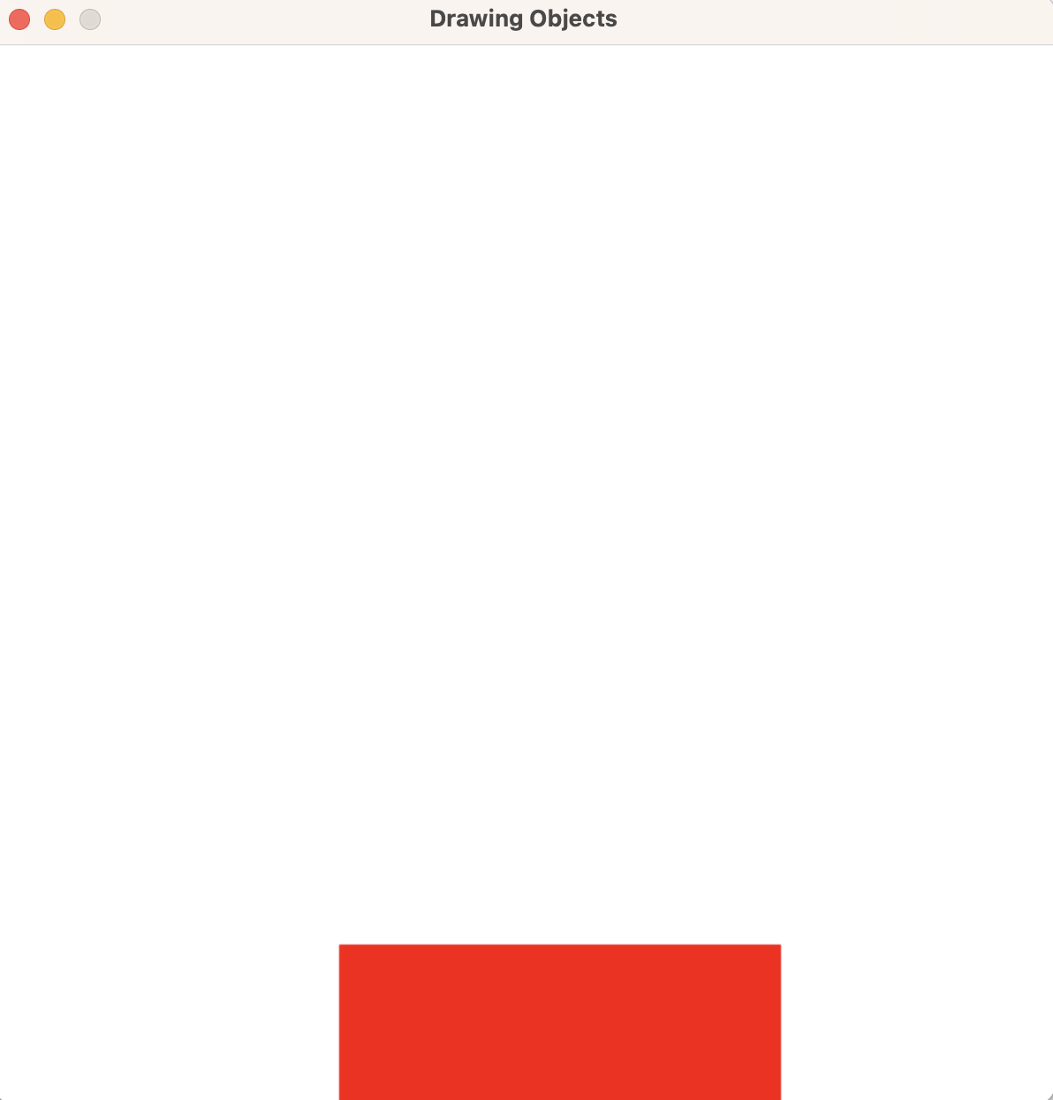
Task 2: Restrict the movement out of screen

Slide 18
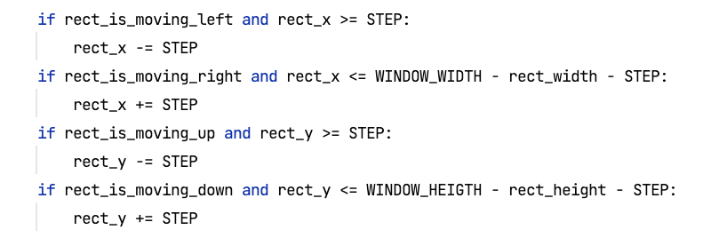
Answer: How to restrict the movement of object out of screen frame

Slide 19
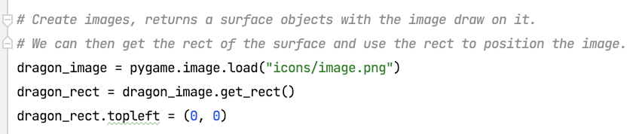
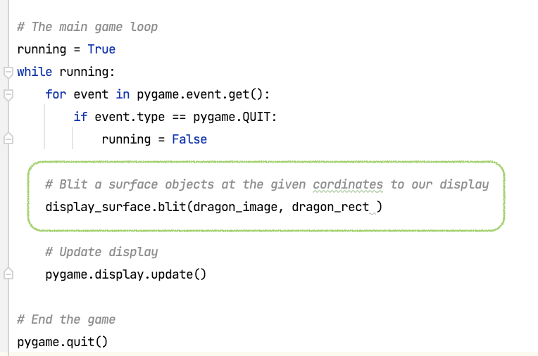
Blitting images
Step 1:
Step 2:
Resource to download icons:
iconarchive.com

Slide 20
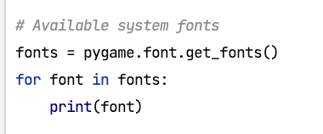
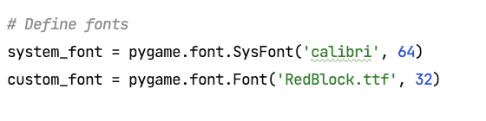
Blitting text: define fonts
Step 1:
Step 2:
Resource to download fonts:
fontspace.com/

Slide 21
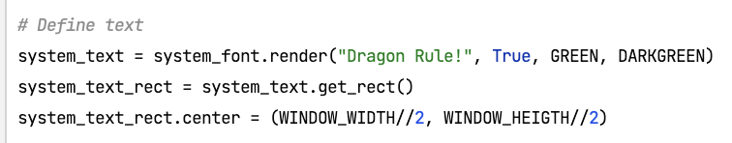
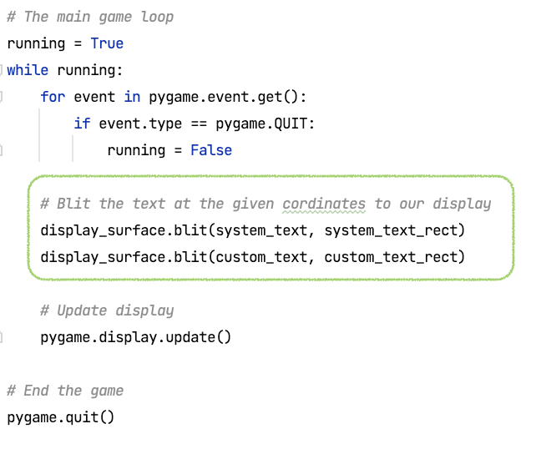
Blitting text: Blit the text on the screen
Step 1:
Step 2:

Slide 22
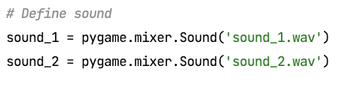
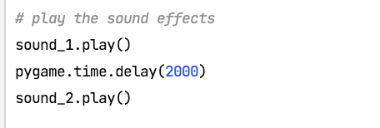
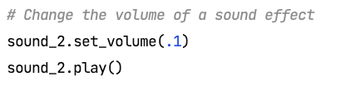
Add sound effects and music: define sounds effects, set volume
Step 1:
Step 2:
Resource to download sound effects:
leshylabs.com

Slide 23

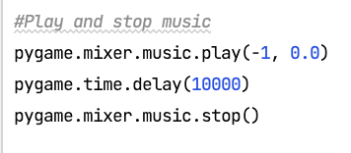
Add sound effects and music: make a background music
Step 1:
Step 2:
Resource to download sound effects:
leshylabs.com

Slide 24
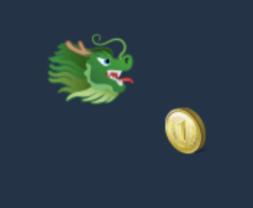
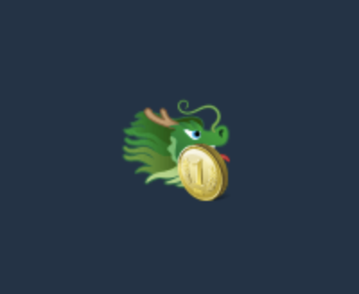
Collision Detection:
Let’s detect when the objects are touching each other:

Slide 25
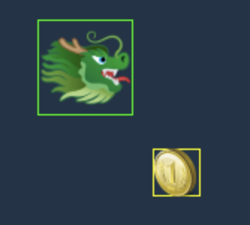
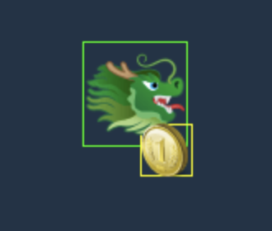
Task 3: Lets draw rectangles to show the rect frame of our objects

Slide 26
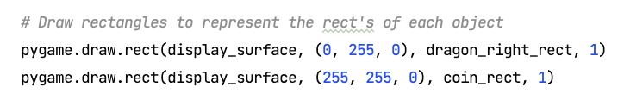
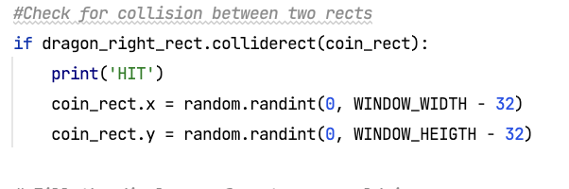
Collision Detection:
Step 0: Lets draw rectangles to show the rect frame of our objects
Step 1: detect when the objects to collide each other and make some actions with them

Slide 27
One more crucial things!

Slide 28
FPS

Slide 29
Conclusion
Congratulations, great game design is now within your reach!
Thanks to Python and a buffet of highly capable Python game engines, you can create your first computer game much more easily than before

Slide 30

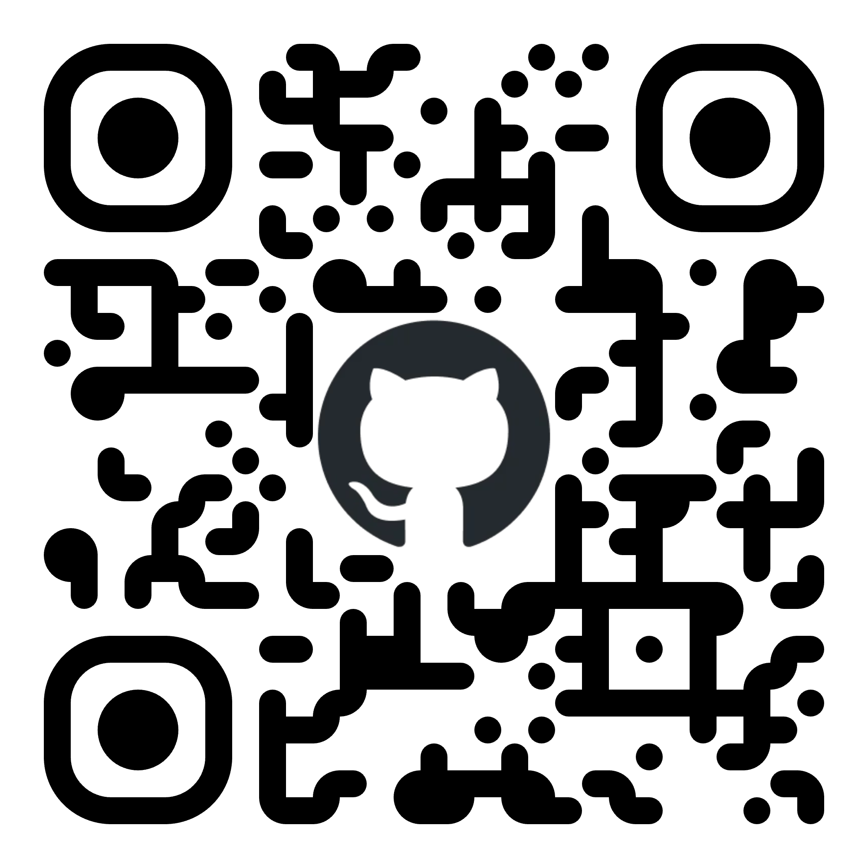
Thank you! Let’s keep in touch
https://www.linkedin.com/in/halloweex
https://github.com/halloweex

