Slide 1
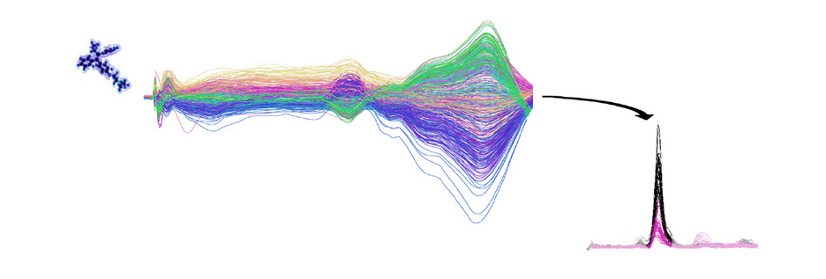
R-Workflow for LC-MS Data Processing

Slide 2
An R-based workflow for processing LC-MS data
Based on XCMS (Scripps) and packages from ImageScope (Nick Bond)
Modified and combined to provide an automated LC-MS data processing workflow using R
Minimal user input
Some parameters require user decision
We will go through the overall workflow, user input and some test data (thanks Frank)

Slide 3
Overall workflow – lcms.R
Setup working directories
Read input files
Packages required
mzR
xcms
reshape2
Read library files
Functions
makelibrary
deisotoping
annotating
Make lipid library
Load functions
XCMS
Prepare output

Slide 4
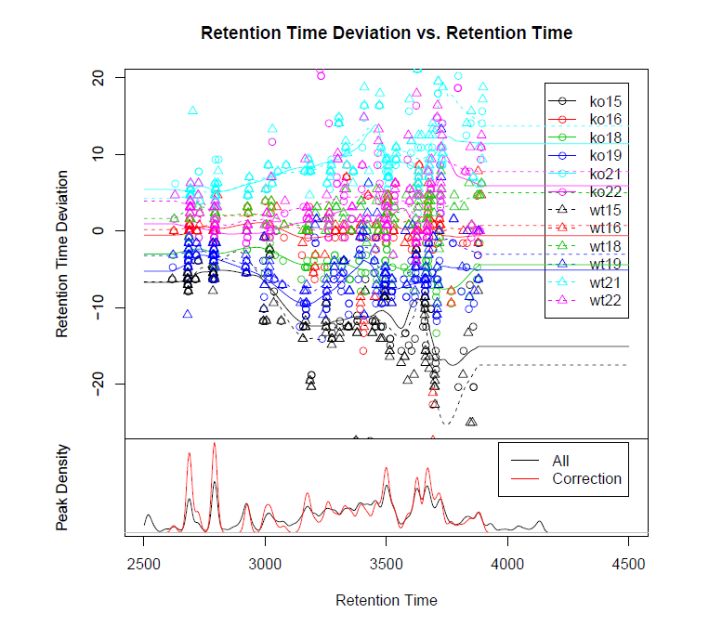
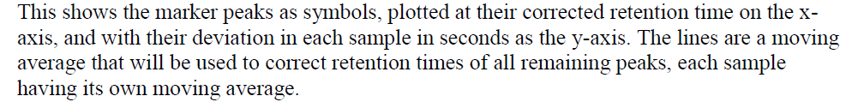
XCMS workflow
Filter and
Identify Peaks
(xcmsSet)
mzML
Data
Match Peaks
Across Samples
(group)
Post-processing
& Output
Retention Time
Correction
(rector)
Post-processing
& Output
Fill in Missing
Peak Data
(fillPeaks)

Slide 5
Post-Processing and Output
“xcms_peak_area_raw.xls”
Raw output
“xcms_peak_height_raw.xls”
Deal with missing peaks
NA -> 0
NA -> integrate noise
“xcms_peak_area_raw_deisotoped.xls”
Deisotope
“xcms_fill_peak_area_raw_deisotoped.xls”
“final_annotated_deisotoped.xls”
Annotate
“final_annotated_deisotoped_fill.xls”
“final_annotated_deisotoped_norm.xls”
Normalise (TIC)
“final_annotated_deisotoped_fill_norm.xls”

Slide 6
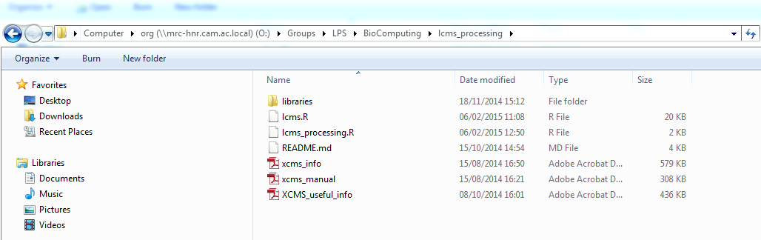
Where can I find the relevant files?

Slide 7
Where can I find the relevant files?

Slide 8
Where can I find the relevant files?

Slide 9
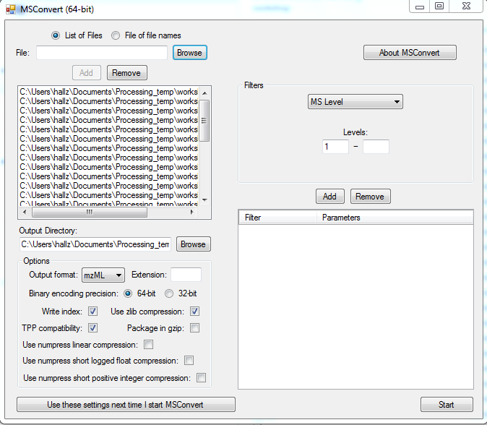
Step 1: Convert .raw files to mzML format
MSConvert from ProteoWizard
Best to exclude blanks/failed injection etc
mzML files in one folder, ensure no subdirectories.

Slide 10
Step 2: Open up lcms_processing.R in R studio

Slide 11
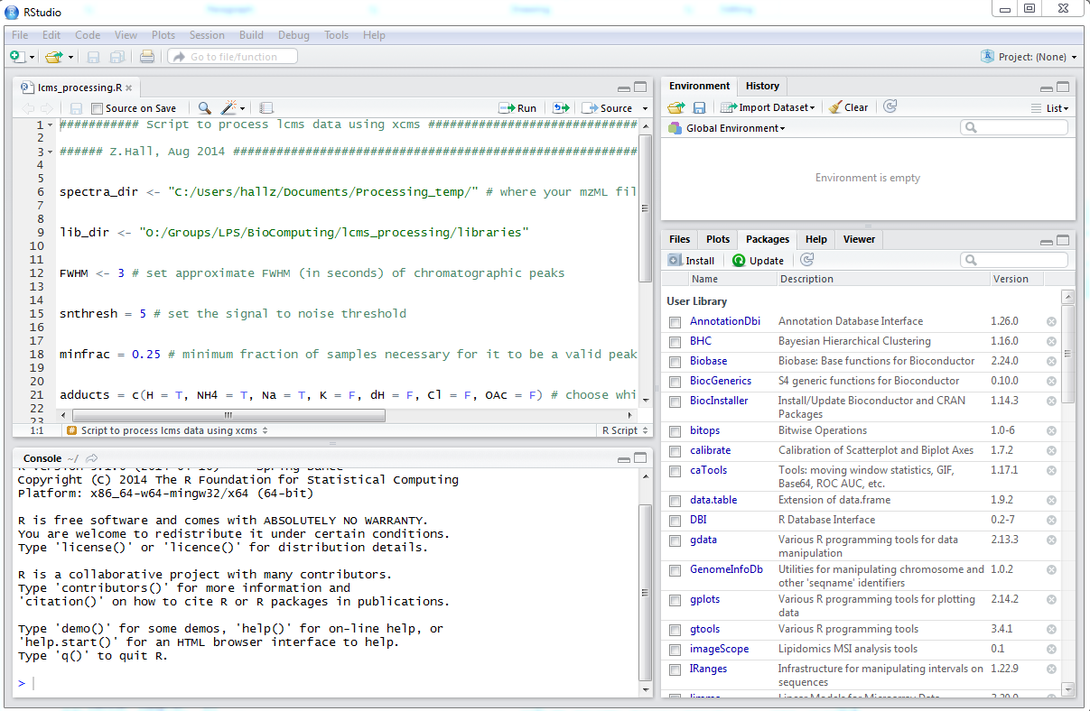
Open Rstudio – Check/Install packages
> install.packages(reshape2)
> install.packages(Rcpp)
> source(“http://Bioconductor.org/biocLite.R”)
> biocLite(“mzR”)
> biocLite(“xcms”)

Slide 12
Step 2: Open lcms_processing.R in R studio
Open script
Run current line of script
Run whole script
Stores variables/functions
Your script
Click tabs for:
packages
plots
help …
Interactive
console

Slide 13
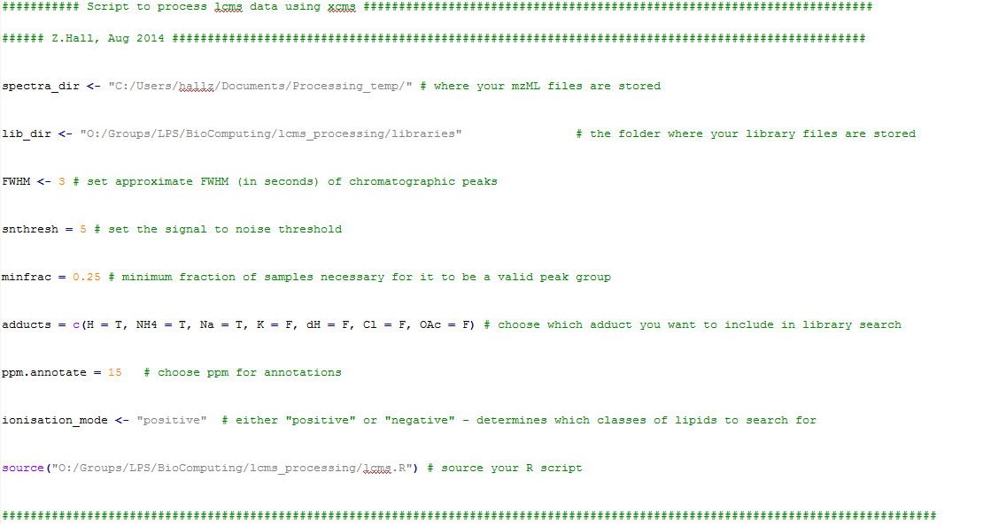
Step 3: Set up some basic parameters

Slide 14
Step 3: Set up some basic parameters

Slide 15
Step 3: Set up some basic parameters

Slide 16
Step 3: Set up some basic parameters

Slide 17
Step 2: Set up some basic parameters

Slide 18
Step 3: Set up some basic parameters

Slide 19
Step 4: Submit batch for processing
Once happy with settings in lcms_processing.R, select all the text and click “Run” or click “Source”:

Slide 20
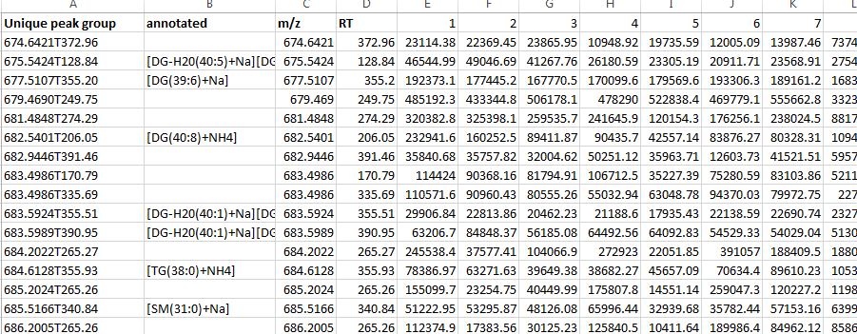
Step 5: Review output files and filter as desired
Unique ID
Lipid ID
m/z
Retention time
Sample intensity values

Slide 21
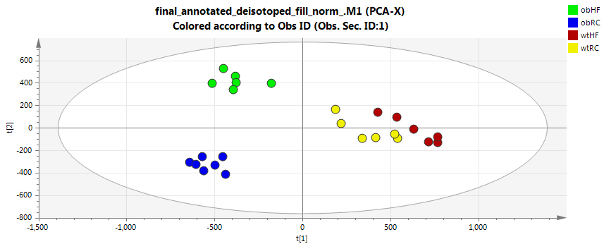
Step 5: Review output files and filter as desired
Normalise to TIC
Pareto scale
PCA plot
1-7 (obHF) 8-14 (obRC) 15-20 (wtHF) 21-26 (wtRC)

Slide 22
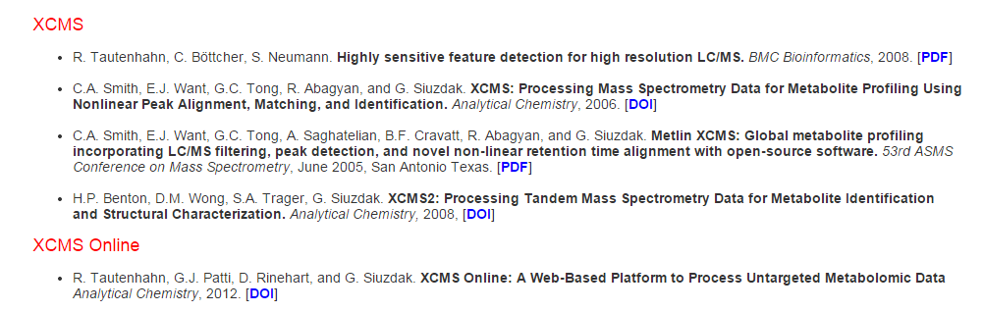
Further reading
https://metlin.scripps.edu/xcms/publications.php
https://metlin.scripps.edu/xcms/xcmsPreprocess.pdf
http://www.bioconductor.org/packages/release/bioc/html/xcms.html

Slide 24
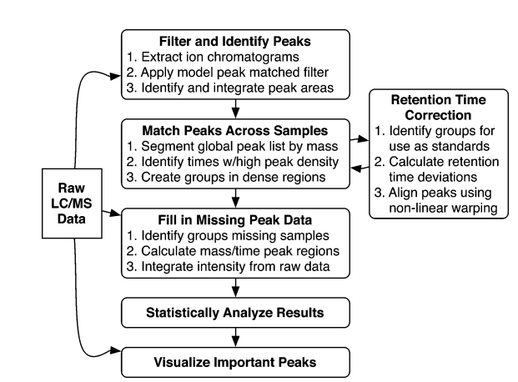
XCMS Overview

Slide 25
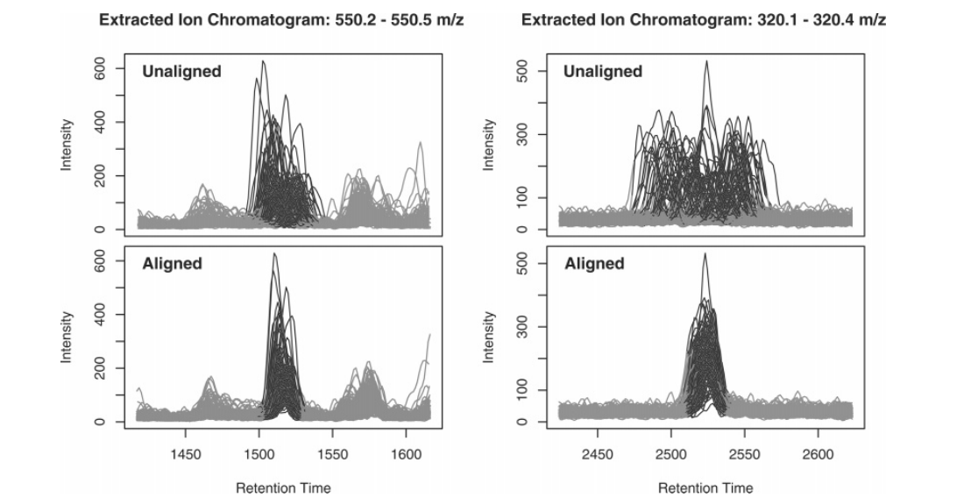
Retention Time Correction

Slide 26
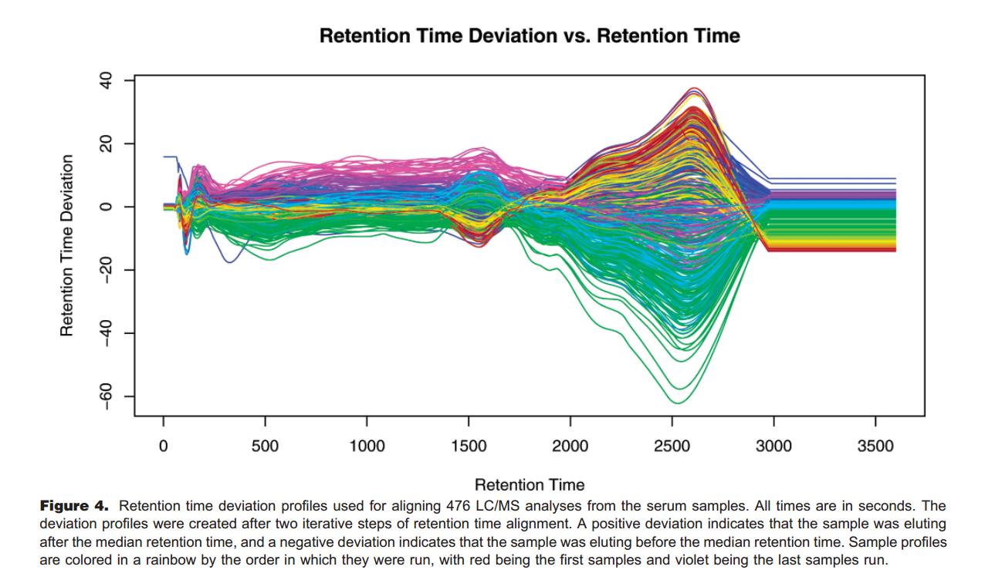
Retention Time Correction

