Slide 1







Glam Perfected Statebybment
GlamPerfectors

Slide 2
What are we trying to solve? The Problem
Applying eyeliner evenly and symmetrically on both eyes.
Need for steady hands, accurate judgment of symmetry, and consistent application technique.
Prone with errors, leading to uneven lines, mismatched thickness, or incorrect angles between the two eyes.
Time-consuming and frustrating process.

Slide 3
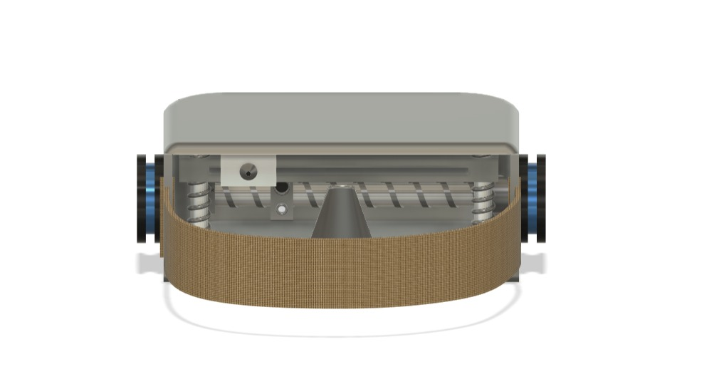
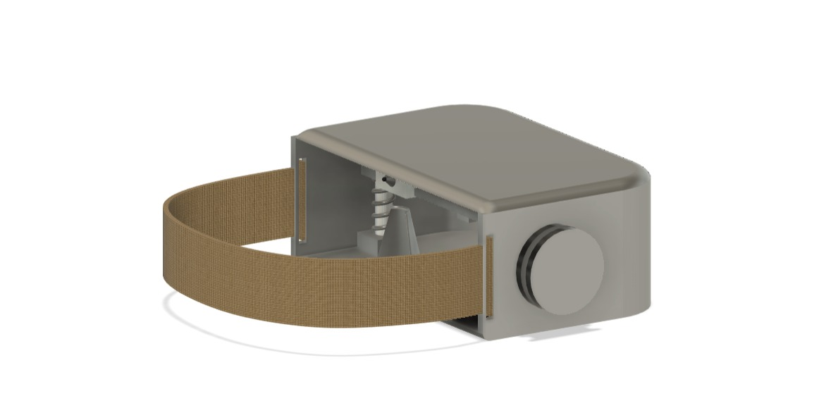
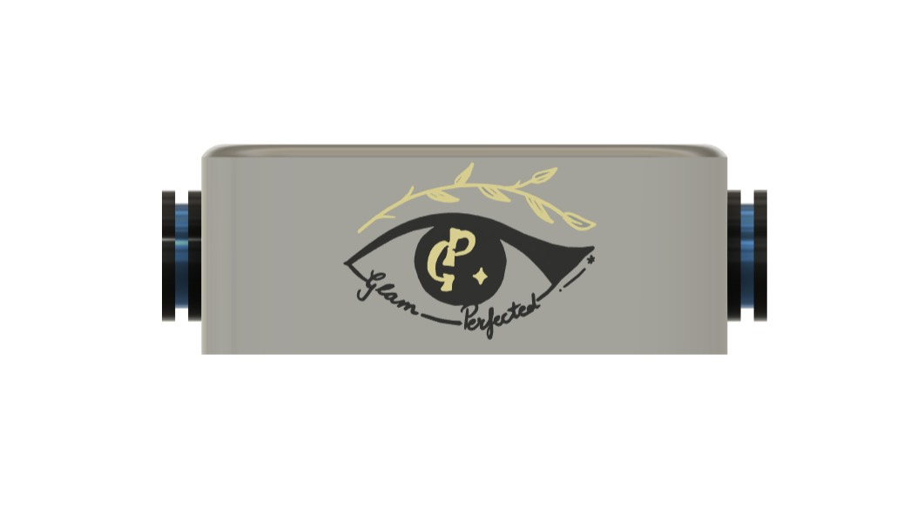
Our Product

Slide 4
What are we using? Our Core Concepts
Precision Engineering for controlling movement and planning paths.
Computer Vision for facial recognition, edge detection, and symmetry analysis.
User Interface that allows user to easily control the device, select eyeliner styles, and receive feedback during the application process.

Slide 5
Working of Glam Perfected
The device has a nozzle with eyeliner inside attached to a moving platform that can move in X, Y, and Z axis, the motors are connected to a microcontroller.
When a user puts the device on, An IR sensor activates and it moves along the direction of the axis, and understands the distance between every points of the face.
These points are then scanned and a 3d model of that portion of the face is made in the software of the microcontroller like Raspberry Pi.
After processing that data, a G-code is made for the motors to understand when and where to move to create the pattern The selected pattern will be drawn on the eyelids of the user by the nozzle.

Slide 6
OUR AIM Creating a tool for perfect eyeliner application.
Ensuring perfectly symmetrical and precise eyeliner, no matter the skill’s level.
Reduce Time and effort.
Make eyeliner application easier for people with unsteady hands, and visual impairments.
Help users feel more confident with consistent, polished results.
Introduce a new product that could set trends and raise standards in the beauty industry.

Slide 7
Target Audience
Makeup Enthusiasts and Professionals
Beginners in Makeup Application
People with Unsteady Hands
Busy Individuals
Innovative Beauty Product Consumers
Cosmetic and Beauty Brands

Slide 8
Competitive Advantage
The innovation of automating or assisting with eyeliner application can set the brand apart from competitors who only offer traditional makeup tools.
This ease of use can attract a broad audience, including those who struggle with traditional application methods.
The device could offer customizable settings (e.g., different eyeliner styles, thickness levels, or application angles) to cater to individual preferences.
The technology developed for this device could be adapted for other makeup applications (e.g., eyebrow shaping, lip liner application).

Slide 9
Thank you
Vanshika 229311041 vanshika.229311041@muj.manipal.edu
Shreya 229310154 shreya.229310154@muj.manipal.edu
M. Suraj Sudhesh 229403005 m.229403005@muj.manipal.edu

