Slide 1

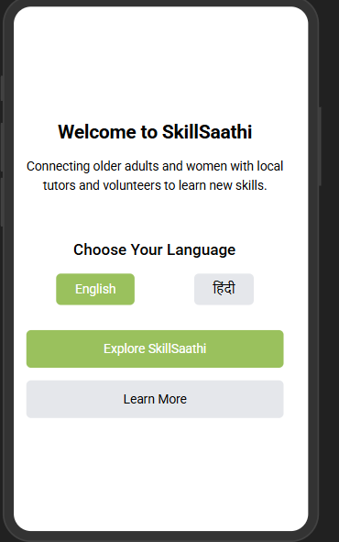
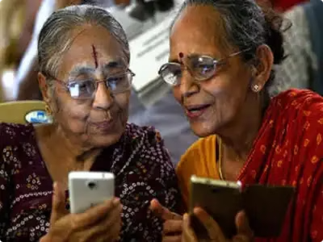
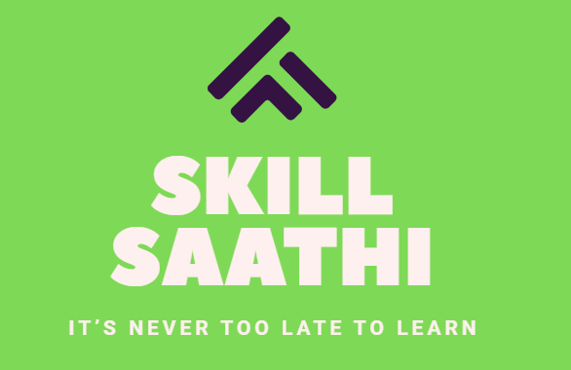
SkillSaathi: It's Never Too Late to Learn
Bridging educational gaps for marginalized learners. Empowering older adults and women through technology. Connecting knowledge seekers with passionate volunteers.

Slide 2
The Learning Opportunity Gap
Millions of older adults and women in India want to learn, but face barriers.
Access Barriers
Systemic Issues
65% of women in rural areas lack access to continued education.
Traditional education systems overlook mature learners.
Older adults face significant learning and skill development barriers.
Digital literacy remains a critical challenge for many communities.
Volunteers willing to teach—but no matching platform
Rural learners lack access to structured learning & mentors
These gaps highlight the urgent need for accessible and inclusive learning solutions.

Slide 3

SkillSaathi: Our Proposed Solution
A mobile app & learning ecosystem that connects women and older adults to volunteers and tutors based on skill, language, and location.
Platform
Learning
Mobile and web platform connecting learners with volunteer tutors.
Personalized learning paths for diverse skill development.
Opportunities
Low-cost educational opportunities.
SkillSaathi offers an inclusive, technology-enabled learning ecosystem to bridge these gaps.

Slide 4

Key Platform Features
🧑‍💻 Volunteer dashboard (for scheduling & tracking learners)
🌐 Multi - language support
🎯 Skill-specific learning (like English, tailoring, finances, smartphone use)
📍 Location-based tutor/volunteer matching
⭐ Encouragement through badges, certificates

Slide 5

User Journeys
1.Woman Learner (Homemaker or Adult Woman)
Chooses skill → Finds tutor near her → Learns in preferred language
2.Older Adult Learner
Gets help using the app → Picks interest area → Matches with local guide
3.Tutor/Volunteer (College students, local educators)
Registers → Lists skills & location → Matches with learners
.

Slide 6
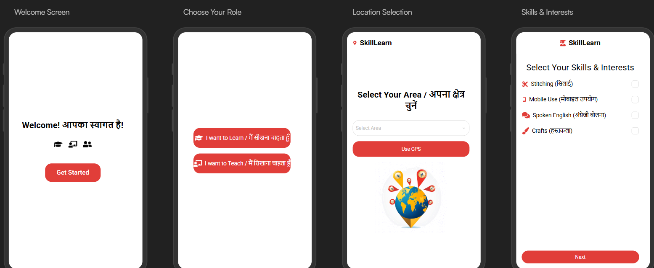
Mockup Samples

Slide 7




Partnerships and Reach
NGO
CSR
Collaborations with NGOs and educational institutions
Corporate social responsibility (CSR) engagement
1
2
4
3
Gov
Reach
Government skill development program alignments
Target: 5000 learners in the first year
Strategic partnerships will enable national and international expansion.

Slide 8
Innovation and Scalability
📱 India-first inclusion tech for non-digital-savvy learners
🔄 Scalable in both urban slums and rural villages
💬 Localized & inclusive: Regional language, cultural relevance
💡 Volunteer-powered model: Cost-effective and community driven
🧩 Customizable modules for skills (spoken English, sewing, digital literacy, etc.)
.

Slide 9

Societal Impact and Vision
Area
Impact
Elder Empowerment
Helps them learn, connect, and feel included
Women Empowerment
Creates access for homemakers & rural women
Mental Wellbeing
Reduces isolation & boredom
Youth Engagement
Promotes intergenerational learning
Digital Literacy
Enables confident use of phones & apps
SkillSaathi's long-term vision is an inclusive, accessible education system that democratizes education across age and gender.

Slide 10
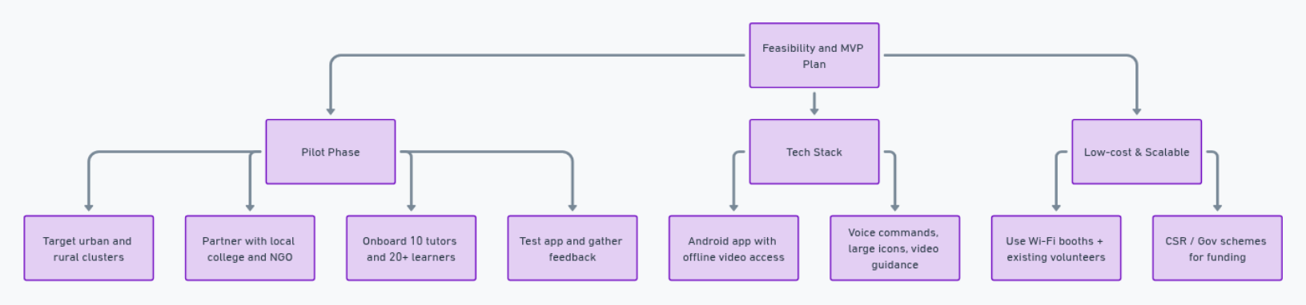
Feasibility and MVP Plan
Pilot:
Target one urban and one rural cluster
Partner with local college + NGO
Onboard 10 tutors, 20+ learners
Test app + feedback loop
Tech Stack:
Android app with offline video access
Tutor dashboard (basic web portal)
Voice commands, large icons, video guidance
Low-cost & Scalable
Wi-Fi booths + existing volunteers
CSR / Gov schemes to fund hardware or content

Slide 11


Conclusion
SkillSaathi is more than an app—it’s a learning movement
It fosters dignity, growth, and independence for those often left behind
Join us in bringing equal learning opportunities to all, regardless of age or gender 🌱
Thank You
Vanshika - vanshikat260@gmail.com
Sagnik Gangopadhyay - amayamix24@gmail.com

