Slide 1
IOT LAB PROJECT
Presented by: Ha Long Do Manasik Hassan
Meshal Iqbal Shah Nafisah Abdulkadir Abidemi
Advised by:
KUBLER Sylvain

Slide 2
CONTENTS
INTRODUCTION
SYSTEM ARCHITECTURE
RANKING ALGORITHM
RESULTS AND VISUALIZATION

Slide 3
1.
INTRODUCTION

Slide 4

PROJECT OBJECTIVES
To build a web application that allows users to select rooms based on certain comfort metrics.
To provide rooms ranking using two different Multi Criteria Decision Making algorithms.

Slide 5
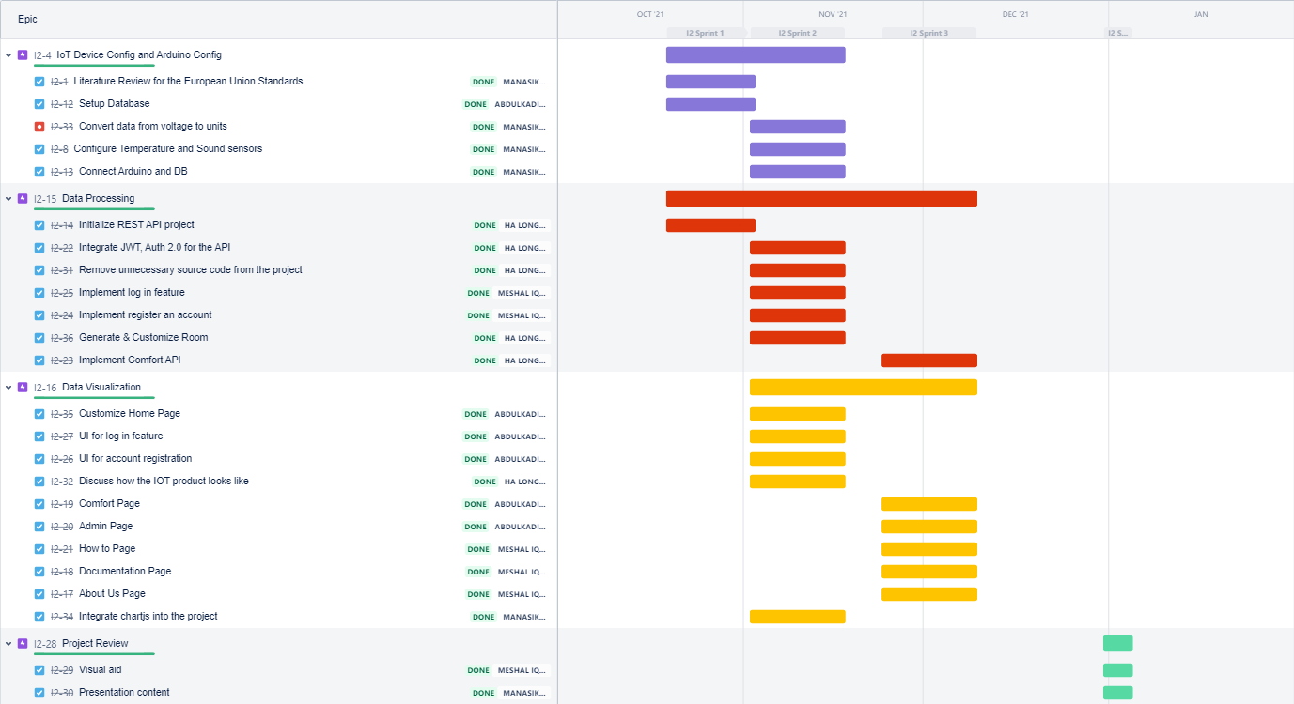
PROJECT TIMELINE

Slide 6
2.
SYSTEM ARCHITECTURE
DEVICES AND PROTOCOLS

Slide 7









Data Storage
UDP
Client-Server
TCP/IP
Worker
Data Acquisition
User

Slide 8
DATA ACQUISITION, and DATA STORAGE
Our Idea
Data collection using Python: (Arduino sensor data, mobile phone and online dataset resource*).
UDP client/server setup on python/arduino.
Send collected data to MongoDB.
Justification
Python is convenient for data collection and processing, and also for communicating with the database.
Different data sources to provide accurate and wide range of data.
MongoDB is a highly powerful DB, its a document oriented DB that stores data from any context.
*GAMS Indoor Air Quality Dataset

Slide 9
WEB APPLICATION - BACKEND
Our Idea
Using spring boot.
REST API
JWT (JSON Web Token)
Justification
Java spring boot is ideal for developing enterprise application, especially a data-centric and processing application like IOT.
REST API is stateless, ideal for client/server model, and easy to use.
JWT to securely transfer information between any two bodies.

Slide 10
WEB APPLICATION - FRONTEND
Our Idea
Using Reactjs
HTTP - TCP/IP
Justification
Most popular frontend framework.
Flexible, easy to manage and use, and scalable.
Potential for developing mobile applications (Future work).
HTTP provides user friendly interface.
HTTP can provide all the CRUD methods.

Slide 11
WORKER
Our Idea
Python code that runs every 5 minutes to update the grade of all rooms from A-F ( excellent - worse) based on all comfort metrics.
Justification
Automatically grading mechanism by the system based on EU Standards, regardless of user preferences.

Slide 12
3.
RANKING ALGORITHM
BASED ON DIFFERENT METHODS

Slide 13
RANKING BASED ON
EUROPEAN COMFORT
STANDARDS
 | TEMPERATURE | LIGHT | NOISE | HUMIDITY | RANK BASED ON WORKER
1ST | OK |  | OK | OK
 | 22.38 | 779 | 30 | 33.44 | 4/B
2ND | OK |  | NOT OK | OK
 | 22.38 | 450 | 43.57 | 37.71 | 3/B
3RD | OK |  | NOT OK | OK
 | 22.54 | 776 | 73.68 | 40.64 | 3/C
4TH | NOT OK |  | NOT OK | OK
 | 11.83 | 538 | 55.97 | 45.83 | 2/D
5TH | NOT OK |  | NOT OK | NOT OK
 | 12.25 | 155 | 79.25 | 29.98 | 1/F
6TH | NOT OK |  | NOT OK | NOT OK
 | 11.42 | 41 | 56.36 | 66.27 | 1/F
ALGORITHM
User Selects preferred comfort metrics.
For each room:
Case 1: For each one of the selected metrics:
If value correspond to EU Standards:
Add 1 point to room grade.
Else:
Nothing is added.
Case 2: For each of the disabled metrics:
Add 1 point to room grade
Sort the rooms in Descending order.
EU comfort standards:
TEMPERATURE (WINTER) : 20 - 24 degree celsius
TEMPERATURE (SUMMER) : 24 - 27 degree celsius
LIGHT: 300 - 500 LUX NOISE: >= 40dB HUMIDITY: 30 - 60%

Slide 14
AHP ALGORITHM BASED ON USER
PREFERENCE
MATRIX BASED ON USER SELECTION
 | TEMPERATURE | LIGHT | NOISE | HUMIDITY
TEMPERATURE | 1 | 1 | 1 | 1/9
LIGHT | 1 | 1 | 1 | 1/9
NOISE | 1 | 1 | 1 | 1/9
HUMIDITY | 9 | 9 | 9 | 1
SUM | 12 | 12 | 12 | 1.333
IMPORTANCE LEVELS
-9 (1/9) : Absolutely less important
-7 (1/7) :Very much less important
-5 (1/5) : Much less important
-3 (1/3) : Somewhat less important
1 : Equal Importance
3 : Somewhat more important
5 : Much more important
7 : Very much more important
9 : Absolutely more important
PRIORITY MATRIX
 | TEMPERATURE | LIGHT | NOISE | HUMIDITY | PRIORITY
TEMPERATURE | 0.083 | 0.083 | 0.083 | 0.083 | 0.0833
LIGHT | 0.083 | 0.083 | 0.083 | 0.083 | 0.0833
NOISE | 0.083 | 0.083 | 0.083 | 0.083 | 0.0833
HUMIDITY | 0.750 | 0.750 | 0.750 | 0.749 | 0.75

Slide 15
AHP ALGORITHM - ROOM RANKING
 | TEMPERATURE | LIGHT | NOISE | HUMIDITY | WEIGHTED SUM
BEST ROOM | OK | OK | NOT OK | OK
 | 22.38 | 450 | 43.57 | 37.71
 | 8.33 | 8.33 | 0 | 75 | 91.67
2ND | OK | NOT OK | OK | OK
 | 22.38 | 779 | 30 | 33.44
 | 8.33 | 0 | 0 | 75 | 91.67
3RD | OK | NOT OK | NOT OK | OK
 | 22.54 | 776 | 73.68 | 40.64
 | 8.33 | 0 | 0 | 75 | 83.33
4TH | NOT OK | NOT OK | NOT OK | OK
 | 11.83 | 538 | 55.97 | 45.83
 | 0 | 0 | 0 | 75 | 75
ROOM RANKING RULES BASED ON EU STANDARDS
OK - 100
NOT OK - 0
EU comfort standards:
TEMPERATURE (WINTER) : 20 - 24 degree celsius
TEMPERATURE (SUMMER) : 24 - 27 degree celsius
LIGHT: 300 - 500 LUX
NOISE: >= 40dB
HUMIDITY: 30 - 60%

Slide 16
AHP ALGORITHM - ROOM RANKING
 | TEMPERATURE | LIGHT | NOISE | HUMIDITY | WEIGHTED SUM
5TH | NOT OK | NOT OK | NOT OK | NOT OK
 | 12.25 | 155 | 79.25 | 29.98
 | 0 | 0 | 0 | 0 | 0
6TH | NOT OK | NOT OK | NOT OK | NOT OK
 | 11.42 | 41 | 56.36 | 66.27
 | 0 | 0 | 0 | 0 | 0
ROOM RANKING RULES BASED ON EU STANDARDS
OK - 100
NOT OK - 0
EU comfort standards:
TEMPERATURE (WINTER) : 20 - 24 degree celsius
TEMPERATURE (SUMMER) : 24 - 27 degree celsius
LIGHT: 300 - 500 LUX
NOISE: >= 40dB
HUMIDITY: 30 - 60%

Slide 17
4.
LIVE DEMO
RESULTS AND VISUALIZATION

Slide 18

Thanks

