Slide 1

Georgia Tech Bootcamp FINAL Project Team Members: Samantha Cassidy Christopher Brownlee Jerome Artis Pean Ralph Tyrone Jenkins

Slide 2
GitFit

Slide 3
Techstack

Slide 4






Techstack
Front End
Back End

Slide 5
1-Column (No Rule) Layout
Subtitle
Text Level 1
Text Level 2
Text Level 3
Text Level 4

Slide 6
2-Column Layout
Subtitle
Subtitle
Text Level 1
Text Level 2
Text Level 3
Text Level 4
Text Level 1
Text Level 2
Text Level 3
Text Level 4

Slide 7
3-Column Layout
Subtitle
Subtitle
Subtitle
Text Level 1
Text Level 2
Text Level 3
Text Level 4
Text Level 1
Text Level 2
Text Level 3
Text Level 4
Text Level 1
Text Level 2
Text Level 3
Text Level 4

Slide 8
4-Column Layout
Subtitle
Subtitle
Subtitle
Subtitle
Text Level 1
Text Level 2
Text Level 3
Text Level 4
Text Level 1
Text Level 2
Text Level 3
Text Level 4
Text Level 1
Text Level 2
Text Level 3
Text Level 4
Text Level 1
Text Level 2
Text Level 3
Text Level 4

Slide 9
Containers
Use these containers for short callouts or simple content, right click and choose “Edit Text”

Slide 10
2-Column Table
Subtitle
Subtitle
Category 1 | Text |  | Text
Category 2 | Text |  | Text
Category 3 | Text |  | Text

Slide 11
3-Column Table
Subtitle
Subtitle
Subtitle
Category 1 | Text |  | Text |  | Text
Category 2 | Text |  | Text |  | Text
Category 3 | Text |  | Text |  | Text

Slide 12
4-Column Table
Subtitle
Subtitle
Subtitle
Subtitle
Category 1 | Text |  | Text |  | Text |  | Text
Category 2 | Text |  | Text |  | Text |  | Text
Category 3 | Text |  | Text |  | Text |  | Text

Slide 13
Solid Table
Subtitle
Table Heading
Text

Slide 14

Section Title over dark image

Slide 15

Section Title over light image

Slide 16
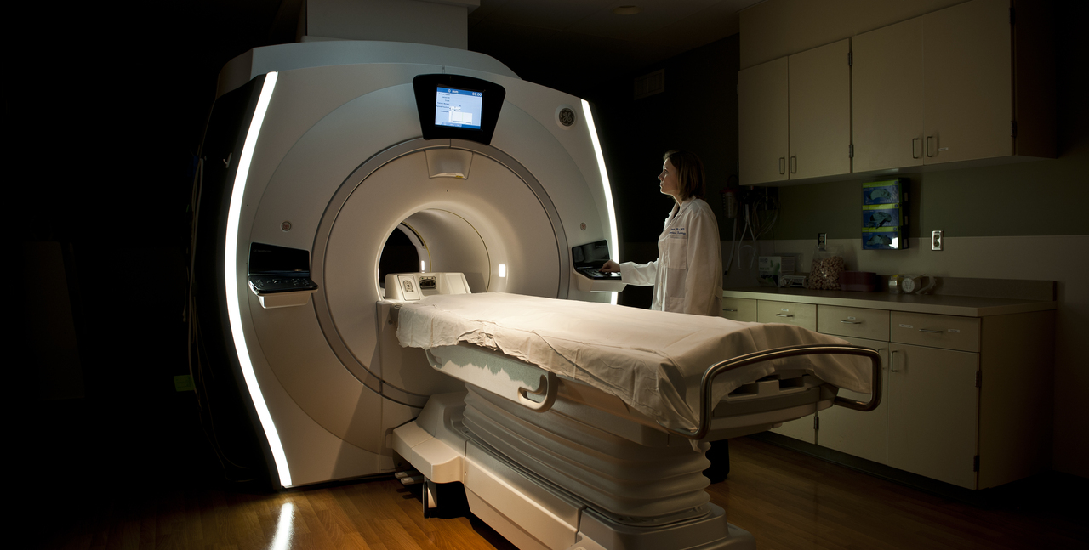
Image

