Slide 1
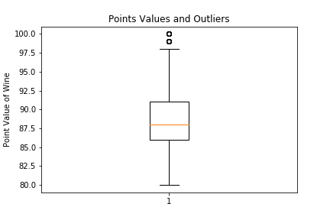
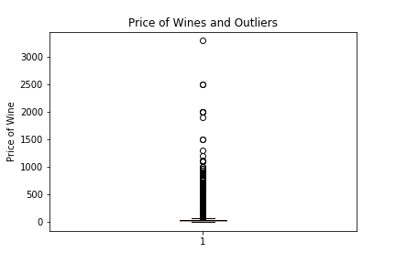
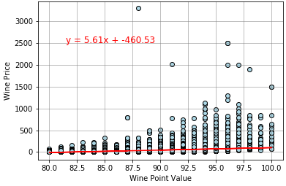
120,916 wines in analyss
7,241 outliers in the price of the wine
Most Wines between $17 and $42 a bottle
There is a small .42 correlation between price and point value of the wines
Price / Point comparison (all wines)

Slide 2
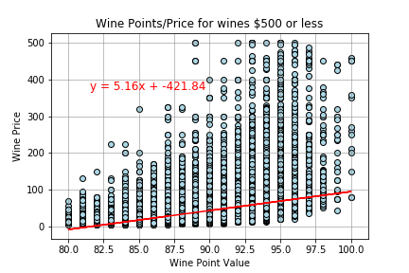
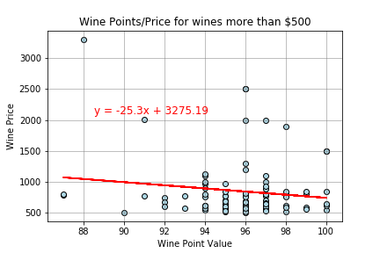
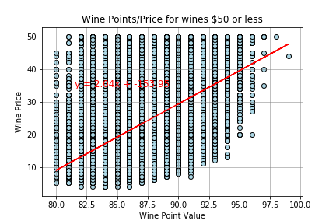
Analyzed based off pricing
<$50
<$500
>$500
There is a stronger correlation between price and point value for cheaper wines
Expensive (>$500 bottle) have a negative correlation
Findings: You will find plenty of high quality wines on a budget, no need to go expensive.

