Slide 1
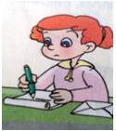

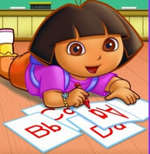
The Most Common Errors in College Students’ Writing
Course: College English-----Writing
Teacher: ...
Students: Non-English majors
University: GUET

Slide 2
Object：learn to revise essays
Content: common writing mistakes
Exercise：revising exercises

Slide 3
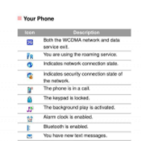
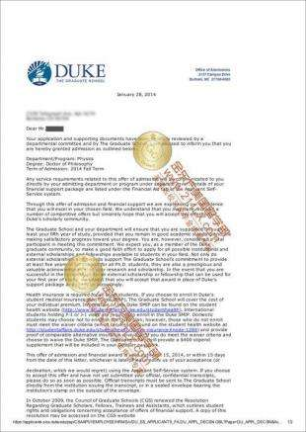
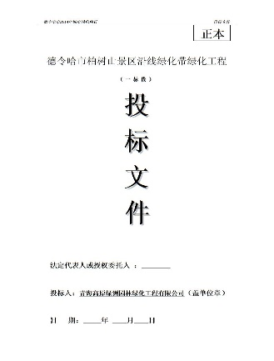

introduction
Writing can show the writer’s language level, views on life and the world, personality, …
Writing can make your mind clear, logic, help you find a job, finish the job, and improve your professional title…

Slide 4


Websites can be used to search information, check up dictionaries, even help translation and writing, but requires revision.

Slide 5
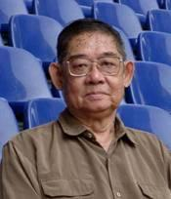
Gui Shichun’s Investigation into Errors
中国学习者英语失误表（频数大于4%者）
失误类型 | 总计 | 百分比
拼写
10440
17.4%
替代
5697
9.49%
大小写
3481
5.8%
结构性缺陷
3178
5.3%
标点符号
2747
4.58%
缺词
2699
4.5%
词类
2506
4.18%
时态
2429
4.06%

Slide 6
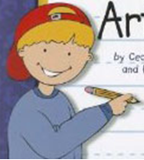
内 容
10 Most Common Errors based on Teaching Experience
1. Capitalizing mistakes 大小写错误
2. Spelling mistakes 拼写错误
3. Punctuation mistakes 符号错误
4. Tense mistakes 时态错误
5. Word form mistakes 词性错误
6. Subject mistakes 主语错误
7. Predicate mistakes 谓语错误
8. Object mistakes 宾语错误
9. Collocation mistakes 词语搭配
10. Confusion of Synonyms 用词错误

Slide 7
Causes of Errors（CE）
Carelessness
Lack of
writing practice
ignorance of CE differences
How to avoid these common writing errors?——Example analysis

Slide 8
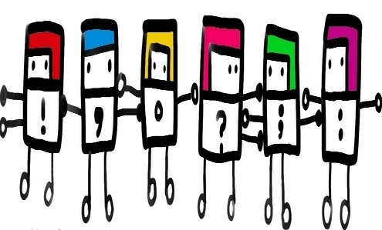
1. Punctuation Errors
1. My Experience of learning a foreign language began in primary school, now, it seems my English is going to stay still.
My Experience of learning a foreign language began in primary school. Now, it seems my English is going to stay still.

Slide 9

2. Spelling Errors
because
2. becauce
√
seize
3. seizing
√
college
4. colledge
√
chooce
5. choose
√
beleive
6. believe
√

Slide 10

3. Tense Errors
7. In my middle school, I have some good friends. They are so friendly and helpful.
In my middle school, I had some good friends. They were so friendly and helpful.

Slide 11

4. Errors in Word Form
8. I successed in my English learning. Now, I want to tell the reasons why I was succeeded.
动词
名词
形容词
副词
介词
连
词
冠
词
I succeeded in my English learning. Now, I want to tell the reasons why was successful.

Slide 13
5. Collocation Errors
9. 做晚饭 do supper
10.犯罪 make a crime
11.保全面子 keep face
12.做诗 make poems
cook supper
commit a crime
Save face
Write poems

Slide 14
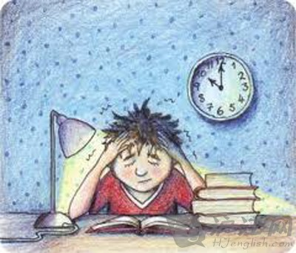
6. Subject Errors
13. For a lot of reasons, leading to I failed the exam.
For a lot of reasons, I failed the exam.

Slide 15

7. Predicate Errors
14. I was got A.
I got A.
15. I worked hard when I sitting in the front of the classroom.
I worked hard when I was sitting in the front of the classroom.

Slide 16

8. Object Errors
16. You can make friend through online communication.
You can make friends through online communication.

Slide 17

9. Confusion of Synonyms
17. I think word is important to who English level is poor.
I think vocabulary is important to them whose English level is poor.

Slide 18
10. Negative Transfer
18. 如果您碰到难题 if you match difficult problem
19. 接触各种人群 to touch all kinds of people
20.你必须有足够的条件
you must have enough conditions
18. If you come across a difficult problem
19. To deal with all kinds of people
20. You must be qualified

Slide 19
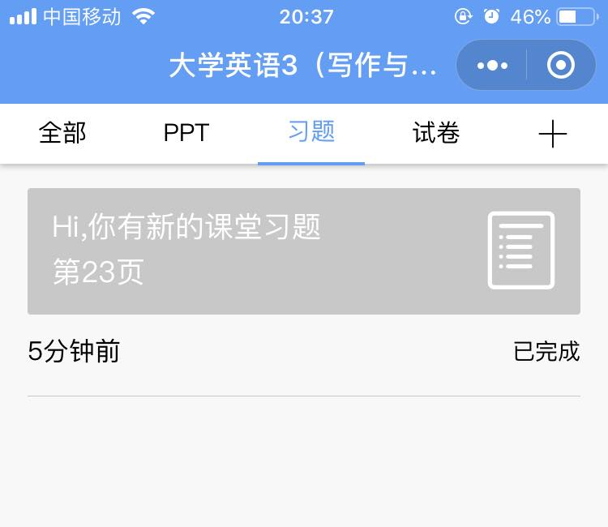
II. Exercise(Wechat+Yuketang)

Slide 20

多选题
1分
To find out mistakes:
As cell phone is expensive and almost everyone can afford it, most people tend to depend on cell phones a lot. Some people believe that cell phones bring them fun, some argue that cell phones will cause disaster. I agree that cell phones faciliate our life.
A
cell phone----a cell phone
B
expensive----inexpensive
C
fun,------fun;
D
faciliate----facilitate
提交

Slide 21
主观题
10分
答案解析
改错1：
people's excessive attention from work or study poses a threat to their physical health and brings bad impacts to their spiritual life.
Pay attention from-----to
bring impacts to-----on
正常使用主观题需2.0以上版本雨课堂
作答
可为此题添加文本、图片、公式等解析，且需将内容全部放在本区域内。正常使用需3.0以上版本

Slide 22
主观题
10分
答案解析
改错2：
People lose themselves in fast food culture , spend more time on scanning smartphone information and less time on paper book reading.
spend ----spending
正常使用主观题需2.0以上版本雨课堂
作答
可为此题添加文本、图片、公式等解析，且需将内容全部放在本区域内。正常使用需3.0以上版本

Slide 23
填空题
2分
Title: How to succeed in college
Beginning :
Everyone wants to be [填空1] and successful. When it comes to succeeding in college, there are some [填空2] you can follow.
正常使用填空题需3.0以上版本雨课堂
作答

Slide 24
参考书目:
桂诗春. 2004. 以语料库为基础的中国学习者英语失误分析的认知模型[J].现代外语》. (4).

