Slide 1
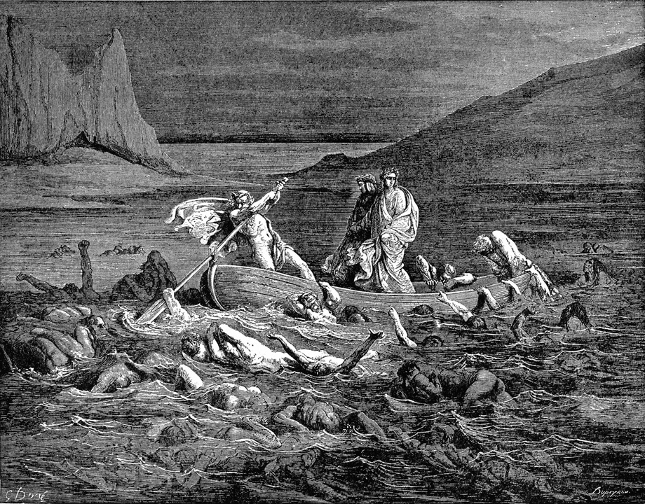
Rhetoric in Limbo
Rhetoric of parody & satire
Unit 3 assignments
style

Slide 2
Part 1: Analyzing Satire

Slide 3
Maybe She’s Born With It
http://www.youtube.com/watch?v=KSjAK3Dzez4
http://www.youtube.com/watch?v=i8lNToO8CMA
Questions:
What argument is the video making? (what is it trying to persuade us of?)
How is the video making its argument? (what strategy is it using?)

Slide 4
Satire & Parody
Parody: An imitation of the style of a particular writer, artist, or genre with deliberate exaggeration for comic effect.
Satire: The use of humor, irony, exaggeration, or ridicule to expose and criticize people’s stupidity or vices, particularly in the context of contemporary politics and other topical issues.

Slide 5
Analyzing Satire
What is being parodied?
What is being exposed / critiqued?
What is the persuasive argument?

Slide 6
Part 2: Intro to Unit 3

Slide 7
Unit 3: Writing Persuasively

Slide 8
Unit 3: Schedule
Tuesday 4-8: Essay 2.2
Tuesday 4-15/17: Presentations
Thursday 4-24: Essay 3.1
Thursday 5-1: Essay 3.2

Slide 9
Essay 3: Persuasive Argumentation
Picking a forum
Analyzing Style
Rebuttal & Concession
Great Writing & What it Does

