Slide 1
A Matter of Feelings
Or: the art of creating persuasive emotions

Slide 2
Writing break: Verbs of Attribution
Problems of repetition…
“Lara Pellegrinelli also writes that…”
“Thomas Ricks writes about…”
“Suzan York… writes about…”
And of meaning…
“He reasons why…”
“He expressed…”
Some alternative terms:
Addresses, discusses, describes, illustrates,
Alleges, argues, claims, declares, reveals, shows, suggests, concludes
Proposes, hypothesizes, speculates
Agrees, concurs
Disagrees, disputes, denies
(see: http://personal.crocodoc.com/YyUDwdO)

Slide 3
Review: Rhetorical Analysis
Rhetorical analysis
Identifying the tools of persuasion (how are they persuading us?)
Analyzing the effect of persuasive tools (why are they persuading us this way?)
Evaluating the effectiveness of persuasive tools (who are they persuading?)
Analysis
The detailed examination of the elements or structure of something, typically as a basis for interpretation.

Slide 4
Review: Approaches to Rhetorical Analysis
Trust
Feelings
Truth

Slide 5


Writing exercise: getting in the door
Notes:
Imagine you are batman. (You do not need to know anything about him aside from what you see on the page, but you can use outside information.) You have recently uncovered a plot whereby a group of Russian spies are planning to take over gotham city. (This is a cold war movie). You need to talk to the city governor, but you’re stopped at the door by a new security guard from out of town who doesn’t know the ropes. Since the information is top-secret, you can’t tell her what’s specifically happening. How do you convince her to let you in? What do you wear? What do you say about yourself?

Slide 6
Establishing Authority
“Situated ethos”: The authority you carry with you
“Invented ethos”: the authority you establish through self-presentation
Commonplaces: what everyone in a given community believes without thinking about it

Slide 7
Three Approaches to Rhetorical Analysis
Trust
Feelings
Truth

Slide 8
The Texas Department of Agriculture
Consumer Protection:
Regulates all fuel pumps in Texas to ensure drivers get the correct quality and amount of fuel
Regulates all weights and measures devices, such as grocery store scales and retail price scanners, to ensure consumers are charged advertised prices
Regulates pesticide use and application from residential to commercial use
Certifies organically-produced products to help ensure consumers have a reliable supply of organic products
Production Agriculture:
Protects agricultural crops, such as citrus and cotton, from harmful pests and diseases
Facilitates trade and market development of agricultural commodities ranging from livestock to crops to ensure Texas remains the nation's leader in the production of cattle, cotton, hay, sheep, wool, goats, mohair and horses
Provides financial assistance to farmers and ranchers in the form of loan guarantees, interest rate reductions and even grants for young farmers
Administers grant funds for agricultural research to develop new technologies
Advocates for policies at the federal, state, and local level that are beneficial to the $106 billion agriculture sector, which comprises 10% of the Texas economy
Healthy Living:
Administers the National School Lunch and Breakfast programs for Texas school children
Fights obesity in Texas through a statewide campaign highlighting the 3E's of Healthy Living - Education, Exercise and Eating Right
Administers assistance to feed the hungry through the Texans Feeding Texans initiative
Economic Development:
Provides tools for communities to attract businesses and pursue other economic development opportunities
Offers infrastructure grants to rural communities
Leads in the development of statewide broadband services
Administers the Certified Retirement Community program to attract retirees to the second leading retirement state in the U.S.
Markets Texas products, cultures and communities through the GO TEXAN branded campaign
(http://www.texasagriculture.gov/)

Slide 9
…More about Texas Agriculture
Texas leads the nation in cattle, cotton, hay, sheep and wool, and goats and mohair production.
Texas leads the nation in number of farms and ranches, with 247,500 farms and ranches covering 130.4 million acres.
Texas also leads the nation in value of farm real estate.
Rural lands, including privately owned forest, total 144 million acres, 86% of the state's total land area.
12% of Texas' population resides in rural areas.
1 of every 7 working Texans (14%) is in an agriculture-related job.
98.5% of Texas farms and ranches are family farms, partnerships or family-held corporations.
The average age of Texas farmers and ranchers is 57 years.
The economic impact of the food and fiber sector totals more than $100 billion annually.
Agricultural cash receipts, including timber, average $20 billion annually.
Top 10 commodities in terms of cash receipts in 2012:
Cattle, $10.5 billion
Cotton, $2.2 billion
Milk, $1.8 billion
Broilers, $1.7 billion
Greenhouse & nursery, $1.3 billion
Corn, $1.2 billion
Grain Sorghum, $594 million
Wheat, $538 million
Vegetables, $439 million
Eggs, $439 million
Agricultural exports to foreign countries totaled nearly than $8 billion in 2011.
Texas ranks # 4 overall in agricultural exports behind California, Iowa and Illinois.
(http://www.texasagriculture.gov/)

Slide 10
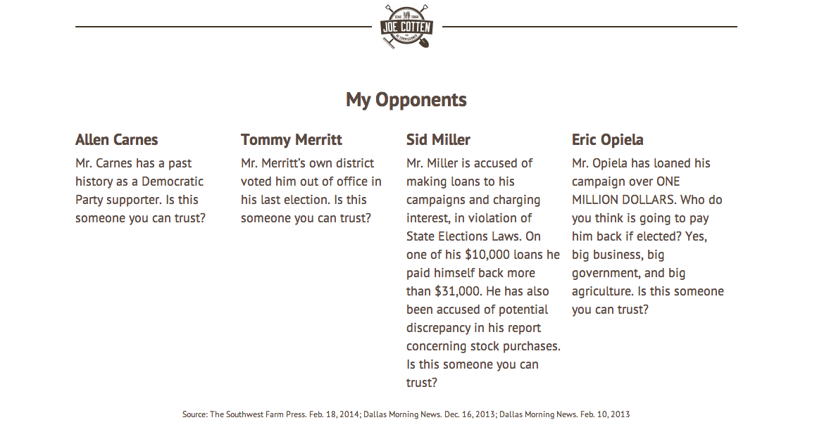
Meet the Republican Candidates for Ag Commissioner (an appeal to ethos)

Slide 11
Analyzing Emotions
What emotions are being evoked, and why?
Emotional Keywords: words that suggest emotional content. Thrilled! Terrified! Saddened! Disappointed!
Honorific Language: Great, wonderful, fabulous, delightful
Disparaging Language: terrible, embarrassing, offensive, stupid
Emotional Connections: Anecdotes, references, images, music

Slide 12
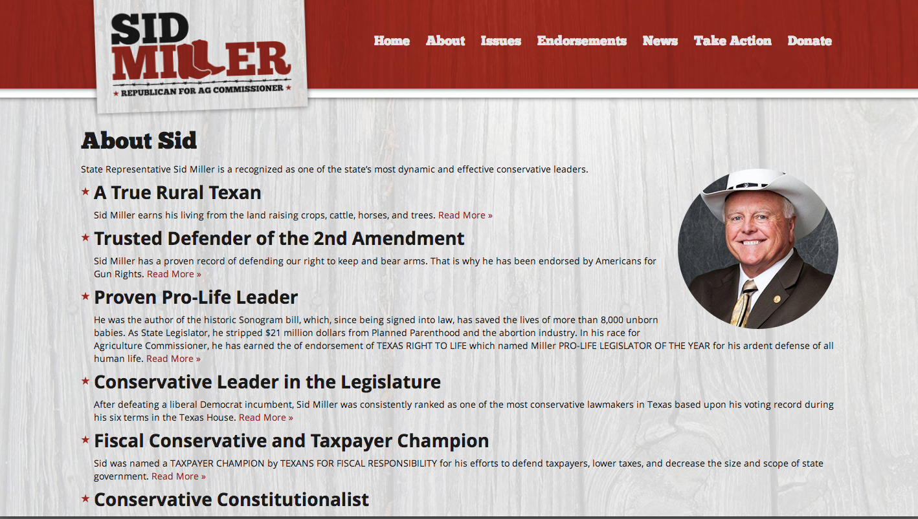
Meet Sid Miller
http://www.millerfortexas.com/

Slide 13
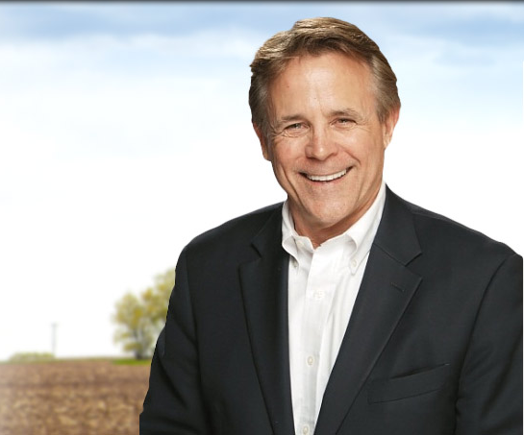
Meet Joe Cotten
http://youtu.be/AfcdCpu0TWA

Slide 14

Meet J. Allen Carnes
https://jcarnesfortexas.com/

Slide 15
Daily Recap
Ethical appeals:
The art of sounding trustworthy
situated & invented
Commonplaces
Emotional appeals:
The art of producing emotions
Emotional keywords,
Disparaging/honorific language,
Emotional connection
Analysis
The detailed examination of the elements or structure of something, typically as a basis for interpretation.

