Slide 1
A Brief History of Science (writing)
Hannah Alpert-Abrams
Fall 2014

Slide 2
Review: What is Rhetoric?
“The art of using language effectively so as to persuade or influence others” … “the study of principles and rules to be followed by a speaker or writer striving for eloquence”
The analysis of language as a means of persuasion.

Slide 3
Review: What is Science?
A branch of study that deals with a connected body of demonstrated truths or with observed facts systematically classified and more or less comprehended by general laws, and incorporating trustworthy methods (now esp. those involving the scientific method and which incorporate falsifiable hypotheses) for the discovery of new truth in its own domain.

Slide 4
Has science always been the same?
How has the meaning of science changed over time?
How has the way we talk about science changed over time?

Slide 5
Science in history
“Viewing science through the lens of historicism, as a social formation, to be studied as one would study other social formations.” (cambridge history of science)

Slide 6
The “Scientific Revolution”
Medieval Science: not exactly “science”… but they still learned a whole lot of things
Early Modern Science (1490-1730)
Efforts to explain natural phenomena using reason
Emphasis on observation
Efforts to describe & catalogue the world

Slide 7
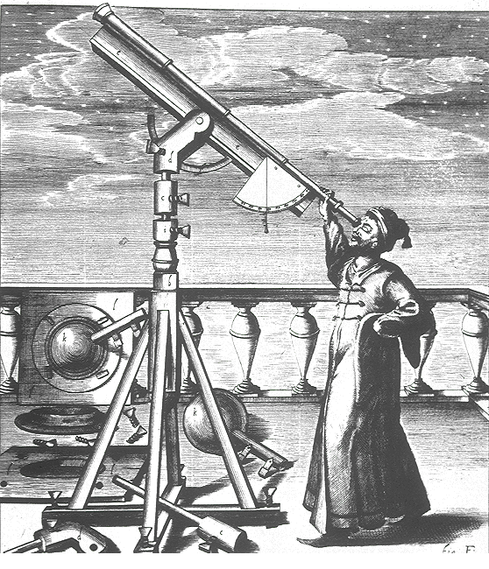
Example: Astronomy & Astrology
Concerned with the measurements of the cosmos (not its meanings)
Supporting astrology & medicine in the courts
Galileo and Kopler: objects in the heavens obey the same laws as things on earth

Slide 8
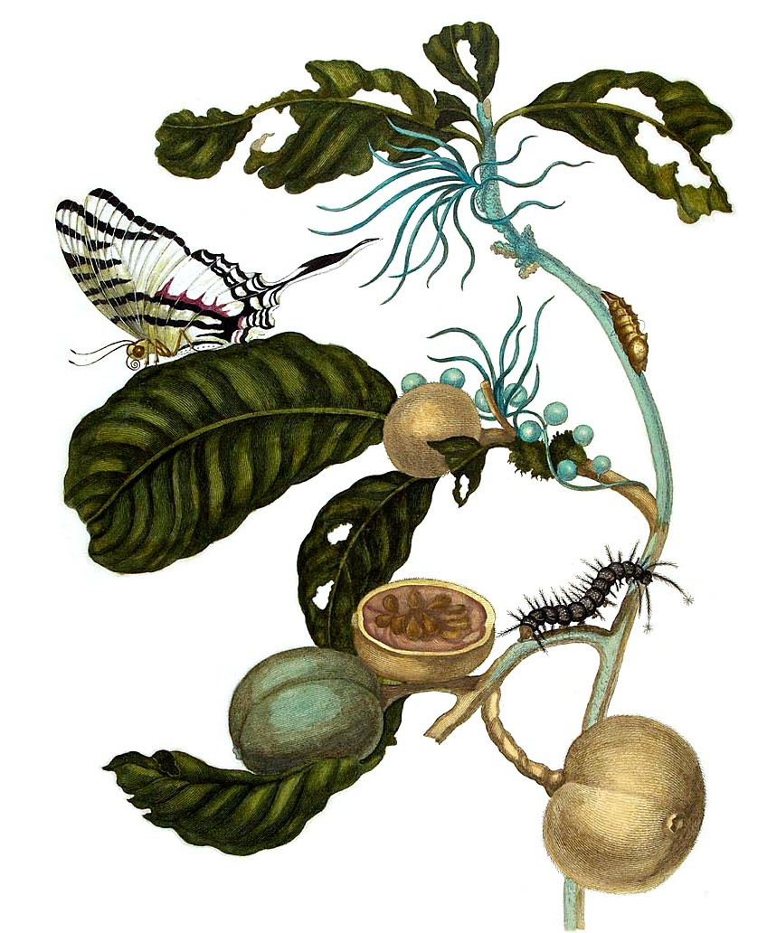
Example: Natural History
Pliny the Elder (ca 22-78): the encyclopedic observation and description of everything found in or derived from nature.
New emphasis on observation: collectors, illustrators, doctors, travelers to the New World.
Importance of systematic organization of the world (Linnaeus)

Slide 9
Example: Linnaean Taxonomy (1767)
Primates – Homo sapiens -
"Europaeus albus" -- white, sanguine, browny; with abundant, long hair; blue eyes; gentle, acute, inventive; covered with close vestments; and regulated by customs.
"Americanus rubescens" --red, choleraic, righteous; black, straight, thick hair; stubborn, zealous, free; painting himself with red lines, and regulated by customs
"Asiaticus fuscus" -- yellow, melancholic, stiff; black hair, dark eyes; severe, haughty, greedy; covered with loose clothing; and regulated by opinions.
"Africanus niger" -- black, phlegmatic, relaxed; black, frizzled hair; silky skin, flat nose, tumid lips; females without shame; mammary glands give milk abundantly; crafty, sly, careless; anoints himself with grease; & regulated by will.
[monstrosus]

Slide 10
Changes in modern science
~1800: “Science” comes to mean “organized pursuit of knowledge”
Rise of the “scientific method”: the recognition and formulation of a problem, the collection of data through observation and experiment, and the formulation and testing of hypotheses
Institutionalization of the sciences

Slide 11
Science Writing

Slide 12
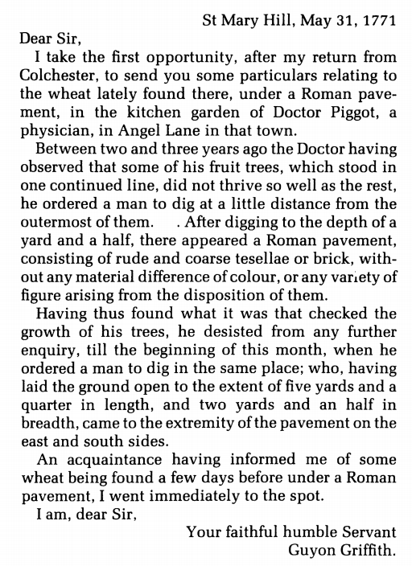
Changes in science writing

Slide 13
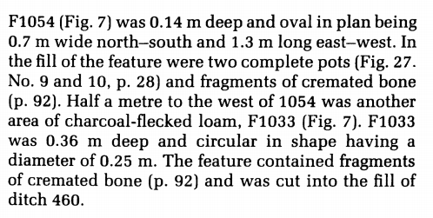
Changes in science writing
- 1978 CBA Research Report 28 Ashville Trading Estate, Abingdon

Slide 14
Changes in science writing
Ian Hodder:
“Writing has become increasingly distant, objective, impersonal and universal. We have become blind to the fact that we are writing.”
- Writing Archaeology, 1989

Slide 15
The myth of objectivity
Rosemary Joyce:
“The creation of narratives is a practice that literally binds the discipline of archaeology together from the field through to formal and informal presentation of interpretation.”
- The Languages of Archaeology, 2002

Slide 16
The myth of objectivity
Emily Martin:
“Part of my goal is to shine a bright light on the gender stereotypes hidden within the scientific language of biology. Exposed in such a light, I hope they will lose much of their power to harm us.”
- The Egg and the Sperm, Spring 1991

Slide 17
The myth of objectivity
Douglas Allchin:
“Scientific culture is an instrument or apparatus, not unlike a microscope, with which individuals view the world through the testimony of others. Like any scientific instrument, however, the scientific culture of reporting must be carefully constructed, tested, calibrated, maintained, and regularly checked and retuned to support its intended function.”
- “Do We See Through a Social Microscope?” 1999

Slide 18
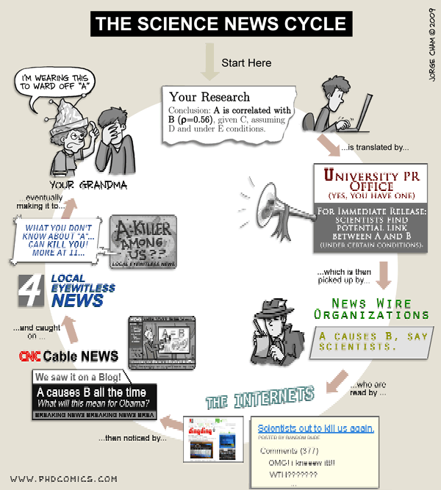
From Science Writing to Science Reporting

Slide 19
Unit 1: Rhetorical Analysis
How is scientific language persuasive? Is there “rhetoric” in science writing?
How is science used as a persuasive strategy in popular discourse?
How does science work alongside other persuasive strategies to make claims about politics, ethics, etc.?
Assignment: rhetorical analysis

Slide 20
Unit 1: Rhetorical Analysis
Who is speaking? Can we trust them?
Who is being spoken to?
What is the speaker trying to persuade us of?
What strategies is the speaker using to persuade?

Slide 21
Unit 1: Rhetoric of Vaccination
Who is speaking?
Who is being spoken to?
How does Sarah Pope use science as a persuasive strategy? Note down any language-of-science used.
How does Paul Offit use science as a persuasive strategy? Note down any language-of-science used
How does Samantha Bee use vaccination as a metaphor?

Slide 22
Unit 1: Rhetoric of Vaccination
http://thedailyshow.cc.com/videos/g1lev1/an-outbreak-of-liberal-idiocy

Slide 23
Unit 1: Rhetoric of Vaccination
Who is speaking?
Who is being spoken to?
How does Sarah Pope use science as a persuasive strategy? Note down any language-of-science used.
How does Paul Offit use science as a persuasive strategy? Note down any language-of-science used
How does Samantha Bee use vaccination as a metaphor?

Slide 24
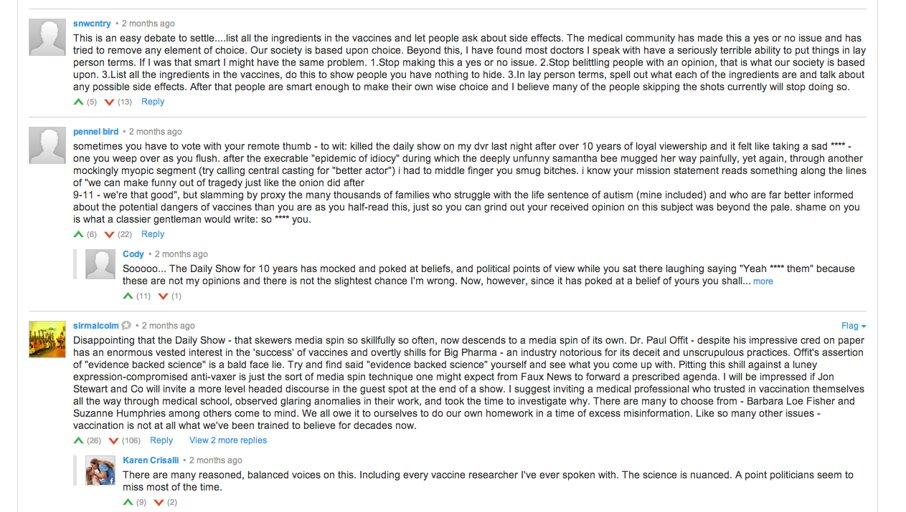
Unit 1: Rhetoric of Vaccination

Slide 25
Assignments: Unit 1
Science Article Analysis
Wikipedia Worksheet
Popular Article Analysis
Rhetorical Analysis

Slide 26
Assignments
Wakefield et al. article and worksheet
Due printed, in class.

Slide 27
References
Allchin, D. (1999, September). Do We See Through a Social Microscope?: Credibility as a vicarious selector. Philosophy of Science, 66, S287-S298. Retrived from jstor.org.
Cambridge History of Science. (2014). Retrieved from universitypublishingonline.org.
Hodder, I. (1989, June 1). Writing Archaeology: Site reports in context. Antiquity, 63, 239, 268-274. Retrieved from media.proquest.com.
Joyce, R. A. (2002). The Languages of Archaeology: Dialogue, Narrative, and Writing. Malden, MA: Blackwell Publishers.
Martin, E. (1991 Spring). The Egg and the Sperm: How Science has Constructed a Romance Based on Stereotypical Male-Female Roles. Signs, 16, 3, 485-501. Retrieved from jstor.org.

