Slide 1
A matter of trust
Or: the art of sounding trustworthy

Slide 2
Essay 1.1: Structural revision
An “author-based” structure
A “position-based” structure
Introduction
Background
Author 1
The Rolling Stones take the position that folk music is dead.
Author 2
Arlo Guthrie, in contrast, thinks folk music will never die.
Author 3
Bob Dylan takes a third path, seeing a place for both folk and electronic music.
Conclusion
Introduction
Background
Position 1
Many people think that since the invention of the electronic guitar, folk music is a thing of the past. For example…
Position 2
Not everyone agrees. Some people believe that folk music is a form of music that transcends history and technological advances. For example, Arlo Guthrie…
Position 3
Though some people have strong positions for or against folk music, many artists have found ways to work between mediums. Bob Dylan and Nirvana are two example. Bob Dylan says….
Conclusion

Slide 3
Essay 1.2: Requirements
Your cover page for essay 1.2 should include:
Name
Date
Essay title
Essay subtitle: “Essay 1.2”
A brief description of your three revision goals (you can copy from my e-mail).
For each revision goal, several sentences describing your efforts to meet your revision goal.
Grading is based on…

Slide 4
Three Approaches to Rhetorical Analysis
Trust
Feelings
Truth

Slide 5
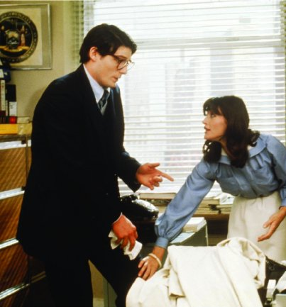

Who do you trust more?

Slide 6


Who do you trust more?

Slide 7
Who do you trust more?
…if you are being held hostage by the Joker/Lex Luther?

Slide 8
Who do you trust more?
…if you are the Joker/Lex Luther?

Slide 9
Who do you trust more?
…if you are having a heart attack?

Slide 10
Who do you trust more?
…if you are choosing a new governor?

Slide 11
Establishing Authority
Vocabulary:
“Situated ethos”: The authority you carry with you
“Invented ethos”: the authority you establish through self-presentation
Commonplaces: what everyone in a given community believes without thinking about it
Context-specificity

