Slide 1
A matter of truth
Or: the art of sounding reasonable

Slide 2
Selecting an article for essay two
Finding Persuasive Texts: MOOCs
A blog post, newspaper article, magazine report, etc., arguing for or against MOOCs.
A TED talk about the effectiveness of MOOCs, or about the return to the classroom.
A news report about MOOCs
An advertisement (video or print) for a MOOC
An anti-MOOC advertisement for a university
A radio show
A speech
(NOTE: WRITE RS5 NOW)

Slide 3
Three Approaches to Rhetorical Analysis
Trust
Feelings
Truth

Slide 4
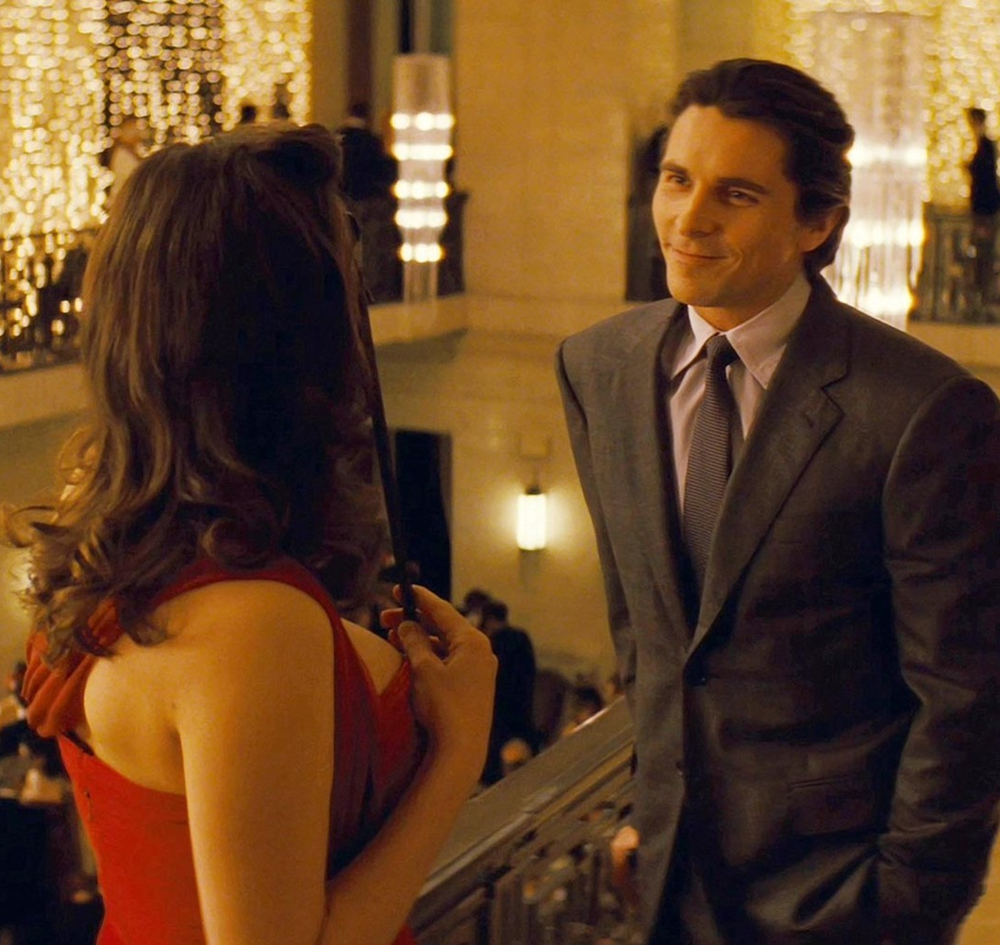

Review: Ethos & Pathos
Notes:
Ethos: did you show up as Batman or as Bruce Wayne? Did you refer to your relationships with other people? The good deeds you had done in the past? Your money?
Pathos: did you talk about the risk of people dying?
Pathos: did you threaten the security guard/ produce fear?

Slide 5
Establishing Authority
“Situated ethos”: The authority you carry with you
“Invented ethos”: the authority you establish through self-presentation
Commonplaces: what everyone in a given community believes without thinking about it

Slide 6
Emotional Persuasion
Emotional Keywords: words that suggest emotional content. Thrilled! Terrified! Saddened! Disappointed!
Honorific Language: Great, wonderful, fabulous, delightful
Disparaging Language: terrible, embarrassing, offensive, stupid
Emotional Connections: Anecdotes, references, images, music

Slide 7
Writing break: Making a Claim
Thesis: Joe Cotten’s video persuades people to vote for him by using language, music, and imagery to create an atmosphere of fear.
Making a claim
Cotten describes his opponents as dangerous pests who need to be stopped.
Providing evidence for that claim
Cotton refers to democrats as “obamanites,” calling them “political termites.”
Analyzing a claim
This metaphor suggests that democrats are an invasive species which will destroy governmental infrastructure, leading to collapse. It further suggests that the only solution is extermination – and that Joe Cotten is the best exterminator.
Connecting to the next claim/evidence.
Cotten further promotes this idea in his description of the elections.

Slide 8
Three Approaches to Rhetorical Analysis
Trust
Feelings
Truth

Slide 9
Analyzing Logos
Presence of facts: statistics, dates, measures, legal language, etc.
What kind of information is being used? Is it valid?
Is any key information missing?
Use of facts: how are facts being used to produce an argument?
What are the explicit premises of the argument? Are they sound? What are the implicit premises of the argument? Are they sound?
What is the conclusion of the argument? Is it sound?

Slide 10
Analyzing Logic: A basic argument
Modus Ponens: You’re going to die.
(“Every man is mortal; Socrates is a man; therefore, Socrates is mortal”)
Every man is mortal
Socrates is a man
Therefore, Socrates is mortal

Slide 11
Analyzing Logic: More Basic Arguments
We cannot trust this man, for he has perjured himself in the past.
Those who perjure themselves cannot be trusted. (Major premise – omitted)
This man has perjured himself in the past. (Minor premise – stated)
This man is not to be trusted. (Conclusion - stated)
In logic:
Forall x . [P(x) -> ~T(x)]
P(m)
Therefore, ~T(x)
Brigham Young!
Notes:
For all “x” such that P of X , T of X (where P is perjure and T is trust) ,

Slide 12
Texas Voter ID Laws
Texas Attorney General Dan Branch:
http://youtu.be/hnmvnk2UXV0
Sandra Watts and the Texas Voter ID Laws Controversy
http://youtu.be/PPQsJKpZKCM
Rick Perry Rebuttal to the DOJ concerns
http://video.foxnews.com/v/2625289022001/gov-perry-on-doj-plan-to-sue-texas-over-voter-id-law/
Notes:
Sandra Watts: 3:55

Slide 13
Analyzing Logos: Writing Practice
Presence of facts: statistics, dates, measures, legal language, etc.
What kind of information is being used? Is it valid?
Is any key information missing?
Use of facts: how are facts being used to produce an argument?
What are the explicit premises of the argument? Are they sound? What are the implicit premises of the argument? Are they sound?
What is the conclusion of the argument? Is it sound?

Slide 14
Daily Recap
Logical Appeals
The art of sounding reasonable
Use of facts as evidence
Use of evidence to construct logical claims
Writing about logic
Claim
Evidence
Analysis
Claim…

