Slide 1
Constructing Arguments
Making a claim
Conducting analysis
Building an argument

Slide 2
Review: Three Approaches to Rhetorical Analysis
Trust (ethos)
Feelings (pathos)
Truth (logos)

Slide 3
Review: Establishing Authority
“Situated ethos”: The authority you carry with you
“Invented ethos”: the authority you establish through self-presentation
Commonplaces: what everyone in a given community believes without thinking about it
Notes:
Opening Bit: Obama
Hangover Movie bit: 1:15

Slide 4
Review: Emotional Persuasion
Emotional Keywords: words that suggest emotional content. Thrilled! Terrified! Saddened! Disappointed!
Honorific Language: Great, wonderful, fabulous, delightful
Disparaging Language: terrible, embarrassing, offensive, stupid
Emotional Connections: Anecdotes, references, images, music
Notes:
Obama bit: 3:19

Slide 5
Review: Analyzing Logos
Presence of facts: statistics, dates, measures, legal language, etc.
What kind of information is being used? Is it valid?
Is any key information missing?
Use of facts: how are facts being used to produce an argument?
What are the explicit premises of the argument? Are they sound? What are the implicit premises of the argument? Are they sound?
What is the conclusion of the argument? Is it sound?
Notes:
Obama bit: 3:19.

Slide 6
Part 1: Conducting Analysis
Claim
Evidence
Analysis
Claim

Slide 7
Sample Analysis: Appeals to Authority
[Balsey] shortly includes a short reference to Monet, a famous impressionist painter who even someone without a degree in art can recognize. Although she only mentions him briefly “because [she likes] him personally,” it’s still worth mentioning that she name-drops a famous painter to further prove her authority as a successful educator and teacher of art and also to give her human qualities of having a personal bias. (Balsley)

Slide 8
Sample Analysis: Appeals to Authority
Randy Edsall establishes authority from the very beginning of the video when he mentions the words “our profession.” He explains why he is disappointed with how his profession recruits young athletes. The simple statement establishing his career shows that he isn’t just a random person talking on the subject of recruitment, but instead he is knowledgeable and informed. This establishes authority because the audience knows that Edsall is knowledgeable since his career directly deals with recruitment of athletes. Knowledge, in turn, becomes power, which is a form of authority.

Slide 9
Sample Analysis: Appeals to Authority
Another appeal the viewer notices is the use of “scientific” imagery. The “Stuxnet” video’s very first image is a 3D model of a microscope. The microscope is often the very first scientific tool people are exposed to when they are taught in school about the history of science and the scientific process. By opening with that image, Hungry Beast implies that the information to follow was thoroughly hypothesized and tested, and the conclusions reached are provable and irrefutable.

Slide 10
Sample Analysis: Obama
Claim: Obama uses the contrast between his situated ethos as president and his self-presentation as an ‘ordinary guy’ to establish authority.
Evidence 1: people watch this show?
Analysis: Calls the show stupid; implies that he’s stupid for watching the show; but we know he’s not stupid!
Evidence 2: the hangover movies
Analysis: Makes Zach seem stupid; establishes pop-culture knowledge; make self seem smart.
Analysis: In both cases, Obama makes fun of the context to make himself seem like an ordinary guy, but does so in a way that reasserts his intelligence and authority as president.

Slide 11
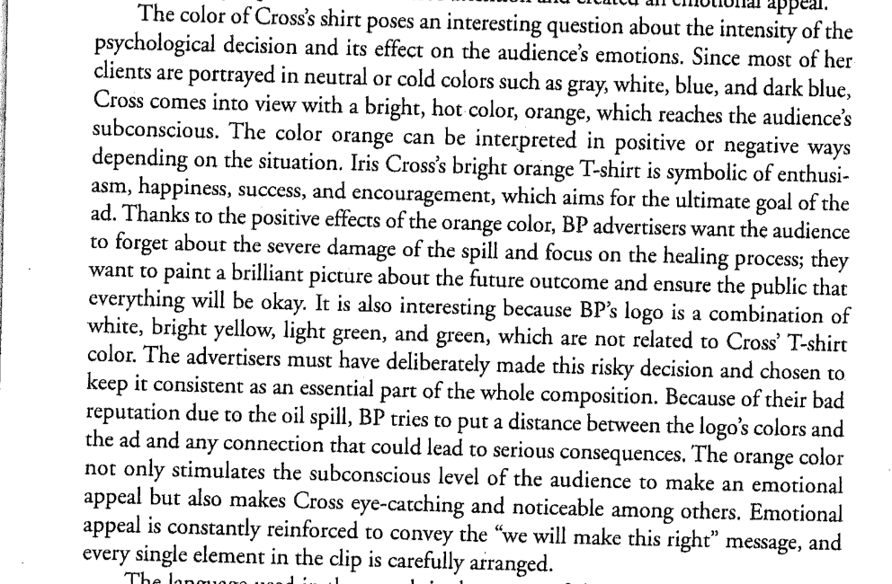
Sample Analysis: The Color Orange

Slide 12
Part Two: Thesis
Building an argument

Slide 13
Identifying the Question
What question(s) does essay two ask you to answer?
What strategies does the text use to persuade its audience?
Why does the author use these strategies, and to what end?

Slide 14
What is a Thesis?
Good Theses (V1)
Answer the question asked by the assignment.
Go beyond the question by offering a new and unique analysis.
Good Theses (V2)
Arguable
Worth Arguing About

Slide 15
Sample Thesis 1
Because he is not a professional on the subject matter, Tanguay uses a close personal view to build credibility, relate to the audience, and create a more real context for the debate. This approach keeps the reader from questioning the integrity of the argument. Tanguay is thus able to present his subjective beliefs without being pulled back by the lack of empirical support.

Slide 16
Sample Thesis 2
Food & Water Europe uses the structure, style, and logical reasoning of a scientific peer reviewed article to establish an ethos of scientific credibility. However their uses of emotional appeals and language reveals they are writing to persuade a non-scientific audience that a regulatory control method would be better suited for controlling emissions then emissions trading.

Slide 17
The Thesis Formula
This essay uses [STRATEGIES] to persuade its audience that [ARGUMENT].
I argue that by doing so, it…

Slide 18
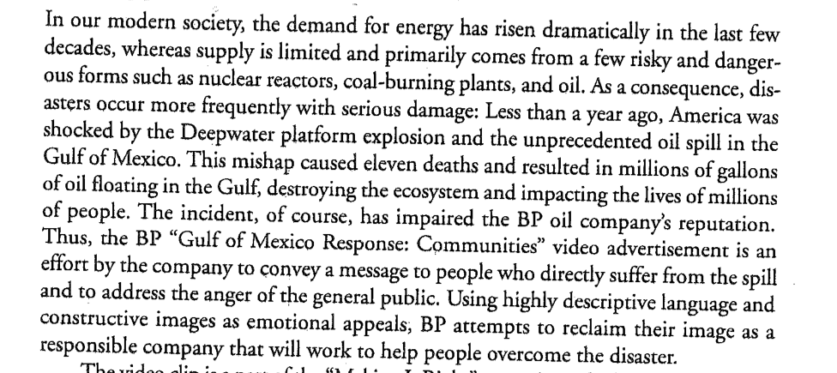
Sample Introduction

Slide 19
Introduction Formula
Attention Grabber: “Dramatic demand for energy!”
Background Info: Introduce controversy & article
Thesis: 1-2 sentences, “I argue that…”
Signals: What your essay is going to do.

Slide 20
Essay Two Outline
Introduction: thesis
Context:
where, when, who, etc.: Claim, evidence, analysis
Analysis:
Strategy 1: claim, evidence, analysis
Strategy 2: claim, evidence, analysis
Strategy 3 claim, evidence, analysis
Etc.
Conclusion: recap, evaluation

Slide 21
Daily Recap
Conducting Analysis
Authority: Situated ethos, invented ethos, commonplaces
Writing a Thesis
Arguable & Worth Arguing About
Essay Two Outline
Due Thursday

