Slide 1
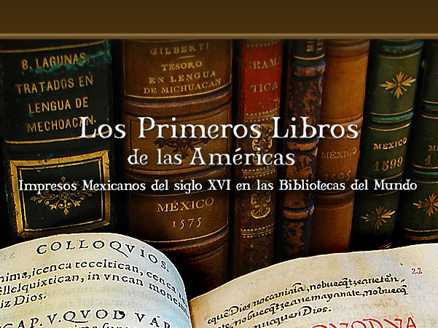
Anton duPlessis, Cushing Library – Texas A&M University
Notes:
Slide A

Slide 2
Primeros Libros: Project Description
Create a digital collection of the primeros libros printed in Mexico before 1601
The first books printed in the New World
These works are primary sources for investigation and research in fields such as cultural history, linguistics, histroy of the book, religious studies, etc.
There are approximately 220 known titles, ≈130 are exist to present
It is important to include as many exemplars of the same work as possible because of variation in print, missing pages, fire marks, marginalia and other copy specific attributes
Institutions in Mexico and The United States have the majority of the primeros libros
Notes:
2nd line – mention el Peru.

Slide 3
Primeros Libros: Goals
Repatriate items of cultural patrimony
The collection of the books and associated materials are available free of charge at
The project web site http://primeroslibros.org
  View the primeros libros in a variety of formats and image viewers: JPG, JPG 2000, PDF
  Download the images of the primeros libros
  Navigation aides
  Metadata that describe the materials
  Supplemental materials, such as bibliographies

Slide 4
Primeros Libros: Goals
Preserve the digital editions of the primeros libros
  Multiple preservation sites among the project members
Demonstrate international collaboration
Reveal institutions and / or primeros libros that belong to the Project that do not appear in WorldCat or other digital or print bibliographies
Develop technology for digital libraries
Create opportunities for academic investigation and instruction

Slide 5
Primeros Libros: History and Participants
Initiated by Texas A&M University and The University of Texas at Austin
Web site launched August 2010
  http://primeroslibros.org
Partners in Mexico, Spain, Chile and the US
The project is seeking additional partners
Use of technology to share the historical and cultural patrimony

Slide 6
Primeros Libros: History and Participants
México:
Biblioteca Histórica José María Lafragua (Puebla)
Biblioteca Palafoxiana (Puebla)
Biblioteca Franciscana (San Andrés Cholula)
Biblioteca Pública de la Universidad Michoacana de san Nicolás de Hidalgo (Morelia)
Biblioteca Centro Cultural Vito Alessio Robles (Saltillo)
Centro de Documentación Histórica Rafael Montejano y Aguiñaga (San Luis Potosí)
Biblioteca Francisco de Burgoa (Oaxaca)
Chile:
Biblioteca Nacional de Chile (Santiago)
Notes:
mention xmLibris

Slide 7
Primeros Libros: History and Participants
España:
Biblioteca Histórica Marqués de Valdecilla de la Universidad Complutense de Madrid (Madrid)
United States:
Benson Latin American Collection (Austin, TX)
Cushing Memorial Library (College Station, TX)
The John Carter Brown Library (Providence, RI)
The Latin American Library (New Orleans, LA)
Houghton Library (Cambridge, MA)
Dumbarton Oaks Research Library and Collection (Washington, DC)
Notes:
LPL GoogleMap

Slide 8
Primeros Libros: History and Participants
Technical:
The University of Texas at Austin Libraries
The Texas A&M University Libraries
Biblioteca Histórica José María Lafragua
Biblioteca Virtual de la Universidad Autónoma de San Luis Potosí
CIRIA de la Universidad de las Américas Puebla
Texas Digital Library
Corporación Universitaria para el Desarrollo de Internet 2 (CUDI)
Red Abierta de Bibliotecas Digitales (RABiD)
Notes:
LPL GoogleMap

Slide 9
Primeros Libros: Partner locations

Slide 10
Primeros Libros: Exemplar data
Currently there are 232 exemplars in the project
91 different titles
40 titles are not held in common by another project member; however,
Duplicates are great!
Larger collection than the physical holdings of any single institution
Each project member receives digitized exemplars
Notes:
Note: not all exemplars are on the project site or have not been scanned yet.

Slide 11
Primeros Libros: Project Funding
Scanning Station
Texas A&M University Libraries
  Purchased a portable, archival scanner, personal computer, and external storage; provides training as needed.
  Located in Puebla for scanning primeros libros
  Available to other participating Mexican institutions
Hosting of Digital Collection
Texas Digital Libraries and the Universidad Autónoma de San Luis Potosí Digital Library
  Complete collection hosting and archiving
  File distribution system
Notes:
Project Funding
Scanning Station. Texas A&M University Libraries purchased a portable, high-quality scanner, personal computer, and external storage. The scanner is located in Puebla for scanning the first books of Biblioteca Palafoxiana and Biblioteca Franciscana. The scanner will then be available to other Mexican institutions that wish to digitize their first books for inclusion in the digital collection.

Slide 12
Primeros Libros: Project Funding
Project Web site
  University of Texas at Austin
  Site design, programming, and hosting
  Metadata (METS, MODS, Preservation, Technical)
  Database
Image Viewers
JPG and JPG 2000 files
  University of Texas at Austin
  CIRIA UDLAP / Lafragua (xmLibris)
  UASLP
  Texas A&M (Cobre)
Notes:
Project Funding
Scanning Station. Texas A&M University Libraries purchased a portable, high-quality scanner, personal computer, and external storage. The scanner is located in Puebla for scanning the first books of Biblioteca Palafoxiana and Biblioteca Franciscana. The scanner will then be available to other Mexican institutions that wish to digitize their first books for inclusion in the digital collection.

Slide 13
Primeros Libros: Project Agreement
For each of their first books an institution receives:
Comprehensive set of images produced within the project for all members
  File distribution via University of Texas or UASLP
Display of the primeros libros images in each complete collection hosted in the world with branding to indicate their institution / provenance
Archival images of the exemplars preserved in a preservation network
Notes:
Project Agreement
For each of their first books an institution receives:
A complete set of all archival images
A complete set of all derivative images
Inclusion of their display images in each complete collection hosted in the world with branding to indicate their institution
A copy of their archival images preserved in the Texas Digital Library Preservation Network and at UDLAP

Slide 14
Primeros Libros: Preservation Advantages
Quality of scanned images often easier to read
  Greater contrast, increase text size in viewer
  Necessary for eventual OCR
Overall, less handling of the primero(s) libro(s)
  Scanning is done to minimize strain on the binding and spine of the particular volume
Increased accessibility increases the valuation of the primero(s) libro(s)
  Not neglected, but appreciated by a wider audience.

Slide 15
Primeros Libros: Preservation Advantages
Protects unique materials in the event of a calamity
  9 member libraries hold 40 titles that no other project members hold
  Complete collection will be hosted and archived in several places in the world, including Mexico and Texas
  Bibliographic
    Marginalia
    Compare state, emission, edition, etc. of an exemplar
    Future capability for curators and scholars to annotate the texts via a web interface

Slide 16
Primeros Libros: Interdisciplinary Digital Library Research Model
Applications and Use
People
Technology
Content
Creation and
Preservation
Presentation and Usability
Retrieval
Notes:
Graphic adapted from Chen, “The Promise of International Digital Library Collaboration for Innovative Use of Invaluable Resources”.

Slide 17
Primeros Libros: Collaborative Digital Library
Point of access for digitized specific collections of materials
  Historical, cultural, linguistic scholarship among others
High-quality digital content at the core
  Selection, design, management, preservation, and tools to ensure its discovery and availability
    Project site by University of Texas and Texas A&M
    Preservation by TDL and UASLP
    Metadata by University of Texas
    Image viewers from University of Texas , Texas A&M, UDLAP/ Lafragua, UASLP
Notes:
Virtual collections is a deliberate strategy not only to make high-demand materials available in digital form, but also to encourage new analysis and scholarship drawn from those materials to flourish. The ideal digital library leverages collaboration to provide access to high-quality content and also encourages, indeed enables, the creation of new scholarship (Ober)

Slide 18
Primeros Libros: Optimizing Collaboration
Removing technological costs as a barrier
  Scanner and necessary equipment
  Resource and knowledge sharing
  Training
Maximizing potential for participation
  Material providers
  Technical providers
Recognizing the “not obvious” method of participation
  Institution barriers
Notes:
To replace “not obvious” Unobtrusive, imperceptible, unnoticed, unappreciated, indistinct, quiet?

Slide 19
Primeros Libros: Benefits of Collaboration
Permits collection growth in an atmosphere of constrained finances
Good faith reparation of cultural patrimony
Discover forgotten or previously unknown, unique holdings
Promote smaller / specialized institutions to a larger scholarly audience
Develop contacts among special collections

Slide 20
Primeros Libros: Realizing Collaborative potential
  Provenance
    marcas de fuego, ex libris
    digital avoids export issues
  Instruction
    classes for Náhuatl using PDFs rather than photocopies of microfiche printouts.
    Book History as Novohispano and Spanish methods differed from France, Germany, England, etc
    Digital Humanities
      A corpus of primeros libros will make a significant contribution to OCR, text recognition and related digital methodologies

Slide 21
Primeros Libros: Contact Information
The University of Texas - Austin
Mark McFarland m.mcfarland@austin.utexas.edu
Kent Norsworthy kentn@mail.utexas.edu
Biblioteca Lafragua, BUAP
Manuel de Santiago manuel.desantiago@correo.buap.mx
Iván Pérez Pineda ivan.perez@correo.buap.mx
Texas A & M University
Anton duPlessis duplessis@tamu.edu
http://primeroslibros.org

Slide 22
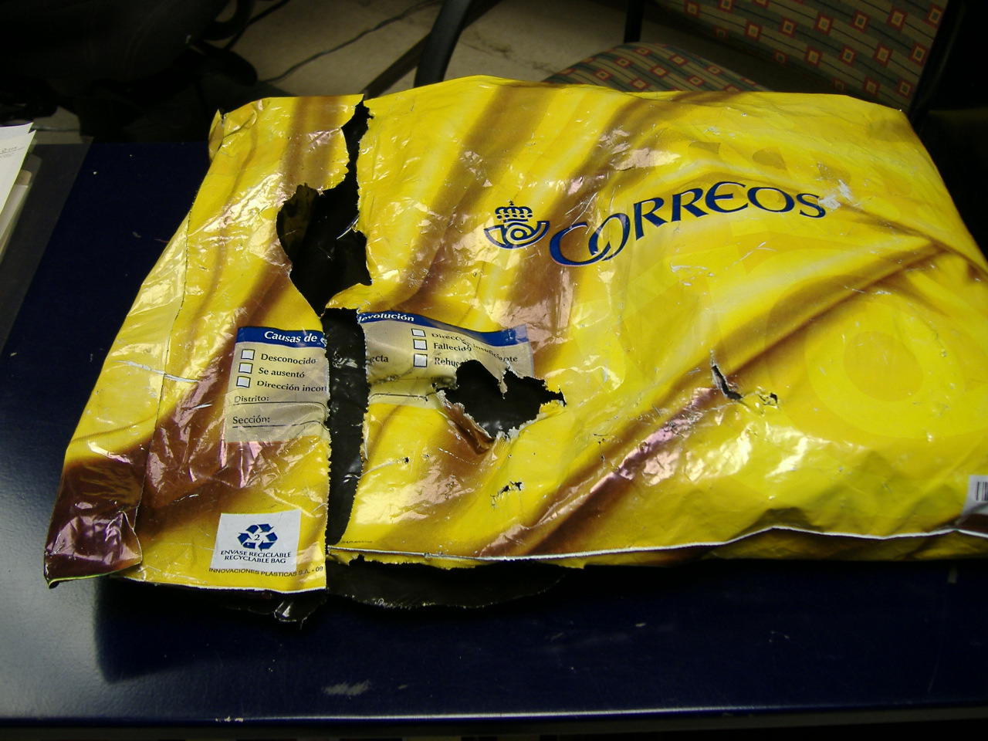
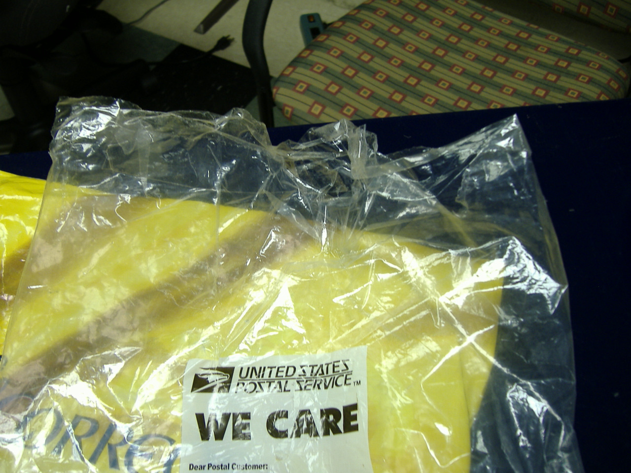
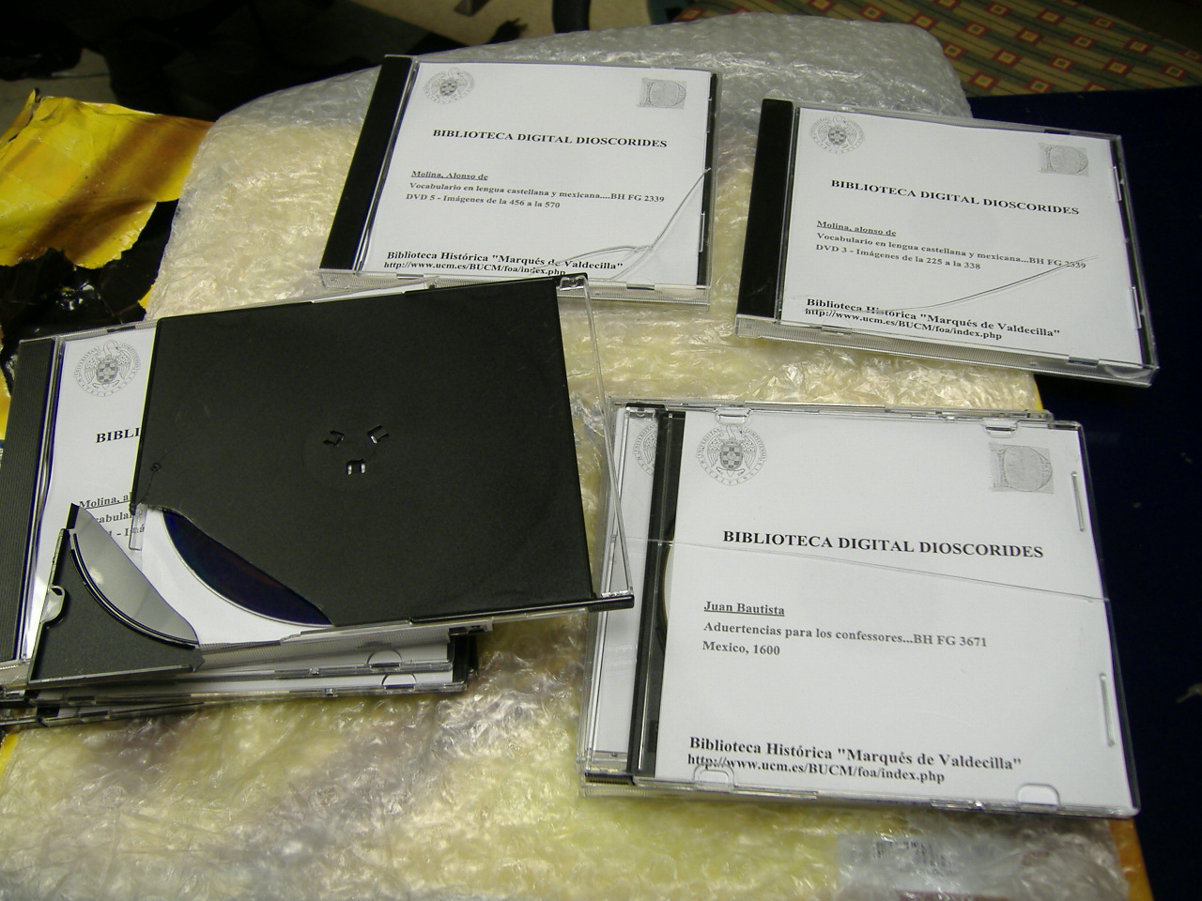
Notes:
Waited 6 weeks for this to arrive. Of the 7 books that the Valdecilla sent, 4 arrived. Of the other 3… Eventually, all the books arrived safely via Manuel de Santiago’s son acting as a courier brought them to Puebla and then shipped to College Station.

