Slide 1

Capstone Project
Build a Information Management System for a datacenter
Instructor: Ngo Dang Ha An
Member:
Le Thi Thu Ha
Huynh Lam Ha Tien

Slide 2
OUTLINE
Current Situation
Solution
Scope
Demonstration
Advantages and Disadvantages
Future Plan
Question & Answer

Slide 3
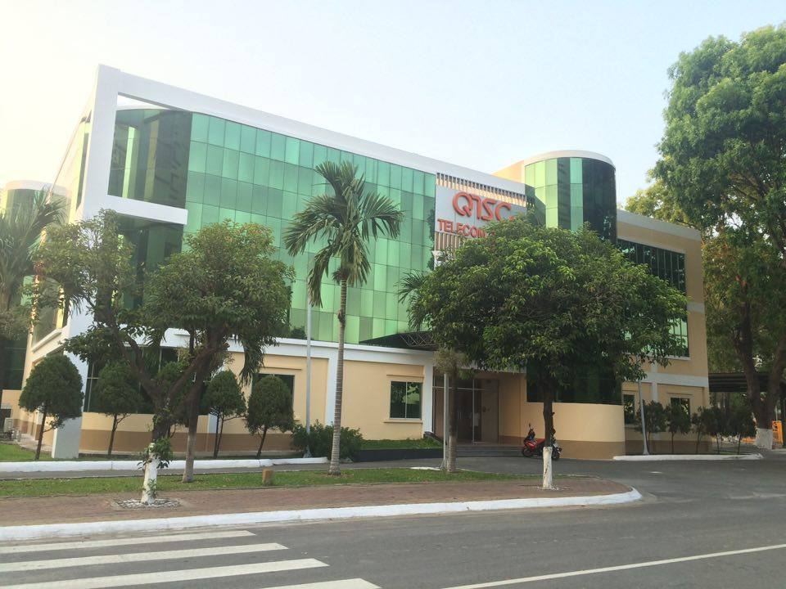
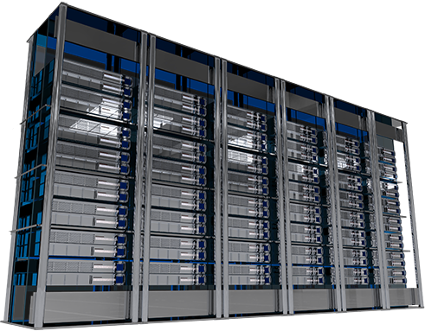
CURRENT SITUATION

Slide 4


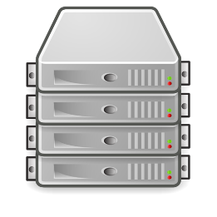






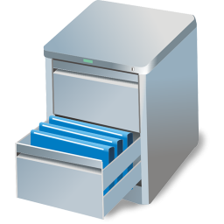
CURRENT SITUATION
IP Address: 127.0.0.7

Slide 5
SOLUTION
Energy Management
Power Management
Environment Management
Maintenance Management
Capacity Management
Facility Management
Customer Management
Asset Management

Slide 6
SOLUTION
Energy Management
Power Management
Environment Management
Maintenance Management
Capacity Management
Facility Management
Customer Management
Asset Management

Slide 7
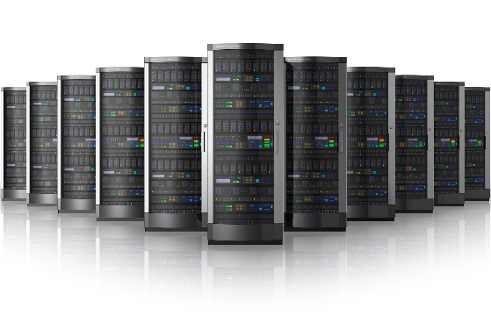
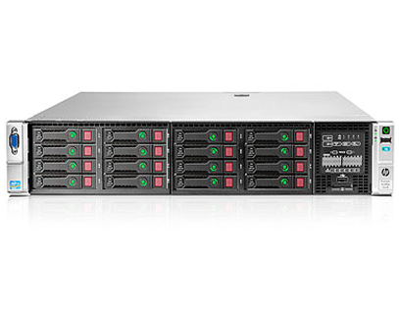
SOLUTION
IP Address
Asset Management

Slide 8

SOLUTION
IMS

Slide 9
CURRENT SITUATION
Add Server
Bring Server Away
Assign IP Address
Change IP Address
Return IP Address
Rent Rack
Return Rack

Slide 10

SOLUTION
Rejected
Send Request
Pending
Waiting
Processing
Done
Offline request
Request “Add Server”
Cancelled
Request “Bring Server Away”

Slide 11
SOLUTION
Managing equipment is automatic
Automatic receive and analyze data report => System makes decisions.
IMS
Notice based on SMS and notification in real time
Require less human resource

Slide 12



SCOPE
Manage all accounts in the system
Shift Manager
Shift Head
Shift Head
Shift Head
Shift Head
Staff
Staff
Staff
Staff
Staff
Staff
Staff
Staff

Slide 13
SCOPE
Receive notification directly from customer
Manage mainly all requests
Assign task to staff in the same group
Shift Manager
Shift Head
Shift Head
Shift Head
Shift Head
Staff
Staff
Staff
Staff
Staff
Staff
Staff
Staff

Slide 14
SCOPE
Manage asset in the center
Can be able to process request if assigned
Shift Manager
Shift Head
Shift Head
Shift Head
Shift Head
Staff
Staff
Staff
Staff
Staff
Staff
Staff
Staff

Slide 15
SCOPE
Create 7 types of request
Manage his requests
Manage remoted servers
Customer

