Slide 1

Capstone Project
Build a Information Management System for a datacenter
Instructor: Ngo Dang Ha An
Member:
Le Thi Thu Ha
Huynh Lam Ha Tien

Slide 2
OUTLINE
Current Situation
Solution
Demonstration
Advantages and Disadvantages
Future Plan
Question & Answer

Slide 3
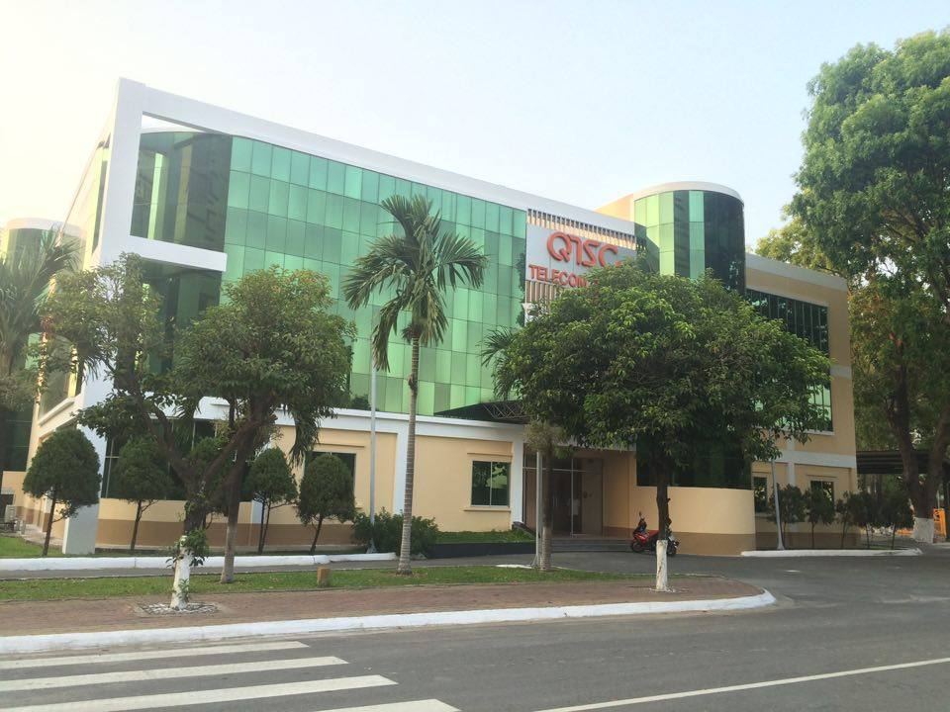
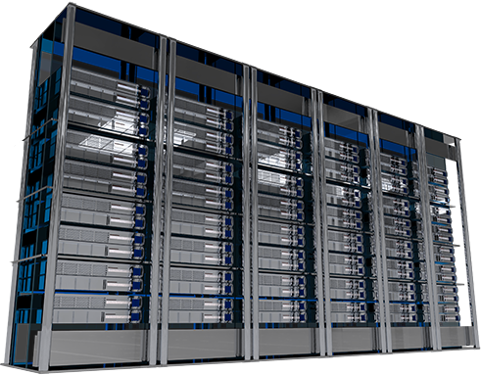
CURRENT SITUATION

Slide 4









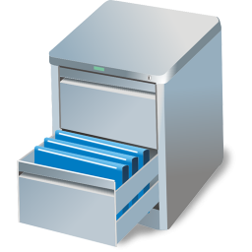
CURRENT SITUATION
IP Address: 127.0.0.7

Slide 5
SOLUTION
Energy Management
Power Management
Environment Management
Maintenance Management
Capacity Management
Facility Management
Customer Management
Asset Management

Slide 6
SOLUTION
Energy Management
Power Management
Environment Management
Maintenance Management
Capacity Management
Facility Management
Customer Management
Asset Management

Slide 7
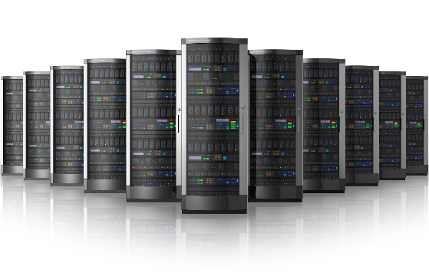
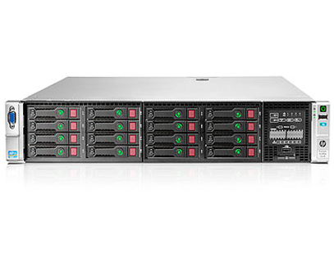
SOLUTION
IP Address
Asset Management

Slide 8

SOLUTION
IMS

Slide 9
SOLUTION
1
2
IMS
Send Request
Push notification
Push notification
Response Request
4
3

Slide 10
SOLUTION
Manage client – server transaction
Why should we use Request?
Search information more quickly
Collect data to create report, statistic
Avoid data conflict

Slide 11
SOLUTION
Scope
Web Application

Slide 12



SOLUTION
Manage all accounts in the system
SCOPE
Shift Manager
Shift Head
Shift Head
Shift Head
Shift Head
Staff
Staff
Staff
Staff
Staff
Staff
Staff
Staff

Slide 13
SOLUTION
Receive notification directly from customer
Manage mainly all requests
Assign task to staff in the same group
SCOPE
Shift Manager
Shift Head
Shift Head
Shift Head
Shift Head
Staff
Staff
Staff
Staff
Staff
Staff
Staff
Staff

Slide 14
SOLUTION
Manage asset in the center
Can be able to process request if assigned
SCOPE
Shift Manager
Shift Head
Shift Head
Shift Head
Shift Head
Staff
Staff
Staff
Staff
Staff
Staff
Staff
Staff

Slide 15
SOLUTION
SCOPE
Create 7 types of request
Manage his requests
Manage remoted servers
Customer

Slide 16
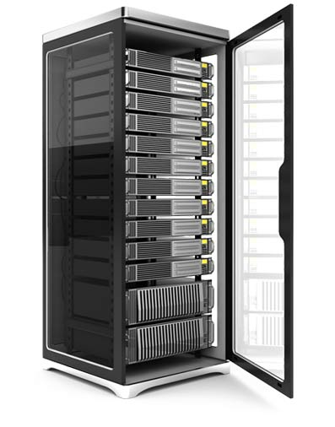
SOLUTION
7 Types of Request
IP Address
Add Server
Assign IP Address
Rent Rack
Bring Server Away
Change IP Address
Return Rack
Return IP Address

Slide 17

SOLUTION
Request Status
Rejected
Reject
Reject
Reject
Send Request
Accept
Process
Complete
Pending
Waiting
Processing
Done
Cancel
Cancel
Cancel
Offline request
Request “Add Server”
Cancelled
Request “Bring Server Away”

Slide 18
SOLUTION
Request Status
Rejected
Reject
Reject
Send Request
Accept
Complete
Pending
Processing
Done
Online request
Cancel
Cancel
Request “Assign IP Address”
Request “Return IP Address”
Cancelled
Request “Rent Rack”
Request “Change IP Address”
Request “Return Rack”

Slide 19


SOLUTION
Create Request
1
2
2

Slide 20
SOLUTION
Accept Request
3
1
2

Slide 21
SOLUTION
Process Request
3
1
2

Slide 22
SOLUTION
Cancel Request
1
3
2

Slide 23
SOLUTION
Reject Request
3
1
2

Slide 24
SOLUTION
Task Status
Not Finished
Completed
Not Finish
Complete (request)
Assign Task
Accept
Cancel (request)
Waiting
Doing
Reject (request)
Reassign
Cancelled

Slide 25
SOLUTION
Assign Task
1
3
4
2

Slide 26
SOLUTION
Reassign Task
3
1
Pre-assigned Staff
2
4
New assigned Staff
if(TaskStatus == “Waiting” || TaskStatus == “Not Finished”)

Slide 27
SOLUTION
Accept Task
3
1
2

Slide 28
SOLUTION
Not Finish Task
3
1
2

Slide 29
SOLUTION
Schedule

Slide 30
SOLUTION
Schedule

Slide 31
SOLUTION
IP Address Status
Bring Server Away
Change IP
Return IP
Generate IP
Assign IP
Available
Used
Block IP
Unblock IP
Blocked

Slide 32



SOLUTION
Assign IP
1
3
5
4
Result
2
Used
Current

Slide 33





SOLUTION
Change IP
Used
Current
1
3
5
4
2
Available
Old
Changing

Slide 34






SOLUTION
Change IP
Used
Current
1
3
5
4
2
Available
Old
Changing

Slide 35





SOLUTION
Return IP
Used
Current
1
3
5
4
2
Available
Old
Returning

Slide 36
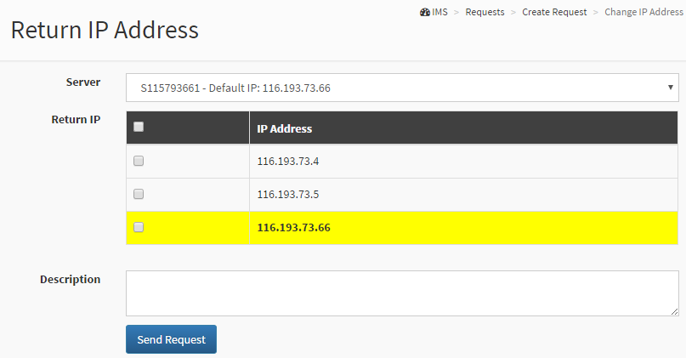
SOLUTION
Return IP
Return Default IP

Slide 37
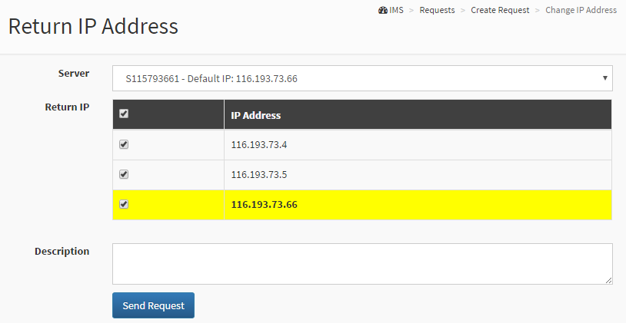
SOLUTION
Return IP
Return Default IP

Slide 38
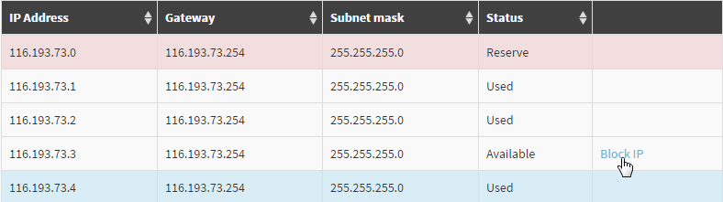
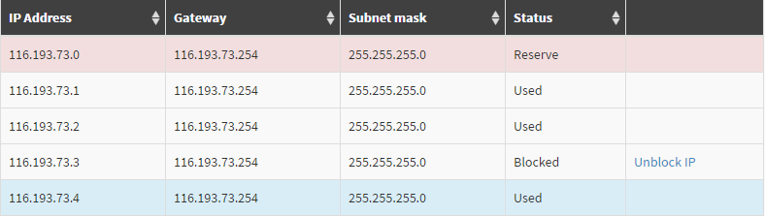
SOLUTION
Block IP

Slide 39
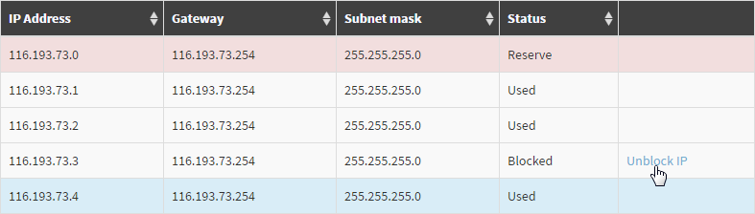
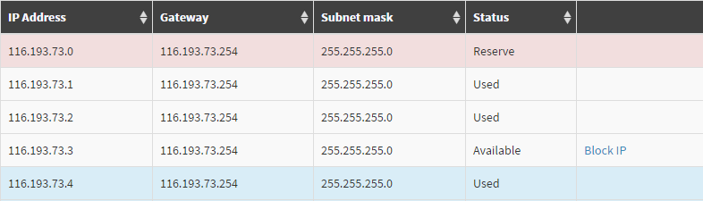
SOLUTION
Unblock IP

Slide 40
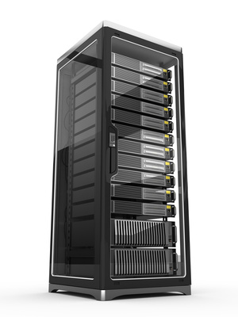
SOLUTION
Rack
1U
1U = 4,45 cm
42U
2U
4U

Slide 41
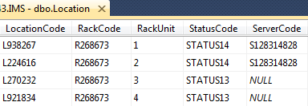
SOLUTION
Rack
Used
2U
. . . . .
Available

Slide 42
SOLUTION
Rack Status
Add Rack
Assign Location
Available
Used
Rent Rack
Return Rack
Rented

Slide 43



SOLUTION
Rent Rack
Available
1
3
5
4
2
Rented
Current

Slide 44
SOLUTION
Return Rack

Slide 45
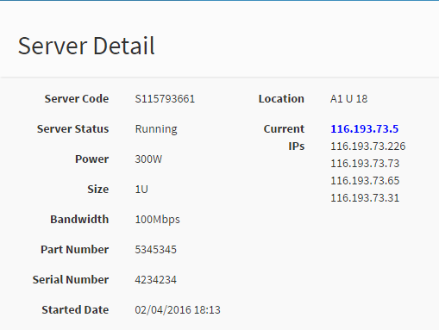
SOLUTION
Server
Only one Default IP
Default IP is server’s identification
All IPs in the same range

Slide 46
SOLUTION
Server Status
Send Request “Add Server”
Complete Request
Waiting
Running
Send Request “Bring Server Away”
Complete Request
Bringing away
Deactivate

Slide 47
SOLUTION
IP Address
Add Server
5
4
1
3
9
8
6
2
7
Location

Slide 48
SOLUTION
Bring Server Away
1
3
5
4
2

Slide 49
DEMONSTRATION

Slide 50
ADVANTAGES
Support staff managing information easier and faster, save time and reduce effort of staff.
Customer can view information of their servers immediately by this system.
IMS
Reduce conflicts, satisfy customer by meeting their need.
Avoid losing information of data center.
Can create report to make a fast decision.

Slide 51
DISADVANTAGES
Initially, it takes time to input information into the system.
IMS
The staff must spend time to learn how to use the system and practice to use expertly.
A few problems arising can happen and the system cannot cover all of the functions.

Slide 52
FUTURE PLAN
Customer can use the electronic card or fingerprint to check the time they go into data center
IMS
Improve performance
Create more report for analysis

Slide 53
QUESTION & ANSWER

Slide 54
THANK YOU

Slide 55
GENERATE IP ADDRESS
Important attributes when generate IP Address Range:
IP Address
NetworkIP (First IP Address of Range)
Gateway
Subnetmask

Slide 56
GENERATE IP ADDRESS
Subnetmask of IP Address:
Ex: Input: 120.70.85.4/26
Netmask = 26 => first 26 bit are 1, last 6 bit are 0
Subnetmask: 255.255.255.x (first 24 bit are 1)
x in binary: 11000000 => x = 2^7 + 2^6 = 192
Subnetmask = 255.255.255.192
IP Addresses are in the same range when:
IP Address AND Subnetmask = NetworkIP

Slide 57
GENERATE IP ADDRESS
With netmask 26, we have 4 ranges of IP:
Range 1: 120.70.85.0 -> 120.70.85.63
Range 2: …………….. .64 ->……………. .127
Range 3: …………….. .128 ->………….. .191
Range 4: …………….. 192 -> ………….. .255
4 NetworkIP are just different at last number: 0, 64, 128, 192
We can see: 0 = 0*64
64 = 1*64
128 = 2*64
192 = 3*64
=> 0, 1, 2, 3: count = 4 = number of ranges
64 : base number of NetworkIP
=> So, if we want to find out NetworkIPs, we must find the number of ranges and base number of NetworkIP

Slide 58
GENERATE IP ADDRESS
In all case of Netmask:
a = Netmask mod 8
Number of range = 2^a
Base number of NetworkIP = 2^(8 – a)
( In above example: a = 2; number of range = 4; base number of NetworkIP = 2^6 = 64)
NetworkIP = i*Base number (with 0< I < number of range)
We have list of NetworkIPs

Slide 59
GENERATE IP ADDRESS
From list of NetworkIPs, we will find out the NetworkIP of necessary range.
Inputted IP: A.B.C.D
A,B,C is same between IP Addresses => We care about D
head = List(Fourth number of NetworkIPs)
If(head[i] ≤ D < head[i+1])
Fourth number of NetworkIP = head[i-1]
Else (head[i] ≤ D < 255)
Fourth number of NetworkIP = head[i+1]

Slide 60
GENERATE IP ADDRESS
In above example: Inputted IP Address: 120.70.85.4
In list of NetworkIP:
120.70.85.0; 120.70.85.64; 120.70.85.128; 120.70.85.192
We consider: 0< 4< 64
=> NetworkIP of necessary range: 120.70.85.0

Slide 61
GENERATE IP ADDRESS
From NetworkIP of range, we can generate list of IP Addresses of range easily.
Fourth number of NetworkIP = startIndex
By variable count = 0;
if(heads contain i) count++;(startIndex ≤ i < 255)
And while (count<2) we take IP Address in necessary range
From list of IP Address of range, we find NetworkIP and Gateway.

Slide 62
REFERENCE
http://pasco.com.vn/giai-phap/he-thong-quan-ly-ha-tang-trung-tam-du-lieu-142/

