Slide 1

Capstone Project
Build a Information Management System for a datacenter
Instructor: Ngo Dang Ha An
Member:
Le Thi Thu Ha
Huynh Lam Ha Tien

Slide 2
OUTLINE
Current Situation
Solution
Demonstration
Advantages and Disadvantages
Future Plan
Question & Answer

Slide 3
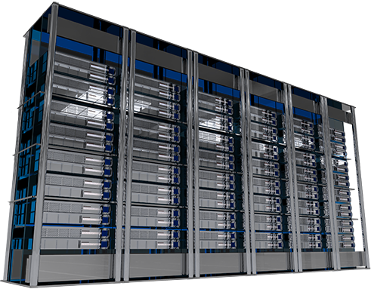
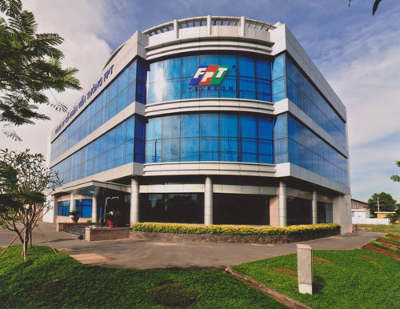
CURRENT SITUATION

Slide 4


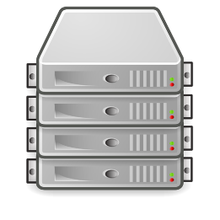






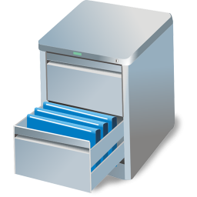
CURRENT SITUATION
IP Address: 127.0.0.7

Slide 5
SOLUTION
Energy Management
Power Management
Environment Management
Maintenance Management
Capacity Management
Facility Management
Customer Management
Asset Management

Slide 6
SOLUTION
Energy Management
Power Management
Environment Management
Maintenance Management
Capacity Management
Facility Management
Customer Management
Asset Management

Slide 7
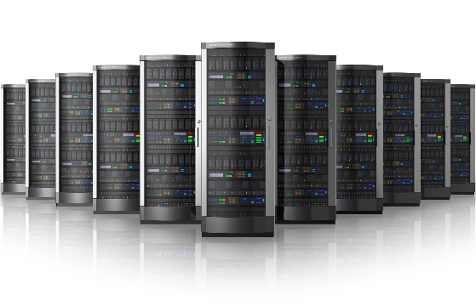
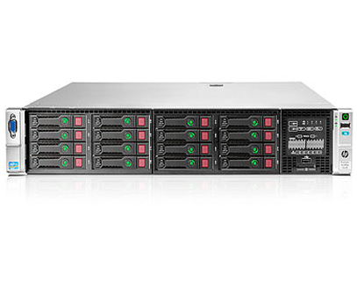
SOLUTION
IP Address
Asset Management

Slide 8

SOLUTION
IMS

Slide 9



SOLUTION
Shift Manager
Shift Head
Shift Head
Shift Head
Shift Head
Staff
Staff
Staff
Staff
Staff
Staff
Staff
Staff

Slide 10
CURRENT SITUATION
Add Server
Bring Server Away
Assign IP Address
Change IP Address
Return IP Address
Rent Rack
Return Rack

Slide 11

SOLUTION
Rejected
Send Request
Pending
Waiting
Processing
Done
Offline request
Request “Add Server”
Request “Bring Server Away”
Cancelled

Slide 12
SOLUTION
Managing equipment is automatic
Automatic receive and analyze data report => System makes decisions.
IMS
Notice based on SMS and notification in real time
Require less human resource

