Slide 1

Capstone Project
Build a Information Management System for a datacenter
Instructor: Ngo Dang Ha An
Member:
Le Thi Thu Ha
Huynh Lam Ha Tien

Slide 2
OUTLINE
Current Situation
Solution
Scope
Demonstration
Advantages and Disadvantages
Future Plan
Question & Answer

Slide 3
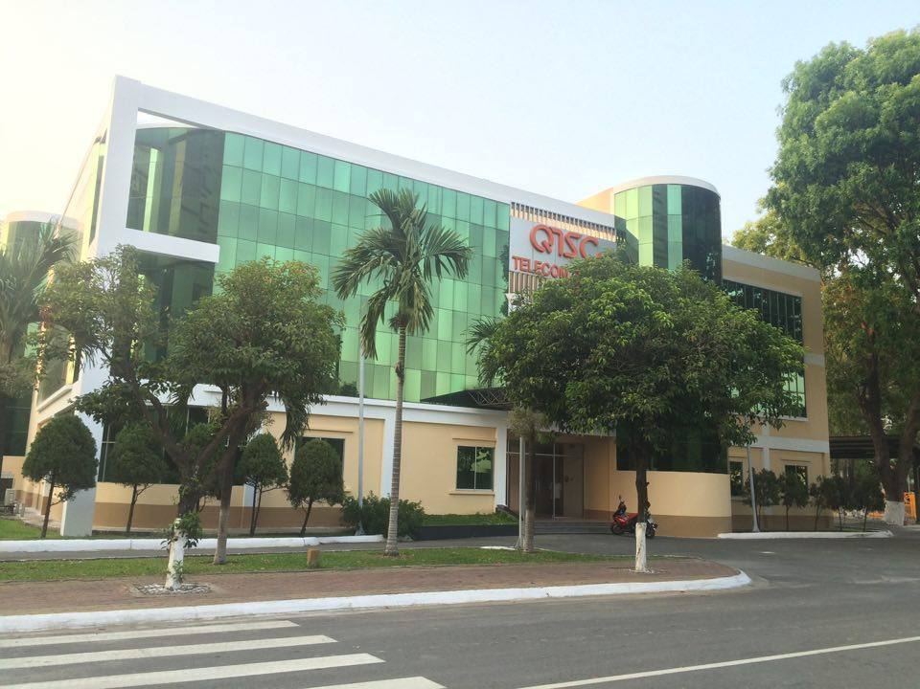
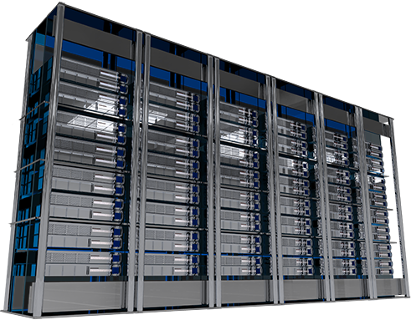
CURRENT SITUATION

Slide 4









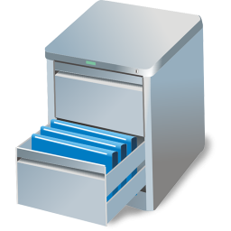
CURRENT SITUATION
IP Address: 127.0.0.7

Slide 5
SOLUTION
Energy Management
Power Management
Environment Management
Maintenance Management
Capacity Management
Facility Management
Customer Management
Asset Management

Slide 6
SOLUTION
Energy Management
Power Management
Environment Management
Maintenance Management
Capacity Management
Facility Management
Customer Management
Asset Management

Slide 7
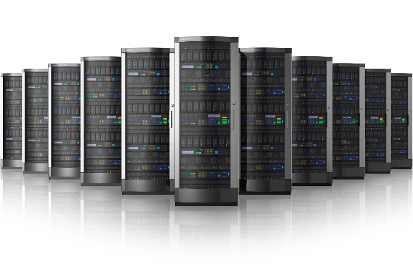
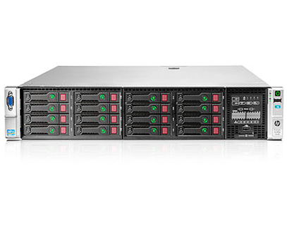
SOLUTION
IP Address
Asset Management

Slide 8

SOLUTION
IMS

Slide 9
SOLUTION
Why should we use Request?

Slide 10
SOLUTION
Managing equipment is automatic
Managing equipment is automatic
Why should we use Request?
Managing equipment is automatic
Managing equipment is automatic

Slide 11
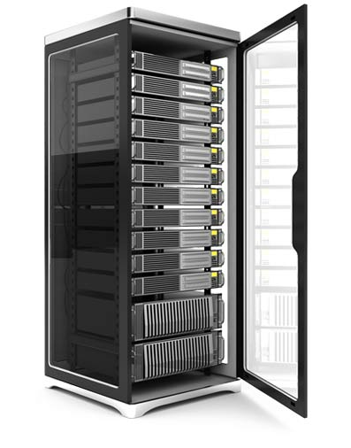
SOLUTION
7 Types of Request
IP Address
Add Server
Assign IP Address
Rent Rack
Bring Server Away
Change IP Address
Return Rack
Return IP Address

Slide 12

SOLUTION
Request Status
Rejected
Reject
Reject
Reject
Send Request
Accept
Process
Complete
Pending
Waiting
Processing
Done
Cancel
Cancel
Cancel
Offline request
Request “Add Server”
Cancelled
Request “Bring Server Away”

Slide 13
SOLUTION
Request Status
Rejected
Reject
Reject
Send Request
Accept
Complete
Pending
Processing
Done
Online request
Cancel
Cancel
Request “Assign IP Address”
Request “Return IP Address”
Cancelled
Request “Rent Rack”
Request “Change IP Address”
Request “Return Rack”

Slide 14
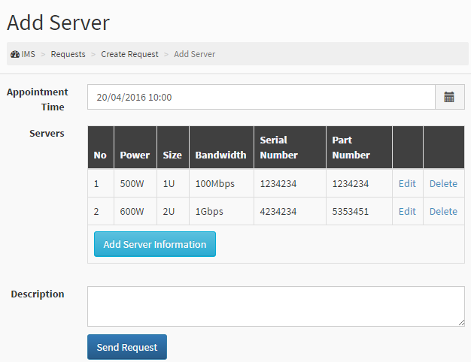
SOLUTION
Request Flow

Slide 15
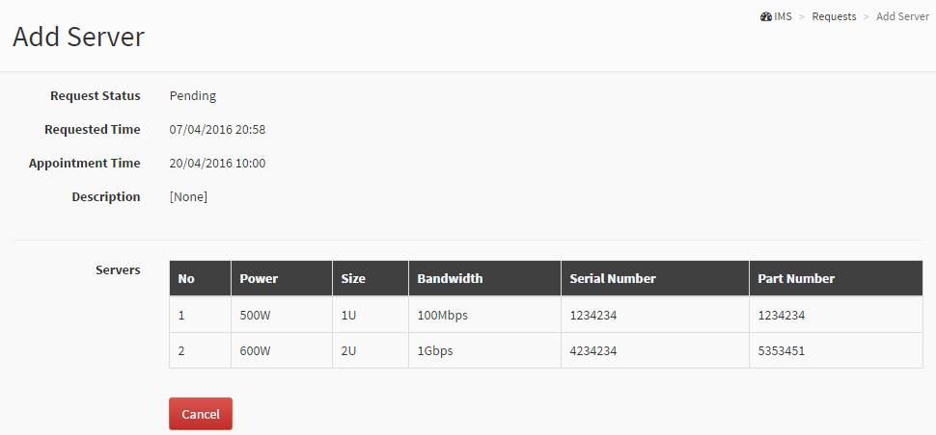
SOLUTION
Request Flow

Slide 16
SOLUTION
Task Flow

Slide 17
SOLUTION
Task Flow

Slide 18
SOLUTION
IP Address

Slide 19
SOLUTION
Rack

Slide 20
SOLUTION
Server

Slide 21



SCOPE
Manage all accounts in the system
Shift Manager
Shift Head
Shift Head
Shift Head
Shift Head
Staff
Staff
Staff
Staff
Staff
Staff
Staff
Staff

Slide 22
SCOPE
Receive notification directly from customer
Manage mainly all requests
Assign task to staff in the same group
Shift Manager
Shift Head
Shift Head
Shift Head
Shift Head
Staff
Staff
Staff
Staff
Staff
Staff
Staff
Staff

Slide 23
SCOPE
Manage asset in the center
Can be able to process request if assigned
Shift Manager
Shift Head
Shift Head
Shift Head
Shift Head
Staff
Staff
Staff
Staff
Staff
Staff
Staff
Staff

Slide 24
SCOPE
Create 7 types of request
Manage his requests
Manage remoted servers
Customer

Slide 25
DEMONSTRATION

Slide 26
ADVANTAGES
Managing equipment is automatic
Automatic receive and analyze data report => System makes decisions.
IMS
Notice based on SMS and notification in real time
Require less human resource

Slide 27
DISADVANTAGES
Managing equipment is automatic
Automatic receive and analyze data report => System makes decisions.
Notice based on SMS and notification in real time
Require less human resource

Slide 28
FUTURE PLAN
Managing equipment is automatic
Automatic receive and analyze data report => System makes decisions.
Notice based on SMS and notification in real time
Require less human resource

Slide 29
QUESTION & ANSWER

Slide 30
THANK YOU

