Slide 1
Arrays
What are they and what are they used for?

Slide 2
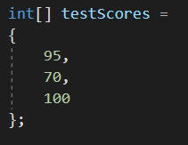
What is an Array?
An array is a data structure with a fixed size that allows you to store multiple values of the same data type in one variable.
Each value in an array is called an element.
Each element in an array can be referenced by its index.
Example:

Slide 3
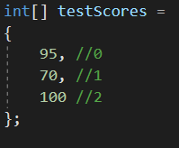
How to Know the Index of an Element
The first element of an array always has an index of zero.
The indexes in the array always increment by one.
The index of the last element in the array is always the length/size of the array – 1.
Example

Slide 4

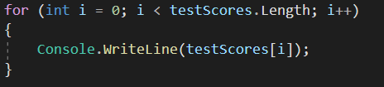
Printing Elements in an Array
To print elements from an array you must use the index(s) of the elements as shown here:

Slide 5

Replacing an Element in an Array
To replace an element in an array with a new value, you must call the index of the element you are trying to replace.
After you do this, you can assign it a new value.
Example:

Slide 6
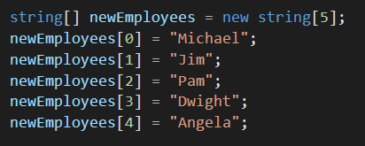
Creating an Empty Array
You may need to create an empty array because you do not know the details of what will be in there.
You do this by instantiating an array object with the size of what the array will be.
For example, if you know five new employees are joining your company but you do not know who they are, you would use this technique.
Example:

