Slide 1

Stroke Prediction
Hameed Alanazi

Slide 2
Contents
Abstract
Data Loading and Description
Data Cleaning
Exploratory Data Analysis
Splitting data
Model

Slide 3
Abstract
stroke is a medical condition that can lead to the death of a person. It’s a severe condition and if treated on time we can save one’s life and treat them well. There can be n number of factors that can lead to strokes and in this project blog, we will try to analyze a few of them.

Slide 4
Data loading and Description
A population of 5110 people are involved in this study with 2995 females and 2115 males. The dataset for this study is extracted from Kaggle data repositories (https://www.kaggle.com/datasets) to predict whether a patient is likely to get stroke.

Slide 5
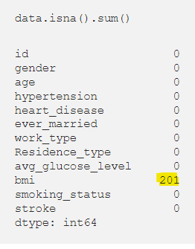
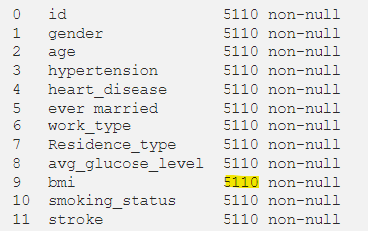
Data Cleaning
Lets clean the data from null value
There are 201 missing values in BMI feature. A simple way to dealing with the missing values is to remove the rows with null values

Slide 6
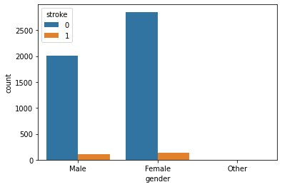
Exploratory Data Analysis
Gender with Stroke:
Seems like the dataset is imbalanced when stroke rate concerning gender

Slide 7
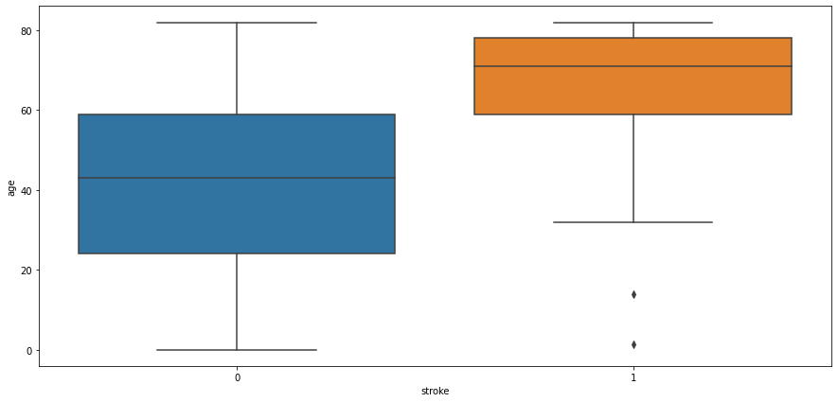
Exploratory Data Analysis
Let’s analyze our data using age factor and see how much impact actual impact it has.
Observation:
People aged more than 60 years tend to have a stroke. Some outliers can be seen as people
below age 20 are having a stroke it might be possible that it’s valid data as stroke also
depends on our eating and living habits.

Slide 8
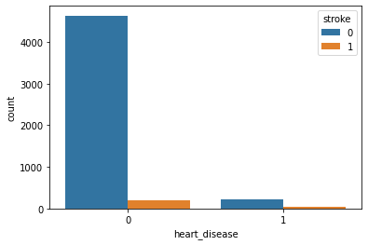
Exploratory Data Analysis
Observation:
that heart disease is not affecting Stroke.

Slide 9
Splitting data
split the data into training and testing sets for training and testing our classification models Logistic Regression.

Slide 10
Model
Logistic Regression gives accuracy score of 87.28%
Training accuracy 87.31%.
Test accuracy 87.28%.

