Slide 1
Direct the SAR 40M to four lagging regions to bring every region to the 65% target
1 · BLUF / THE ASK
Big Idea Tayseer is above 65% nationally, but four regions sit 2–4 points below target and will not get there for 8–19 months on their own. Concentrating the SAR 40M on them closes the gap.
Najran
Northern Borders
SAR 15M
SAR 9M
Adoption today: 60.9%
Adoption today: 62.7%
Decision requested today
Al-Baha
Jazan
Approve the SAR 40M allocation below and a 90-day checkpoint on the Power BI dashboard.
SAR 8M
SAR 8M
Adoption today: 62.8%
Adoption today: 63.0%
Digital adoption, December 2025 (latest month). Source: Tayseer services dataset, Jan 2022–Dec 2025; Power BI dashboard.
Notes:
PRESENTER: Student 1 · TIME: 0:00–0:30
[Say the ask in the first 30 seconds]
"Our recommendation: direct the next SAR 40 million to four regions — Najran, Northern Borders, Al-Baha and Jazan. Tayseer is already above the 65% target nationally, but these four are 2 to 4 points behind and, at today's pace, won't reach 65% for 8 to 19 months. We are asking you to approve this allocation today, with a 90-day checkpoint."
Hand-off: "Let me show you where we stand nationally."

Slide 2
Nationally, Tayseer is on track: adoption crossed 65% in August 2025 and reached 66.2%
2 · SITUATION — NATIONAL STATUS
66.2%
66.2% in Dec 2025
National digital adoption, December 2025
+12.1 pts
Gained since January 2022 (54.1%)
~3 pts / yr
Steady yearly gain: 55.4 → 58.5 → 61.7 → 64.8% (annual averages)
Digital adoption % = user-weighted average across all regions, services and channels. Source: Tayseer services dataset; Power BI dashboard (KPI + trend).
Notes:
PRESENTER: Student 1 · TIME: 0:30–1:15
Orient: "This line is national digital adoption every month since January 2022; the red line is the 65% target."
Point: "Look at the right-hand end."
What: "We crossed 65% in August 2025 and reached 66.2% in December — about 3 points of growth every year."
So what: "Nationally, we are on track. But the national average hides a regional split."
Hand-off to Student 2.

Slide 3
But 8 of 13 regions are still below 65%, and the gap between leading and lagging regions is widening
3 · COMPLICATION — REGIONAL GAP
8 of 13
regions below 65% in December 2025 (all 13 were below in December 2023)
7.5 → 9.9 pts
Gap between best and worst region, Dec 2022 vs Dec 2025: the leaders are pulling away
Red = below target; grey = at or above target. Same view as the Power BI “Regional Adoption” bar with the 65% reference line (see appendix).
Notes:
PRESENTER: Student 2 · TIME: 1:15–2:00
Orient: "Each bar is a region; zero is the 65% target. Red bars are below target, grey bars are above."
Point: "Focus on the red bars at the top."
What: "Eight of thirteen regions are still below 65%. And the spread between the best and worst region has grown from 7.5 to almost 10 points since 2022."
So what: "The national number is good, but the gap is regional and it's getting wider. Not all eight red bars are the same problem, though."

Slide 4
Four regions need 8–19 more months at today's pace; the other four will cross 65% within a quarter
4 · EVIDENCE — WHERE THE PRIORITY IS
2–4 pts
Bigger gap
Najran, Northern Borders, Al-Baha and Jazan are 2.0–4.1 pts short; the other four are within 0.7 pts.
84%
Most users to convert
≈784 users a month must switch to digital in these four — 84% of the total gap to 65% across all eight regions.
−6 pts
Lower adoption in every channel
Even on the Mobile App, adoption is 70% here vs 76% in leading regions; branch 48% vs 54%. Access isn't the issue — uptake is.
Pace = average monthly gain Jan 2022–Dec 2025 per region. Users to convert = (65% − adoption) × monthly unique users, Dec 2025. Channel figures are 2025 averages.
Notes:
PRESENTER: Student 2 · TIME: 2:00–4:00
Orient: "This chart shows how many months each below-target region needs to reach 65% if it keeps its current pace."
Point: "Look at the four red bars."
What: "Najran needs about 19 months; Al-Baha, Northern Borders and Jazan need 8 to 10. The four grey regions — Asir, Tabuk, Hail, Al-Jouf — will cross within one quarter on their own."
Three beats (right):
1) The gap is 2 to 4 points in the red four vs under 1 point in the grey four.
2) 84% of the users who still need to switch to digital are in these four regions.
3) Adoption is lower in every channel — even the Mobile App — so this is about uptake and support, not access.
So what: "If we want every region at 65%, these four are where the money changes the outcome."
Hand-off to Student 3.

Slide 5
Of three realistic options, only one targets the regions that won't close the gap on their own
5 · OPTIONS — USING THE SAR 40M
A
Spread evenly
B
Concentrate on 4 regions
C
National channel upgrade
SAR 5M to each of the 8 below-target regions
SAR 40M to the deep-gap four, split by users still to convert (15 / 9 / 8 / 8M)
Improve the app and portal for all 13 regions
+ Simple; every lagging region gets support
– Half the budget goes to 4 regions that will cross 65% within a quarter anyway; Najran gets only 1/8
+ All money goes where the gap won't close by itself; Najran gets the largest share
– Near-target regions get monitoring, not new funding
+ Benefits every user
– National target is already met; leading regions gain most, so the regional gap likely widens
Closes the regional gap: Partial
Closes the regional gap: Strong
Closes the regional gap: Weak
Allocation in Option B is proportional to users still to convert to reach 65% (Dec 2025): Najran 37%, Northern Borders 23%, Al-Baha 20%, Jazan 20%.
Notes:
PRESENTER: Student 3 · TIME: 4:00–5:00
"We looked at three realistic ways to use the SAR 40 million."
A — Spread evenly: simple, but half the money goes to regions that will reach 65% within a quarter anyway, and Najran — the furthest behind — gets only one eighth.
B — Concentrate on the four deep-gap regions, weighted by how many users still need to switch: every riyal goes where the gap won't close by itself.
C — National app/portal upgrade: helps everyone, but the national target is already met and the leaders would gain most, so the regional gap would likely widen.
"Option B is the only one that targets the problem we just saw."

Slide 6
Choose Option B: weight the SAR 40M to the four regions with the largest gap
6 · RECOMMENDATION
Expected effect
13 / 13
regions at or above 65%: the four funded regions by month 6 (target), the four near-target regions on their current pace within ~3 months
+0.6 pts
national adoption from these four regions alone reaching 65% (66.2% → ~66.8%)
≈ SAR 9
saved per transaction moved from branch (SAR 24.1) to mobile app (SAR 15.0)
Proposed levers assisted-digital onboarding in branches and call centres (lowest-adoption channels), local awareness campaigns, and kiosk-to-app hand-off.
Month-6 target requires +0.7 pts/month in Najran and ~+0.35 pts/month in the other three (vs ~0.23 today). Cost per transaction: 2025 national channel averages.
Notes:
PRESENTER: Student 3 · TIME: 5:00–6:15
"We recommend Option B."
Orient: "The bars show how the SAR 40 million would be split."
What: "Najran gets 15 million because it has the largest gap and the most users still to convert; Northern Borders 9, Al-Baha and Jazan 8 each."
Expected effect: all 13 regions at or above 65% — the funded four by month 6 as our target, the near-target four on current pace within about a quarter. National adoption gains about 0.6 points from these four alone, and every transaction moved from branch to app saves roughly 9 riyals.
Uncertainty (say it honestly): the month-6 target needs Najran to roughly triple its monthly gain and the others to about 1.5x — that's why we propose a 90-day checkpoint.

Slide 7
Approve SAR 40M for Najran, Northern Borders, Al-Baha and Jazan today, with a 90-day checkpoint
7 · THE ASK + NEXT STEP
TODAY
DAY 30
DAY 90
MONTH 6
Approve
Launch
Checkpoint
Target
Najran SAR 15M
Northern Borders 9M
Al-Baha 8M
Jazan 8M
Regional teams start assisted-digital onboarding and awareness campaigns
Each funded region on pace: Najran ≥ +0.7 pts/month, others ≥ +0.35 — tracked on the Power BI dashboard
All four at ≥ 65%; move funds from any region that is off pace
Decision today: approve the allocation and the day-90 checkpoint.
Checkpoint pace = monthly gain needed to reach 65% six months after funding, from Dec 2025 levels.
Notes:
PRESENTER: Student 3 · TIME: 6:15–7:00
[Restate the ask at the close]
"So our ask is simple: approve SAR 40 million for Najran, Northern Borders, Al-Baha and Jazan today.
Within 30 days regional teams launch onboarding and awareness work.
At day 90 we come back with the dashboard: each region must be gaining at least 0.35 points a month — Najran 0.7.
By month 6 all four should be at 65%, and any region off pace has its funds moved.
Approve the allocation and the 90-day checkpoint — that's the decision we need today."
Then: "We're happy to take questions — the live Power BI dashboard is ready."

Slide 8
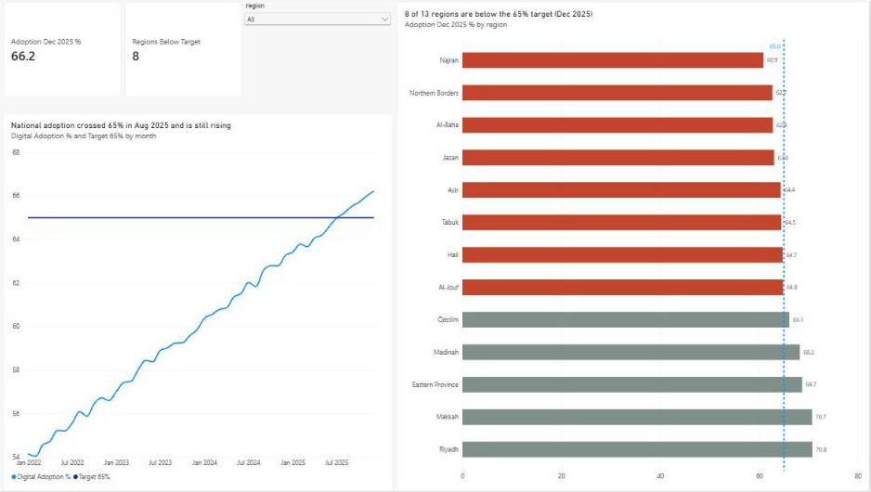
The Power BI dashboard shows the same story: 66.2% nationally, 8 regions below the 65% line
APPENDIX A · EVIDENCE SOURCE
KPI cards
Dec 2025 adoption (66.2%) and number of regions below target (8)
Trend
Monthly national adoption vs the 65% target line
Regional bars
Sorted lowest first; red = below target, grey = on/above; dashed 65% line
Filter
Region dropdown slicer (default: All)
Power BI report “Tayseer - Digital Adoption” (My workspace), semantic model “Tayseer Digital Adoption”. Use live for Q&A.
Notes:
Use only in Q&A. Switch to the live Power BI report to filter by region if asked.

Slide 9
Every number in the story traces back to one user-weighted measure on one dataset
APPENDIX B · METHOD AND DATA NOTES
Data | Tayseer services dataset: 24,960 rows, Jan 2022–Dec 2025, 13 regions × 8 service categories × 5 channels (synthetic, course-provided)
Digital Adoption % | Σ(digital_adoption_pct × unique_users) ÷ Σ unique_users — the same formula as the Tableau lab; built as a DAX measure in Power BI
Snapshot | December 2025 (latest month) for regional status; 2025 full-year averages for channel and cost comparisons
Months to 65% | Gap to 65% ÷ the region's average monthly gain, Jan 2022–Dec 2025 (linear pace)
Allocation weights | Users still to convert = (65% − adoption) × Dec 2025 monthly unique users; SAR 40M split pro rata, rounded to whole millions
Limitations | Single-month snapshots are noisy; the same four regions are also the bottom four on 2025 full-year averages. Pace and expected effects are targets, not forecasts
Notes:
Use only in Q&A, especially for 'your data is wrong' questions: separate the number from the recommendation.

Slide 10
Likely questions, and how each answer bridges back to the decision
APPENDIX C · Q&A PREPARATION
Why not fund all eight below-target regions?
Asir, Tabuk, Hail and Al-Jouf are within 0.7 pts and cross 65% within ~3 months at today's pace. Funding them buys little; we keep them on the dashboard watch-list.
Is December 2025 just a bad month?
No — on 2025 full-year averages the same four regions are the bottom four (60.4–61.6%). The ranking holds.
Your numbers look wrong.
The measure is user-weighted and matches the dashboard. Even if one region moves by a point, the deep-gap four stay the priority.
What if a region doesn't respond?
The day-90 checkpoint: a region below its required pace has its remaining funds moved to the regions that are on track.
Notes:
Acknowledge → answer → bridge back to the Big Idea: four regions, SAR 40M, 90-day checkpoint.

