Slide 1
New Slide Title
This is the content of the new slide.

Slide 2
Understanding Climate Change
Climate change is a long-term shift in global or regional climate patterns. It is primarily due to human activities such as burning fossil fuels, deforestation, and industrial processes.

Slide 3
Causes of Climate Change
The main causes of climate change include greenhouse gas emissions (carbon dioxide, methane, nitrous oxide), deforestation, industrialization, and agricultural practices.

Slide 4
Effects of Climate Change
Climate change leads to a range of impacts including rising global temperatures, more frequent and severe weather events (such as hurricanes, floods, and droughts), melting ice caps and glaciers, and rising sea levels.

Slide 5
Impact on Ecosystems
Climate change disrupts ecosystems, leading to loss of biodiversity, habitat destruction, shifts in species distribution, and increased risks of extinction for many plants and animals.

Slide 6
Impact on Human Health
Climate change poses significant risks to human health, including heat-related illnesses, respiratory problems due to air pollution, increased spread of infectious diseases, and food and water shortages.

Slide 7
Economic Implications
Climate change has substantial economic costs, including damage to infrastructure, loss of agricultural productivity, increased healthcare expenses, and disruption of industries such as tourism and fishing.

Slide 8
Mitigation Strategies
Mitigation involves reducing the emissions of greenhouse gases and enhancing carbon sinks. Strategies include transitioning to renewable energy sources, improving energy efficiency, and implementing policies to reduce emissions from transportation and industry.

Slide 9
Adaptation Measures
Adaptation involves adjusting to the impacts of climate change to minimize harm and build resilience. Measures include improving infrastructure to withstand extreme weather events, implementing early warning systems, and developing drought-resistant crops.

Slide 10
Global Cooperation
Addressing climate change requires international cooperation and collective action. Initiatives such as the Paris Agreement aim to limit global warming and support vulnerable communities in adapting to climate change.

Slide 11
Call to Action
We must take urgent action to address climate change. This includes reducing greenhouse gas emissions, investing in renewable energy and sustainable practices, and advocating for policies that prioritize climate action and environmental protection.

Slide 12
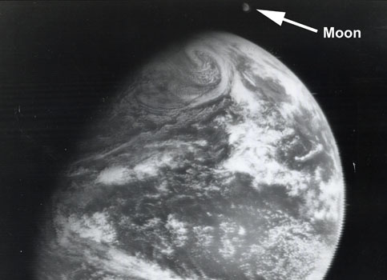
Slide Title
Text content goes here.

