Slide 1
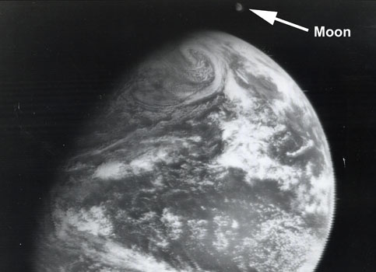
Slide Title
Text content goes here.

