Slide 1
WELCOME TO OUR PRESENTATION

Slide 2
ABOUT ME
Name: Hamad Ismail
ID: 201902046

Slide 3
TOPIC
Green Chat (Customer Manager Chatting Application

Slide 4
AGENDA
INTRODUCTION
FEATURES
DESIGN
RESULTS
Q&A SESSIONS

Slide 5
INTRODUCTION
Chatting is a method of using technology to adding people and ideas together despite of the geographical barriers.

Slide 6
FEATURES
Customers can send message to the manager
Manager can be reply the message
Manager can handle multiple customers at a same time
One customer messages are secure from the other customers
All of the features are work on GUI interface

Slide 7
DESIGN
FUNCTIONAL PART
Java Socket
DESIGN PART
Java Swing

Slide 8
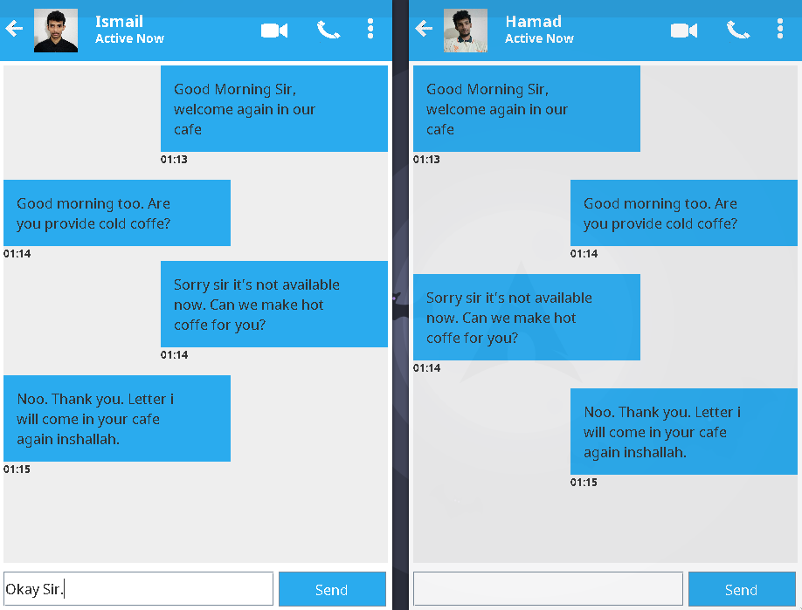
RESULTS

Slide 9
Q&A SESSIONS

Slide 10
THANK YOU!

