Slide 1
Foodie
By: Matt and Hamad

Slide 2
introduction
Technology is becoming more prevalent in the restaurant industry
It is important to make sure your business model is up to date
It is also important that all businesses invest in technology

Slide 3
What’s the problem?
Wait times?
Order inaccuracies
Waiters can be more efficient

Slide 4
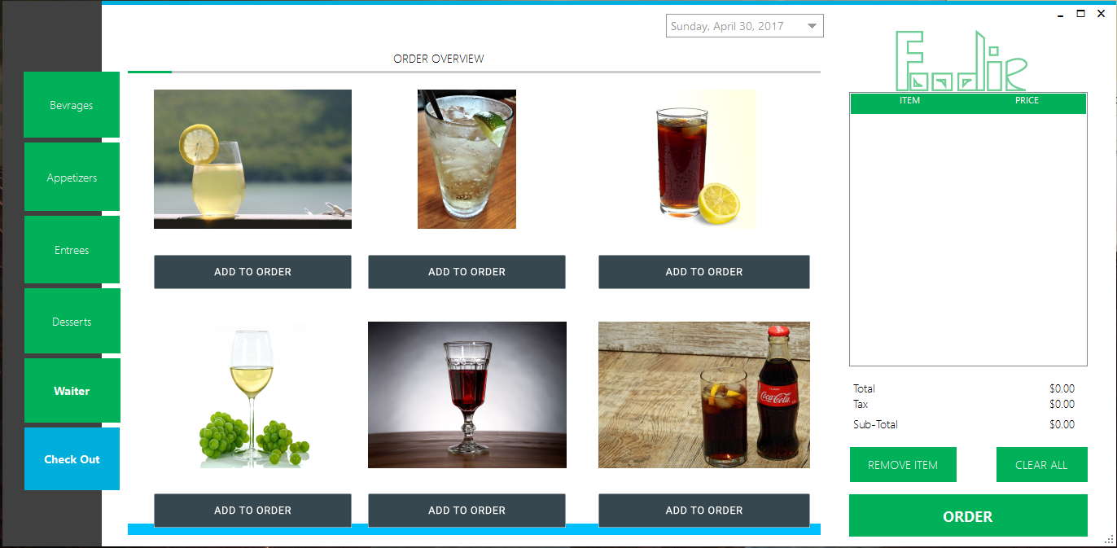
Foodie our concept of a digital menu

Slide 5
The foodie solution
Without the responsibility of taking orders waiters can focus on the process of delivering the food
Customers can order there meal as soon as they sit at the table without having to wait for a waiter
No need to wait for the check at the end either
Throughout the meal a waiter can be requested at any time
Also because your order is sent directly to the chef, order inaccuracies are exceptionally rare

Slide 6
Demo

