Slide 1

George Mauer
Senior Developer
Westway Terminal Co
gmauer@gmail.com
You Can't Dance The Lambda
Why I use lambdas all the time for everything and so should you
x => x.BeAwesome( )
Notes:
Unlike many of my other talks this one is not about best practices. Its about the C# 3.5 lambda feature but really it's more about applying certain FP techniques that are now possible.
Use it all the time and for everything
I am not an expert
Widely used in functional programming and hybrid languages like F#, Ocaml, Ruby, and Javascript.
Used heavily by libraries like StructureMap, RhinoMocks, MoQ, Fluent Nhibernate – beacons of the .NET OSS world. Why?
Time to get on board

Slide 2
Contents
Definitions
Delegates Review
Lambda Syntax
Examples of Lambda Usage
  Syntax
  In-code patterns
  Architectural patterns
  Advanced functionality
Notes:
Review how FP has been available before
Review need for lambda syntax
Go over the syntax and why the idea is nothing new
I'm going to throw some examples at the wall
This is going to be dense and code heavy.

Slide 3

A Whatchada?
A Lambda function is an invokable object
Don't Panic
  Just a different syntax for anonymous delegates
  Can be parsed with System.Linq.Expressions namespace
    Fast and accurate reflection
    Allows for currying
    Used for the magic of all LINQ2X providers
Notes:
The Wikipedia definition is terrifying
Different syntax for anonymous delegates
Very similar to regular delegates and events
While not fully the same as functions in FP, many ideas from functional programming

Slide 4

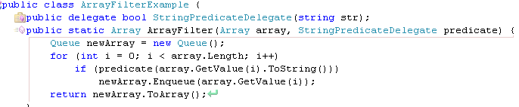
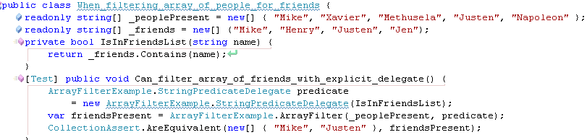
Time For Review
Events
  Framework support for simple observer pattern
  Widely used in winforms and webforms
Equivalent
Delegates
Declare
delegate
Use
delegate
Instantiate
delegate
Notes:
Has everyone used events before?
Has everyone written their own, not just used those provided by controls?
Events are useful for notifying other components
Events are an invokable list of delegates
A delegate is an object with an invoke method. A delegate type is a class type that determines the argument and return types for a delegate.
On creation a delegate takes a reference to a function that implements its type
Go through how it works.
Note scope
This concept exists in most modern languages

Slide 5


Time For Review (cont'd)
Anonymous Delegates
  No need to explicitly instantiate delegate or create function
But We Can Do Better!
Notes:
That is crap
Take a look at code
I'm anti code noise esp infrastructure and repetition
This is one line of code in many languages
Explicit functions have too large a usage scope
As of .NET 2.0 can use anonymous delegates
Note scope inside anon delegate

Slide 6
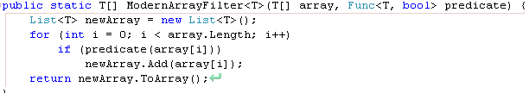

And Now the Main Event
A Slight Detour
Creating delegate types is a pain. Is it possible to create a Generic Delegate?
public delegate bool Filter<T>(T item);
Since .NET 2.0 we have Predicate<T>
Supplanted in .NET 3.5 by Func<T, R> - just set R to bool
Many combinations provided: Func<R>, Func<T, R>, Func<T1, T2, R>
Parameter1 Type, Return Type
Func<string, bool> instance
Notes:
Finally we get to Lambdas

Slide 7


Lambda Syntax Tips
When method has no return use Action, Action<T>, Action<T1, T2>, etc
Single-line lambdas do not need braces, semi-colons, or return keyword
Multi-line lambdas need braces and the return keyword if it has a return value
No arguments
( ) => Console.WriteLine(“I <3 Lambdas”)
Multiple Arguments
(a, b) => a + b
Explicitly Typed Arguments
( MyClass c) => c.DoSomething()
Conventions
A lambda with an argument that you don't care about
_ => Console.WriteLine(“I just don't care what that parameter one is”)
One character variable names for short, simple lambdas (< 3 lines), descriptive variable names for longer lambdas

Slide 8



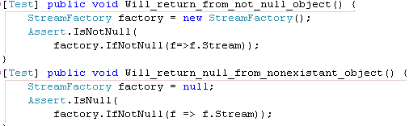
So...Why do I care?
Great for abstracting patterns of code usage
  using block is an example of usage patterns. Get IDisposable → Run Code → call Dispose()
Execute a method only if an object is not null inline
DoIfNotNull(thing, x => x.DoSomething());
Get a value from an object if the object is not null, otherwise get null
Extension Method on any nullable type
No error because this doesn't execute

Slide 9

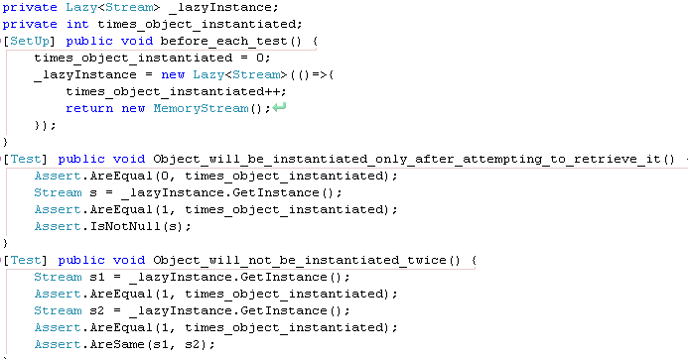
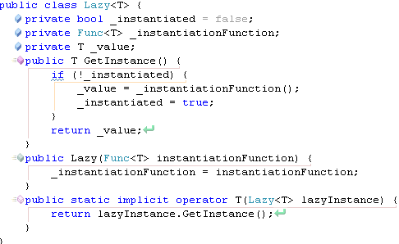
Never Lazy Load Again
Lazy loading: If the instance exists return it, otherwise create it, store and return the instance
Solve with Lazy<T> which knows how to instantiate T
Who you calling lazy fool?

Slide 10

Events – The Right Way
DIE!!
EventHandler Sucks!
public delegate void EventHandler(object sender, EventArgs e);
Passes in parameters you don't ever use, forces you to cast.
Forces a signature exposing how a method is used rater than its function
Lambda Delegate Adapter:
btnSayHello.Click += (o, e) => ShowHelloDialog();
No need to declare functions for simple event handlers:
this.Load += (o, e) => Console.WriteLine("This can be a good alternative to a method");
Route to a different object (ie in MVP):
this.Load += (o, e) => _presenter.Start(this);
No need for null check
Modern way to declare an event:
public event Action OnSomethingImportant = delegate { };

Slide 11
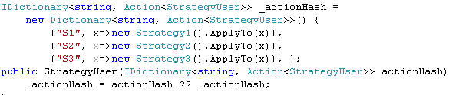

Conditionals With Hashes
Complicated if and switch statements - BLEH!
Strongly couples conditions to each other, can be awkward to read, violates Open/Closed Principle, cannot be changed during run-time
Can ease these problems with a hash of lambdas by condition
hash[condition] = Action when condition is matched
Make the condition a predicate:
IDictionary<Func<string, bool>, Action<string, StrategyUser>>
Execute first matching
_predicateActionHash.First(kv => kv.Key(code)).Value.Invoke(code, this);
Execute all matching
_predicateActionHash.Where(kv=>kv.Key(code)).ToList().ForEach(kv=>kv.Value(code, this));

Slide 12
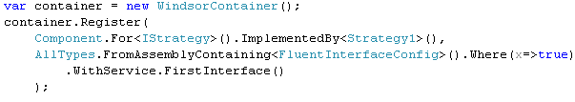
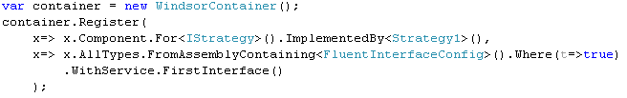
Easily Navigable DSLs
Domain Specific Languages for configuration are Great!!!
DSLs + Intellisense == <3 – Intellisense/Strong Typing can guide your configuration so that you know all the options
No Intellisense for the starting point!
Component/AllTypes/AllTypesOf – How am I supposed to know the possibilities?
Get Intellisense from the start!
Don't just fetch an IRegistration
Transform a starting point to an IRegistration

Slide 13
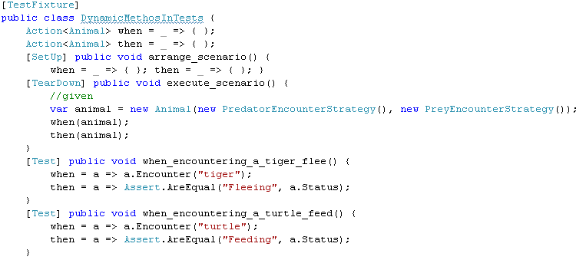

Dynamic Methods
Subclass and override virtual method is great but bound to the class hierarchy
Delegates are invokable like functions yet are changeable at run-time!
Be cautious – a good way to write unmaintainable code
Great for simple one-off frameworks with replaceable functionality
Sample Usage: BDD-Style Tests
Traditionally each test fixture will set up a scenario, and execute an action
Each test evaluates a post-condition
Sometimes useful to test pre-and post condition combinations
Each test sets conditions and expectations. Fixture executes them

Slide 14
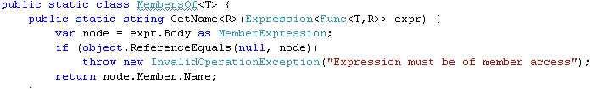
And More!
Delegate Goodies!
Asynchronous execution with BeginInvoke()
Easy access to MethodInfo and Target objects
System.Linq.Expressions
Very powerful expression analysis
Where all the meat of LINQ Providers is
Reflection, Metaprogramming, Optimization...almost anything!
Example: Strongly typed get property name
Some libraries reflect over property names
“Name” is a
Property on Cat
IList cats = session.CreateCriteria(typeof(Cat))
.Add(Expression.Eq(“Name”, “Elmo”)).List();
Refactoring resistant, spelling errors, bypasses type checking – ick

Slide 15
Round-Up
Simple Patterns
  DoIfNotNul()
  IfNotNull()
  Lazy<T>
Event Handling
  Legacy event adapters
  Inline event methods
  Proper event types
Occasional Patterns
  Map/Reduce with Hash
  Changeable Methods
Navigable DSLs
Easy asynchronous execution
Expression Reflection
Thanks!
George Mauer
http://georgemauer.net/blog
Twitter: togakangaroo
Email: gmauer@gmail.com

