Slide 1

Rate me on SpeakerRate
http://tinyurl.com/ffcc2010-lambdas
George Mauer
gmauer@gmail.com
@togakangaroo
You Can’t Dance the Lambda
Why I use lambdas all the time for everything and so should you
x => x.BeAwesome( )
Notes:
I am a .NET developer with an interest in making sustainable software.
I am a big proponent of SOLID, TDD, DDD
Can't Dance The Lambda is actually about Functional Programming techniques and patterns that you can use in C#. Also cover the basics of LINQ, extension methods, and Type Inference.
These are widely used in functional programming and hybrid languages like F#, Ocaml, Ruby, and Javascript. Time to get on board
There will be lots of code – stop me and ask questions.

Slide 2
















Fairfield / Westchester Code Camp 4 (2010)
We thank the following companies for their gracious sponsorship:
Platinum
Gold
Silver
Other Material Contributions Came From:

Slide 3
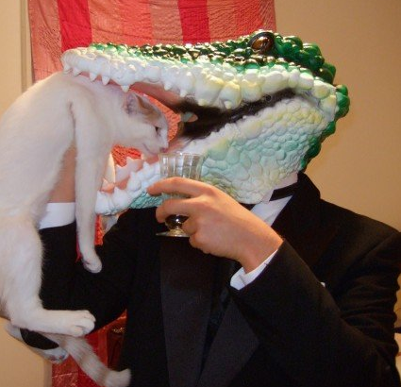



About Me
Senior Software Developer at EPS Software
Leader of New Orleans .Net Usergroup
Member - VirtualBrownBag, VirtualAltNet, gnocode, PhpNOLA, RubyBayou
Improv and Sketch Comedy with www.NolaComedy.com
@togakangaroo
gmauer@gmail.com
http://georgemauer.net/blog

Slide 4
EPS-Software / CoDE
CoDE Magazine
Consulting
VFP Conversion
Xamalot
Training
CodeCast

Slide 5
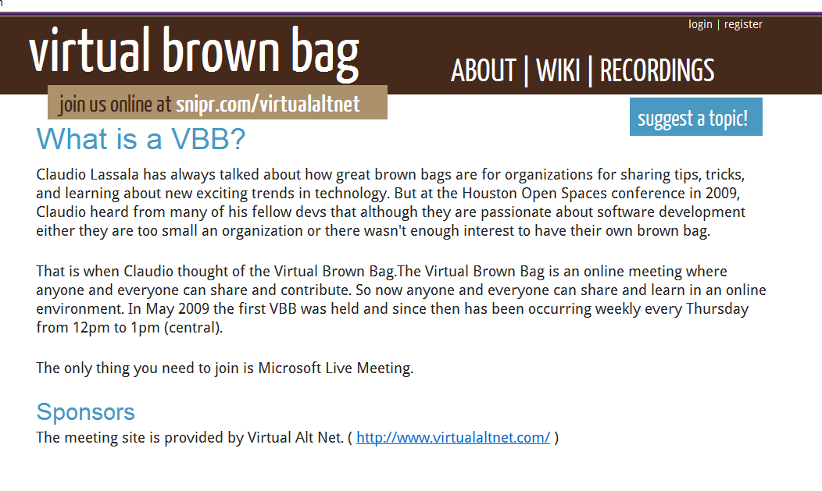
Join Us For the Virtual Brown Bag
1:00 PM EST Thursdays on Livemeeting
www.virtualbrownbag.com
Twitter: @virtualbrownbag

Slide 6
Contents
Definitions
Delegates Review
Lambda Syntax
Examples of Lambda Usage
Syntax
In-code patterns
Architectural patterns
Advanced functionality
Notes:
This is not a best practices talk. It is about using this one feature. Some things I downright recommend against doing
We will talk about what exactly this lambda is
Evolution and the need for it
Syntax tips and tricks
Show in code useful classes and extensions using lambdas
Show useful patterns where you could use lambdas
Scrape some of the advanced things you can do
Basically going to throw examples at the wall and hope they get you excited
This is going to be dense and code heavy. Ask questions

Slide 7

A Whatchada?
A Delegate is an invokable object
var lamba =
(x, y) => {
Crazy(x.Stuff);
All.Over(()=>The.Place);
}
Don’t Panic!
A lambda function is just some different delegate syntax
Notes:
The Wikipedia definition of lambdas is terrifying
Whats a delegate? An object created to encapsulate a function. Has an invoke() method and is therefore invokable.
Lambdas are a simpler syntax for delegates which use type inference to clear away some redundancies
Add in ability to work with System.LINQ.Expressions
We will talk about very briefly since it is vast and powerful
Magic of all LINQ providers is here
Lambdas are nothing new since .NET 2.0 – only thing new since .NET 1.1 is anonymous delegates

Slide 8


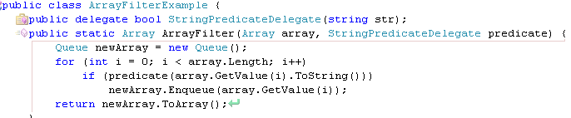
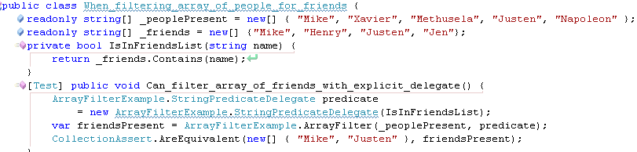
Time For Review
Events
Framework support for simple observer pattern
Widely used in winforms and webforms
Equivalent
Delegates
Declare
delegate
Use
delegate
Instantiate
delegate
Notes:
Has everyone used events before?
Has everyone written and invoked their own, not just used those provided by controls?
Note .Invoke() and () syntax – they are equivalent. We will see this throughout
Events are an invokable list of delegates
Who has created delegats before? You will recognize this
A delegate is an object with an invoke method. A delegate type determines the signature of methods that it can wrap
On creation a delegate takes a reference to a function that matches its type's signature
Show an application of delegates by filtering an array using a custom filter
Best thing for figuring out scope is to go with your fist instinct

Slide 9


Time For Review (cont'd)
Anonymous Delegates
No need to explicitly instantiate delegate or create function
But We Can Do Better!
Notes:
That pattern was crap for readability
Take a look at code – too much noise and repitition!
This should all be one line – no ceremony
Explicit functions have too large a usage scope can be used from places you didn't want them to be accessible from
As of .NET 2.0 can use anonymous delegates to inline function declaration
Note scope inside anon delegate
This addresses many of these problems but still...

Slide 10
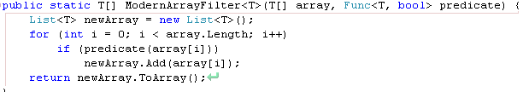

And Now the Main Event
A Slight Detour
Creating delegate types is a pain. Is it possible to create a Generic Delegate?
public delegate bool Filter<T>(T item);
Since .NET 2.0 we have Predicate<T>
Supplanted in .NET 3.5 by Func<T, R> - just set R to bool
Many combinations provided: Func<R>, Func<T, R>, Func<T1, T2, R>
Parameter1 Type, Return Type
Func<string, bool> instance
Notes:
Finally we get to Lambdas but first StringPredicateDelegate – creating a new delegate for each method signature is a pain! What happens if we want Integer Predicates? Class1 Delegates? Sounds like a job for generics.
Now you just specify what argument type you want.
Already exists in .NET 2.0 as Predicate<T> and supplanted by Func<T,R> -if R is bool then it will be predicate
Func<T,R> is a delegate same as Filter<T> and StringPredicateDelegate, after T and R are filled out it will be compiled to exactly the same code.
Alternatives exist for methods with more or less arguments
Take time and go over this.
Rewrite our ArrayFilter function to use Func<T, bool>
Use it by explicitly creating a Func<string, bool> delegate around our anon method – but not necessary
Still lots of duplication, and the delegate keyword is awkward
So use lambda syntax. That T is string can be figured out by the compiler
ArrayFilter already exists as Where() method in the Linq space – they are identical

Slide 11


Lambda Syntax Tips
When method has no return use Action, Action<T>, Action<T1, T2>, etc
Single-line lambdas do not need braces, semi-colons, or return keyword
Multi-line lambdas need braces and the return keyword if it has a return value
No arguments
( ) => Console.WriteLine(“I <3 Lambdas”)
Multiple Arguments
(a, b) => a + b
Explicitly Typed Arguments
( MyClass c) => c.DoSomething()
Conventions
A lambda with an argument that you don't care about
_ => Console.WriteLine(“I just don't care what that parameter one is”)
One character variable names for short, simple lambdas (< 3 lines), descriptive variable names for longer lambdas
Notes:
It is a major language design error that void is not a type – therefore it is impossible for Func<> to match the signature of a method with no return
Fortunately we have the Action<> delegates to handle these. Other than void return they are identical to the Func<> delegates
You already saw the 80% use case for lambda usage: single line – more complicated lambdas have slightly more awkward syntax
Conventions – note underscore is a valid variable name
Conventions – for short and obvious methods it is distracting to provide lengthy variable names. For long ones you need them.

Slide 12


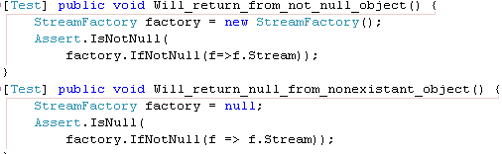
So...Why do I care?
Great for abstracting patterns of code usage
using block is an example of usage patterns. Get IDisposable → Run Code → call Dispose()
Execute a method only if an object is not null inline
DoIfNotNull(thing, x => x.DoSomething());
Get a value from an object if the object is not null, otherwise get null
Extension Method on any nullable type
No error because this doesn't execute
Notes:
So the syntax is nice but what good is it really short of using the Where() filter?
First lets talk about DRY – Don't Repeat Yourself – it is a good principle
Ways to do it: Extract method; Move to base class; Static Helpers; For the really enlightened Dependency Injection
Object oriented languages are great at this but not at abstracting patterns of code use
Example is so common: the using keyword. Can't abstract because of the “do something” in the middle. If .NET 1.1 had lambdas using would probably have been left as an exercise to the reader
Show how to implement CustomUsing() in code
I wouldn't recommend implementing your own using without good reason
Whats another pattern? Only do something to an object if its not null.
Notice the contents of DoIfNotNull() do not necessarily execute
Something a bit more useful – return the result of a method or a property only if an object is not null. IfNotNull() takes a Func<> instead of an action and is an extension method.
Notice default(R)
Useful for not breaking your train of thought when in the middle of an expression. Can chain them together to maintain stream of thought without having to intersperse null checks. Show a good example in code. As always, be careful with this power.

Slide 13

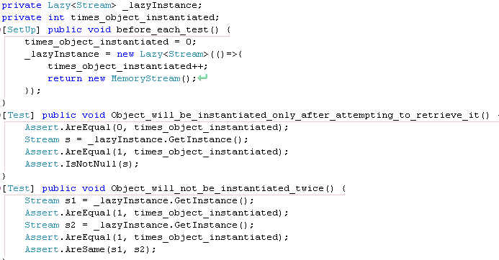
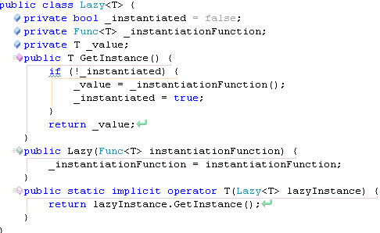
Never Lazy Load Again
Lazy loading: If the instance exists return it, otherwise create it, store and return the instance
Solve with Lazy<T> which knows how to instantiate T
Who you calling lazy fool?
Notes:
Admittedly the previous snippets don't save you all that much typing, let's do something more substantial – this is the applause getter.
Who has an application that does lazy loading?
Its a pain! There are lots of caveats (run through it). You need something like 10-15 lines of code to support the pattern!
Can we abstract away all this? Abstract away everything but creating the actual object.
Here is how we would use something like this – explain test flow for people who don't understand it.
Show implementation. Trace through it.
Notice the implicit conversion operator. One of C#'s most hidden features. This lets the compiler how to convert between Lazy<T> and T without you having to call GetInstance() explicitly.
Show usage in code.

Slide 14

Events – The Right Way
DIE!!
EventHandler Sucks!
public delegate void EventHandler(object sender, EventArgs e);
Passes in parameters you don't ever use, forces you to cast.
Forces a signature exposing how a method is used rater than its function
Lambda Delegate Adapter:
btnSayHello.Click += (o, e) => ShowHelloDialog();
No need to declare functions for simple event handlers:
this.Load += (o, e) => Console.WriteLine("This can be a good alternative to a method");
Route to a different object (ie in MVP):
this.Load += (o, e) => _presenter.Start(this);
No need for null check
Modern way to declare an event:
public event Action OnSomethingImportant = delegate { };
Notes:
Events are great. As a framework-baked observer pattern they're a simple way to notify unrelated components of something. They are awesome for loose coupling.
I hate the EventHandler delegate type – there is so much wrong with it. I have almost never used sender or e. You have to cast sender to do anything interesting. What if you want to call the method from somewhere else? You know...that abstraction thing?
Method signature like name should reveal what it does not how others might use it.
Which of these two examples would you prefer for showing a messagebox?
With lambdas you can get write the event handler that you want. If you really want you can cast o or e and pass them in.
What about simple event handlers? Like simple logging – its almost a waste to create a separate method for them. You can create them in line! Be careful of course – if something should be a method then make it a method!
What about routing an event to the presenter like in a Model View Presenter architecture? Easily achievable with an inline method.
From now on please declare events with the appropriate Action<> delegate – set their handler signatures to exactly what you want.
What is that delegate{} doing there? It's a trick so you don't have to do a null check
For some crazy reason the event list is null until someone registers a delegate to it
This stores a delegate for an empty inline method so there's always at least one

Slide 15
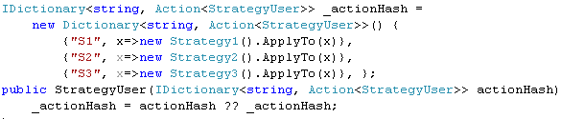

Conditionals With Hashes
Complicated if and switch statements - BLEH!
Strongly couples conditions to each other, can be awkward to read, violates Open/Closed Principle, cannot be changed during run-time
Can ease these problems with a hash of lambdas by condition
hash[condition] = Action when condition is matched
Make the condition a predicate:
IDictionary<Func<string, bool>, Action<string, StrategyUser>>
Execute first matching
_predicateActionHash.First(kv => kv.Key(code)).Value.Invoke(code, this);
Execute all matching
_predicateActionHash.Where(kv=>kv.Key(code)).ToList().ForEach(kv=>kv.Value(code, this));
Notes:
Let's get even further out there. This is one of those techniques you should be careful with but useful to have in your toolbelt.
Long switch statements, complex ifs – they're not exactly evil but they are a cludge.
Conditionals in code strongly couple results of each condition to each other.You cannot change the logic during run-time, you can't actually change it at all without editing that file. Violation of Open/Closed Principle. Would be nice to externalize that logic.
How about something like an associative array? The look-up key can be the condition, and the value can be the action you take on that condition.
If this looks familiar you've probably done some functional programming before. This is quite similar to the very widely used functional pattern Map/Reduce pattern.
Show what a switch looks like in code. We can easily put it in a dynamic structure as a hash. This is nice it can be injected and modified. We can even provide a default and override it if we choose to. Trace through the logic.
Show how to run a matching value.
What if we knocked this up a notch? Instead of a string condition we provide a delegate that evaluates a string? The signature is messy but we can make a dedicated class
Now we can have multiple matches. We can run the first matching or all matching. We can dynamically generate handlers.
Think long and hard before doing something like this but know your options.

Slide 16
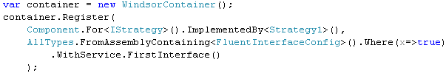
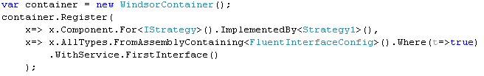
Easily Navigable DSLs
Domain Specific Languages for configuration are Great!!!
DSLs + Intellisense == <3 – Intellisense/Strong Typing can guide your configuration so that you know all the options
No Intellisense for the starting point!
Component/AllTypes/AllTypesOf – How am I supposed to know the possibilities?
Get Intellisense from the start!
Don't just fetch an IRegistration
Transform a starting point to an IRegistration
Notes:
Who knows what a Domain Specific Language is? Who has used one.
They're great for configuration. Not the least of which because static typing and Intellisense can easily guide you though the options.
Here's the Castle Windsor DSL. You use Windsor by requesting a class that implements an interface and it provides you with an instance. First you've got to configure it. You can do so explicitly or by telling it to scan an assembly.
The Register() method takes IRegistration objects. How do I know how to generate one? How do I know that Component or AllTypes are the static classes to start with? Is there a way to get Intellisense from the onset?
The trick is that instead of taking IRegistration objects you take a function that will transform a starting point to an IRegistration object – the starting point dictates options.
Show in code how you would do this.
Added bonus. No static classes.

Slide 17
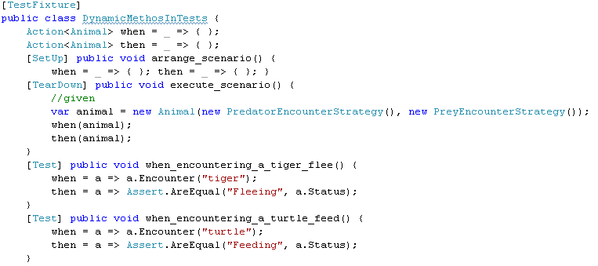

Dynamic Methods
Subclass and override virtual method is great but bound to the class hierarchy
Delegates are invokable like functions yet are changeable at run-time!
Be cautious – a good way to write unmaintainable code
Great for simple one-off frameworks with replaceable functionality
Sample Usage: BDD-Style Tests
Traditionally each test fixture will set up a scenario, and execute an action
Each test evaluates a post-condition
Sometimes useful to test pre-and post condition combinations
Each test sets conditions and expectations. Fixture executes them
Notes:
How about another crazy “maybe you shouldn't do this” thing?
Everyone can agree that overriding virtual methods is powerful and useful
Its tied to the class hierarchy though. You can't change a method implementation at runtime. And maybe you shouldn't but what if you could? Do you have to use IronRuby? Well functional programming is about functions so maybe you can do this with lambdas?
Indeed you can – consider that a delegate can substituted in and out like any variable and can be invoked just like a function.
The most useful application of this for me has been in setting up little mini-frameworks such as in testing.
Behavior Driven Development is a subset of Test Driven Development with a focus on writing your tests so they read as an analyst might describe the feature. The standard approach is to use Given-When-Then.
This approach is great but its not always sufficient. Sometimes the essence of the feature is that each post-condition varies in response to pre-conditions.
Here is an example of such a test. We have an Animal that reacts differently to an encounter with a predator than a prey. We can still use the Given-When-Then language but change out the When action and Then test dynamically!
Again, this stuff is really cool but maybe its not always the best thing to use. Think carefully. If you need dynamic methods maybe you should use a dynamic language.

Slide 18
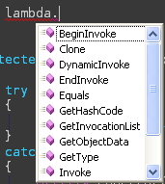
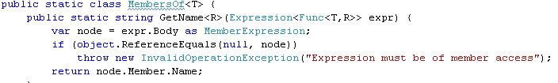
And More!
Delegate Goodies!
Asynchronous execution with BeginInvoke()
Easy access to MethodInfo and Target objects
System.Linq.Expressions
Very powerful expression analysis
Where all the meat of LINQ Providers is
Reflection, Metaprogramming, Optimization...almost anything!
Example: Strongly typed get property name
Some libraries reflect over property names
“Name” is a
Property on Cat
IList cats = session.CreateCriteria(typeof(Cat))
.Add(Expression.Eq(“Name”, “Elmo”)).List();
Refactoring resistant, spelling errors, bypasses type checking – ick
Notes:
And there's a few more!
Remember that a lambda is implicitly an Action<> of Func<> which are delegates.
This means we get easy access to reflection info on the enclosed function and the BeginInvoke() method. That's right, they can be easily run asynchronously – no need to explicitly create a new thread.
And what about that mythical System.Linq.Expression namespace that I mentioned? This namespace contains objects that will let you analyze the contents of a lambda.
You can use expression trees to optimize an expression, you can do meta-programming on the expression – maybe add logging if you see a certain object or method referenced.
The simplest thing you would use it for is reflection. This is the example that I will show you now.
Here is some code from the NHibernate library. What is “Name”? It is a property on the Cat class. What happens if we change that property name or misspell it to begin with. This bypasses the whole point of static typing. What if we could use it to our advantage?
A helper class that contains methods to derive members. Notice the input of Expression<> - Expressions wrap a delegate and allow you to analyze them.
Notice the output is a string, but we never actually have to reference it. Now we can find all references to Status and renaming tools will access it because the compiler knows that x is of type Animal.
Performance is worse

Slide 19
Round-Up
Simple Patterns
DoIfNotNul()
IfNotNull()
Lazy<T>
Event Handling
Legacy event adapters
Inline event methods
Proper event types
Occasional Patterns
Map/Reduce with Hash
Changeable Methods
Navigable DSLs
Easy asynchronous execution
Expression Reflection
Thanks!
SpeakerRate: http://tinyurl.com/ffcc2010-lambdas
gmauer@gmail.com
@togakangaroo
http://georgemauer.net/blog

