Slide 1
K. HEMANATH
V. GOKUL
S. D. HARSUDHAN
B. BALAJI
ESTIMATION OF BUSINESS EXPENSES

Slide 2
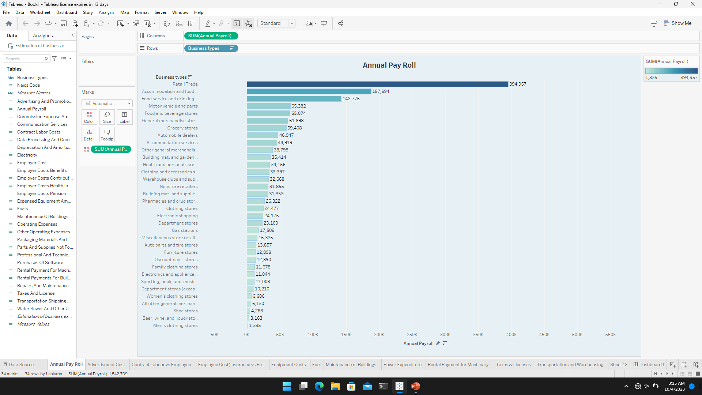
Annual Pay Roll

Slide 3
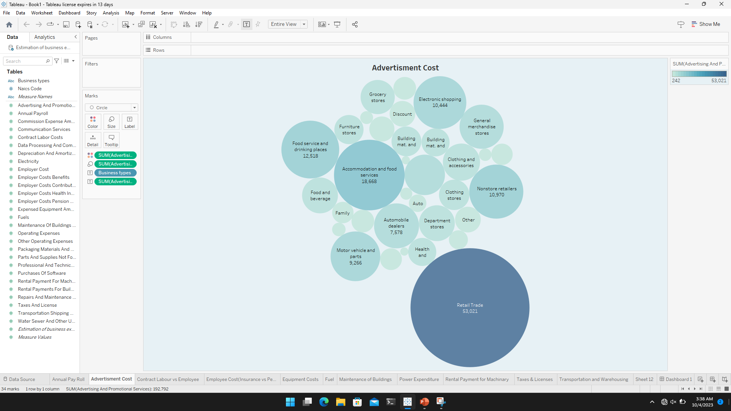
Advertisment Cost

Slide 4
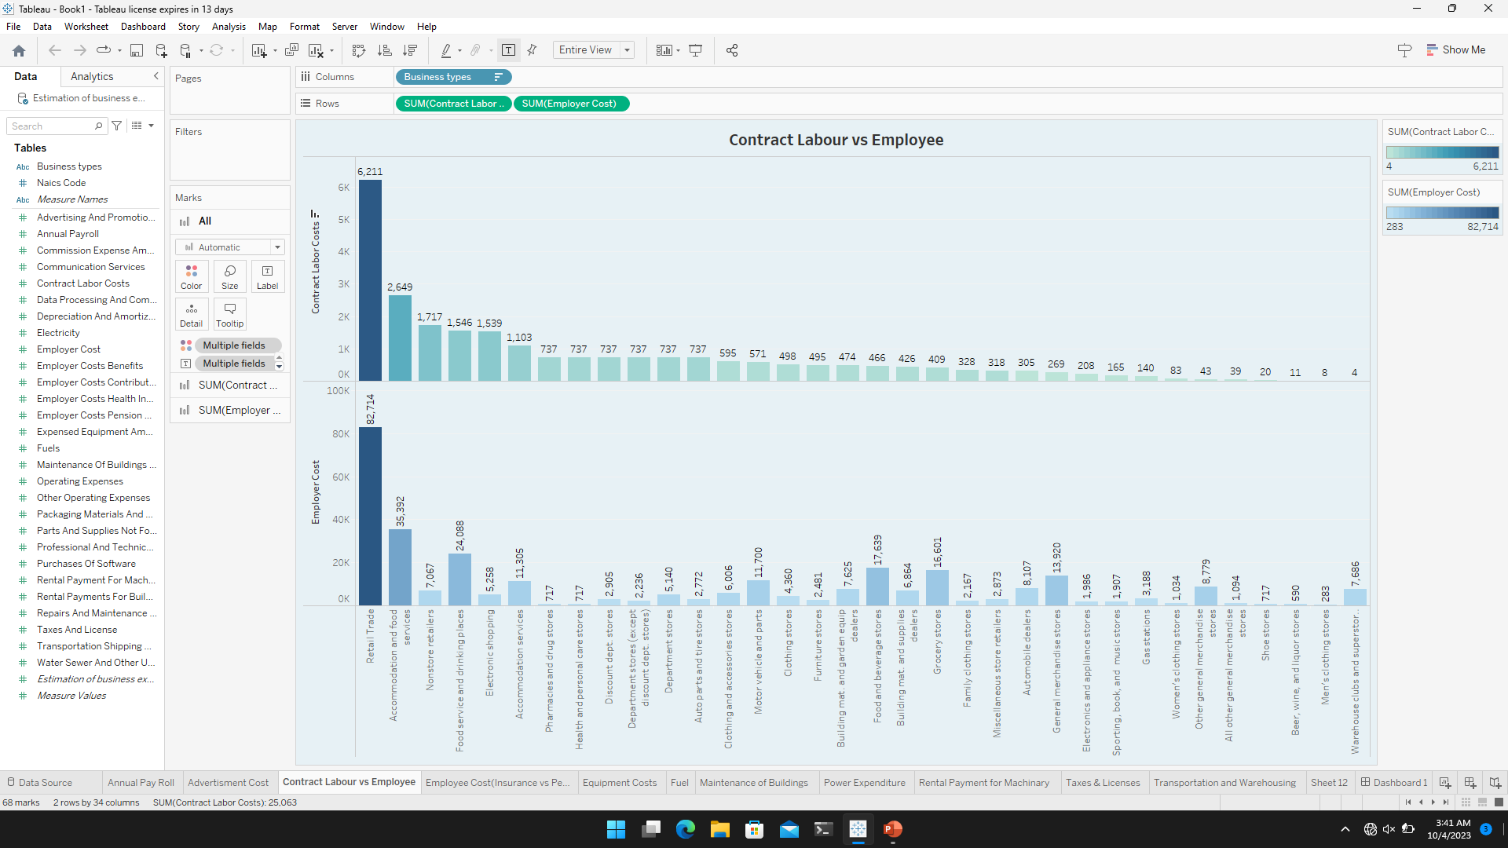
Contract Labour VS Employee

Slide 5
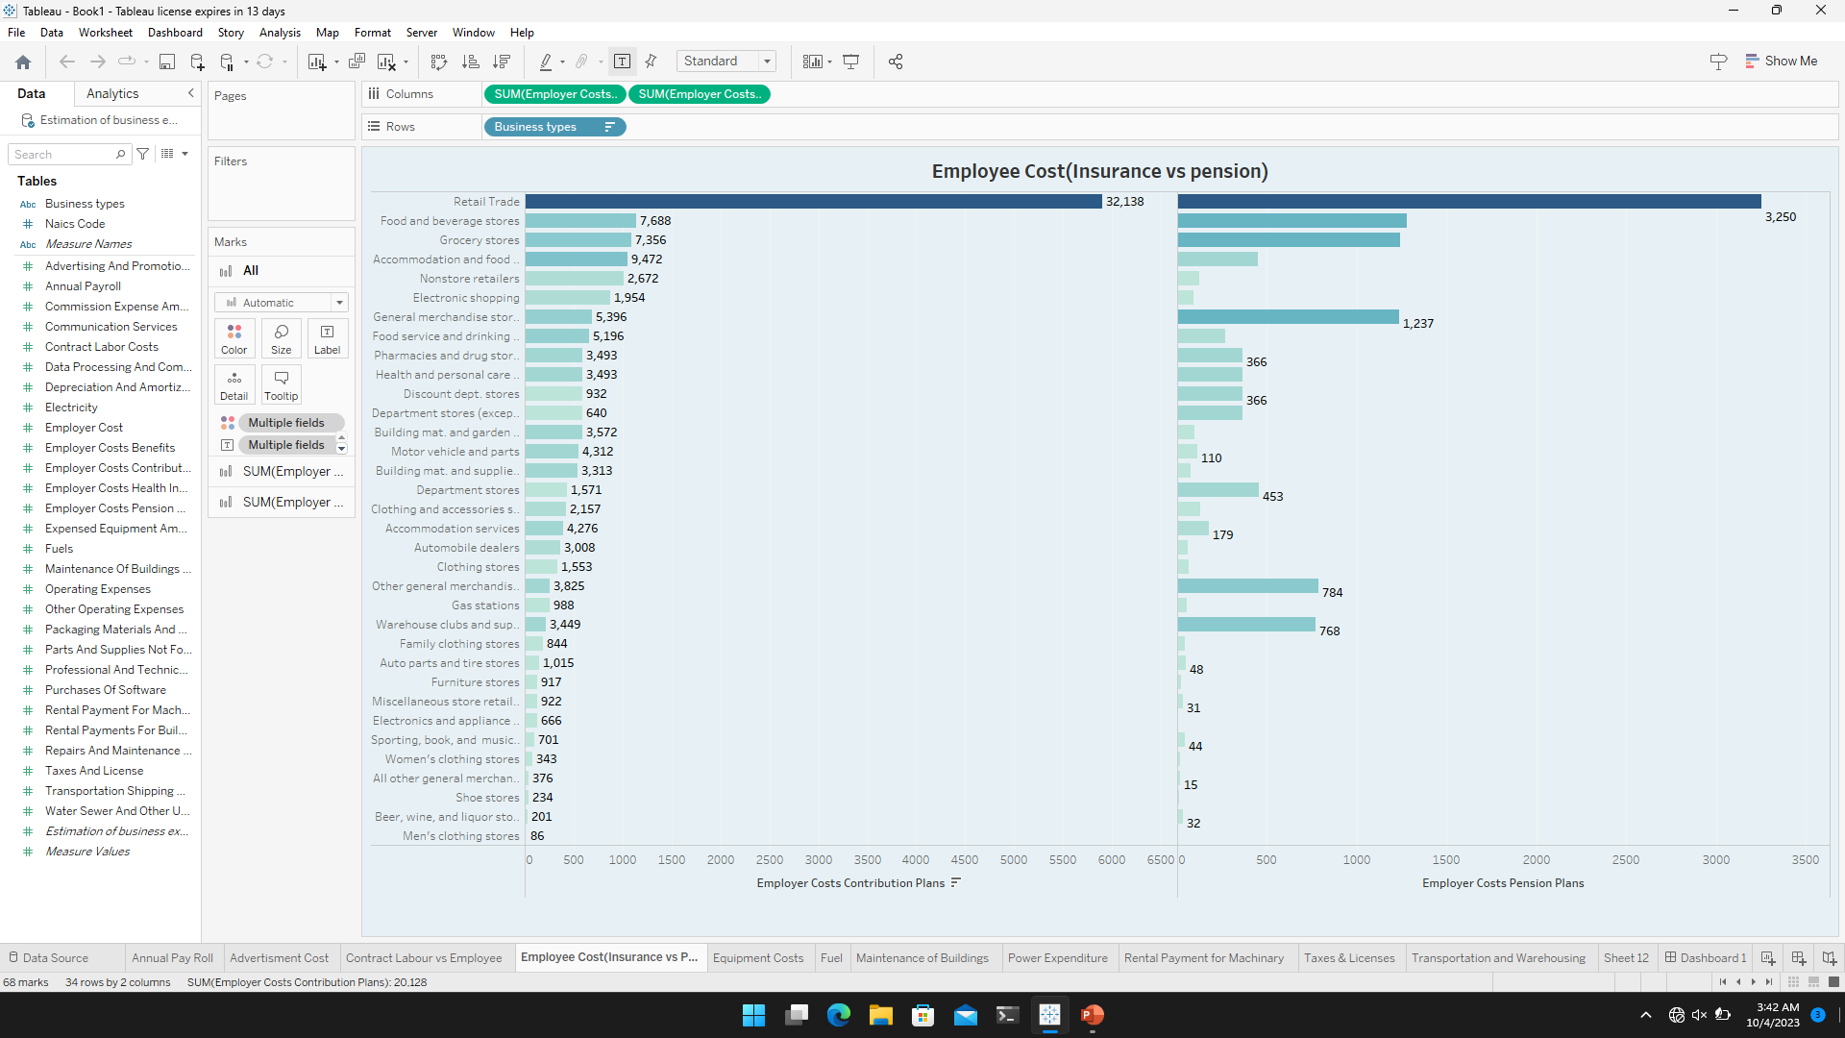
Employees cost (Insurance VS pension)

Slide 6
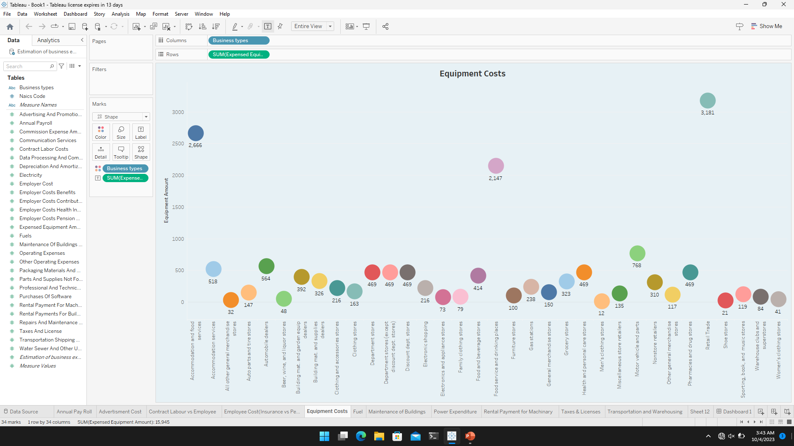
Equipment Costs

Slide 7
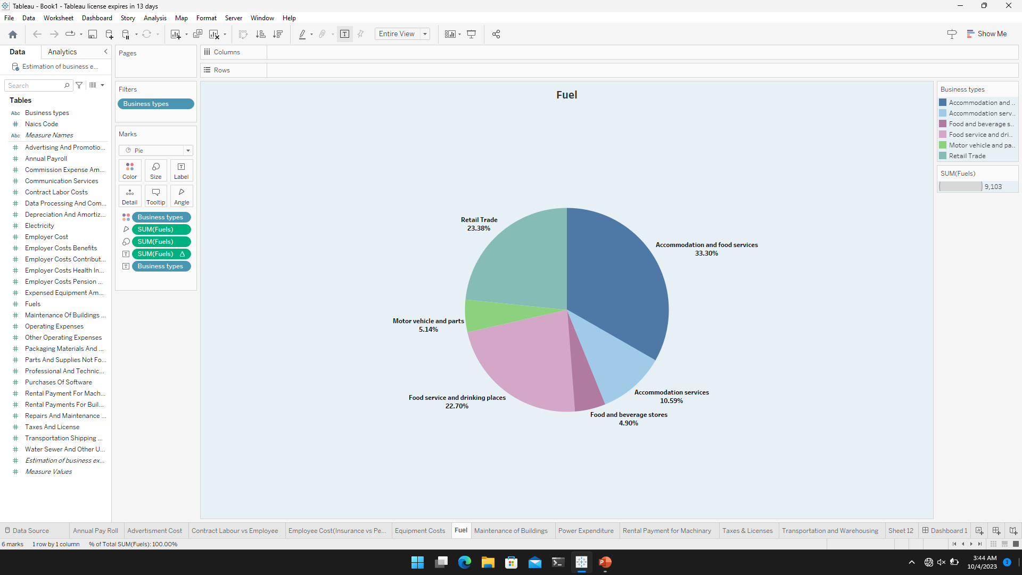
Fuel

Slide 8
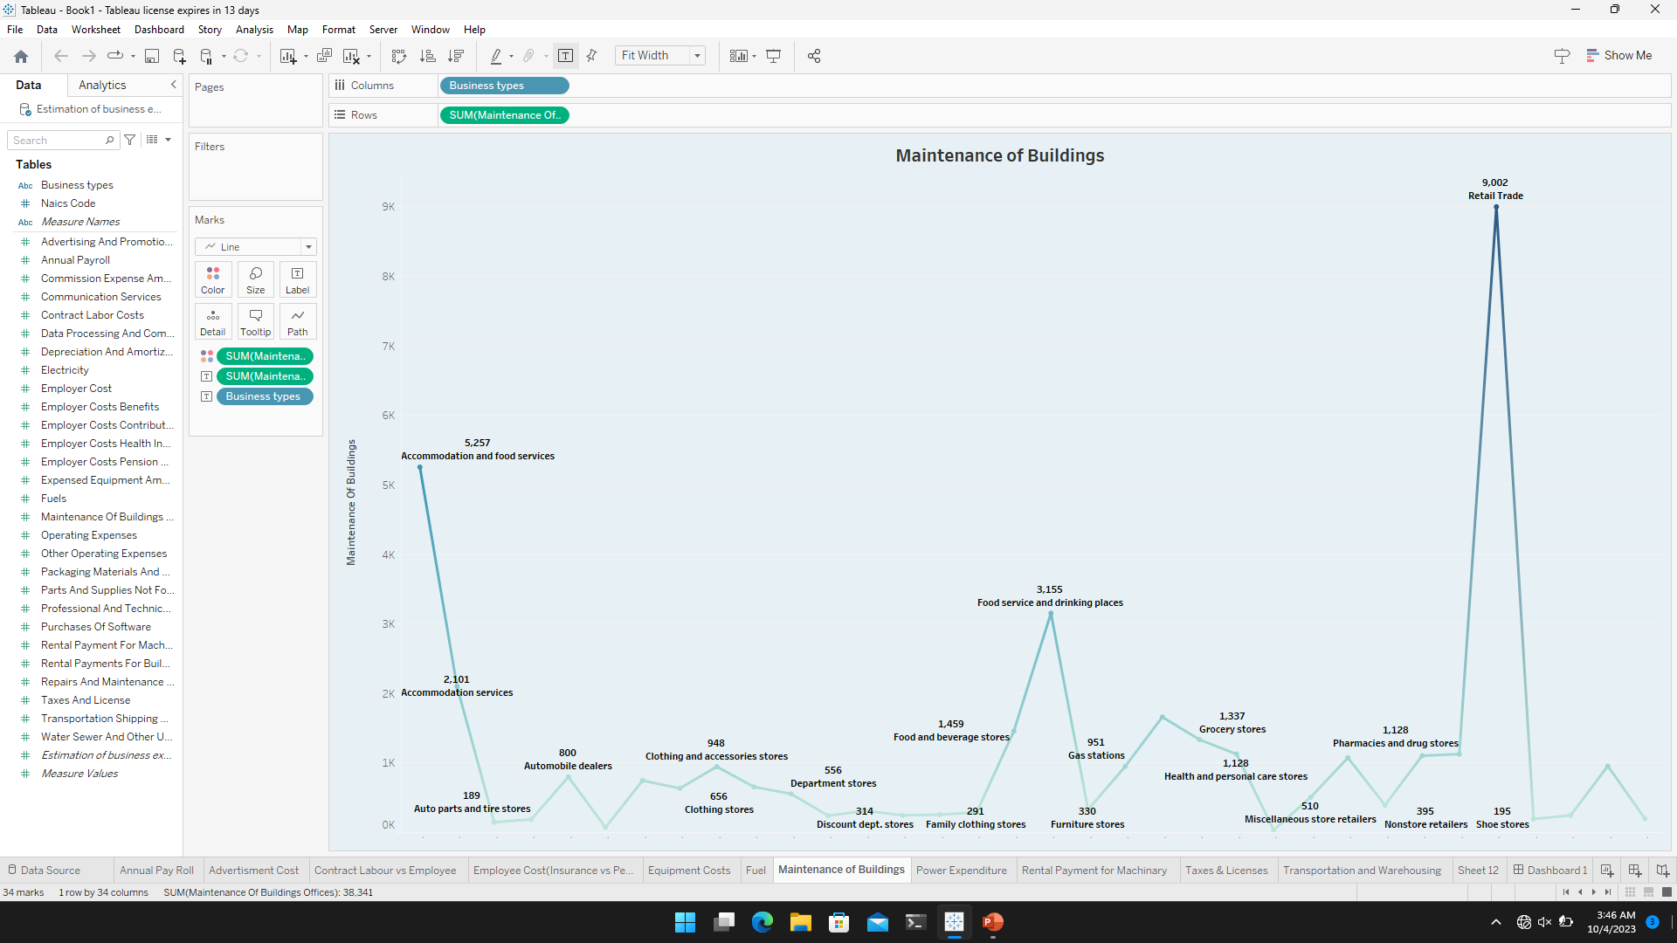
Maintenance of Buildings

Slide 9
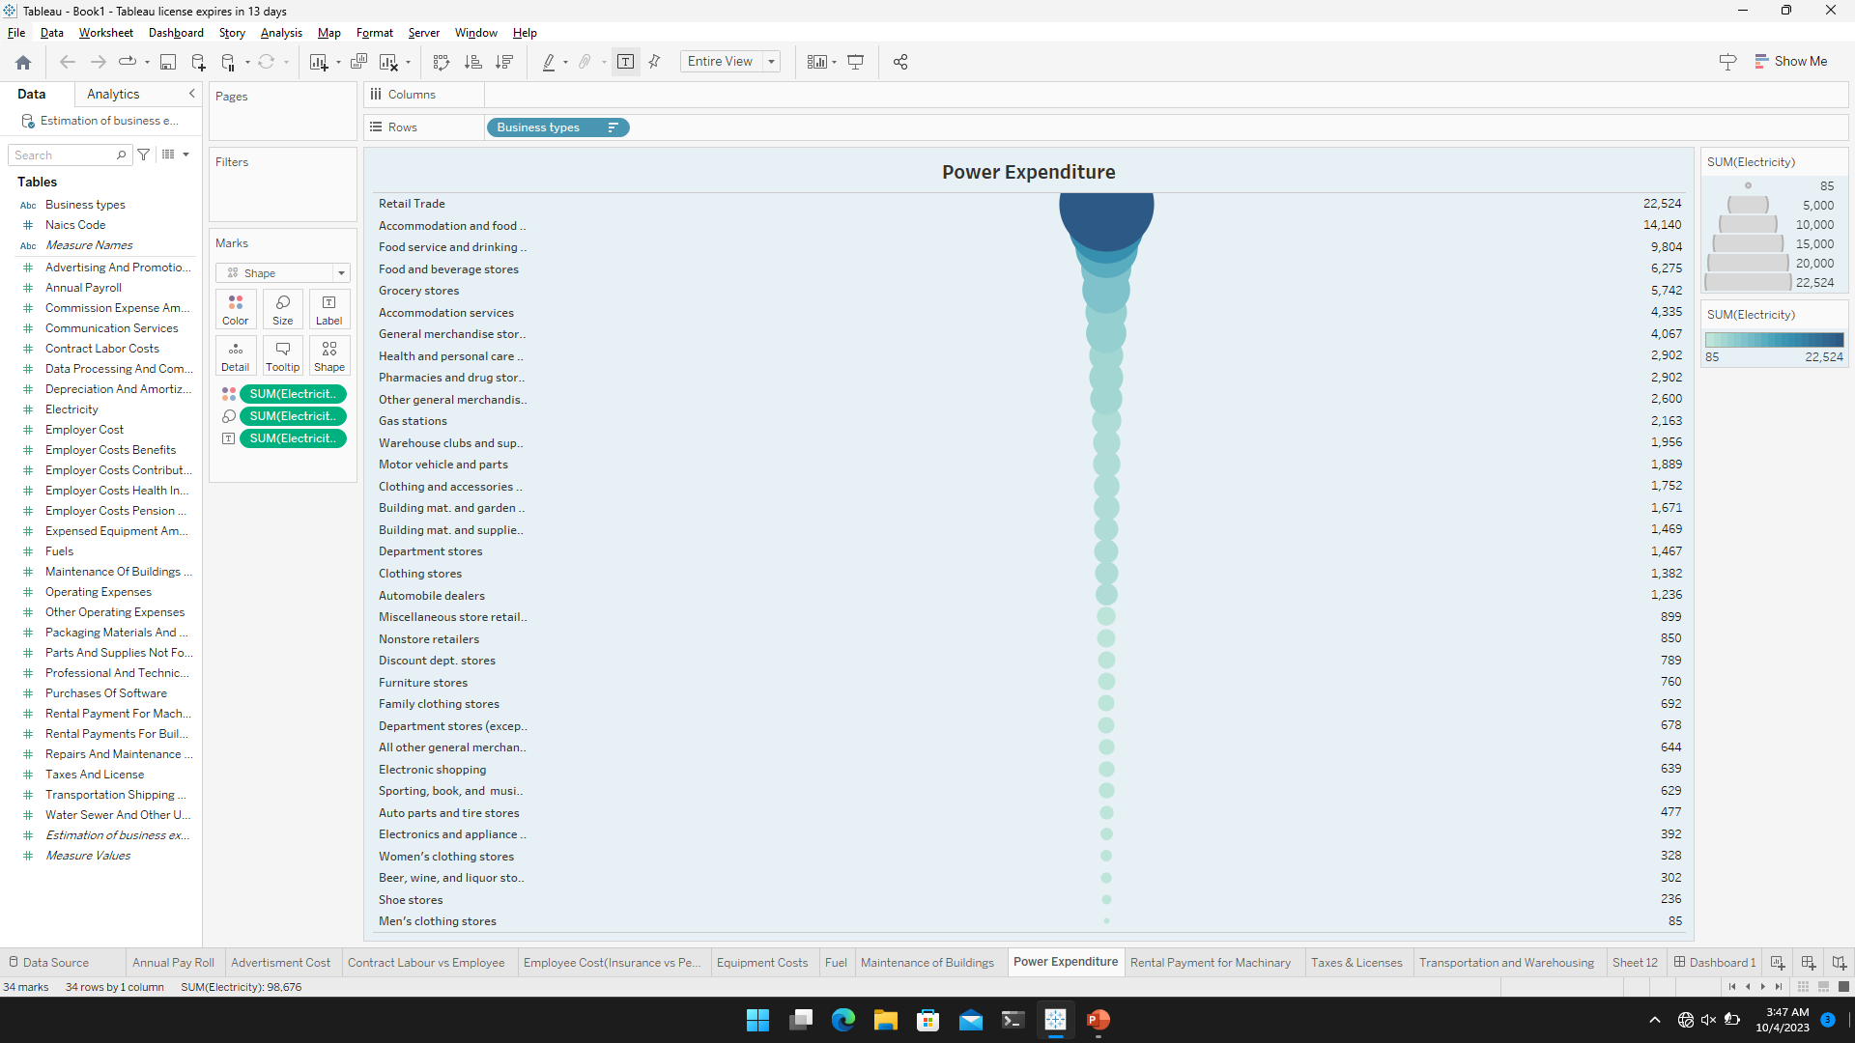
Power Expenditure

Slide 10
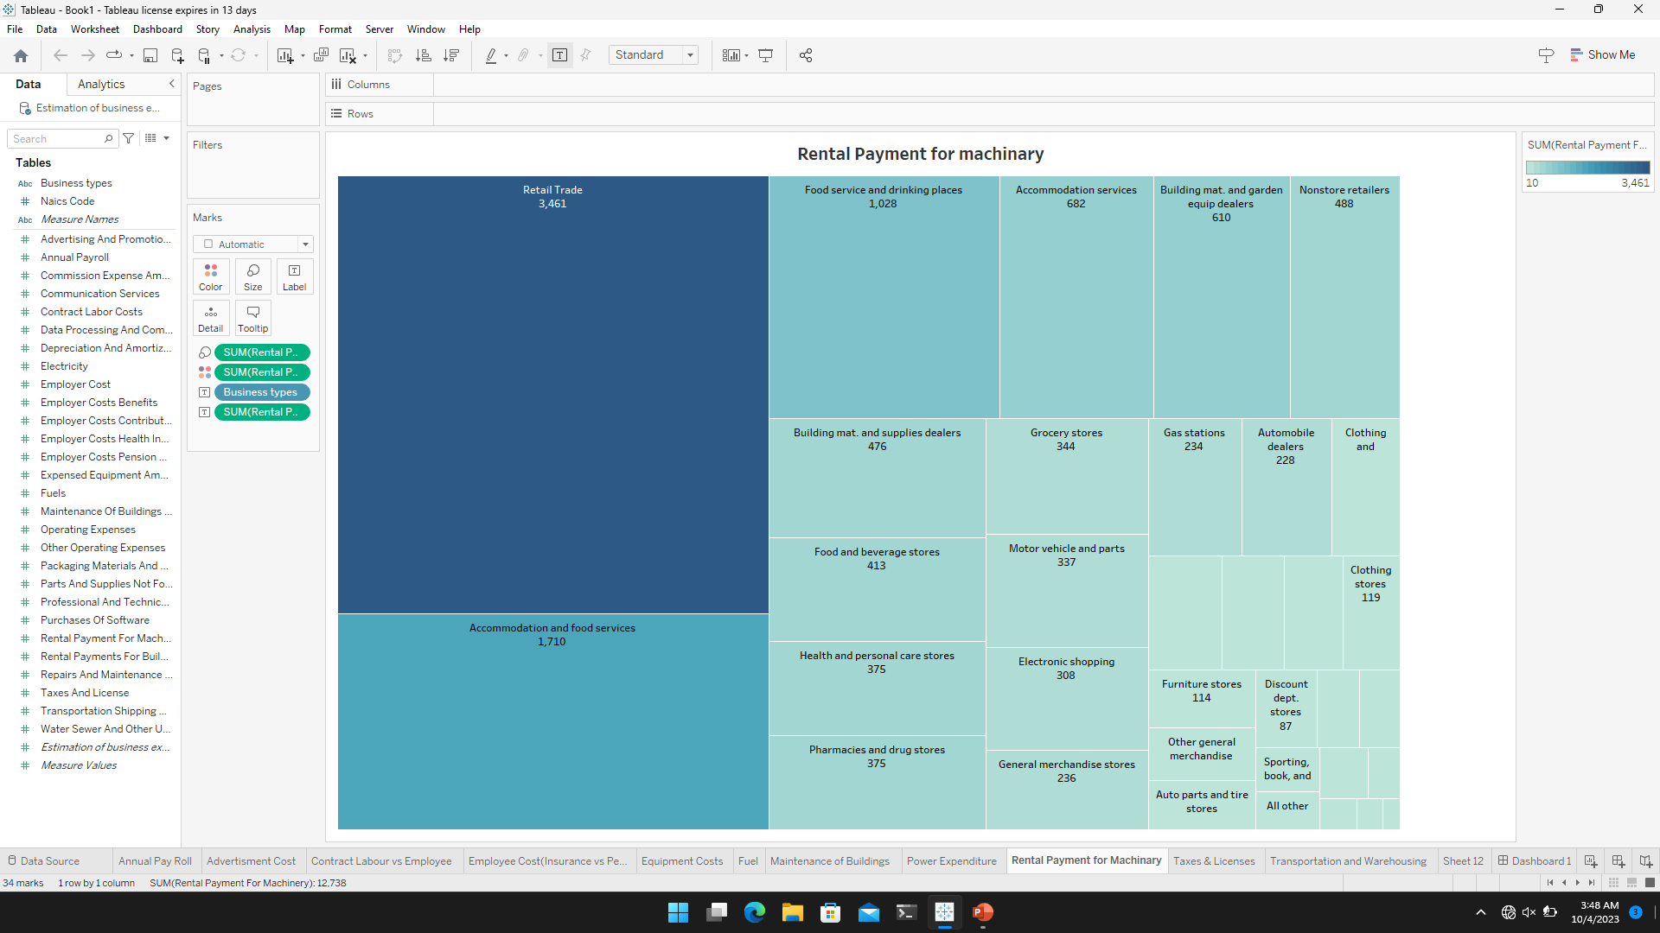
Rental Payment For Machinery

Slide 11
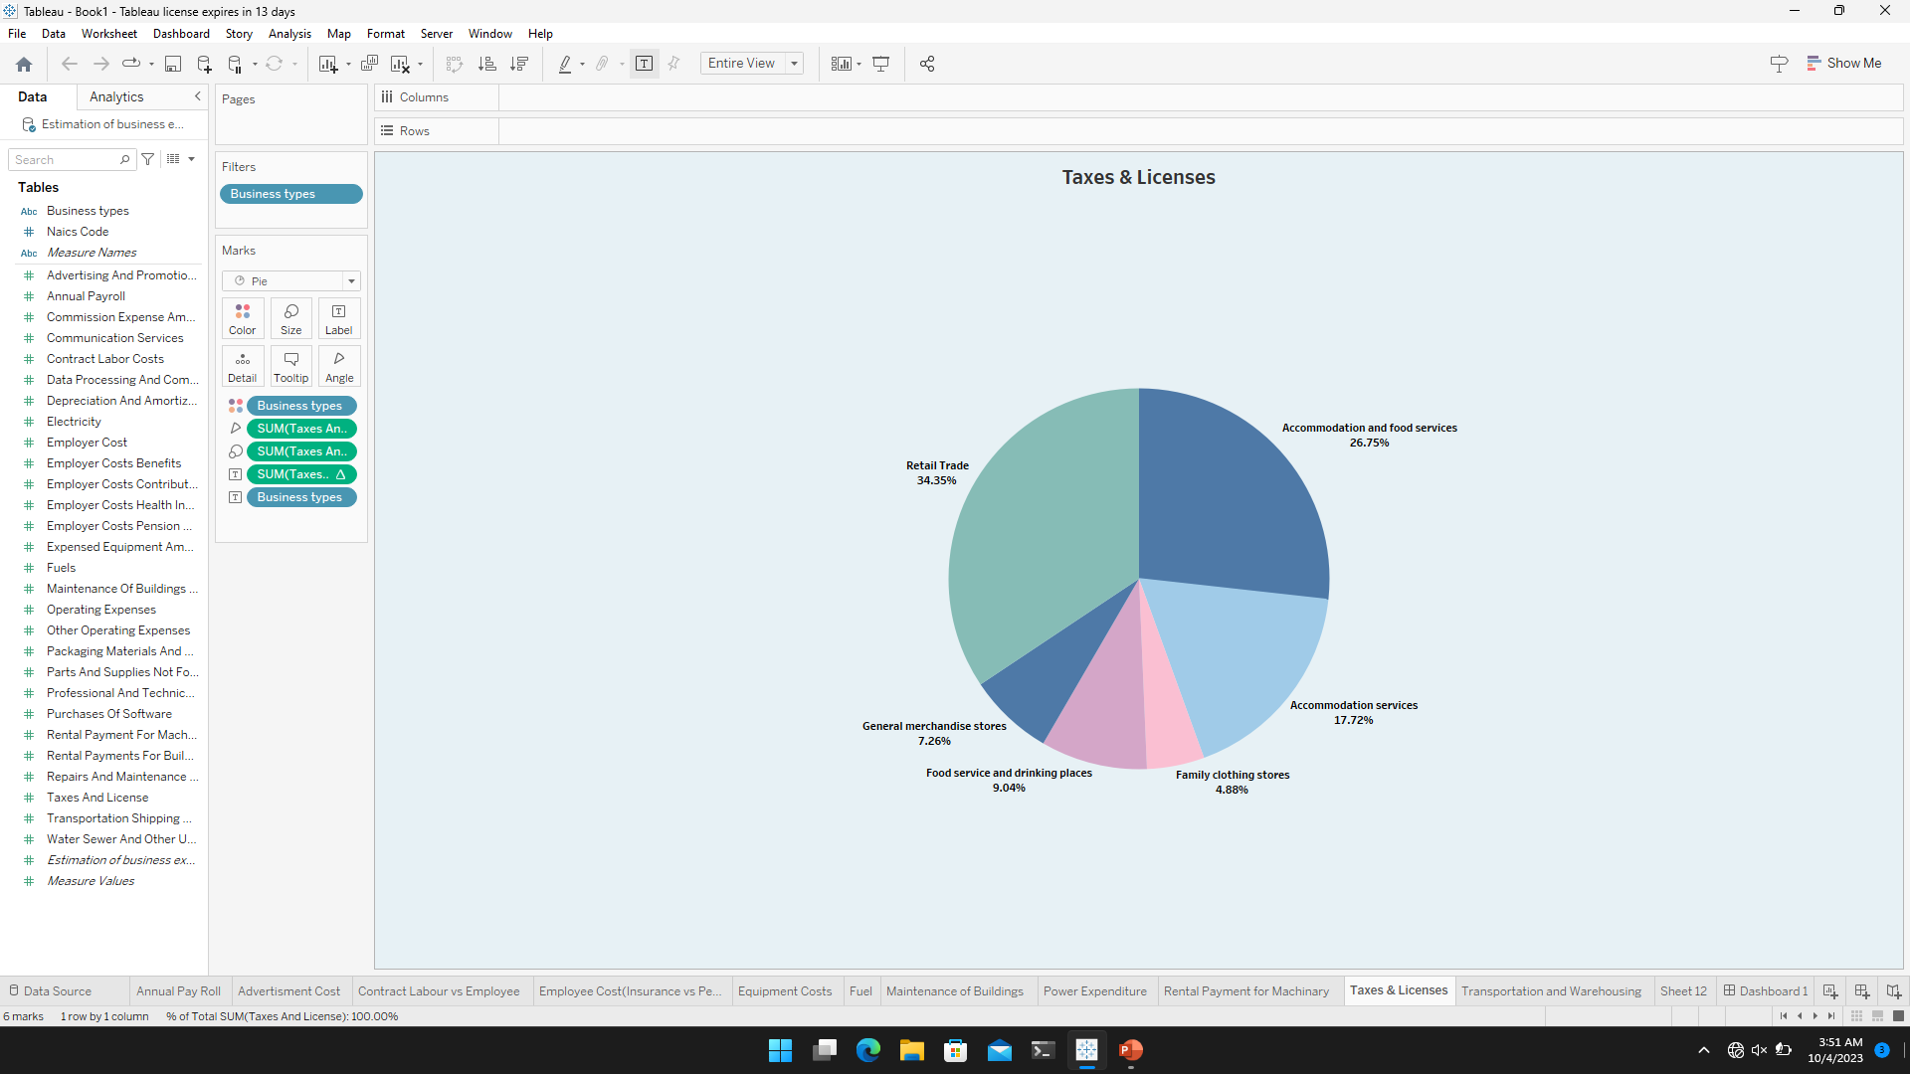
Taxes & licenses

Slide 12
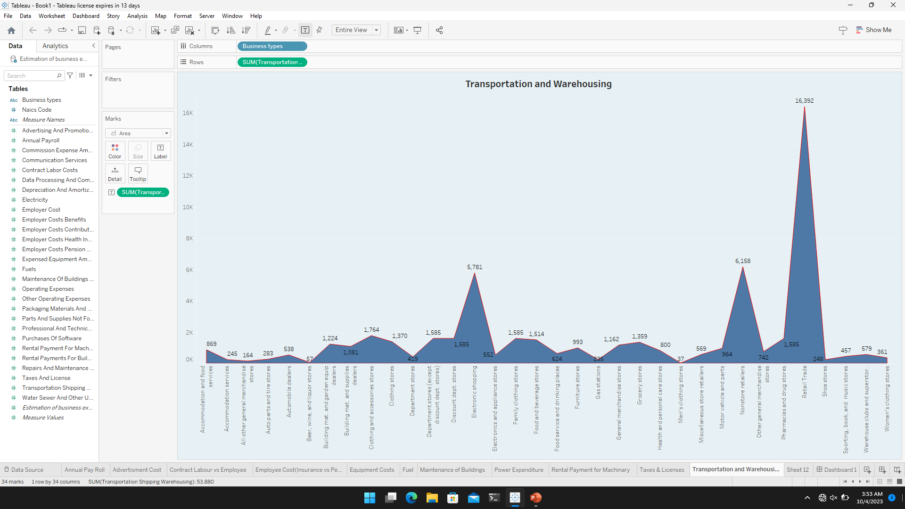
Transportation and Warehousing

Slide 13
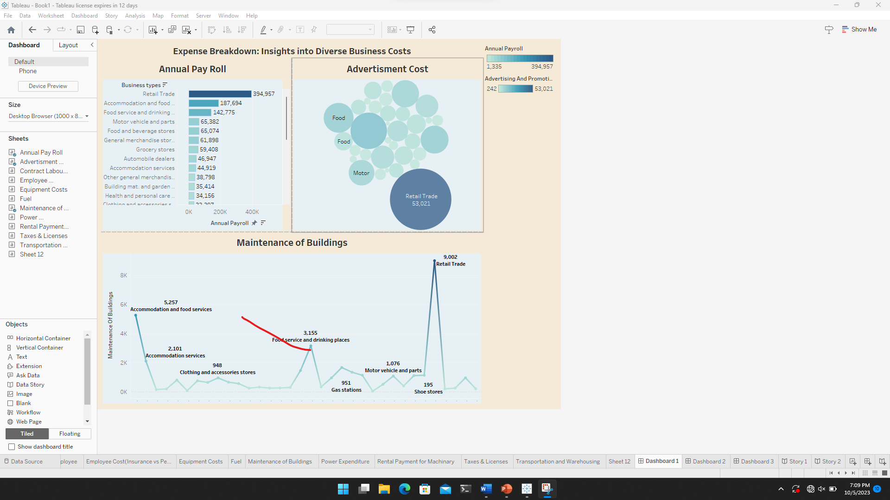
Dashboard 1

Slide 14
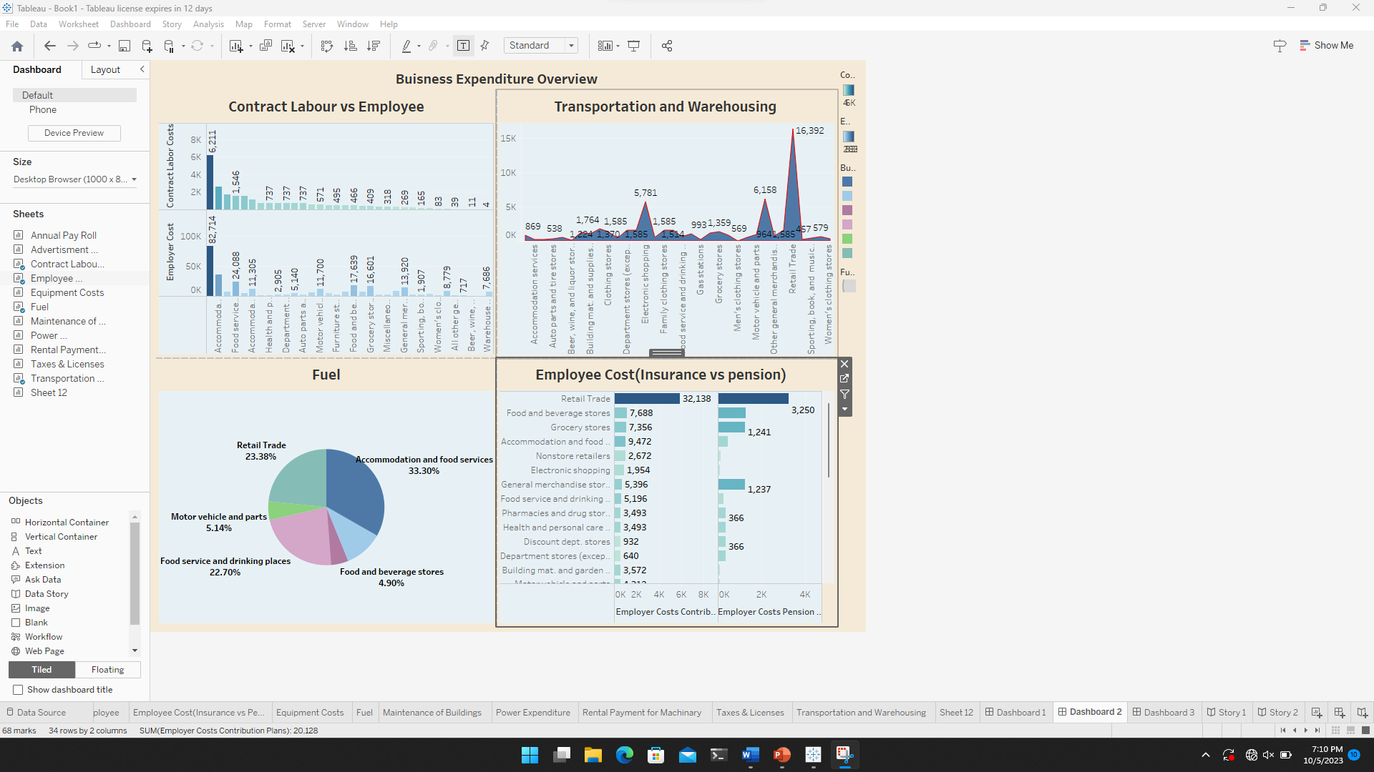
Dashboard 2

Slide 15
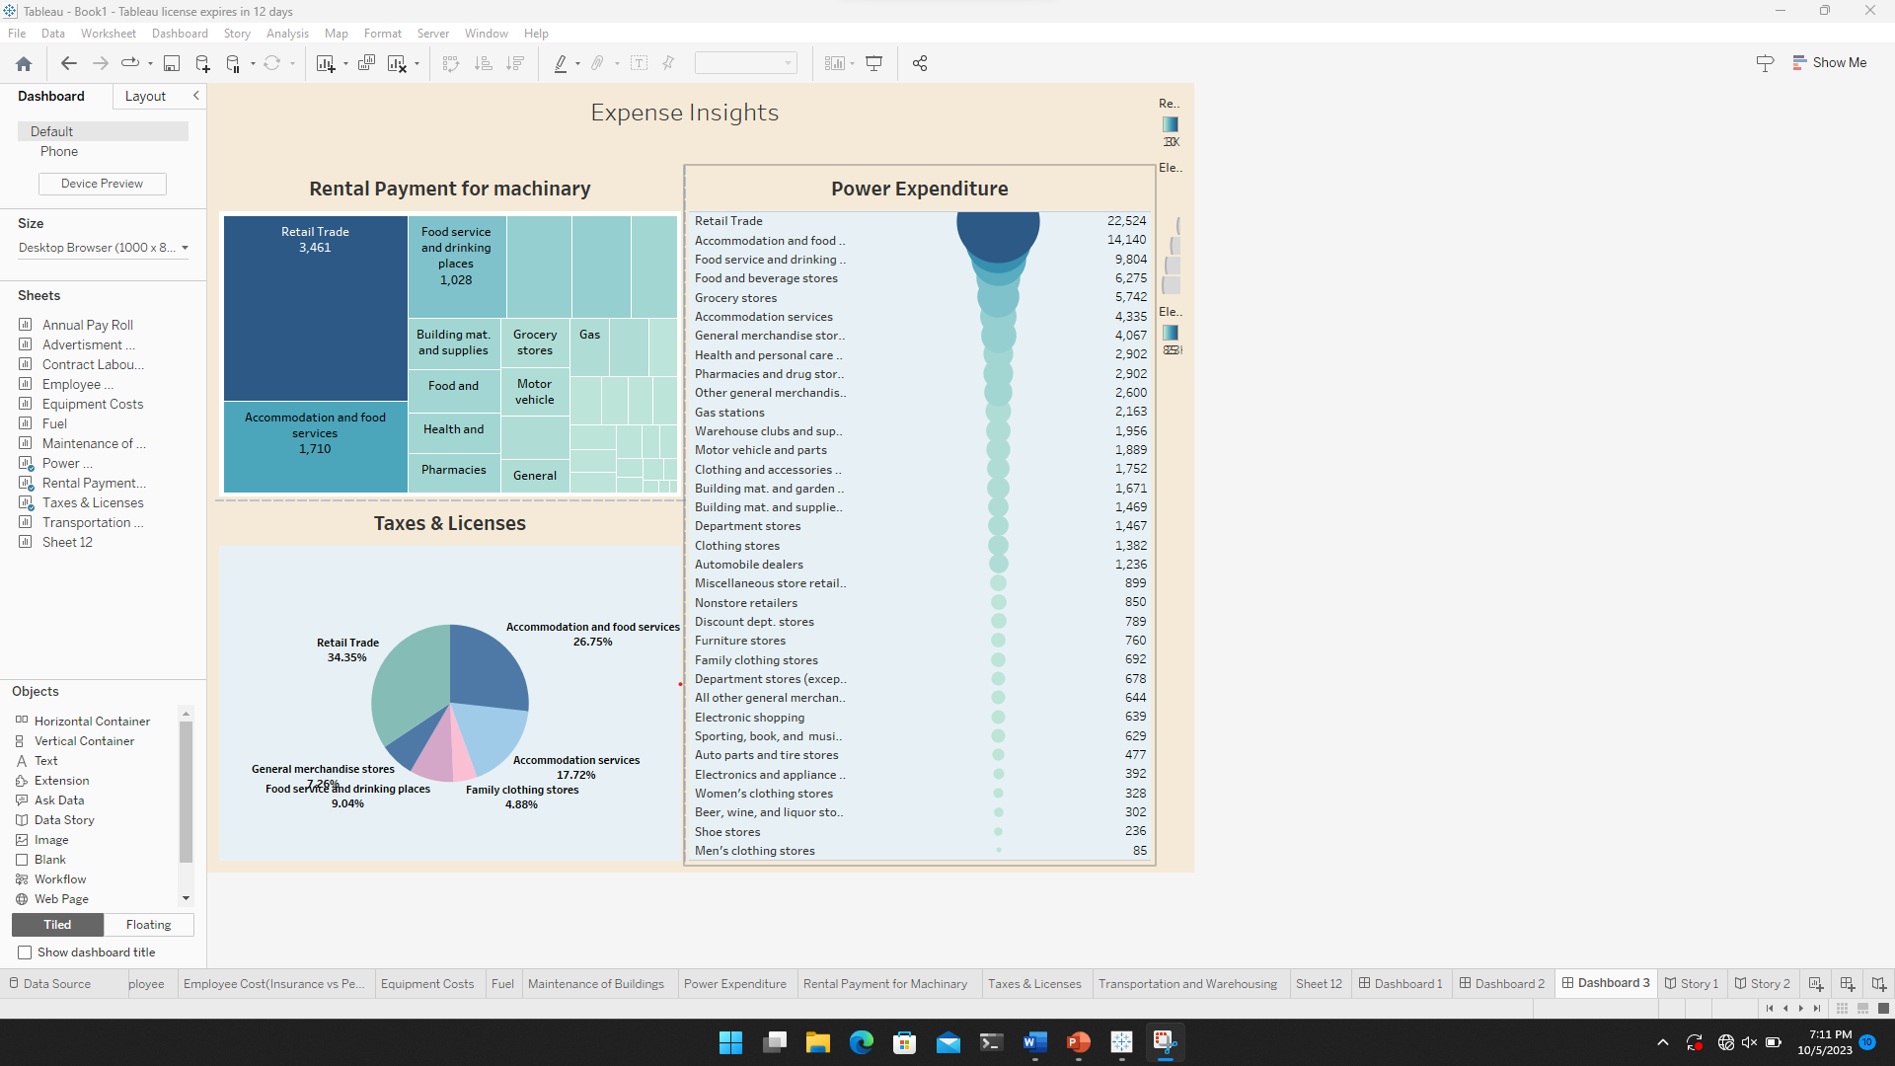
Dashboard 3

Slide 16
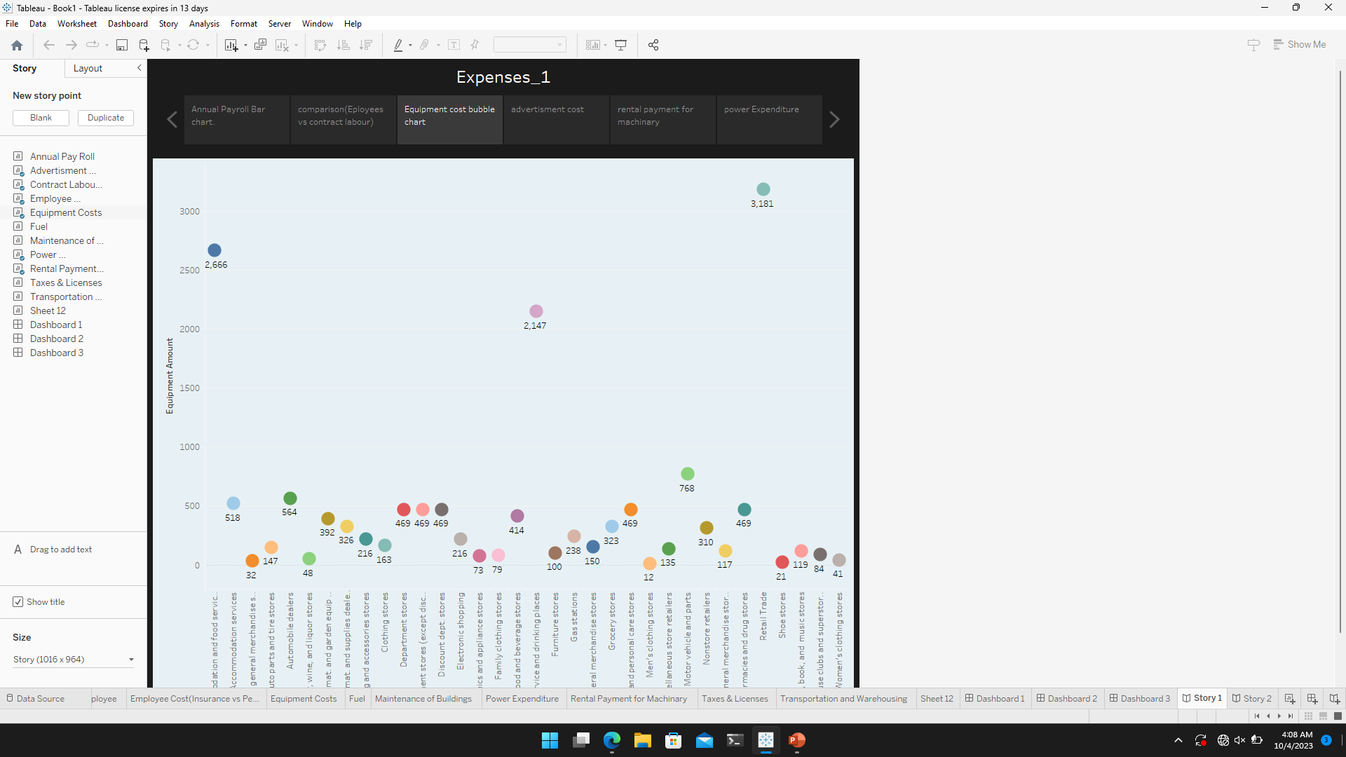
Story 1

Slide 17
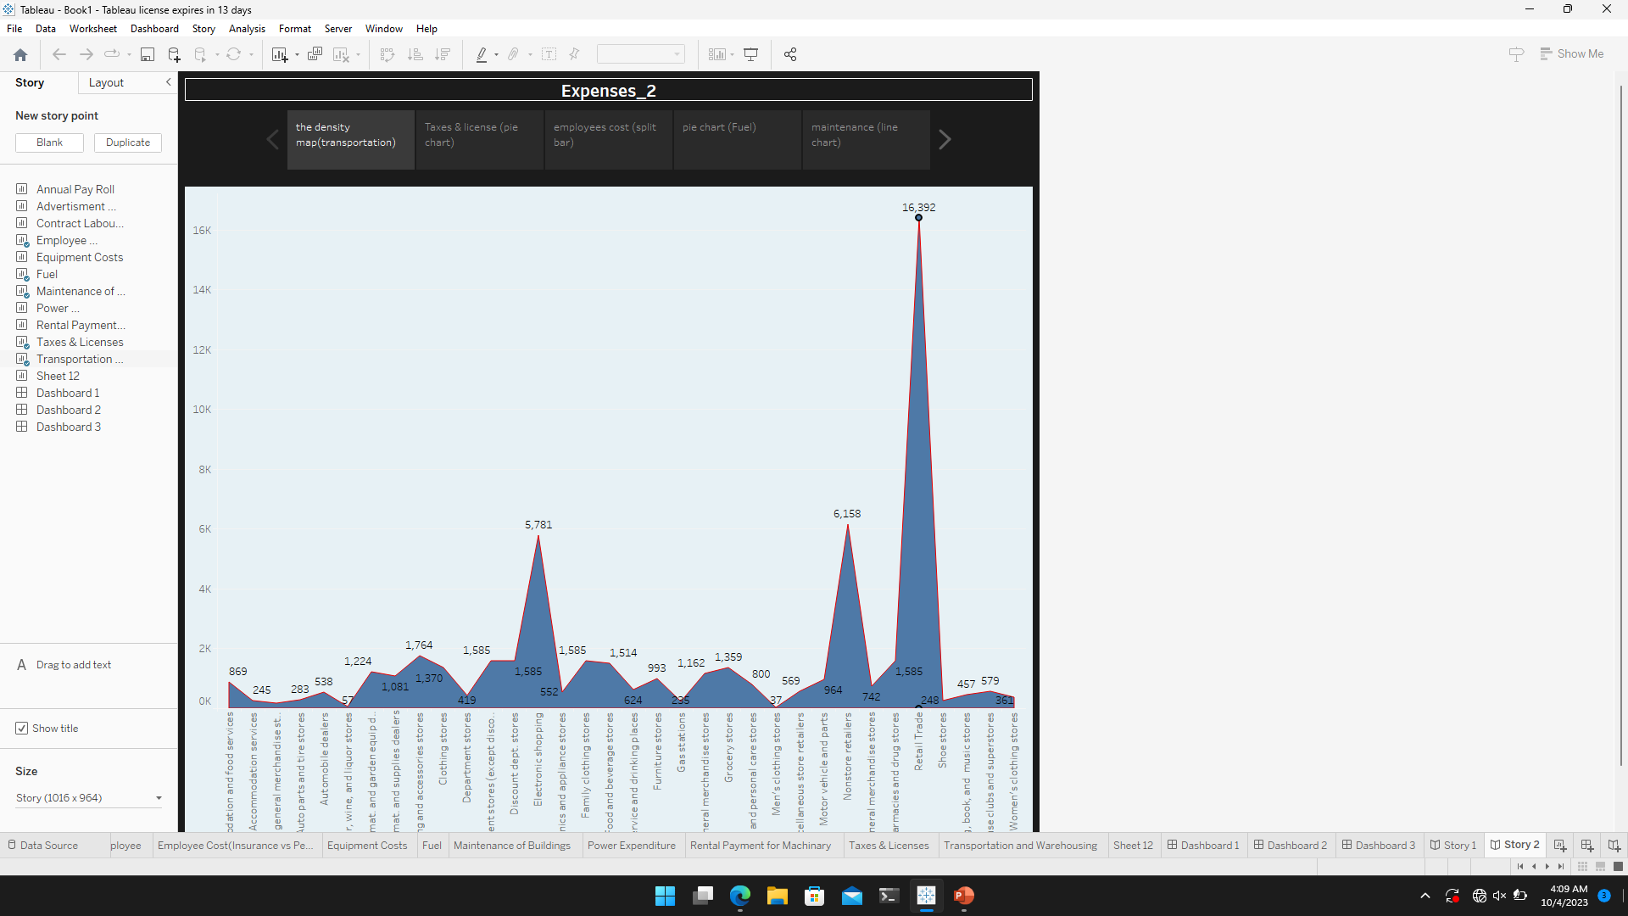
Story 2

