Slide 1
APPLIED MACHINE LEARNING
Asssignment : 1
Submitted by:
Hamant Jagwan
590010133
B1
Submitted to:
Prof. (Dr.) Tanupriya Choudhury

Slide 2
What type of ML algorithm is used in a dataset? How to find it out?
Types of Machine Learning Algorithms
Supervised Learning – Labeled data (e.g., classification, regression)
Unsupervised Learning – Unlabeled data (e.g., clustering, dimensionality reduction)
Semi-Supervised Learning – Mix of labeled and unlabeled data
Reinforcement Learning – Learning through rewards and penalties

Slide 3
How to Find the Type of ML Algorithm?
Check the Target Variable:
If a clear target/output variable is present → Likely Supervised Learning
If no target/output variable is provided → Likely Unsupervised Learning
If learning is based on actions and feedback (reward/punishment) → Reinforcement Learning
Analyze the Type of Target Variable (if present):
Categorical → Classification (Supervised)
Continuous → Regression (Supervised)
Look at Data Context and Task Goal:
Want to group similar items → Clustering (Unsupervised)
Want to reduce number of input features → Dimensionality Reduction (Unsupervised)
3. Want an agent to learn through trial and error → Reinforcement Learning
Dataset Characteristics:
High-dimensional → Dimensionality Reduction (e.g., PCA)
Time-based or sequential → Time Series Models or Reinforcement Learning

Slide 4
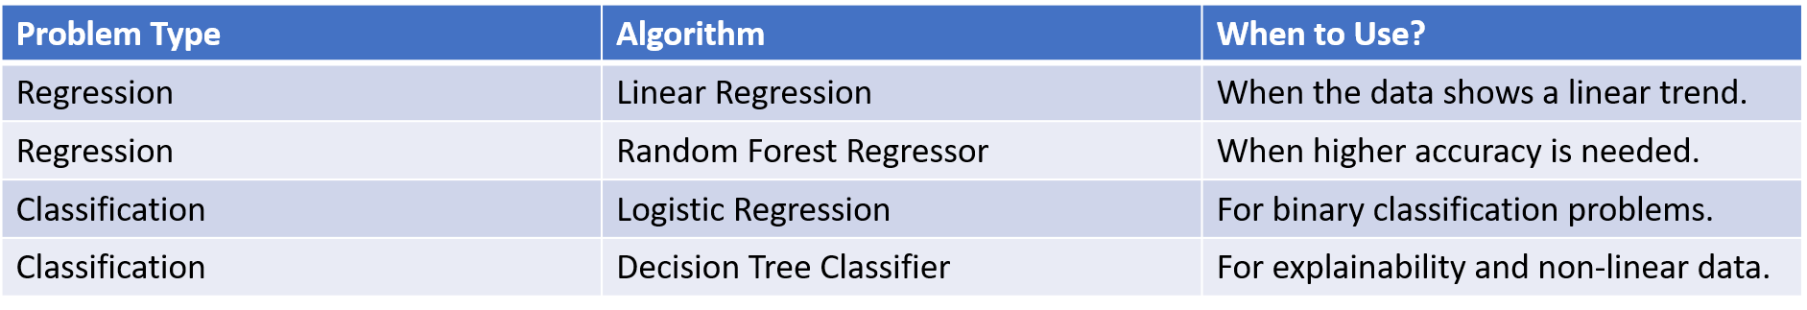
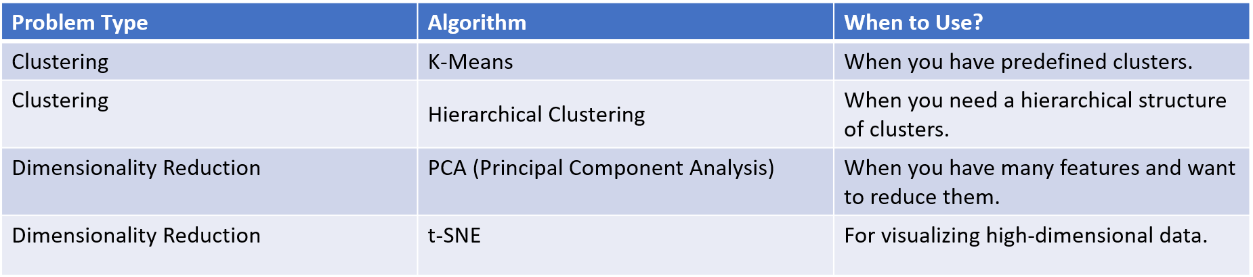
Algorithms for Supervised Learning:
Algorithm for Unsupervised Learning (Unlabeled Data)

Slide 5
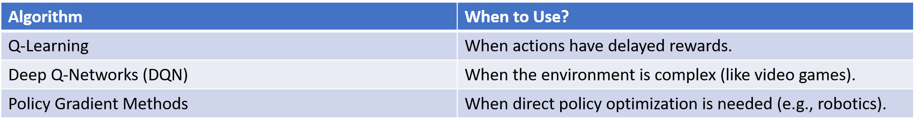
Algorithms for Reinforcement Learning:

Slide 6
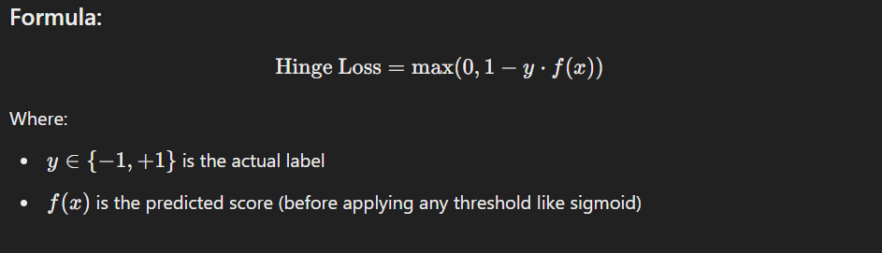
Question2 .Difference between hinge loss and triplet loss with example?
1. Hinge Loss
Hinge loss is a loss function used for binary classification, especially with Support Vector Machines (SVMs), It penalizes predictions that are either wrong or not
confident enough, meaning they are too close to the decision boundary.

Slide 7
Real-Life Example (Email Spam Classifier):
Suppose we are building a spam email classifier:
Label spam emails as +1
Label normal emails as -1
Now, suppose:
An email is actually spam, so y=+1
The model predicts a score f(x)=0.4
Since the score is not confident (less than 1), the model is penalized.
But if the model had predicted f(x)=1.2, then:
Now the score is confidently beyond the margin, so no penalty is applied.

Slide 8
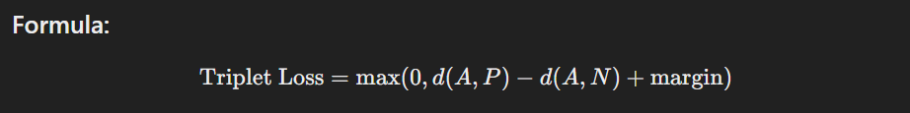
2. Triplet Loss
Triplet loss is used in metric learning. It helps the model learn a way to measure similarity by embedding inputs into a space where similar ones are closer, and dissimilar ones are farther apart.
AAA: Anchor
PPP: Positive (same class)
NNN: Negative (different class)
d(⋅) : distance function (e.g., Euclidean)
Margin is a small value like 0.2

Slide 9
Real-Life Example (Face Recognition):
Imagine you are training a face recognition system.
Anchor (A): Photo of Alice
Positive (P): Another photo of Alice
Negative (N): Photo of Bob
Let’s assume:
Distance between A and P = 0.5
Distance between A and N = 0.9
Margin = 0.2
Then:
No loss is applied because the model is doing well — Alice’s photos are close, and Bob’s is far. But if the distance between A and N becomes 0.6 (too close), then:
Loss=max(0,0.5−0.6+0.2)=max(0,0.1)=0.1
Now there is some loss because the model is not separating Bob from Alice properly.

Slide 10
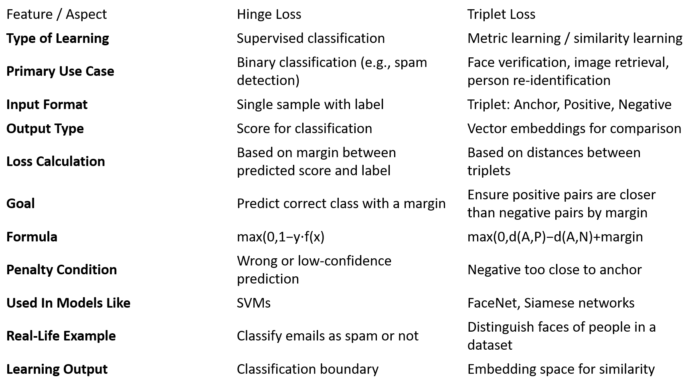

Slide 11
Question 3 : What do you mean by training, testing, and validation of data? Showcase with the help of a Python programming example.
Training data
- This is the actual dataset from which a model trains .i.e. the model sees and learns from this data to predict the outcome or to make the right decisions.
- Most of the training data is collected from several resources and then preprocessed and organized to provide proper performance of the model.
- Type of training data hugely determines the ability of the model to generalize .i.e. the better the quality and diversity of training data, the better will be the performance of the model. This data is more than 60% of the total data available for the project

Slide 12
Testing:-
- This dataset is independent of the training set but has a somewhat similar type of probability distribution of classes and is used as a benchmark to evaluate the model, used only after the training of the model is complete.
- Testing set is usually a properly organized dataset having all kinds of data for scenarios that the model would probably be facing when used in the real world If the accuracy of the model on training data is greater than that on testing data then the model is said to have overfitting.
- This data is approximately 20-25% of the total data available for the project.

Slide 13
Validation
- The validation set is used to fine-tune the hyperparameters of the model and is considered a part of the training of the model.
- Validation dataset can be utilized for regression as well by interrupting training of model when loss of validation dataset becomes greater than loss of training dataset .i.e. reducing bias and variance.
- This data is approximately 10-15% of the total data available for the project but this can change depending upon the number of hyperparameters .i.e. if model has quite many hyperparameters then using large validation set will give better results.
- Now, whenever the accuracy of model on validation data is greater than that on training data then the model is said.

Slide 14
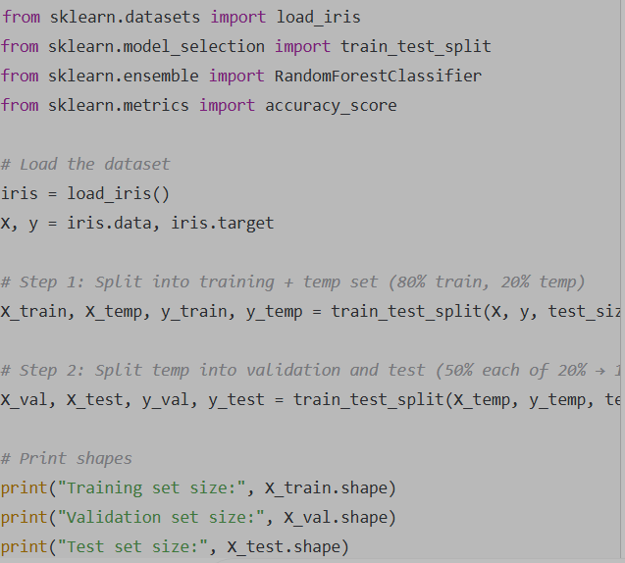
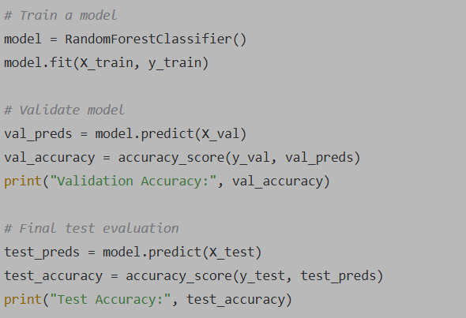
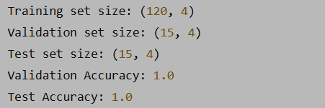

Slide 15
Question 4 : What is the use of training and testing of data? For training and testing, how can a random operator be used?
In machine learning, we work with data to build models that can make predictions or decisions. But to ensure the model works well, we divide the data into training and testing parts.
Training of Data:
Purpose: To teach the model how to understand patterns in the data.
During training, the model learns from labeled examples (input and expected output).
It uses this information to adjust its internal parameters and reduce prediction errors.
For example, in an email spam detector, training data would include many emails marked as spam or not spam. The model uses this data to learn the difference between the two.

Slide 16
Testing of Data:
Purpose: To evaluate how well the model performs on new, unseen data.
After the model has learned from the training data, we give it testing data to see if it can make correct predictions without having seen that data before.
It helps us check whether the model is generalizing well or just memorizing the training data (a problem called overfitting).
Why is this split necessary?
If you only train and evaluate the model on the same data, it might perform very well — but only because it has seen those exact examples.
This does not guarantee it will work well on real-world data.
Testing ensures the model’s predictions are reliable and accurate in practice.

Slide 17
How can a random operator be used in training and testing?
When we split the data into training and testing sets, it's important that the split is
random and not based on the original order of the data. Here's why:
If the data is sorted or grouped in some way (for example, all similar items together), and we don’t shuffle it, then one set might contain very different examples than the other.
This could lead to biased results — the model might not get a proper variety during training, and testing will not reflect true performance.
Role of a Random Operator:
A random operator helps shuffle or randomly divide the dataset into training and testing sets.
This ensures that both sets contain a diverse and representative mix of examples from the overall data.
It prevents unfair advantages or disadvantages and creates a more balanced evaluation of the model's performance.
A random seed (like a specific number) can be used to control the randomness. This ensures that if you repeat the process, you get the same results each time. It is useful for debugging and comparing models.

Slide 18
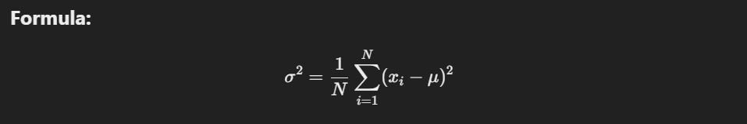
Question 5 : Differentiate between population variance and sample variance. Share with easy & example.
What is Variance?
Variance is a measure of how much the values in a dataset spread out from the mean (average). It helps us understand how consistent or diverse the data is.
1. Population Variance
Population variance is used when you have data for the entire population — that is, all members of a group.
FORMULA:
Where:
σ2: population variance
N: number of elements in the population
xi: each value
μ: population mean

Slide 19
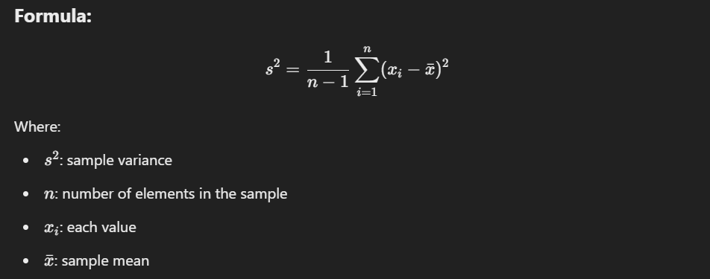
2. Sample Variance
Sample variance is used when you are working with a sample (a smaller part) taken from the population. It estimates the variance of the full population.
Where:
s2: sample variance
n: number of elements in the sample
xi: each value
x: sample mean
Note: We divide by (n - 1) instead of n to correct for bias. This is called Bessel's correction. It helps the sample variance to better estimate the population variance.
When to Use:
When you only have a subset of the data.
Example: If a researcher surveys 100 people out of a city of 10,000, they’ll calculate the sample variance.

Slide 20
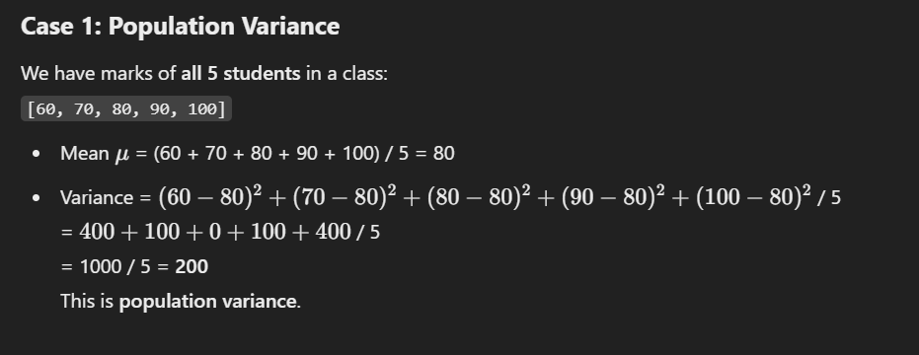
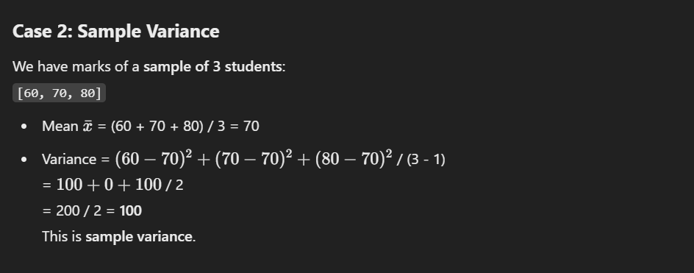
Example for Easy Understanding

Slide 21
Question 6 : In loss function, what is the meaning of one-hot encoding & integer encoding?
What is Encoding in Machine Learning?
In many machine learning problems (especially classification), the target labels are categorical (like "cat", "dog", "car"). Machines work with numbers, so we must convert categorical labels into numerical form before feeding them into the model.
This process is called label encoding, and two common types are:
Integer Encoding
One-Hot Encoding

Slide 22
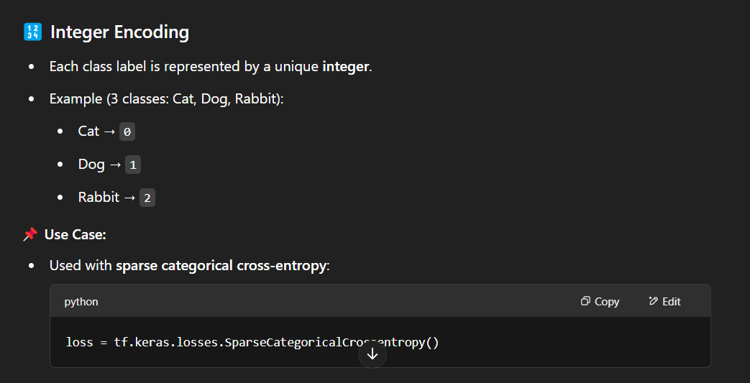

Slide 23
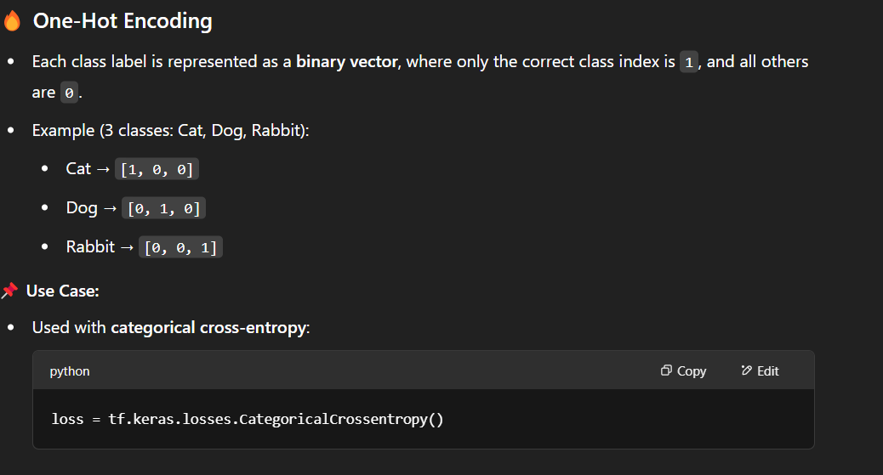

Slide 24
Question 7 : In ML, what do you mean by overfitting of a model & how do we deal with overfitting? Showcase with Python programming.
Overfitting in Machine Learning happens when a model learns the training data too well, including its noise and outliers, which results in poor generalization to new/unseen data. The model performs well on training data but poorly on test/validation data.
Causes of Overfitting
Model is too complex (e.g., too many parameters)
Too few training examples
Noise in the data
Training for too many epochs (in deep learning)

Slide 25
How to Handle Overfitting
Train with more data
Use simpler models
Regularization (L1, L2)
Cross-validation
Pruning (for decision trees)
Early stopping (in deep learning)
Dropout (in neural networks)

Slide 26
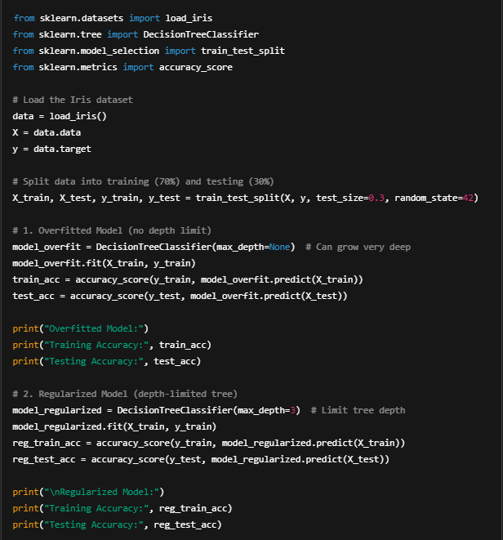

Slide 27
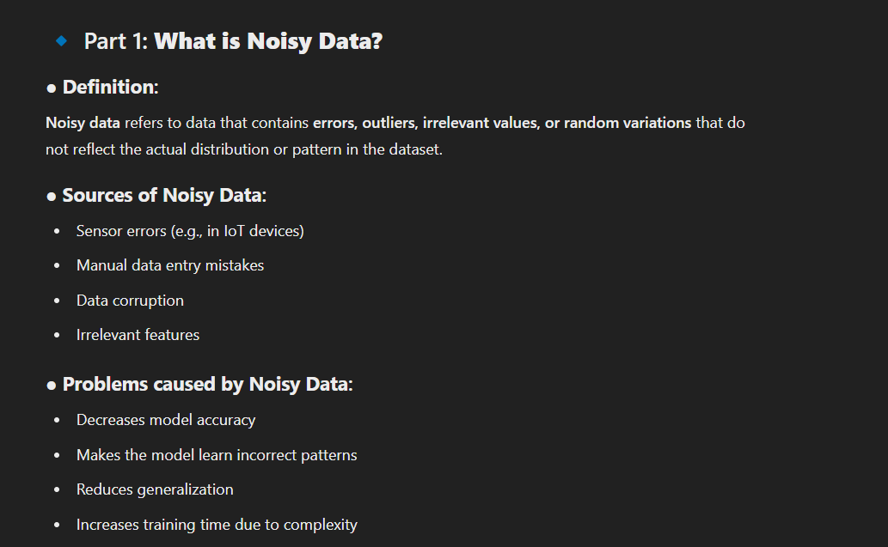
Qusestion 8 : How to handle noisy data and also what do you mean by imbalanced data? Showcase with a Python example & programming. What type of measurement will we take to handle non-type of datasets?

Slide 28
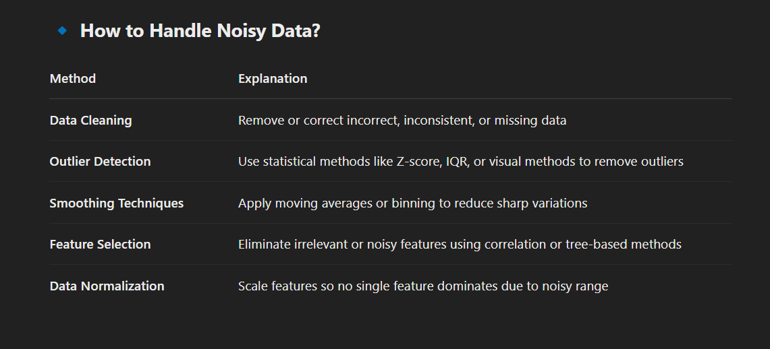

Slide 29
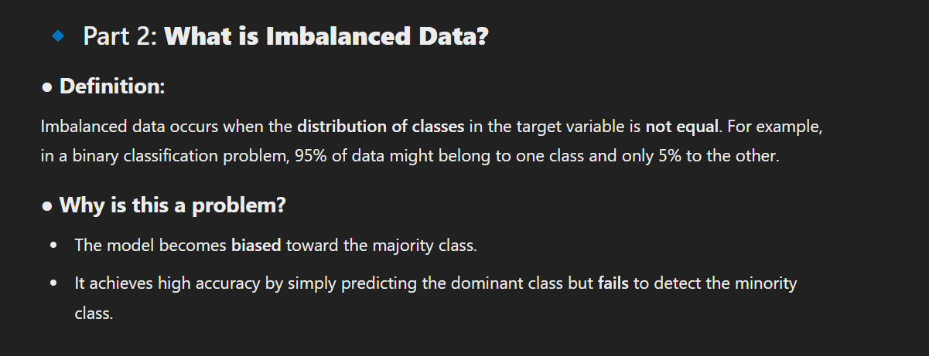

Slide 30
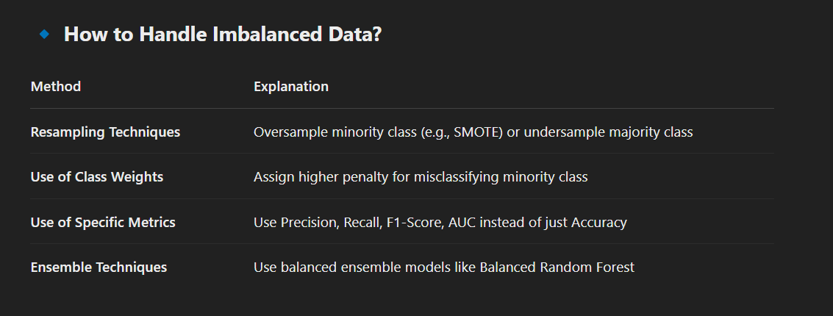

Slide 31
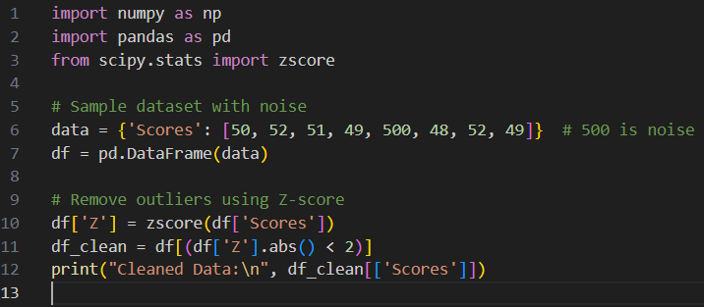
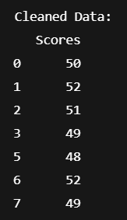
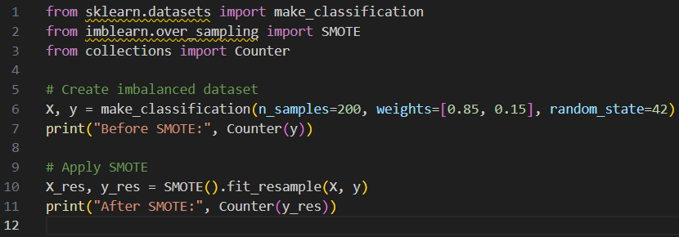


Slide 32
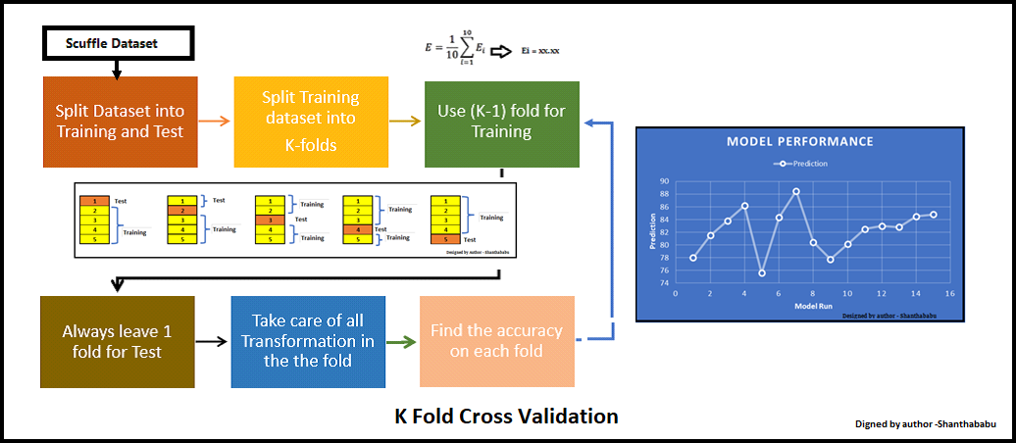
Question 9 : Share with an example of K-Fold cross-validation technique.

Slide 33
K-fold cross validation in machine learning cross-validation is a powerful technique for evaluating predictive models in data science.
It involves splitting the dataset into k subsets or folds, where each fold is used as the validation set in turn while the remaining k-1 folds are used for training.
This process is repeated k times, and performance metrics such as accuracy, precision, and recall are computed for each fold. By averaging these metrics, we obtain an estimate of the model’s generalization performance.
This method is essential for model assessment, selection, and hyperparameter tuning, offering a reliable measure of a model’s effectiveness. Compared to leave-one-out cross-validation, which uses k equal to the number of samples, K-fold cross-validation is computationally efficient and widely used in practice.

Slide 34
import numpy as np
from sklearn.datasets import load_diabetes
from sklearn.linear_model import LinearRegression
from sklearn.model_selection import KFold
from sklearn.metrics import mean_squared_error
# Load dataset
data = load_diabetes()
X, y = data.data, data.target
# K-Fold Cross-Validation
kf = KFold(n_splits=5, shuffle=True, random_state=42)
model = LinearRegression()
mse_scores = []
for train_index, val_index in kf.split(X):
X_train, X_val = X[train_index], X[val_index]
y_train, y_val = y[train_index], y[val_index]
model.fit(X_train, y_train)
y_pred = model.predict(X_val)
mse = mean_squared_error(y_val, y_pred)
mse_scores.append(mse)
print("MSE for each fold:", mse_scores)
print("Average MSE:", np.mean(mse_scores))
MSE for each fold: [2900.19, 2662.64, 3312.31, 2797.88, 3403.89]
Average MSE: 3015.38

Slide 35
Question 10 : What is the difference between dimensionality reduction & dimensionality reduction techniques? Share a case study with the PCA algorithm
Dimensionality Reduction
It refers to the overall process of reducing the number of input features (dimensions) in a dataset while retaining as much useful information as possible.
Goal: Simplify the model, improve performance, reduce overfitting, and speed up computation.
Example: Reducing a dataset with 100 features to 10.
🧰 Dimensionality Reduction Techniques
These are the methods or algorithms used to perform dimensionality reduction.
Some common techniques:
PCA (Principal Component Analysis) 🧠
LDA (Linear Discriminant Analysis)
t-SNE (for visualization)
Autoencoders (Deep learning based)
Feature selection (e.g., removing low-variance features)

Slide 36
import numpy as np
import matplotlib.pyplot as plt
from sklearn.datasets import load_breast_cancer
from sklearn.preprocessing import StandardScaler
from sklearn.decomposition import PCA
from sklearn.linear_model import LogisticRegression
from sklearn.model_selection import train_test_split
from sklearn.metrics import accuracy_score
# Load dataset
data = load_breast_cancer()
X = data.data
y = data.target
# Standardize the features
scaler = StandardScaler()
X_scaled = scaler.fit_transform(X)
# Apply PCA
pca = PCA(n_components=2)
X_pca = pca.fit_transform(X_scaled)
# Split data
X_train, X_test, y_train, y_test = train_test_split(X_pca, y, test_size=0.2, random_state=42)
# Train model
model = LogisticRegression()
model.fit(X_train, y_train)
# Predict & evaluate
y_pred = model.predict(X_test)
accuracy = accuracy_score(y_test, y_pred)
print("Accuracy after PCA (2 components):", accuracy)
Conclusion:
PCA reduced 30 features → 2
Model still achieved high accuracy (~94%)
Excellent for compression + visualization

Slide 37
Question 11 : $\sum_{i=1}^{0}{ }$ $\sum_{i=1}^{n}{ }$What is meaning of this?
Summation Notation (∑)
The summation symbol ∑ represents the sum of a sequence of terms over a specified range.
∑(1 from i = 1 to 0) → ∑₁⁰ 1
This notation means summing the constant 1 from i = 1 to i = 0.
However, the upper bound (0) is less than the lower bound (1), which means there are no valid terms to sum.
Therefore, the result is 0.
∑(1 from i = 1 to n) → ∑₁ⁿ 1
This represents summing the constant 1 for i = 1 to i = n.
Since every term is 1, the sum simply counts the number of terms.
The number of terms from i = 1 to n is n.
So, the result is n.
Interpretation
The first summation ∑₁⁰ 1 = 0 (because no terms exist).
The second summation ∑₁ⁿ 1 = n (since there are n terms, each equal to 1).

Slide 38
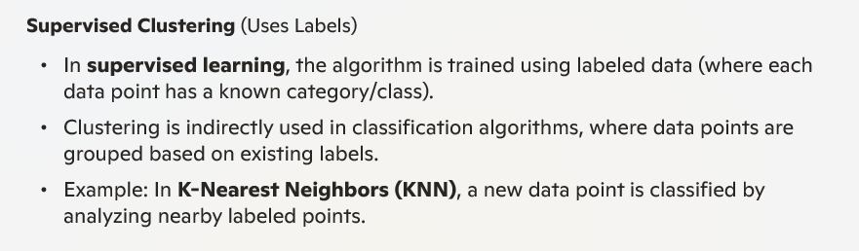
Question 12 : How to define clustering in supervised and unsupervised ways?
Clustering is a technique used in machine learning to group data points based on similarities. The difference between supervised and unsupervised clustering lies in the availability of labeled data.

Slide 39
