Slide 1

CommutLink
To build Intelligent Transport Solutions by providing following tools:
(i) Travel & Transport Demand Modeling
(ii) Planning of Public Transport Network
(iii) Recommendation of Public Transport Accessibility
(iv) Implementing proper and cost-effective Urban Road Traffic Systems
(v) Encouraging Public Private Partnership (PPP) in Urban Mobility Development
(vi) Incentivisation of Road Safety Audit
(x) Land Use Transport Integration and quick implementation of temporary Urban Growth Policy

Slide 2
Objective
The objective is to implement, promote, encourage and coordinate the state of the art of urban transport & to improve the usage of environment-friendly transport modes at local, national & global level including :
Planning
Development
Operation
Education
Research
Management

Slide 3
Travel Demand Modelling
The efficient transport demand management will enable the citizens to decide how/ when and where they can travel efficiently with safety, comfort and conveniently resulting in least travel time.
Transportation demand modelling plays a vital role in land use transport decision making process. It is a tool which can be used to study the impact of alternative strategies, so that the cities can take more informed decisions.
Travel demand models are developed to compute total number of trips being generated, connect the trip origins and destinations, predict the travel mode and assign the trips on road or public transport network.

Slide 4
Travel Demand Modelling
This toolkit provides an overview of the travel demand modelling and its applicability in various urban transport contexts and decision making. It further provides a step-by-step guidance on the travel demand modelling process, its prerequisites, inputs and outputs for different level of decision makers.
The toolkit will be useful for city transport planning authorities for managing consultants undertaking travel demand modelling for the city as a part of strategic land use planning and/or public transport network planning exercise.

Slide 5
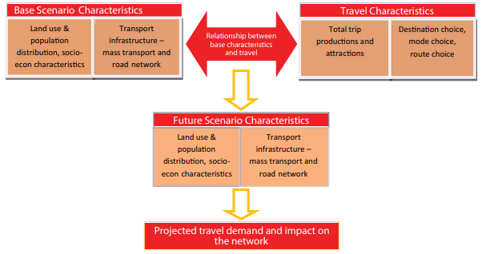
Role of travel demand modelling in the planning process
Travel demand modelling is a tool which helps in developing an understanding of the existing travel pattern of the city.

Slide 6
Travel demand modelling process
Of the existing scenario, relationships between the land use and socio-economic factors and the trip characteristics are developed in order to explain the travel pattern of the city.
To represent the relationship, mathematical models are developed which are based on certain assumptions and data collected. The mathematical model outputs are matched with existing data to ensure the representativeness of the model. These relationships are then assumed to be valid for the future year as well.
Based on the developed relationships, for the future scenarios and the projected population, employment and land use transport characteristics, travel demand is projected and its impact on the network is analysed.

Slide 7
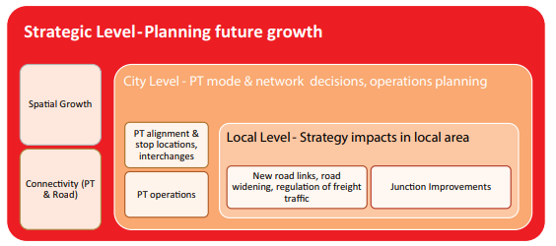
Scale of the model
The cities undertake different levels of decision making – from regional to local level. The models at each of these levels have a definitive scope in terms of its applicability for the three levels of decisions and would require differing sets of inputs and modelling framework. Hence, there cannot be a single model.

Slide 8
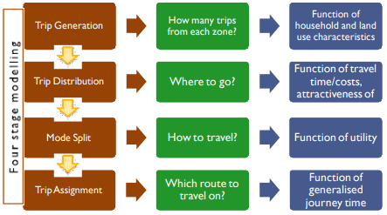
Defining Travel Demand Modelling
Travel demand modelling consists of four stages:

Slide 9
Process of Four Stage Modelling
The first stage is ‘Trip Generation’ which looks at quantifying number of trips which will be made from each zone based on population and employment forecasts. The total trips produced and attracted are assumed to be a function of household and land use characteristics.
‘Trip Distribution’ links the productions and attractions by zones to form travel demand matrix. Trip distribution is carried out based on gravity model which considers trip interactions between two zones as a function of travel time and attractiveness of the two zones.
‘Mode Split’ tries to segregate trips made by various modes in the city like; private modes (cars, two-wheelers), public modes (buses, metro etc) and by walk and cycle.
‘Trip Assignment’ places the trips on to the network through path analysis and helps assess the network sufficiency and its impacts.

Slide 10
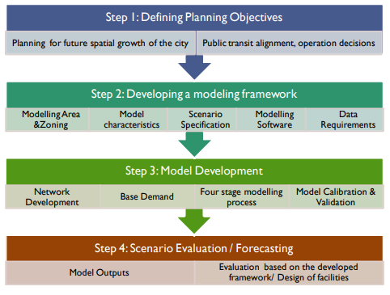
Undertaking Travel Demand Modelling

Slide 11
Defining Planning Objectives
Demand modelling assists in operational decisions like routes, service frequencies, location of interchanges etc.
A public transport operations plan needs inputs in terms of route structuring, service frequencies, identification of major stations and requirement of vehicles.

Slide 12
Developing a modelling framework
These include decisions on the extent and scale of the model along with scenario specification and the software to be used
Modelling area and zoning: The study area can be taken as the modelling area. For the travel demand analysis, this would have to be sub-divided into smaller units known as Traffic Analysis Zones. The zone sizes vary depending on the scale of the model and objective of the modelling exercise.
• Model Characteristics: Depending on the purpose of demand modelling, the model characteristics will vary. These would include decisions on modes to be modelled, level of detail of the network to be coded, the forecast years, and model period (morning peak, evening peak or inter-peak)
• Scenario Specification: A scenario is a possible view of the future. The model needs to include all possible scenarios which have to be assessed for their effectiveness in meeting the plan objectives.
Thus, scenario specification is critical and needs to be defined for all the alternate scenarios / strategy mixes that need to be tested.
• Data Inputs: Developing a model requires base data on transport demand and supply. Additionally, data also needs to be collected for checking model accuracy. The data inputs therefore needs to be collated so that these are available before proceeding to the next stage of model development.
• Model Software: Several transport modelling software like CUBE, TRIPS, TransCAD, Emme etc are available having similar capabilities. The features and prices vary across the different software

Slide 13
Model Development
Deals with creation of the model and its calibration to check its representativeness to the existing situation.
• Network Development: The study area transportation network for both roads as well as public transport would have to be coded. Apart from the network in form of links and nodes, attributes like network speeds, carriageway widths, functional hierarchy etc are also required. Similarly, public transport routes, headways, speeds etc need to be coded in. This information is required for both existing as well as future scenarios to be tested.
• Demand development: Developing demand data is essential for both existing situation as well as forecast years. Demand estimation for base year can be carried out through various surveys like household survey, road-side interviews, on-board passenger survey on public transport services etc.
• Four stage modelling process: The four stages of trip generation, trip distribution, mode split and trip assignment is carried out for travel demand forecasting.
• Model calibration and validation: The base year model needs to be checked for its accuracy before applying the model for forecasting future demand. This checking is known as model calibration and is carried out for every step of the four stage model to verify the ability of the model to reproduce numbers close to observed values

Slide 14
Scenario Evaluation and forecasting
The final stage of the travel demand modelling is scenario evaluation and forecasting. It involves analysing model outputs to assess the difference between different scenarios.
For eg. model outputs like volume-capacity ratios on road network for different scenarios can help in comparing them in terms of their road congestion levels.
The travel demand modelling process helps in evaluating alternative future year scenarios. Based on the overall objectives of the planning exercise, an evaluation framework needs to be set up.
The travel demand modelling process can provide several outputs like expected mode shares in alternative scenarios, volume-capacity ratios on the network, total travel-kms, travel times etc, which can help understand how the scenarios are performing one against the other.

Slide 15
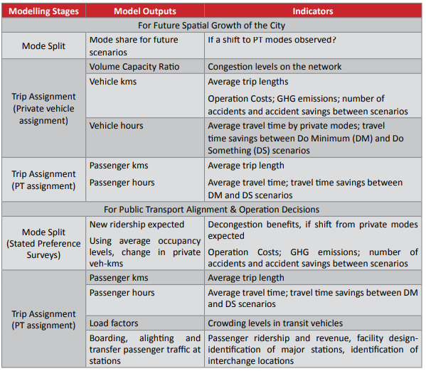
Model Output at Different Stages of Modelling

Slide 16
Challenges
While travel demand modelling is a useful tool to analyse different growth / transit alternatives and helps to arrive at the most suitable alternative, there are some challenges.
Firstly, the amount of data required for developing the model is extensive. Further, the database collection and management is also a tedious and time-consuming exercise. Again, to keep the model updated, it is important to regularly collect, collate and feed data into the model. There is also an absence of database creation and management system in our cities. Every time a study requiring travel demand modelling is commissioned, a new set of data is created having no links with the existing databases.
The developed transport model structure in terms of modeled area, zoning system, network and demand inputs are not standardized and hence it varies from one study to another. Further the model fitness and reliability of its outputs is also a concern as there is no audit mechanism in place to verify the reasonableness of assumptions and quality of model developed. Rather than updating the model over time, for every study a new model is created. As a result of this, comparability of outputs between different models becomes a problem.
Applicability of model outputs is also a concern. The use of model outputs in the strategic planning process is not clearly outlined. If it is being used for scenario appraisal, outlining the indicators for appraisal process and how it links to the model outputs is required. A methodology for appraising scenarios therefore needs to be developed.

Slide 17
Recommendations
For facilitating travel demand modelling in the city’s decision making process, it is suggested that to develop a standard model for the city which is regularly updated and used by consultants for undertaking various studies. This process should be periodically carried out every 5 years to ensure that the model is current and updated.
Managing and maintaining transport models requires continual data collection process which needs to be fed into the model for keeping it current. This calls for enhancing the capacity of the city officials for developing and maintaining such transportation models.
Transport Modelling is based on the principle that Transportation is a derivative of the Land Use. It provides an overview of the Travel Demand Modelling and its applicability in various Urban Transport contexts and Decision making. It further provides a step by step guidance on the Travel Demand Modelling Process, its Pre requisites, inputs and outputs for different levels of decision makers.
It provides reasonably good guidance for City Transport Planning Authorities on Managing Consultants, Undertaking Travel Demand Modelling in the City as a part of Strategic Land Use Planning and/ or Public Transport Network Planning Exercise
Based on the Transport Demand Modelling, the Need and the Mode of Travel can be derived and the Demand on various alternative Transport Systems can be determined. The alternative Transport Systems can be managed as per the demand on those systems.

Slide 18
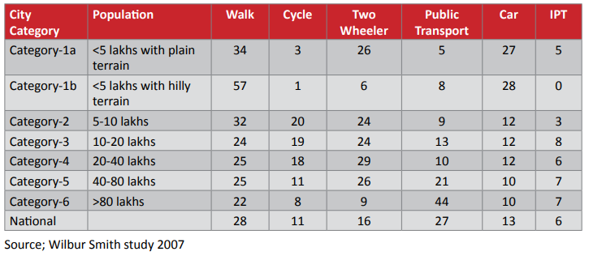
Planning of Public Transport
Network (MRT Network and Modes)
The objective is to create a transport network with all the three basic modes: Walk, Personal & Public transport. The transport network has to be citywide as stated earlier so that the commuter is assured that he can complete his journey all the way by the mode of his choice.
Many trips may have to use more than one mode to complete a trip e.g. walk and bus. Hence network will be multi-modal. Indeed transport is inherently multi-modal. In the early days people used to walk and cross the river by boat.
Thus, the need to interchange between modes / routes becomes a part of the trip. This interchange has to be made as convenient and comfortable as possible which imposes minimum time penalty on the commuter.

Slide 19
Planning of Public Transport
Network (MRT Network and Modes)
. This requires:
• Stops / Stations in close vicinity of each other.
• Single ticket for all modes.
• Integrated Passenger Information
• Integrated service schedules
• Signages and conflict free movement within the interchange

Slide 20
Planning of Public Transport
Network (MRT Network and Modes)
Choice of mode of Transport based on Demand along Corridor & Capacity of Modes:
First and last mile connectivity :
• Walk facilities within 500 m
• Vehicle access within 3 km
• Feeder service within 5 km
• Drop off & pick up at stations
• Park and ride at stations
• Land use control around stations
• Facilities for handicapped
User friendly service :
Centralized control with Intelligent Transport System
• Passenger information system
• Integrated ticketing
• Integration of route time tables
• A pleasant ambience

Slide 21
Public Transport Accessibility
In most developing countries including India, the experience has been that the government agencies are unable to provide adequate formal public transport systems; in such cases ‘informal public transport’ systems emerge to cater to the demand.
Provision of public transit and infrastructure is important, this alone will not help in increasing the attractiveness of public transport. It is also necessary that the system provided is accessible for its users, so that its full potential is realized.
The focus of this toolkit will be on accessibility to public transport and not accessibility via public transport.

Slide 22
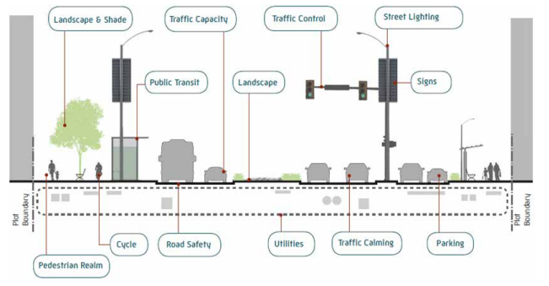
Urban Road Traffic Systems
Objectives include planning network of roads and other elements of the road network for evolving urban centres, designing new facilities, evaluating the existing road network and redesigning to meet the demand.

Slide 23
Intelligent Transport System
Meant for selecting and implementing ITS based Traffic Management System and can be used by city officials, administrators and network managers responsible for safe and efficient operation of vehicular traffic in the city without resorting to much application of transport planning.
The Traffic System Management is generally carried out as per available ground situation without making any major interventions in the present infrastructure.

Slide 24
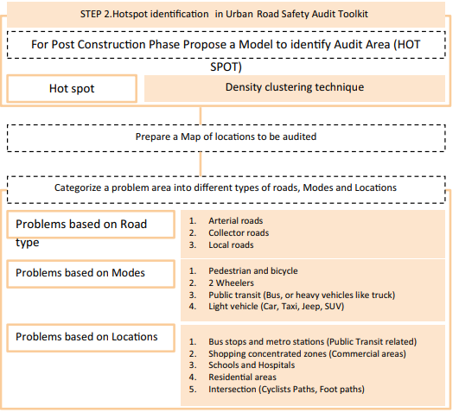
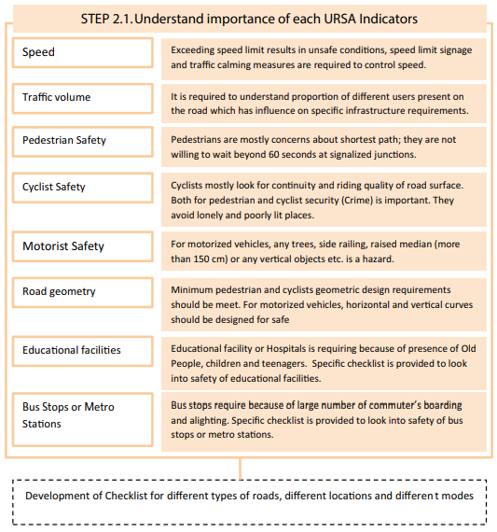
Urban Road Safety Audit
Meant for accident prevention rather than accident reduction.

Slide 25
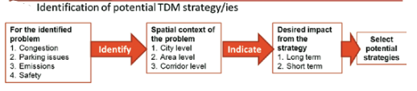
Transport Demand
Management
Practice wherein various strategies (policies, programs, services and products) are used to change travel behaviour (how, when and where people travel) in order to increase the efficiency of transport systems and achieve sustainability of mobility systems.
Transportation of people and goods is an essential feature in Urban Planning as the efficiency of Urban Management is fully dependant on its Transportation facilities between the various land uses in the urban area.

Slide 26
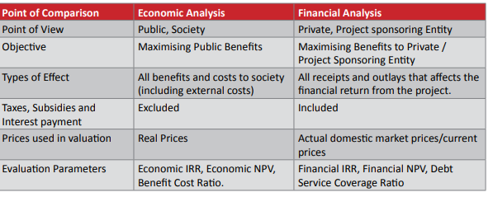
Financing & Financial Analysis
The fast pace of urbanization has fuelled the demand for urban mobility and hence triggering large number of planning and implementation projects in urban transport at city level in India. However, given their capital intensive nature, financing of such projects becomes a key challenge.

Slide 27
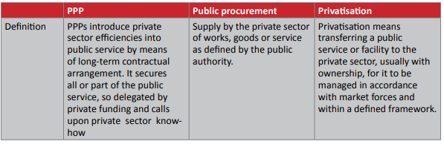
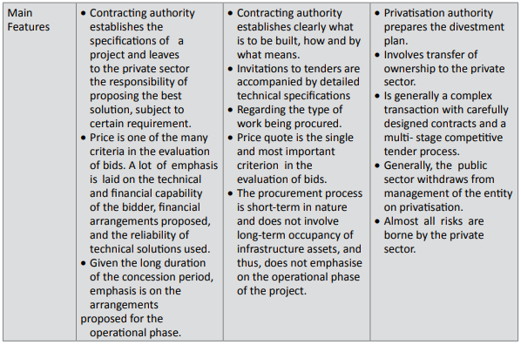
Public Private Partnership
(PPP) in Urban Transport

