Slide 1

Phishing Website Detection
Using Machine Learning Techniques
ICT Risk Assessment | University of Pisa
Hamas Ali • Matricola 726267
Cybersecurity | Machine Learning

Slide 2






Agenda
01
02
03
Problem Statement
Research Papers Overview
Papers Comparison
Why phishing is a threat & traditional limitations
Three ML approaches compared
Side-by-side analysis of techniques & results
04
05
06
Our Implementation
Results & Analysis
Key Findings
Dataset, models, feature engineering
Performance metrics and cross-validation
Insights, conclusions, and takeaways

Slide 3


The Phishing Threat
Why we need intelligent detection systems
Attackers Steal Via Fake Sites
Blacklist/Whitelist Limitations
• Passwords & login credentials
• Bank details & financial data
• Personal & identity information
• Corporate secrets & API keys
• Only detects known malicious URLs
• Fails on newly created phishing sites
• Cannot generalize to unseen attacks
• Requires constant manual updates
Solution: Machine Learning (countermeasures)
Intelligent systems that learn from patterns, generalize to new threats, and detect phishing automatically in real-time, without relying on predefined lists. Machine learning acts as a countermeasure in the risk assessment process by automatically detecting phishing threats and reducing risk.
3.4B
36%
$17.8K
Phishing emails/day
of breaches involve phishing
avg cost per minute of downtime

Slide 4
Paper 1
Detection of Phishing Website Using Machine Learning Approach
Extreme Learning Machine (ELM) with URL & Website Features
Input URL+ other features
Extract 30
Features
ELM
Model
Classify
+1 / -1
Alert
User
Address-based Features
Abnormal Features
URL length
Abnormal URL patterns
Special characters (@, //)
Redirects count
Prefix/Suffix (-)
Submitting to email
IP address in URL
Domain-based Features
HTML / JavaScript Features
Domain age
Popup windows
Web traffic
iFrame usage
Google index
On-mouseover events
DNS record status
⭐ Key Contribution: ELM achieves fast training (no iterative updates) , random input weights, analytically computed output weights. 30 features, real-time detection.
Right-click disabled

Slide 5

Paper 2
Machine Learning Algorithms for Detecting Phishing Websites
NLP + Domain Intelligence + AutoML — The Strongest Approach
NLP Features
Domain Features
AutoML
Suspicious keywords detection
Python-WHOIS queries
Auto model selection
"Urgent login now" patterns
DNS record inspection
Tests RF, Gradient Boost,
Decision Tree, SVM
Spelling error analysis
Domain registration age
Chooses best automatically
Weird/unusual language patterns
Short lifetime detection
No manual trial needed
Content semantics analysis
Suspicious registrar info
Optimal result: 95.8% acc.

Slide 6
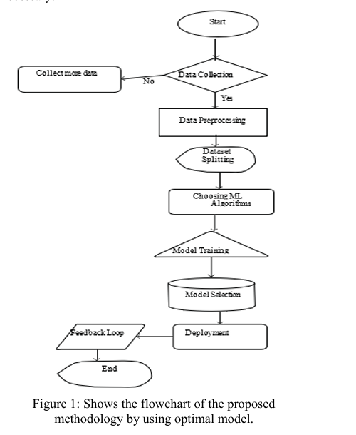
Paper 2
Machine Learning Algorithms for Detecting Phishing Websites
Full Pipeline of proposed solution
NLP Features
The system collects data, extracts NLP and domain features, and then uses AutoML to select and train the best model for phishing detection. The system collects data, extracts NLP and domain features, and then uses AutoML to select and train the best model for phishing detection

Slide 7

Paper 3
Phishing Websites Detection using Machine Learning
Comparing Decision Tree, SVM, Naïve Bayes, Neural Network on URL Features
Dataset: UCI Repository | 1,353 URLs (702 phishing • 548 legitimate • 103 suspicious) | 9 Features | 3-class classification
★ BEST
Decision Tree
SVM
Naïve Bayes
Neural Network
91.5%
86.69%
86.14%
84.87%
Accuracy
Accuracy
Accuracy
Accuracy
Best performer. Works well with categorical/discrete features. Issue: overfitting → solved by pruning.
Finds optimal hyperplane boundary. Maximizes margin between classes.
Probability-based. Assumes feature independence — not ideal for correlated phishing features.
3-layer network (9→10→3). Worst result — data is discrete, not continuous. NN prefers continuous data.

Slide 8
Research Papers — Comparative Analysis
Aspect
Paper 1 (ELM)
Paper 2 (NLP+AutoML)
Paper 3 (Classical ML)
Features Used
30 URL + HTML features
NLP + WHOIS + DNS
9 URL features
Main Algorithm
Extreme Learning Machine
AutoML (auto-selection)
Decision Tree (best)
Best Accuracy
High (ELM competitive)
95.8% ★
91.5%
Dataset Size
UCI (11,055 samples)
PhishTank + UCI
1,353 URLs
Classification
Binary (+1/-1)
Binary
3-class (phishing/legit/suspicious)
Key Strength
Fast training speed
Rich multi-modal features
Simple & interpretable
Key Weakness
Single layer NN architecture
Complex pipeline
Overfitting risk in Decision Tree

Slide 9
Our Implementation
Dataset & Feature Engineering – UCI Repository Phishing DS:
11,055
30
6,157
4,898
Website Samples
Input Features
Legitimate (55.7%)
Phishing (44.3%)
30 Features — 4 Categories
URL-based
Security
Content
Domain/Meta
having_IP_Address
SSLfinal_State
Request_URL
age_of_domain
URL_Length
Prefix_Suffix
URL_of_Anchor
DNSRecord
Shortining_Service
HTTPS_token
Links_in_tags
web_traffic
having_At_Symbol
Domain_registeration_length
SFH
Page_Rank
double_slash_redirecting
Favicon
popUpWidnow
Google_Index
Iframe
Statistical_report

Slide 10
Models Tested & Pipeline
Load
ARFF
Dataset
Byte
Decode
→ int
Label
Convert
80/20
Train/Test
Split
Train 6
Models
Evaluate
Metrics
Cross
Validation
Decision Tree
Random Forest
★ BEST
SVM
Tree-based; handles discrete features well; prone to overfitting
Ensemble of 200 trees; highest performance; most stable
Pipeline: StandardScaler + SVC; finds optimal class boundary
Logistic Regression
Naïve Bayes
KNN (k=5)
Pipeline: StandardScaler + LR; max_iter=2000; linear baseline
GaussianNB; assumes feature independence; poor for correlated features
Pipeline: StandardScaler + KNN; k=5 neighbors; distance-based

Slide 11
Results — Model Performance Comparison
Model
Accuracy
Precision
Recall
F1-Score
ROC-AUC
Random Forest ★
97.69%
98.04%
96.73%
97.38%
99.64%
Decision Tree
96.97%
97.60%
95.51%
96.54%
97.64%
SVM
95.61%
96.33%
93.67%
94.98%
98.90%
KNN
94.71%
94.99%
92.96%
93.97%
98.56%
Logistic Reg.
92.81%
93.44%
90.10%
91.74%
97.85%
Naïve Bayes
61.60%
53.59%
99.90%
69.75%
96.77%
⚠ Naïve Bayes: 99.9% recall but only 53.6% precision → extreme false positive rate. Class imbalance handled via class_weight='balanced' in Random Forest (no recall drop).
Train/Test: 80/20 stratified split | 11,055 samples total | UCI Phishing Websites Dataset

Slide 12
Cross-Validation & Feature Importance
5-Fold Stratified Cross-Validation (Mean F1)
Top 10 Important Features (Random Forest)
CV Insight: Random Forest achieves Mean F1 = 0.966 with Std = 0.003 (lowest variance). Decision Tree shows higher std (0.0065) — more sensitive to data splits. Naïve Bayes performs poorly due to feature independence assumption being violated in phishing data.

Slide 13

Key Findings & Conclusions
Random Forest is the Winner
SSLfinal_State is #1 Feature
Achieved 97.69% accuracy, F1=97.38%, ROC-AUC=99.64% ,most accurate and most stable across all 5 CV folds. Best for deployment.
SSL certificate status accounts for 32.5% of model importance. Followed by URL_of_Anchor (24.9%) and web_traffic (7.4%).
Naïve Bayes — Don't Use for This
Multi-Modal Features Win (Paper 2)
99.9% recall but only 53.6% precision → extreme false positives. Phishing features are correlated; independence assumption is violated.
Combining NLP, WHOIS, DNS, and AutoML gives highest paper accuracy (95.8%). Richer features always outperform URL-only approaches.
Cross-Validation Confirms Reliability
Practical Takeaway
Low standard deviation (0.003) in RF confirms results aren't due to lucky splits. Model generalizes well to unseen phishing sites.
A 30-feature Random Forest with class_weight='balanced' is sufficient for production phishing detection with near-perfect recall.

Slide 14
Thank You
Questions & Discussion
Hamas Ali • Matricola 726267
ICT Risk Assessment | University of Pisa | MSc Computer Science – AI
97.69%
3
6
11K+
Best Accuracy
(Random Forest)
Papers
Analyzed
Models
Implemented
Samples
Tested

