Slide 1
Insight & Intelligence Hub ARC-LBB
Assessing the Risk of Crime in the London Borough of Barnet

Slide 2
Introduction
Part of the ONS Data Science Accelerator Programme
Aims to assess the risk of five most prevalent types of crime in Barnet with machine learning algorithms based on places and socioeconomic data
anti-social behaviour, violence and sexual offence, vehicle crime, other theft, and burglary
Utilises street-level crime data provided by DATA.POLICE.UK

Slide 3
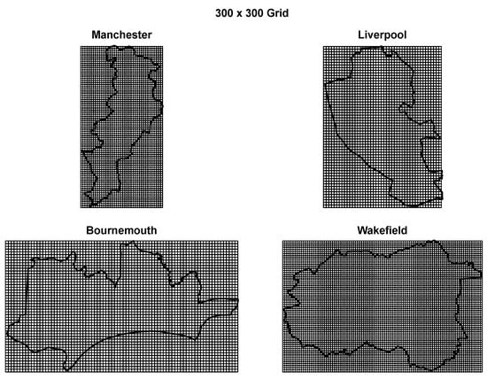
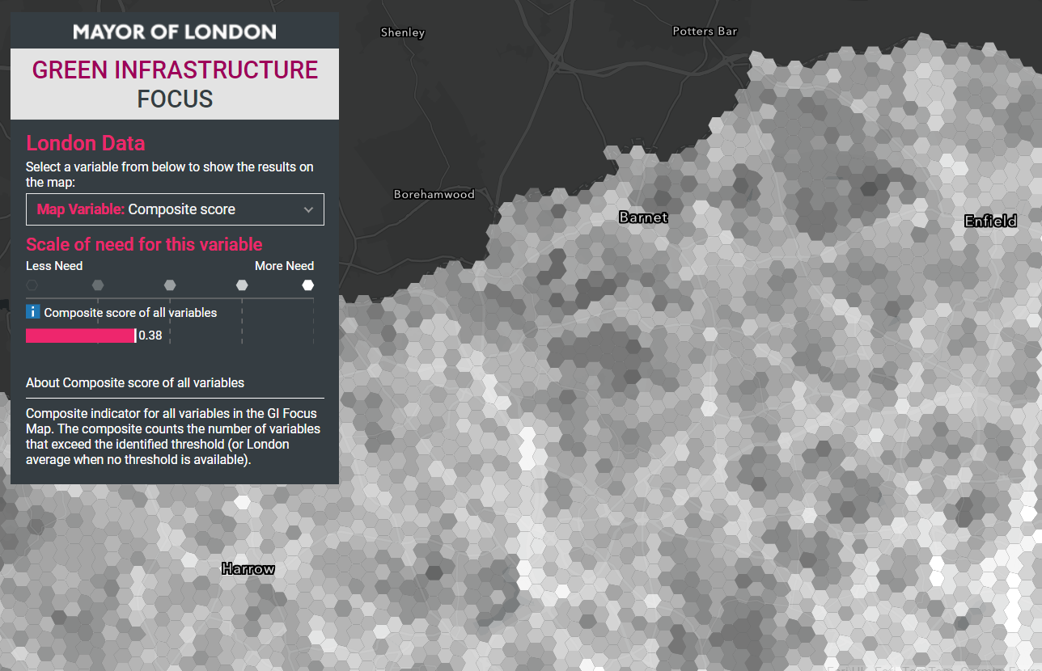
Project Overview
Sourcing data
Exploratory data analysis
Geographical aggregation
Hotspot identification
Dimensionality reduction
Prediction
Evaluation
Cichosz, Paweł. 2020. "Urban Crime Risk Prediction Using Point of Interest Data" ISPRS International Journal of Geo-Information 9, no. 7: 459. https://doi.org/10.3390/ijgi9070459
Greater London Authority. 2018. “Green Infrastructure Focus Map” London Data Store https://apps.london.gov.uk/green-infrastructure/

Slide 4
Project Overview
Geographical aggregation
Partitioning area into a polygon grid
Street-level data will be aggregated into polygon grids
Why? Some difficulties with using administrative area (e.g., LSOA)
Need of smaller areas due to the assumption of spatial homogeneity
Need of single uniform area to reduce spatial bias and better compare areas

Slide 5
Questions
Geographical aggregation
What is the maximum level of granularity that should better not be compromised on to confer the practical utility of final model to police officers?
How many streets (or any other units) can an officer patrol per day on average?
How does patrol works? How many officers are involved per area and how are time slots allocated?
According to the street-level crime data in Barnet, streets near supermarkets appear to be most crime-prone streets. Is there general consensus on crime-prone places (e.g., bus stops, tube stations, etc.)? Is there analysis around this by any chance?

Slide 6


