Slide 1
Insight & Intelligence Hub ARC-LBB
Assessing the Risk of Crime in the London Borough of Barnet

Slide 2
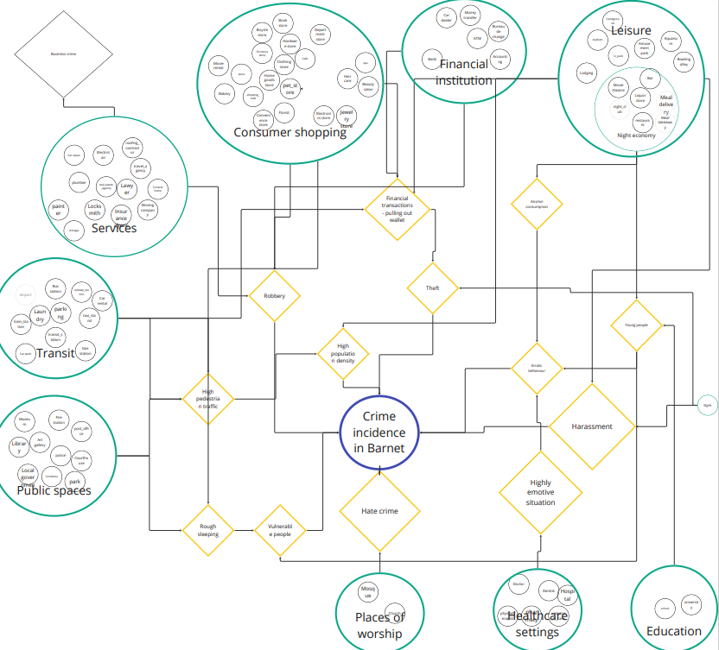
Introduction
Part of the ONS Data Science Accelerator Programme
Aims to assess the risk of five most prevalent types of crime in Barnet with machine learning algorithms based on places of interest
anti-social behaviour, violence and sexual offence, vehicle crime, other theft, and burglary
Utilises street-level crime data provided by DATA.POLICE.UK

Slide 3
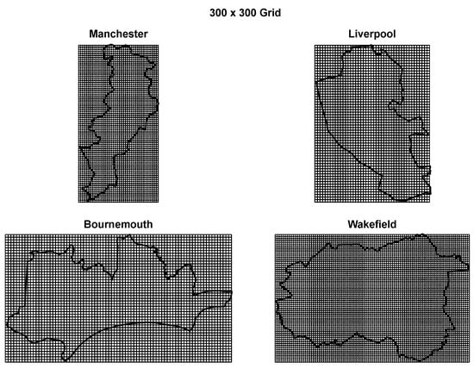
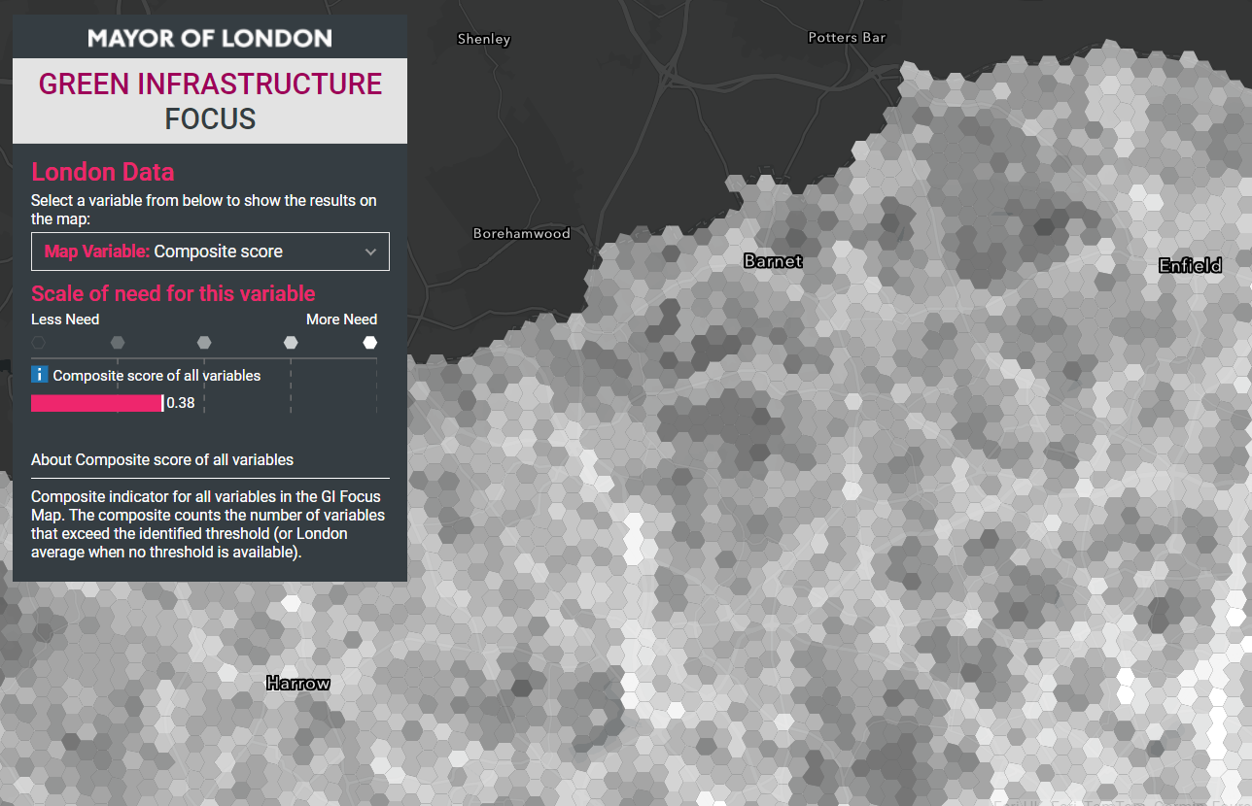
Project Overview
Sourcing data
Exploratory data analysis
Geographical aggregation
Hotspot identification
Dimensionality reduction
Prediction
Evaluation
Cichosz, Paweł. 2020. "Urban Crime Risk Prediction Using Point of Interest Data" ISPRS International Journal of Geo-Information 9, no. 7: 459. https://doi.org/10.3390/ijgi9070459
Greater London Authority. 2018. “Green Infrastructure Focus Map” London Data Store https://apps.london.gov.uk/green-infrastructure/
Notes:
Geographical aggregation
Partitioning area into a polygon grid
Street-level data will be aggregated into polygon grids
Why? Some difficulties with using administrative area (e.g., LSOA)
Need of smaller areas due to the assumption of spatial homogeneity
Need of single uniform area to reduce spatial bias and better compare areas

Slide 4
Project Overview
Sourcing data - crime, POI (places of interest AKA spatial features)
Exploratory data analysis
Count of crime by category / administrative area
Count of POI by type / administrative area
Timeseries analysis (down to month level) – decomposition
Spatial autocorrelation – how are my neighbours doing
Geographical aggregation - partitioning area into a polygon grid of nxn m
Hotspot identification
Binary labelling of crime risk for micro-areas: high / low
Kernel Density Estimation for assessing risk level by distance
Relative risk
Dimensionality reduction
Attribute selection
PCA transformation
Prediction - logistic regression, SVM, decision trees, random forest
Evaluation
Prediction quality: ROC curves for LR, SVM, DT and RF
Attribute predictive utility: RF MDA
Model transfer

Slide 5
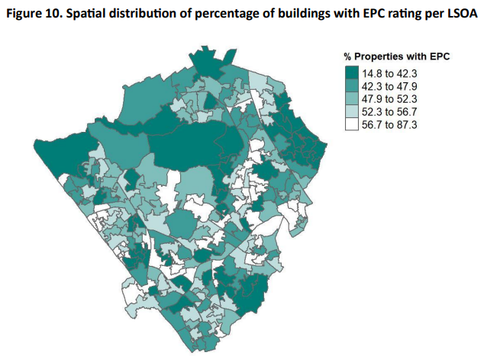
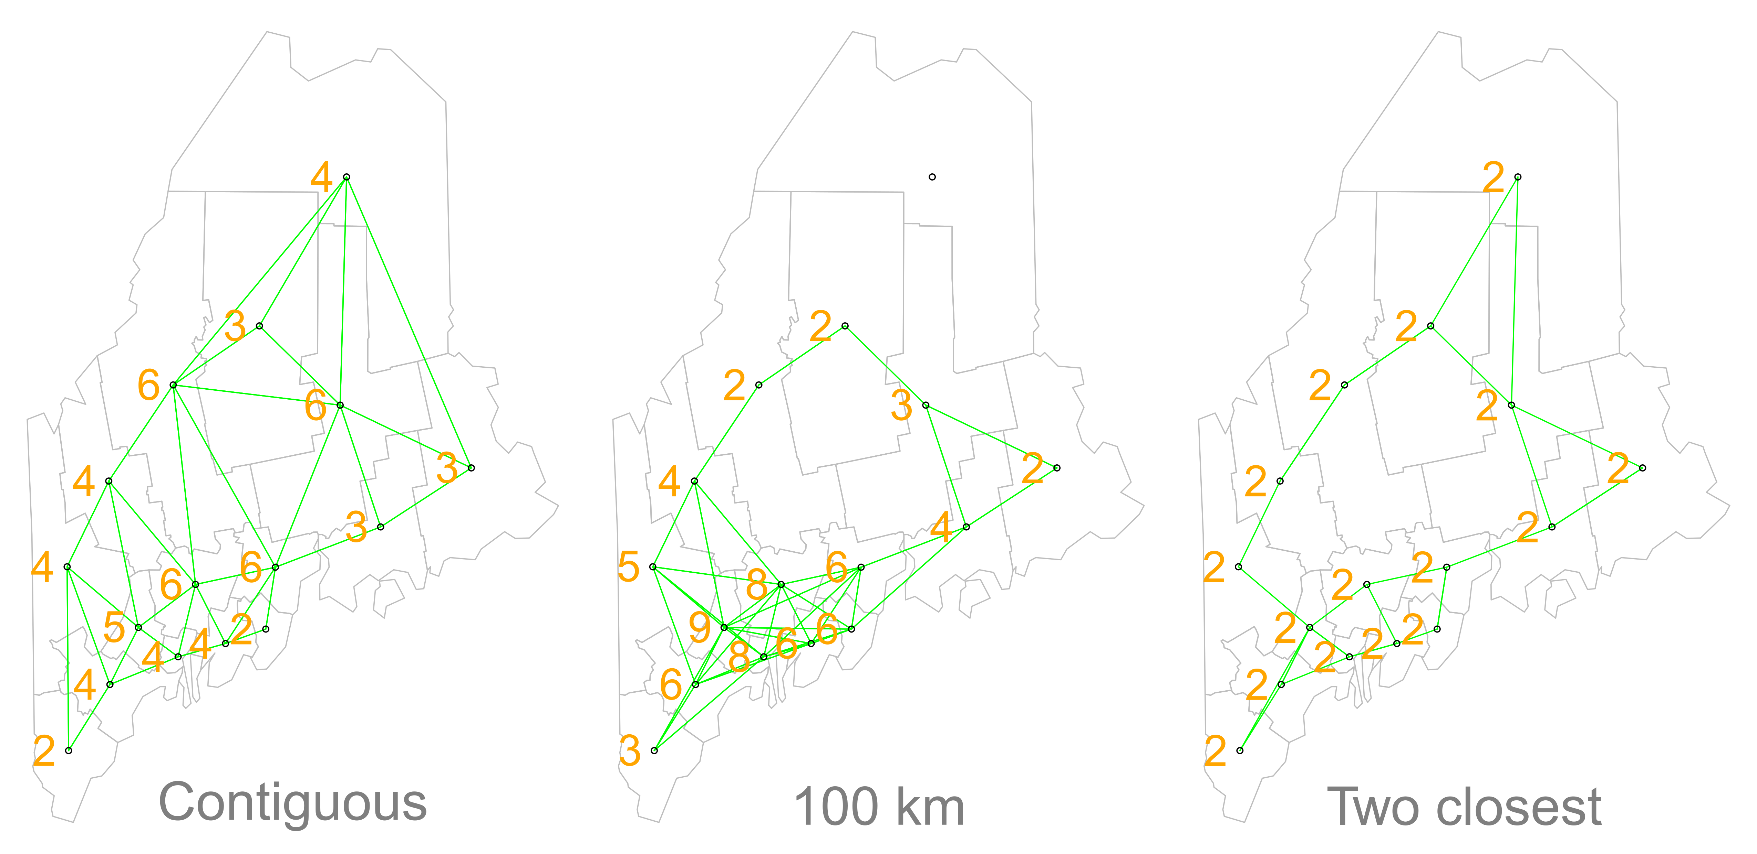
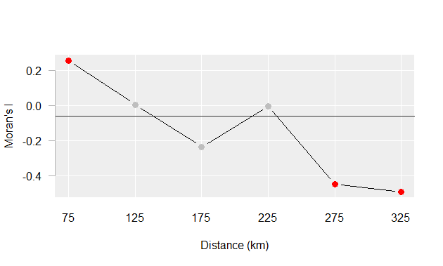
Spatial Autocorrelation
Possible to detect clustering to some extent but needs some measures to quantify the extent of clustering
How to define neighbours
Contiguous
Distance band (e.g., within 100km)
K nearest (e.g., two closest neighbours)
Moran’s I coefficient
Correlation coefficient for the relationship between a variable (e.g., % buildings with EPC rating per LSOA or count of crime per unit area) and its neighbouring values: X v. Xlag
Global
Moran’s I is the slope of the line between X and Xlag
Significance testing through Monte Carlo approach
Moran’s I at different lags (100km -> 200km -> 300km)
Local
Decomposing the global Moran’s I into a localized measure of autocorrelation–i.e. a map of “hot spots” and “cold spots”
Local Spatial Autocorrelation — Geographic Data Science with Python
Manuel Gimond. 2023. Intro to GIS and Spatial Analysis.
https://mgimond.github.io/Spatial/spatial-autocorrelation.html

Slide 6
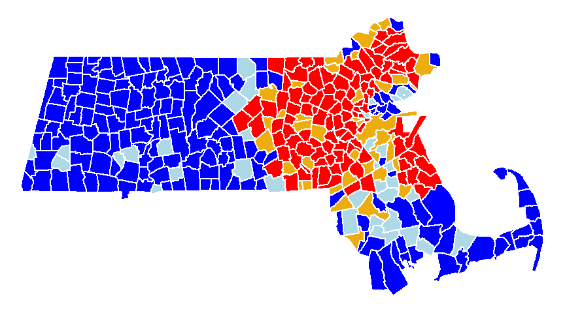
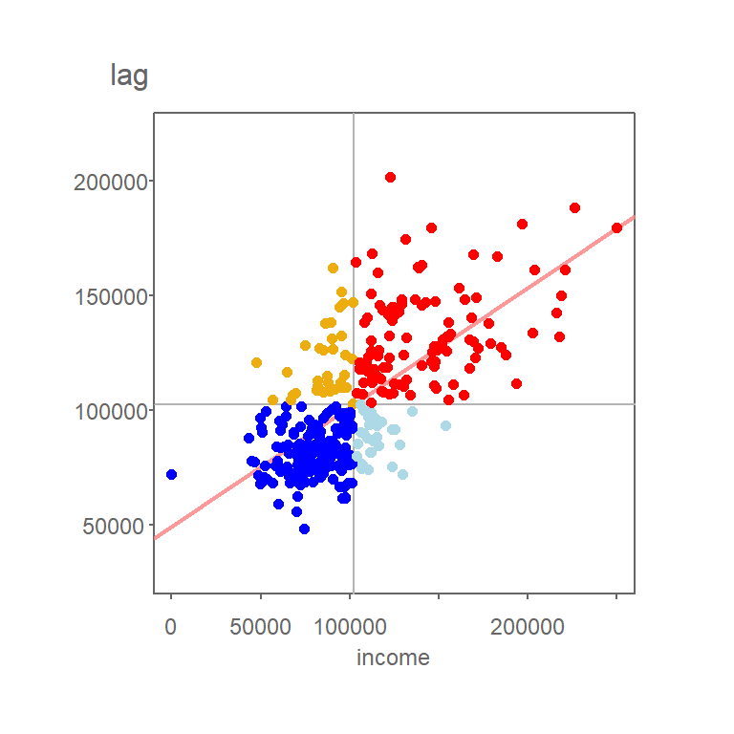
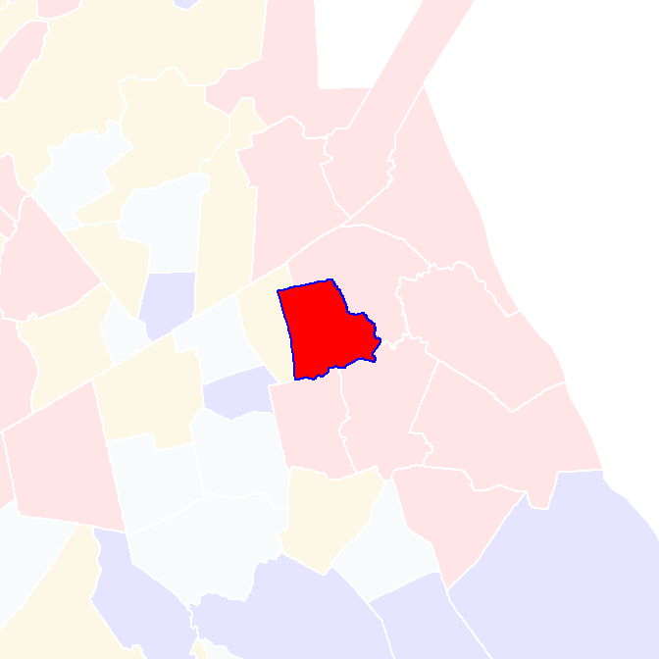
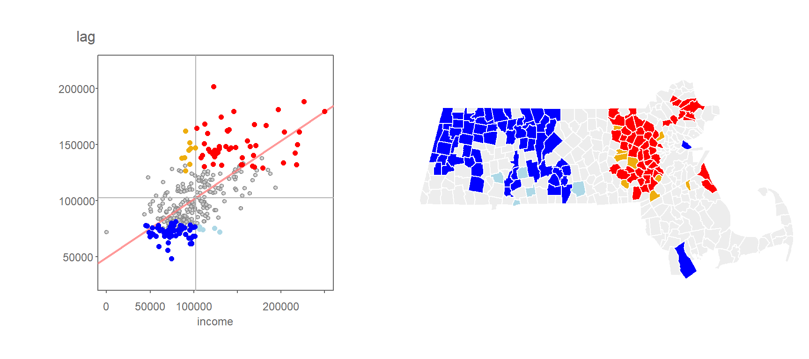
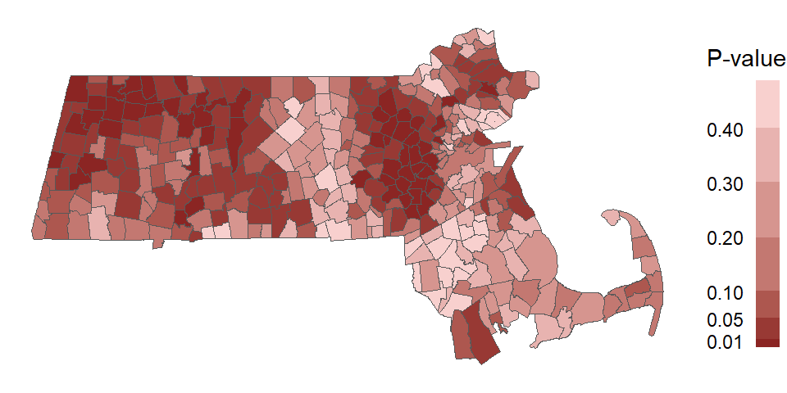
Local Moran’s I
Low-high
High-high
neighbour
Low-low
High-low
ME

Slide 7


