Slide 1
ESPRESSO UI TESTING FRAMEWORK
Aqsa Zia
Myra Arshad
Hamda Naeem
Tazeen

Slide 2
ESPRESSO
UI Testing Framework by Google
The Espresso testing framework provides a set of APIs to build UI tests to test user flows within an app.
Espresso automatically synchronizes your test actions with the user interface of your application.
It can be used to test across applications.
This framework also ensures that your activity is started before the tests run.

Slide 3
WHY ESPRESSO?
It support synchronization, you don’t need to write additional code for waiting until activity will be loaded or finished.
Comparatively faster and Relaible
Simple to write test cases
Efficient Testing.
Up gradation and Reusability.
Consistency.
Vastly Increases Your Test Coverage.
Automation Does What Manual Testing Cannot.

Slide 4
MAJOR COMPONENTS
View Matchers: Allows to find view in the current view hierarchy.
onView((withId(R.id.button)));
View Actions: Which allows to perform actions on the views.
onView((withId(R.id.button))).perform(click());
View Assertions: Which allows to assert state of a view.
onView((withId(R.id.layout))).check(matches(isDisplayed()));

Slide 5
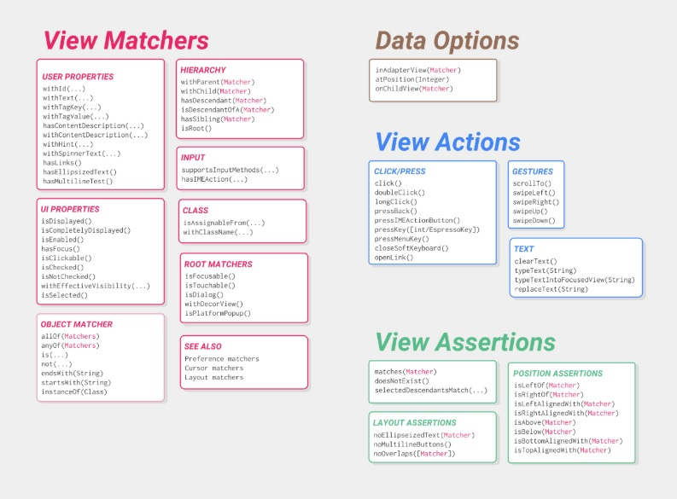
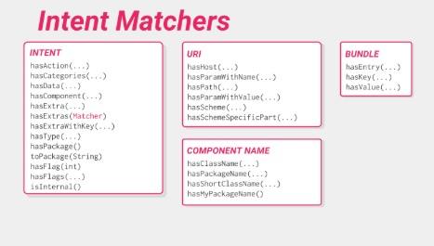

Slide 6
DEMO

Slide 7
THANK YOU!

