Slide 1
Evaluating ML/AI Strategies for Business Growth
Delivering an ML/AI Strategy, AI for Business Leaders, Udacity
Hamdah Al Aydaroos, Dec - 2024
© 2024 Udacity.

Slide 2
Executive Summary
Purpose of Project
Project origination; apply ML/AI techniques learned throughout the course to real world busniness challenges.
Focusing on implementing strategies for overall efficiency.
Methodology
Analysis conducted over _2_ weeks
Over _4_ potential use cases underwent thorough assessment for feasibility and impact
Incorporated both technical knowledge and user feedback
Path Forward
_2_ use cases identified for implementation
Needs and requirements to be successful; providing accurate data, monitoring and measuring models performance, and establishing ethical safeguards.
Next steps; Finalize data, test and evalute performance, address biases, deploy model.

Slide 3
I Began with Four Use Case Ideas
Enhancing tax planning efficiency
Description of Use Case 1:
AI tool optimizes transfer pricing and cuts reliance on tax advisors
Dealership expansion strategy
Description of Use Case 4
Data predicts sales in new dealership locations.
Supply chain optimization
Description of Use Case 2 :
Model reduces factory costs and manage supply disruptions.
Sustainability advancement
Description of Use Case 3
Predicitve charging to align with off-peak renewable energy hours.

Slide 4



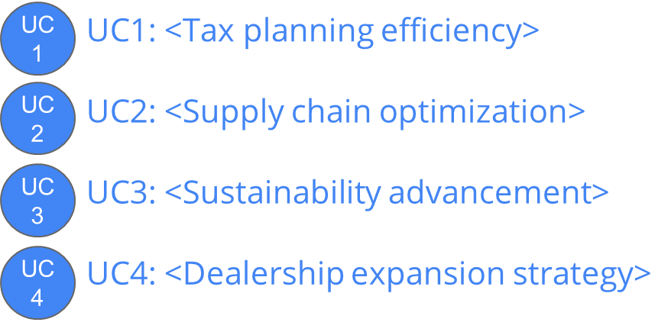

I Assessed Feasibility vs. Impact for All Cases
Impact
low
low
Feasibility
high

Slide 5
Transforming Our Business Using ML/A with These Top Two Use Cases
Enhancing tax planning efficiency
AI tool optimizes transfer pricing and cuts reliance on tax advisors.
Dealership expansion strategy
Data predicts sales in new potential dealership locations.
By executing on these two projects I believe we can drive _growth and efficiency_ for our business by _leveraing data driven insights__ and become a(n) _innovative _ business.

Slide 6
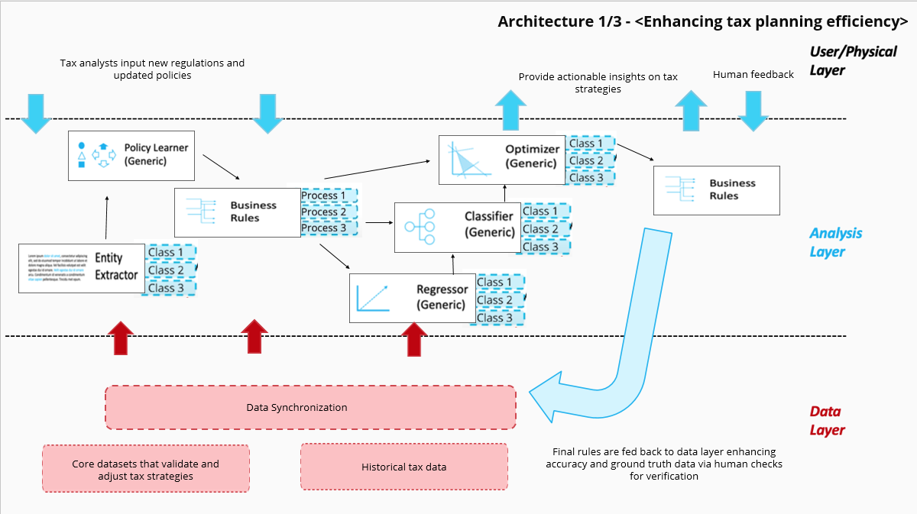
Use Case 1 _Enhancing tax planning efficiency_ Deep Dive
Example Architecture
Process Today
Setup: Income details, Expenditure details, Tax jurisdictions, Tax law changes, Third party advisors details
Transformation: Data is manually assessed by third party advisors in hopes to achieve tax efficiency.
Resolution: Third party advisors formulate a general tax plan, such a strategy would depend on the accuracy of the individuals task (analyzing data) at hand.
Result: Firms' over all tax planning processes are slow and prone to errors due to manual data handling, thus lacking efficiency.
Process Tomorrow
Setup: Structured Income details, Structured expenditure details, Regularly updated tax law changes, Regional tax data
Transformation: Data is used to train and test the model ensuring it predicts efficient tax strategies whilst staying current with updated regulations via algorithms.
Resolution: The structured and constantly updated data provides the model a solid frame work, which guides it to formulating a constructive yet cohesive tax efficient strategy.
Result: Firms' over all tax planning processes would play out periodically and accurately due to automated data handling, thus enhancing efficiency.
The impact of _this tool_ will be _cost savings and efficiency_ thanks to _automated analysis_!

Slide 7
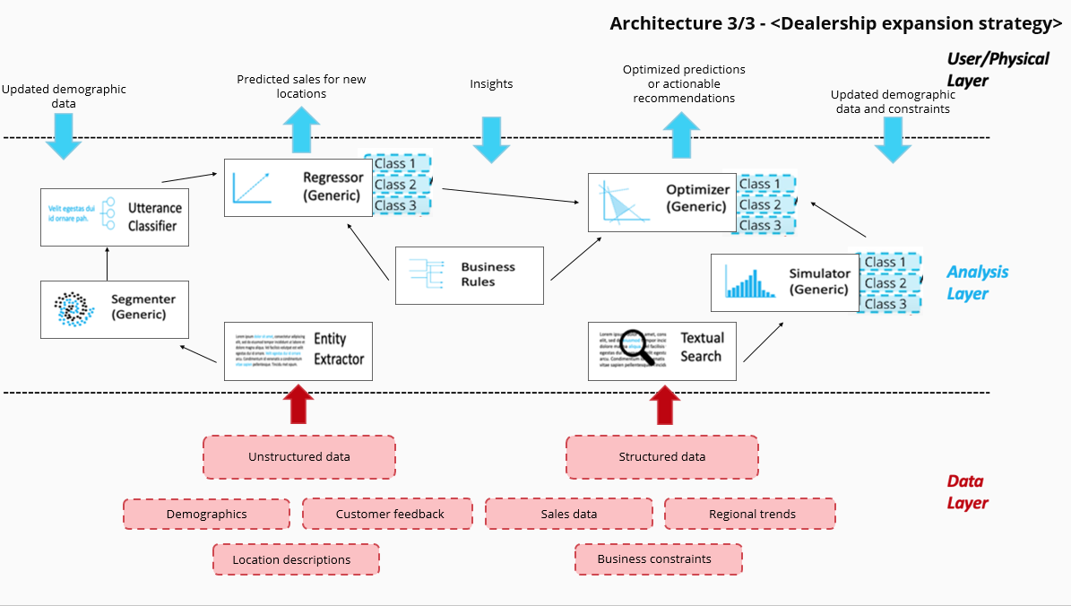
Use Case 2 _Dealership expansion strategy_ Deep Dive
Process Today
Setup: Existing sales data, Population density in concentrated areas
Transformation: Data is manually assessed by the firm, relaying on traditional research and assessments.
Resolution: Team operates on intuition and existing patterns to decide on new dealership locations.
Result: Firms' lack of data driven insights limits dealership placement to densely populated areas.
Example Architecture
Process Tomorrow
Setup: Population demographic trends, Significant sales history data, Compare new and existing location performances
Transformation: Data is used to train and test the model, predicting future sales in new locations by comparing the performance of existing and potential locations.
Resolution: With data driven insights, the team operates on predictive models, thus guides them to formulate an efficient expansion strategy.
Result: Firms' analytical insights enhances dealership placement in various areas by accurately estimating future performance. However, the integration of these models can raise significant implementation costs.
The impact of _this model_ will be _increased revenue and market reach_ thanks to _data driven location insights_!

Slide 8
Risks / Mitigations
 | Enhancing tax planning efficiency | Dealership expansion strategy
Accuracy Definition: Model’s predictions align with actual outcomes. | Concern: Ensuring the model accurately accounts for updated tax regulations and performs consistently over time. Plan: Conduct periodic performance tests and retrain the model using updated datasets to maintain accuracy and efficiency. | Concern: Ensuring accurate sales predictions for potential dealerships based on existing sales and demographic data. Plan: Evaluate predictions using metrics like MAE or RMSE and refine the model to outperform intuition-based decisions.
Underfitting/Overfitting Definition: model fails to learn key patterns, leading to poor performance/ model learns too much, struggles adapting new data (biased). | Concern: The model might overfit to historical tax data, limiting adaptability to new laws or scenarios. Plan: Use cross-validation techniques and retrain regularly with diverse datasets to prevent overfitting and enhance responsiveness. | Concern: Overfitting to urban data may limit the model’s ability to predict sales in rural areas. Plan: Use diverse datasets and conduct regular checks to balance data representation across different regions.
Ethical Concerns Definition: ensuring AI systems are fair and align with ethical principals. | Concern: Stakeholders may distrust AI recommendations due to a lack of transparency, and aggressive strategies might conflict with regulatory boundaries. Plan: Implement an explainability framework and human-in-the-loop reviews to clarify recommendations and ensure ethical compliance. | Concern: Favoritism towards certain locations or groups, risking discrimination against smaller or underprivileged areas. Plan: Implement fairness evaluations, comply with privacy standards, and review recommendations through human feedback to ensure inclusivity.

