Slide 1
AI For Business Leaders Course
Project Slides: Delivering an ML/AI Strategy
© 2024 Udacity.

Slide 2
AI for Business Leaders
Project Step 2C
First Prioritization Grid

Slide 3
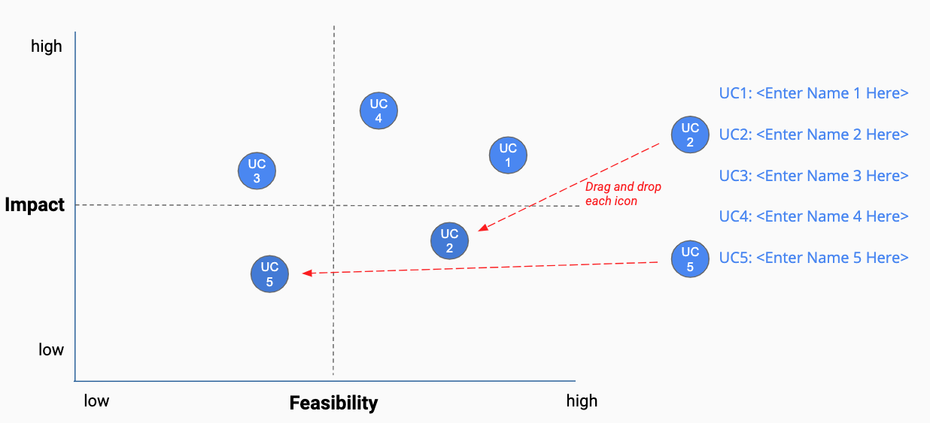
First Prioritization Grid
DIRECTIONS: For each of your use cases, review your answers to the 5V questions in Step 2A, and the operations you chose in Step 2B.
Then on the grid on the next slide, not this slide, move each blue use case icon to a place indicating how you see this use case’s impact and feasibility.
(Recall that the upper right quadrant is usually the most desirable, as it indicates we expect higher feasibility and greater impact.)
UC 2
Drag and drop icons for each use case
Remember to think about both axes!

Slide 4




First Prioritization Grid
(Follow directions on previous slide)
high
UC 1
UC1: <Tax planning efficiency>
UC 2
UC2: <Supply chain optimization>
UC 3
UC3: <Sustainability advancement>
Impact
UC 4
UC4: <Dealership expansion strategy>
low
low
Feasibility
high

Slide 5
Now Prioritize and Eliminate Three Use Cases
1) Review the locations of your use cases on the grid on the previous slide. Remember we want to prioritize use cases for AI and ML that offer the greatest impact for the least difficulty.
2) Now in the grid on the previous slide change the color from blue to grey for one use case circle you want to de-prioritize.
3) This leaves your top three use cases in blue that you want to move forward with in the rest of the project.
UC 3
UC 3

Slide 6
Excellent, you’ve completed this step of the project!

Slide 7
AI for Business Leaders
Project Step 3
Architectures for Top 3 Use Cases

Slide 8
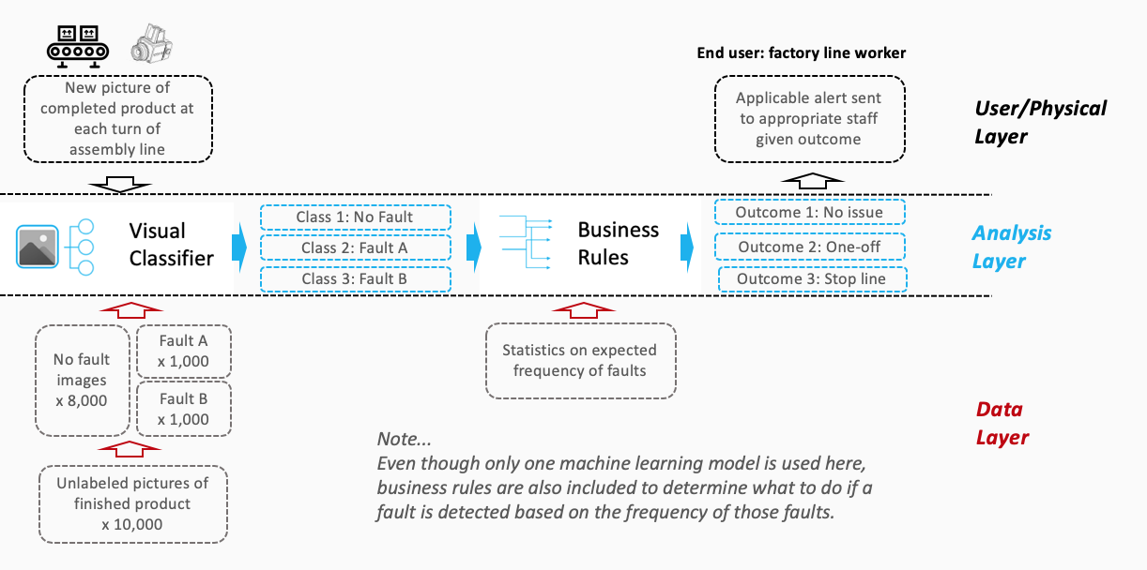

Sample Completed Architecture
Creating High Level Architectures
For the top three use cases you prioritized in Project Step 2C, you’ll now create a high level architecture for each, on slides 10-12.
For this step, be sure to review Lesson 3 but also recognize that this process allows significant creative freedom.
Keep a focus on… - Data flow/direction - Clear view on inputs/outputs - Simplicity
Write the use case name at the top of each slide.
Do all work on slides 10-12:
Copy and paste capabilities from slide 9 into Analysis Layer
Identify relevant User/Physical and Data Layer attributes
Copy and paste arrows from slide 9 to show data flow, input/output
Use annotations to help explain difficult concepts

Slide 9

















AI / ML Toolkit - List of Capabilities
Generic ML Capabilities
Natural Language Processing
Voice/Speech Processing
Computer Vision
Other Capabilities
Drawing Tools
User/Physical Layer
Analysis Layer
Data Layer

Slide 10
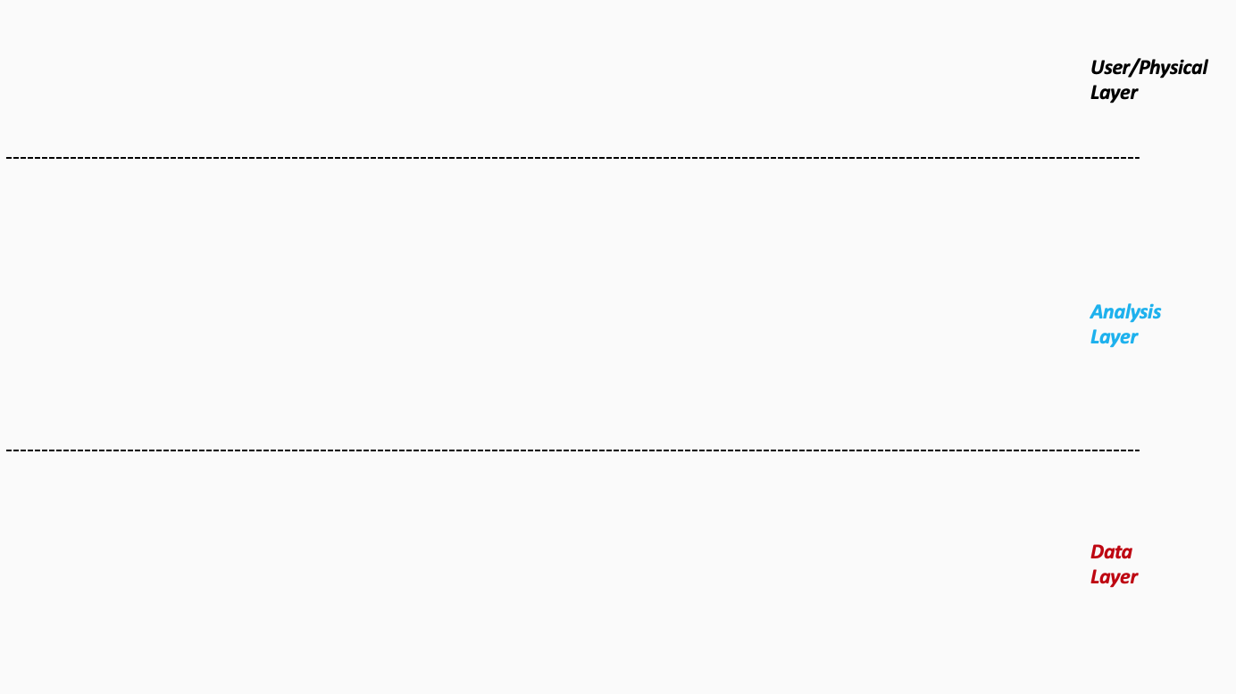


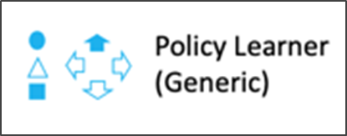
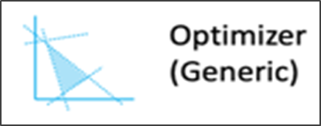
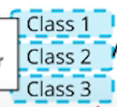

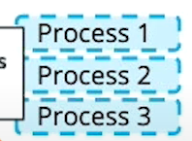


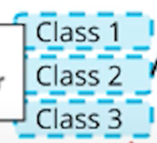
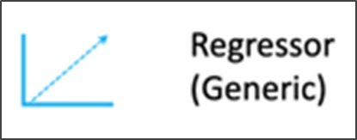



Architecture 1/3 - <Enhancing tax planning efficiency>
Tax analysts input new regulations and updated policies
Provide actionable insights on tax strategies
Human feedback
Data Synchronization
Final rules are fed back to data layer enhancing accuracy and ground truth data via human checks for verification
Core datasets that validate and adjust tax strategies
Historical tax data
Notes:
Please follow the directions on slide 8. Copy and paste the desired icons provided you on slide 9 onto this page.

Slide 11

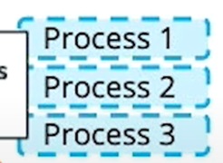

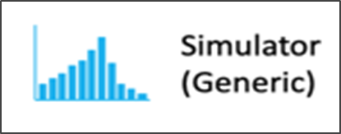




Architecture 2/3 - <Supply chain optimization>
Historical data, trends and market forecasts
Optimized decisions and policy recommendations
Operational strategies and guidelines
Regulatory updated business constraints
Supply chain (operational) variables
Categorical data
Metric data
Past policy data
Textual and historical outcomes
Historical data (quantitative)
Scenario – based data (qualitative)
Notes:
Please follow the directions on slide 8. Copy and paste the desired icons provided you on slide 9 onto this page.

Slide 12



Architecture 3/3 - <Dealership expansion strategy>
Predicted sales for new locations
Optimized predictions or actionable recommendations
Updated demographic data
Insights
Updated demographic data and constraints
Unstructured data
Structured data
Demographics
Customer feedback
Sales data
Regional trends
Location descriptions
Business constraints
Notes:
Please follow the directions on slide 8. Copy and paste the desired icons provided you on slide 9 onto this page.

Slide 13
Excellent, you’ve completed this step of the project!

Slide 14
AI for Business Leaders
Project Step 4C
Second Prioritization Grid

Slide 15
Second Prioritization Grid
Based on new information from your further analyses of your use cases in step 4A and 4B, you’ll engage in the same exercise as you did before in Step 2C to update your prioritization.
Move onto the grid the three use cases that you have been working with in steps 4A and 4B.
You MAY choose different use cases and shift your focus, if you feel these exercises have caused you to significantly revise your prior evaluations.
UC 2
Drag and drop icons for each use case
Remember to think about both axes!

Slide 16
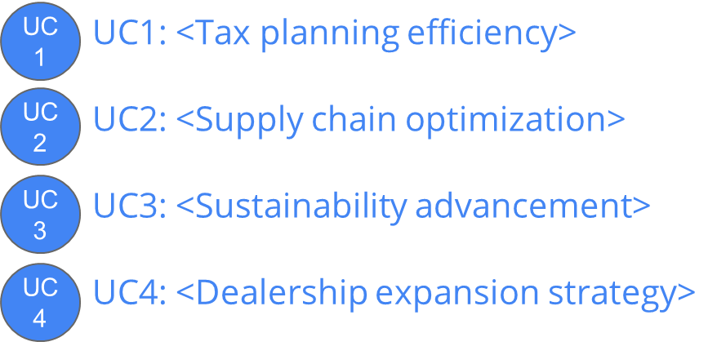
Second Prioritization Grid
(Follow directions on previous slide)
high
UC
2
Impact
Note: You only need to locate three of these onto the grid.
low
low
Feasibility
high

Slide 17
Now Prioritize and Eliminate One More Use Case
1) Review the locations of your use cases on the grid on the previous slide. Remember we want to prioritize use cases for AI and ML that offer the greatest impact for the least difficulty.
2) Now in the grid on the previous slide change the color from blue to grey for one use case circle you want to de-prioritize.
3) This leaves your top two use cases in blue that you want to move forward with in the rest of the project.
UC 3
UC 3

Slide 18
Excellent, you’ve completed this step of the project!

Slide 19
AI for Business Leaders
Project Step 5
Operational Considerations:
Accuracy, Bias, and Ethics

Slide 20
Accuracy, Bias, and Ethics Concerns
For each of your two remaining use cases, on the next two slides please write 2-3 paragraphs discussing how success will be measured and monitored.
Start by focusing on how model effectiveness would be measured, and speak to what success would look like.
Comment on any other operational concerns, including bias in the data, or ethical limitations, that could influence success.
For each concern you raise, comment on how you would measure or monitor this concern on an ongoing basis.

Slide 21
Tax planning efficiency
Please write 2-3 paragraphs here, following the guidelines on slide 19:
Model effectiveness
The success of the model depends on ongoing monitoring and defined performance metrics to create an efficient tax plan strategy. Taking into account the vast amount of input data feed into the model, the risk of data drift could be mitigated by periodic performance tests using updated datasets (e.g. tax regulations). Furthermore, if anomalies are detected the model would be revised and retrained via such datasets. In respect to the comparison of the models optimized output metrics to manual process carried out by third party advisors, such accuracy and efficiency would improve Tekno Ve’s overall decision making, time management, and cost savings skills, which ensures the models optimized effective tax strategy.
Bias concerns
Bias is a major concern in this model, as it relies on historical tax data and region-specific policies that may lead to favoring certain jurisdictions over others. This in turn, could result in the model producing biased or unfair transfer pricing recommendations to future operations. To combat this, human-in-the-loop review processes and inspections could be regularly conducted to identify and correct any inconsistent trends. Furthermore, integrating diverse datasets from various regions may also help ensure balanced learning and reduces overall risk of bias in the model’s outputs. It is also worth noting that the model may be at risk at becoming too accustomed to such historical data provided, limiting its ability to adapt to new tax laws or scenarios. However, using cross-validation techniques during training and continuously retraining the model with updated datasets can mitigate such overfitting, ensuring it remains accurate and responsive over time.
Ethical concerns
Ethically, stakeholders may struggle to understand the rationale behind the AI’s recommendations. As a result, could weaken trust and hinder the adoption of the model entirely. However, to combat this, the implementation of an explainability framework could be essential, as it provides clear justifications and confidence scores for each recommendation output. Furthermore, the potential for the model to order aggressive tax strategies might push regulatory boundaries and damage Tekno Ve’s reputation. Nevertheless, this can be addressed by adapting regular compliance inspections and human-in-the-loop review processes to ensure that all outcomes are assessed thoroughly, aligning them with ethical standards and regional regulations.

Slide 22
Dealership expansion strategy
Please write 2-3 paragraphs here, following the guidelines on slide 19:
Model effectiveness
The success of this model relies on ongoing monitoring and measuring defined performance metrics to predict future sales at new dealership locations, based on existing sales and demographic data. The model’s effectiveness is measured through the comparison of active dealerships’ accurate forecasts sales to potential dealerships predicted sales overtime. Therefore, such accuracy would be tested and evaluated through metrics such as Mean Absolute Error (MAE) or Root Mean Square Error (RMSE). Thus, achieving high accuracy in these predictions and the model’s ability to recommend dealership locations that outperform intuition-based decisions ensure success in the overall Dealership expansion strategy.
Bias Concerns
A major concern in such a model is the potential bias outcome recommendations, mainly due to the dependency on certain populated urban data patterns. It is worth noting that if the data mostly comes from urban locations, the model might not be able to accurately predict sales in more rural or uncommon areas. However, to avoid such overfitting and biases, a diverse range of data should be feed to the model, ensuring that it represents different types of locations and demographic profiles. Therefore, regular checks would be adopted to ensure that data used in training the model is balanced and not biased to any particular region or population.
Ethical Considerations
Ethically, a major concern involves the model favoring certain privileged locations or groups, thus neglects underprivileged communities. Hence, It’s crucial to ensure that any data used complies with privacy and legal standards, and that the model doesn’t unintentionally discriminate against smaller, rural, or minority-based regions. However, this will be mitigated by making sure the model’s recommendations are evaluated for fairness and inclusivity through human-in-the-loop review processes and feed the necessary updated demographic data. Therefore, regular checks will be issued to combat potential biases outcomes, and any deviations will be addressed through model retraining or updated data inputs.

Slide 23
Excellent, you’ve completed this step of the project!

Slide 24
AI for Business Leaders
Project Step 6B

Slide 25
Final Prioritization Grid
Based on all of the previous information for each use case, you’ll now engage in the same prioritizing exercise as you have twice before.
You MAY choose to re-prioritize use cases and shift your focus if you feel these exercises have caused you to significantly revise your prior evaluations.
At the end of this exercise, you should have a final point of view on the use cases you’ll advocate in your ML/AI strategy!
UC 2
Drag and drop icons for each use case
Remember to think about both axes!

Slide 26

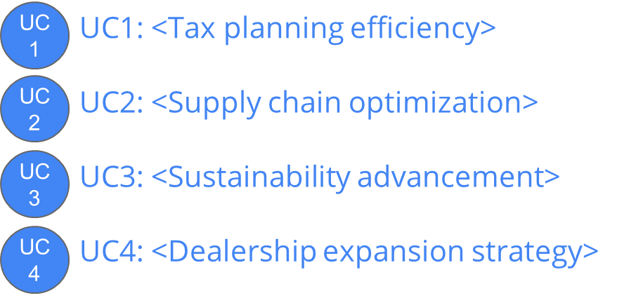

Final Prioritization Grid
(Follow directions on previous slide)
high
Impact
Note: You only need to locate two of these onto the grid.
low
low
Feasibility
high

Slide 27
Excellent, you’ve completed this step of the project!

